Slide 1
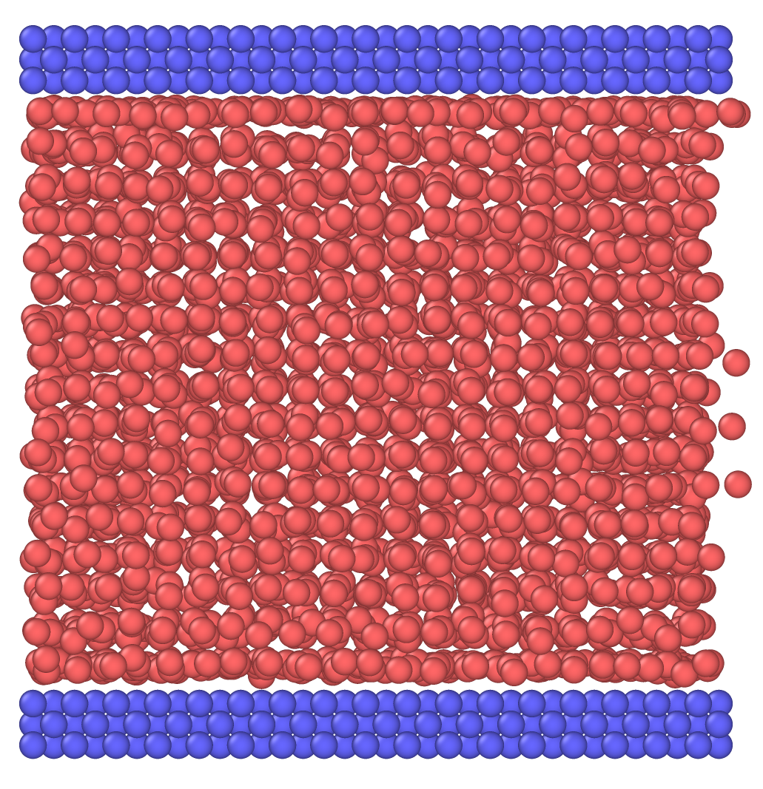
ME 400 : Thesis
Effect of Surface Wettability On Specific Heat Capacity of Nano-confined Liquid
Thesis By
Priom Das (1610148) &
Zairf Ahmad Razin Bhuiyan (1610137)
Supervised By
Dr. A. K. M. Monjur Morshed
Professor
Department of Mechanical Engineering
Bangladesh University of Engineering & Technology

Slide 2
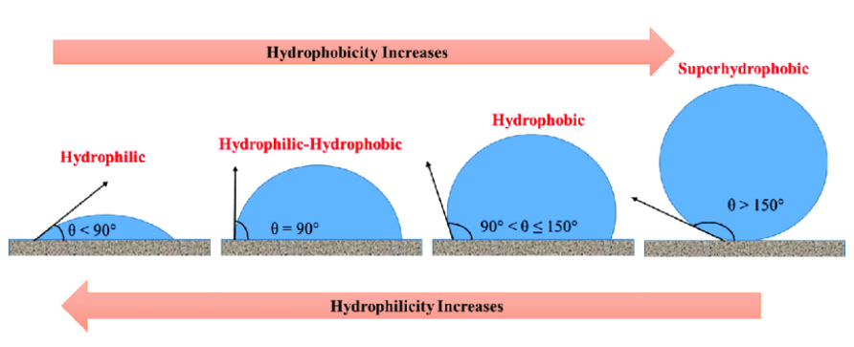
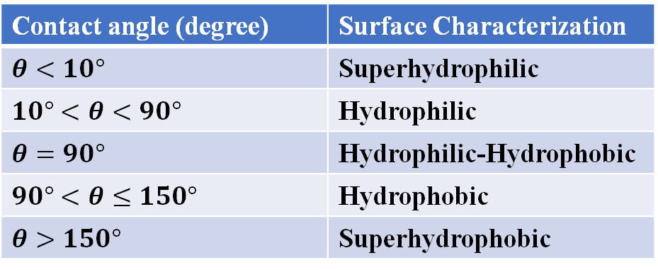
Effect of Surface Wettability On Specific Heat Capacity of Nano-confined Liquid
What is Surface Wettability and How it is defined ?
Wettability is defined as a liquid’s ability to wet a surface and is determined through contact
angle measurement.
Contact angle (degree) | Surface Characterization
$θ<10°$ | Superhydrophilic
$10°<θ<90°$ | Hydrophilic
$θ=90°$ | Hydrophilic-Hydrophobic
$90°<θ≤150°$ | Hydrophobic
$θ>150°$ | Superhydrophobic

Slide 3
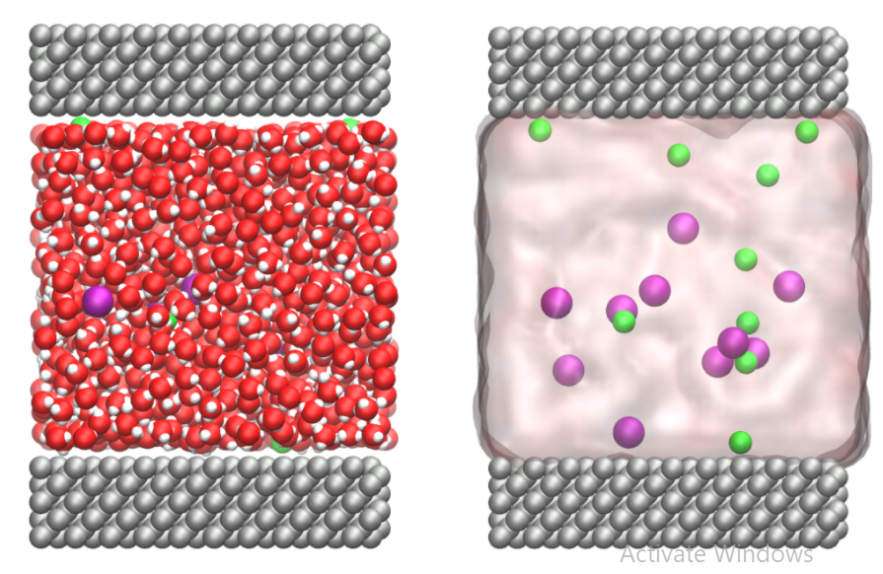
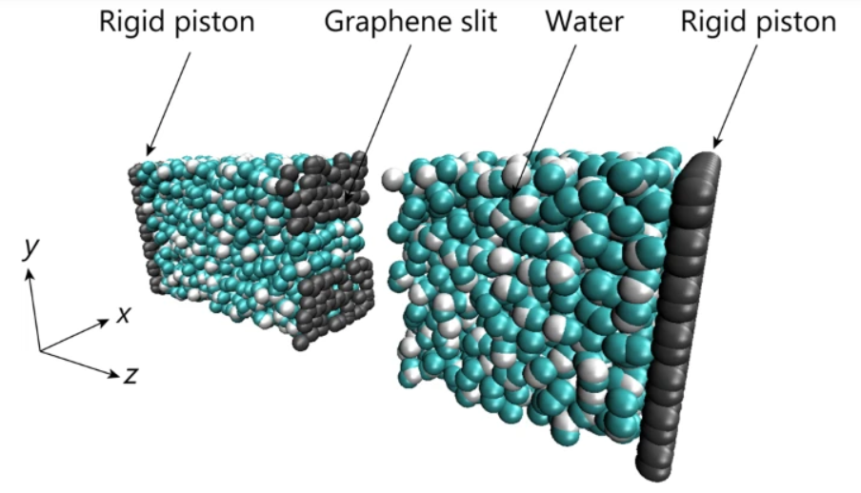
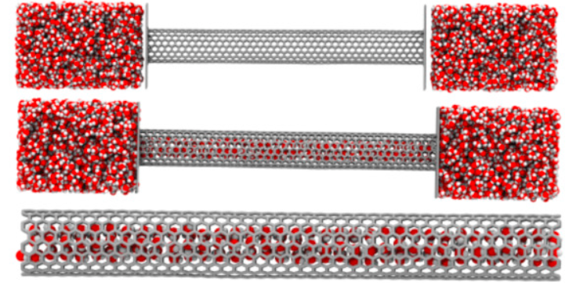
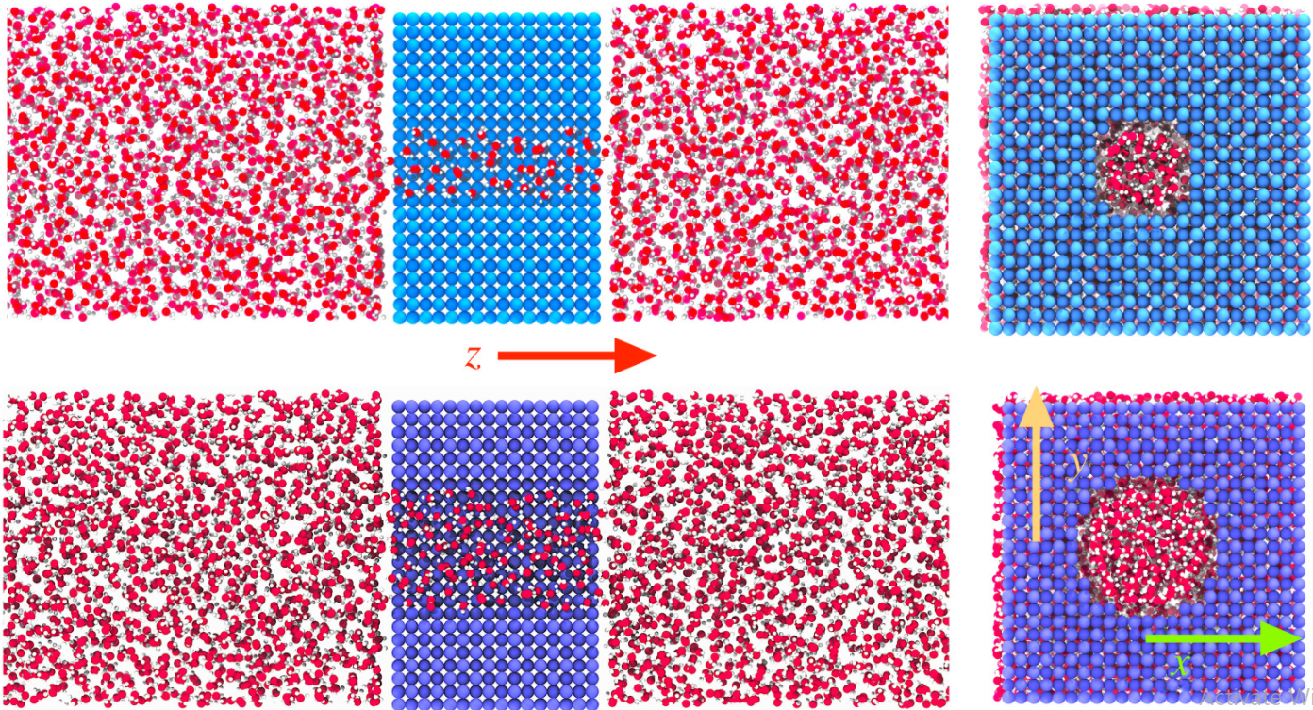
What is nanoconfined Liquid ?
Nano-confined fluid (NCF) is defined as the fluid confined in a nanospace such as
nanochannel, nanotube, nanopore and other complex nanospaces.
Confinement in Nanoslit
Water confinement in Carbon Nanotube
Electrolyte confinement in Graphite Nanochannel
Confinement in Nanopore

Slide 4
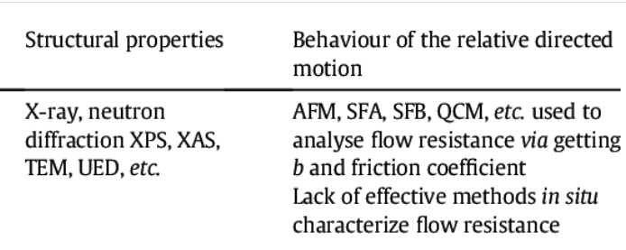
Motivation for our work
No proper theoretical description of mass and energy transport
Recent Research Trend
Experimental works are very scarce !!!!!!!!!!
High capacitance Supercapacitor
Biological Engineering (DNA sequencing)
Ultrafast transportation of Confined water and ions
Nanoscale effects
Size dependence
Anisotropy
Strong surface force (Wettability and roughness)
Quantam effect
Slip boundary condition
MD simulation is the answer to bridge the theoretical and computational gap !!!!

Slide 5
Thesis Outline
Chapter 1 : Introduction
Chapter 2 : Literature Review
Chapter 3 : Simulation Methodology
Chapter 4 : Modelling and Simulation procedures
Chapter 5 : Results and Discussions
Chapter 6: Conclusion
Chapter 7 :Future Recommendation

Slide 6
Objectives
To determine heat capacity of liquid argon at fixed temperature for four different wettable surfaces.
To figure out how maximum heat capacity, critical gap thickness ,range of gap thickness
changes with changing wettability .
To describe possible reasons behind this behavioral changes of of confined liquid with
surface wettability.

Slide 7
Initial Condition $[ \vec{r_{i}}\left(0\right), \vec{v_{i}}\left(0\right)]$
Initial Condition [ (𝑟_𝑖 ) ⃗(0), (𝑣_𝑖 ) ⃗(0)]
Potential, $U_{i}$
$$\vec{F_{i}}=−∇U_{i}$$
$$\vec{F_{i}}=m\vec{a_{i}}$$
Potential, 𝑈_𝑖
(𝐹_𝑖 ) ⃗=−∇𝑈_𝑖
(𝐹_𝑖 ) ⃗=𝑚(𝑎_𝑖 ) ⃗
Integrate Equation of Motion
$$\vec{r_{i}} \left(t\right)→\vec{r_{i}}\left(t+Δt\right)$$
$$\vec{v_{i}}\left(t\right)→\vec{v_{i}}(t+Δt)$$
Integrate Equation of Motion
(𝑟_𝑖 ) ⃗ (𝑡)→(𝑟_𝑖 ) ⃗(𝑡+Δ𝑡)
(𝑣_𝑖 ) ⃗(𝑡)→(𝑣_𝑖 ) ⃗(𝑡+Δ𝑡)
Obtaining Equilibrium
And Extract Data
Post Processing
Simulation Methodology
Basic Steps to perform a molecular dynamic simulation
Simulation Domain
Define Potential Function
Run Simulation
Obtaining Equilibrium
And Extract Data
Connecting Macroscopic & Microscopic World

Slide 8
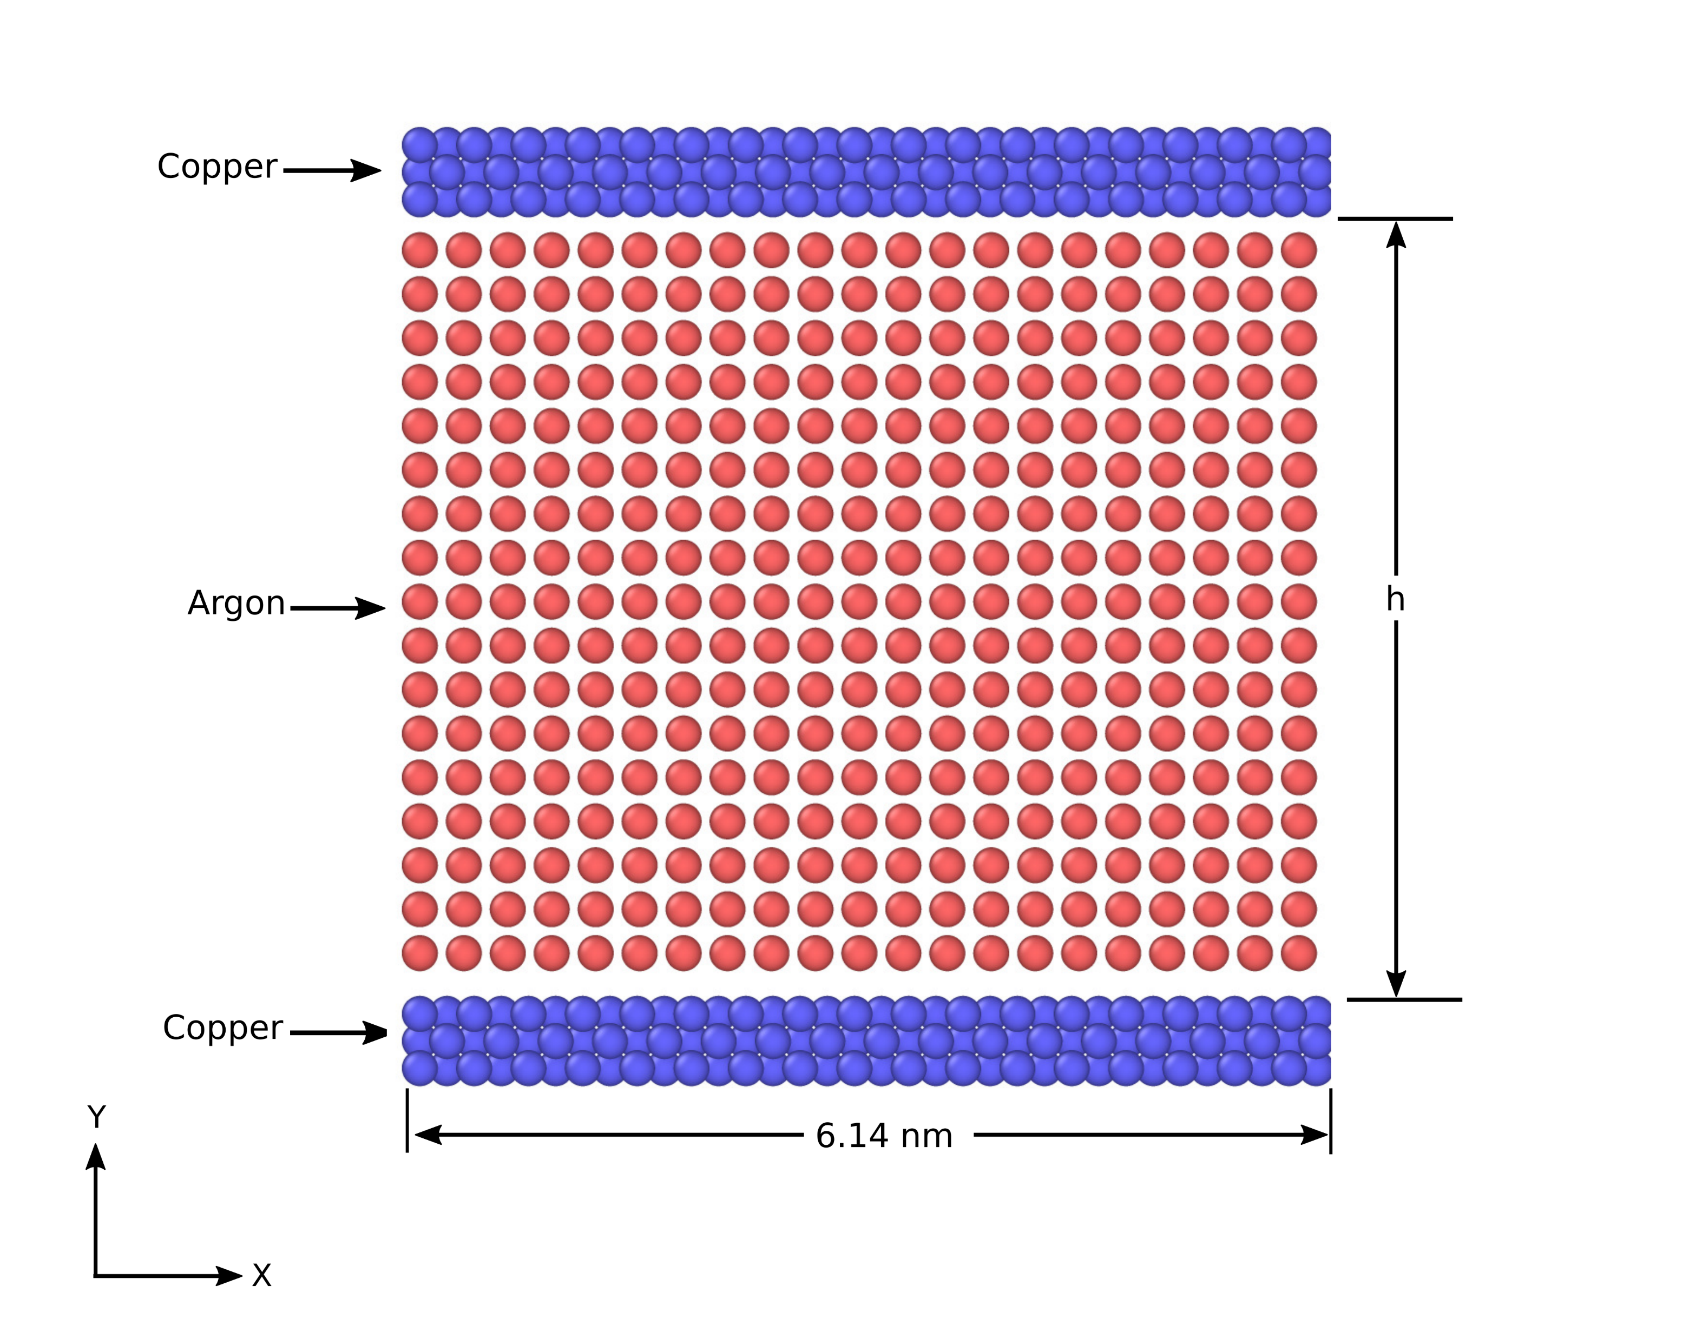
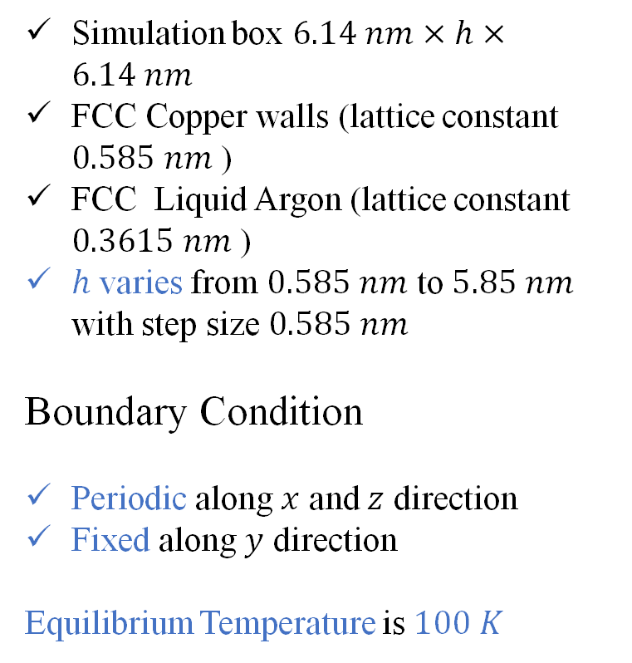
Simulation Methodology
Simulation Domain
Simulation box $6.14 nm×h×6.14 nm$
FCC Copper walls (lattice constant $0.585 nm$ )
FCC Liquid Argon (lattice constant $0.3615 nm$ )
$h$ varies from $0.585 nm$ to $5.85 nm$ with step size $0.585 nm$
Boundary Condition
Periodic along $x$ and $z$ direction
Fixed along $y$ direction
Equilibrium Temperature is $100 K$

Slide 9
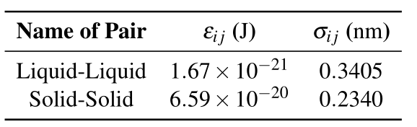
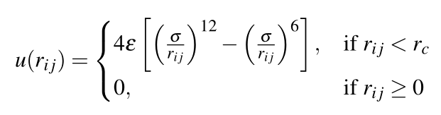
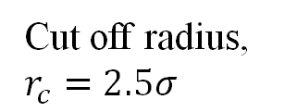
Potential Function
Lennard Jones Potential function was used.
Cut off radius, $r_{c}=2.5σ$
Interaction Strength
Length Scale
Table: Lennard Jones Potential Parameter of Argon and Copper molecules.

Slide 10
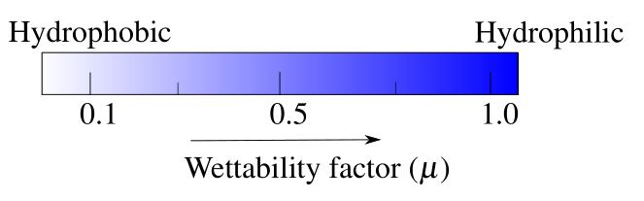
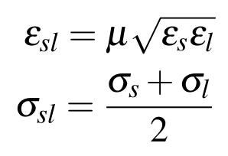
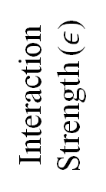
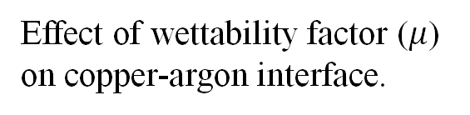
Solid - Liquid Interface
Wettability factor [3]
Hydrophilic
Interaction
Strength ($ε$)
Hydrophobic
Lorentz – Bertholet mixing principle [1]
Wettability and Interaction Potential [2]
Effect of wettability factor ($μ$) on copper-argon interface.
[1]
[2]
[3]

Slide 11

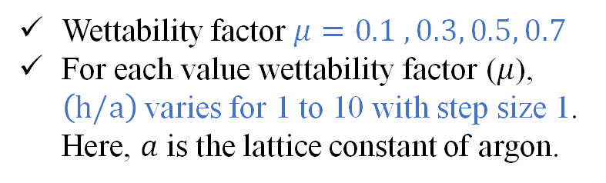
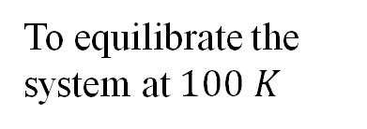
Running a Simulation
Applying Nose Hover Thermostat for 10 ns
To equilibrate the system at $100 K$
Velocity Verlet Algorithm for time Integration
Integrate the Equation of motion to update the atom position.
Time Step = $5 fs$
Check For Equilibrium
Wettability factor $μ=0.1 , 0.3, 0.5, 0.7$
For each value wettability factor ($μ$), $\left(\text{h}\text{/}\text{a}\right)$ varies for 1 to 10 with step size 1. Here, $a$ is the lattice constant of argon.
Extract Data for 10 ns for post processing

Slide 12
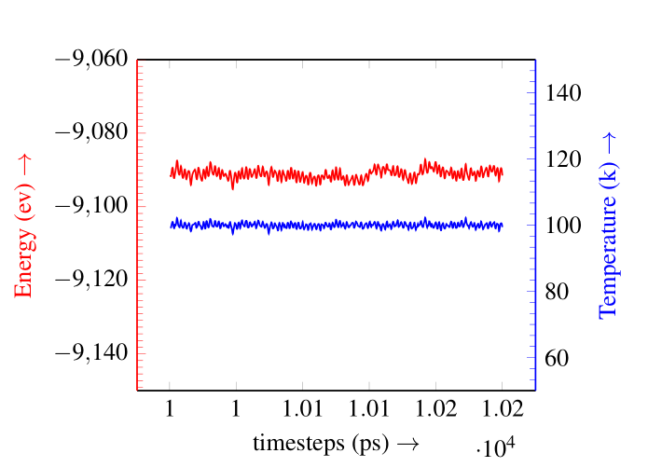
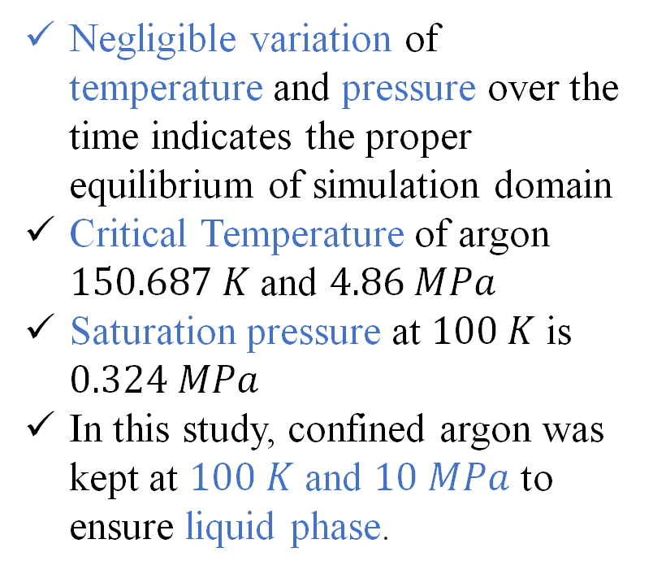
Ensuring Equilibrium and Liquid Phase of Argon
Negligible variation of temperature and pressure over the time indicates the proper equilibrium of simulation domain
Critical Temperature of argon $150.687 K$ and $4.86 MPa$
Saturation pressure at $100 K$ is $0.324 MPa$
In this study, confined argon was kept at $100 K$ and $10 MPa$ to ensure liquid phase.

Slide 13
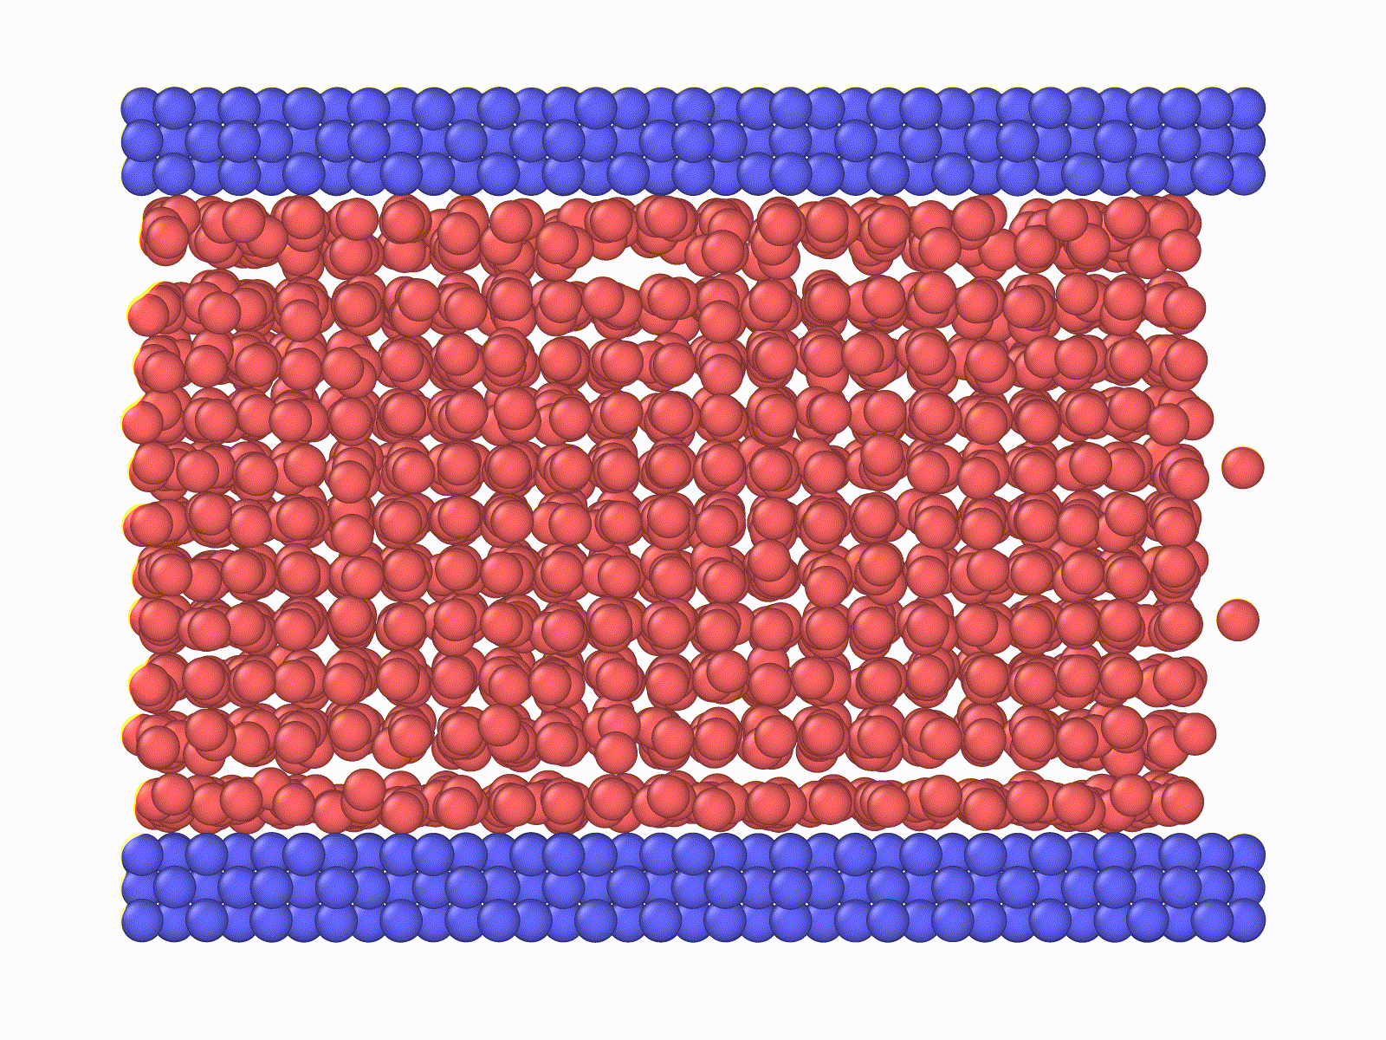
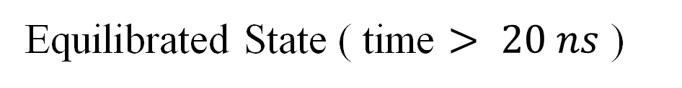
Initial State
Equilibrated State ( time $> 20 ns$ )

Slide 14

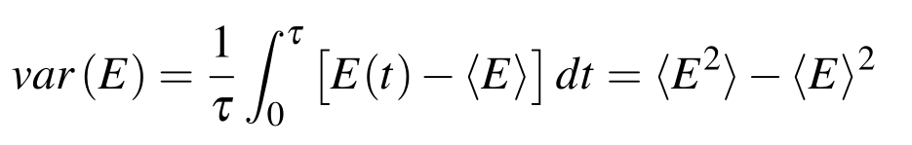
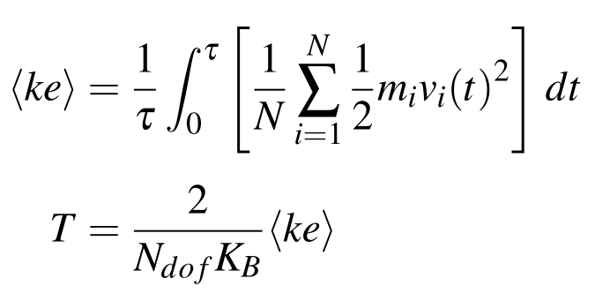
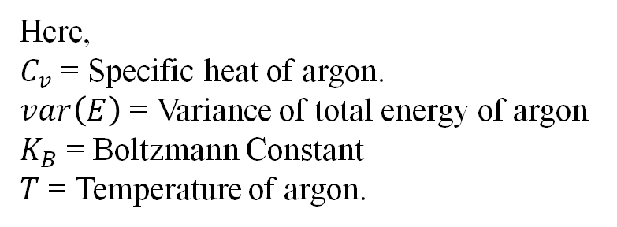
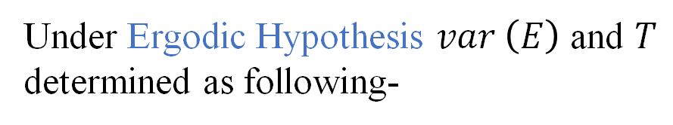
Connecting Microscopic & Macroscopic World
Specific Heat computed using fluctuation formula -
Under Ergodic Hypothesis $var \left(E\right)$ and $T$ determined as following-
Here,
$C_{v}$ = Specific heat of argon.
$var\left(E\right)$ = Variance of total energy of argon
$K_{B}$ = Boltzmann Constant
$T$ = Temperature of argon.

Slide 15
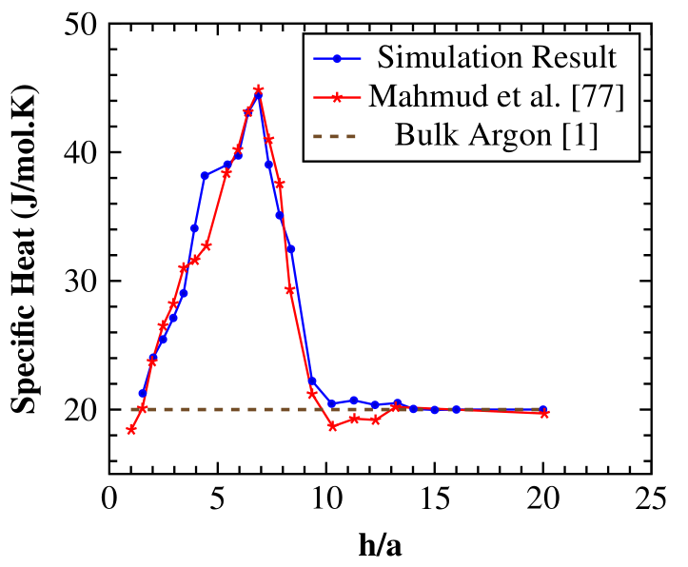
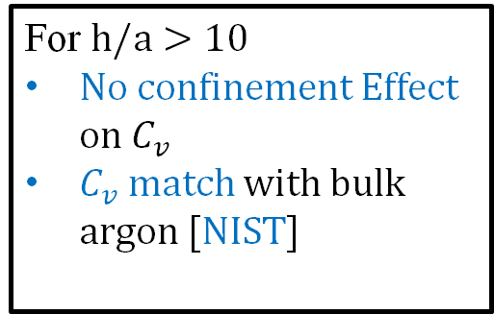
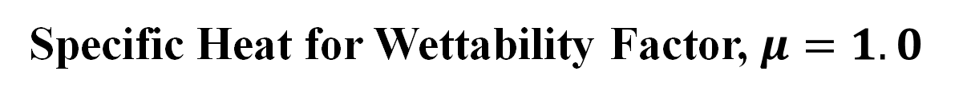
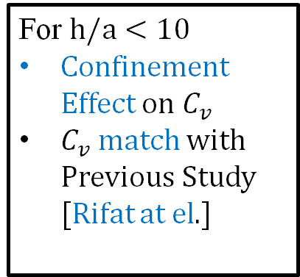
Validation of Simulation Procedure
Specific Heat for Wettability Factor, $μ=1.0$
For $\text{h}\text{/}\text{a}<10$
Confinement Effect on $C_{v}$
$C_{v}$ match with Previous Study [Rifat at el.]
For $\text{h}\text{/}\text{a}>10$
No confinement Effect on $C_{v}$
$C_{v}$ match with bulk argon [NIST]

Slide 16
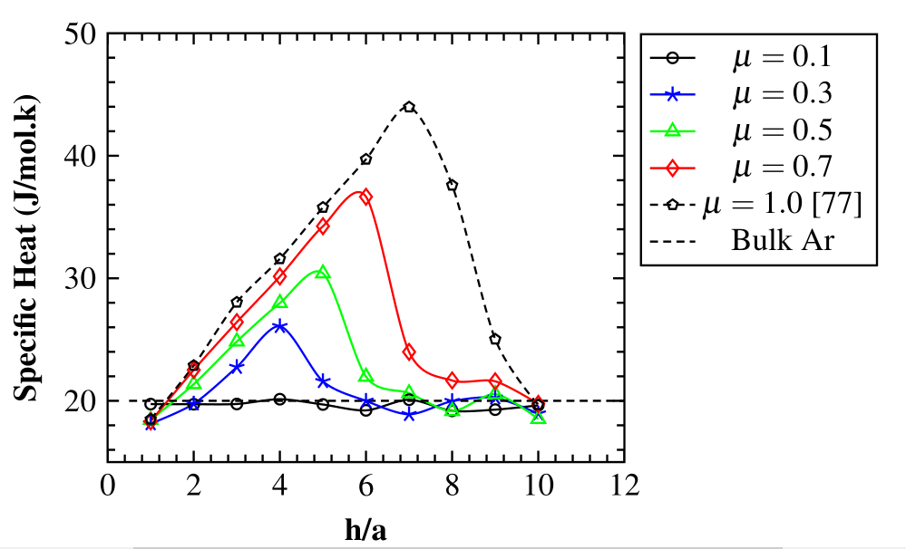


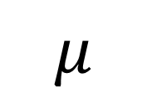
Result
Three Key Findings
Maximum heat capacity (Cv(max)=43.97J/mol.K) and critical gap
thickness (h/a)* (gap thickness at which maximum heat capacity is obtained) decreases
Range of gap thickness where the heat capacity of nanoconfined liquid surpasses that of bulk liquid diminishes
Heat capacity of nanoconfined liquid tends to match its bulk equivalent.
$$μ$$
$$C_{v}$$
$${\left(\text{h}\text{/}\text{a}\right)}^{∗}$$
Range

Slide 17
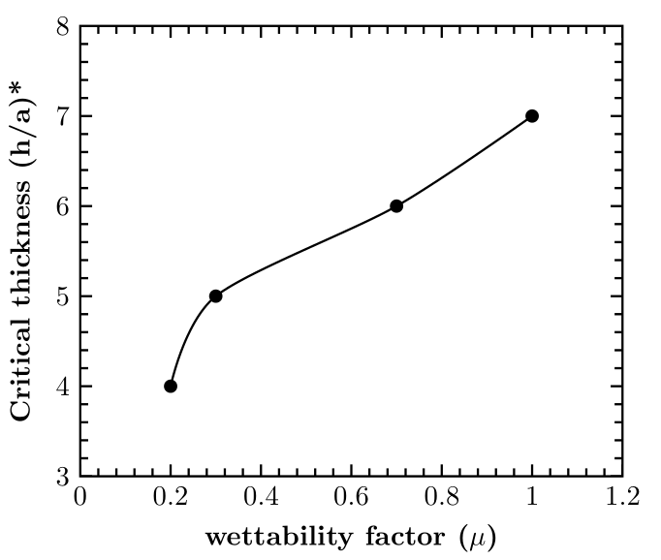
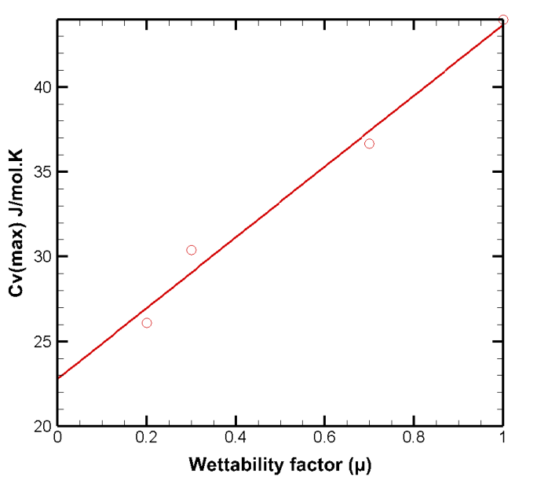
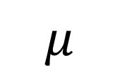

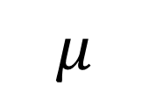

Result
$$μ$$
$${\left(\text{h}\text{/}\text{a}\right)}^{∗}$$
$$μ$$
$$C_{v,max}$$

Slide 18
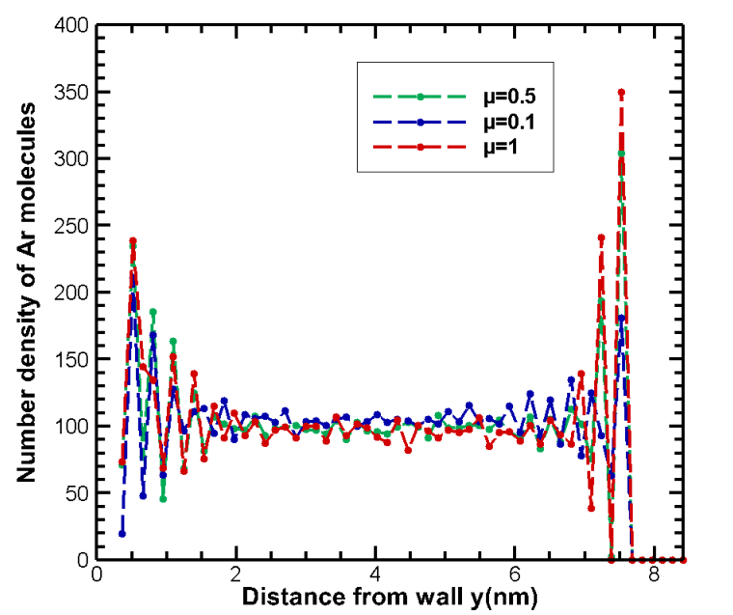
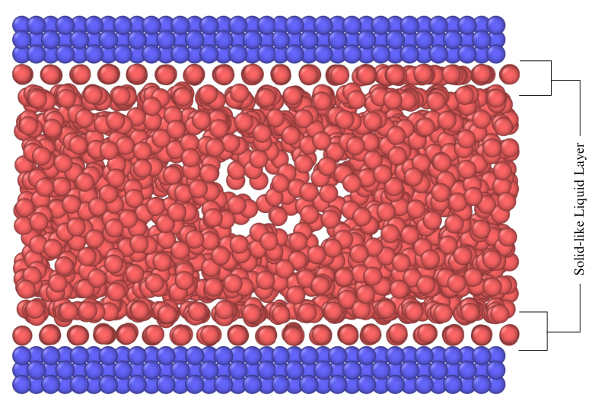
Discussion
Non uniform density distribution

Slide 19
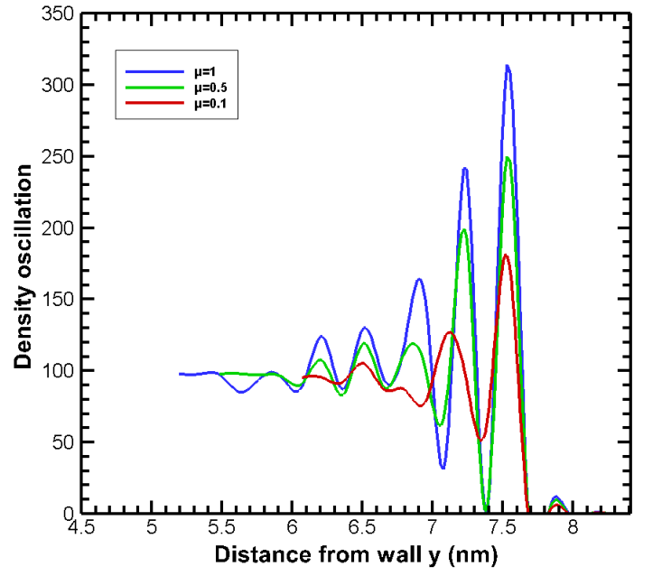
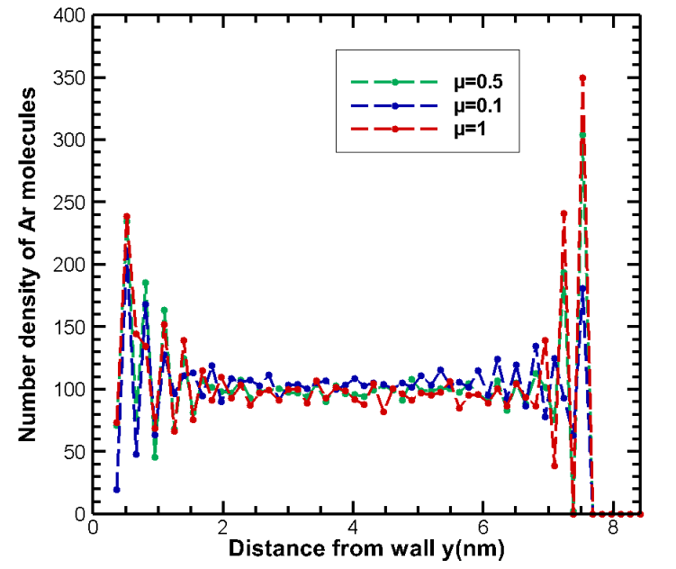
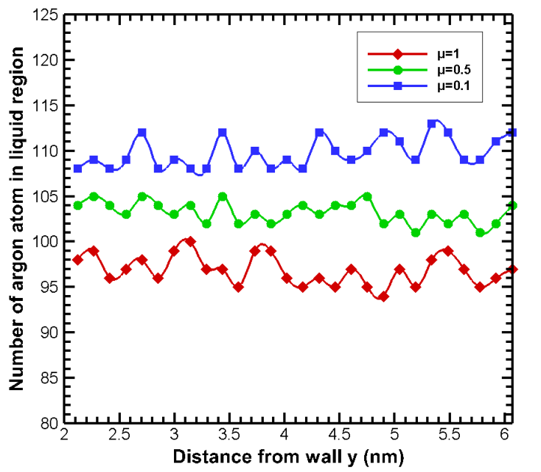

Increasing the surface’s wettability increases the degree of fluctuation of the number density profile near the wall.
the density oscillation near the relaxes earlier with decreasing wettability.
Number of heat carrying molecules reduces in the liquid region as the surface becomes more
hydrophilic.
$$μ$$
Liquid argon

Slide 20
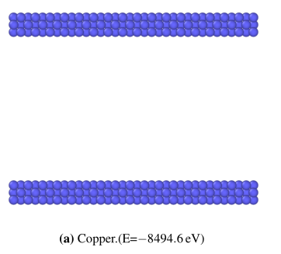
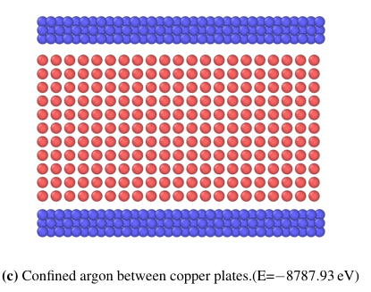
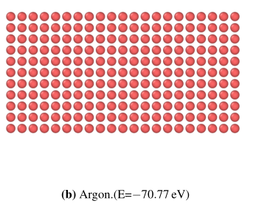
Change in Interface energy
Interface energy = Energy of Argon atoms +Energy of Copper walls –Energy of confined Argon system

Slide 21
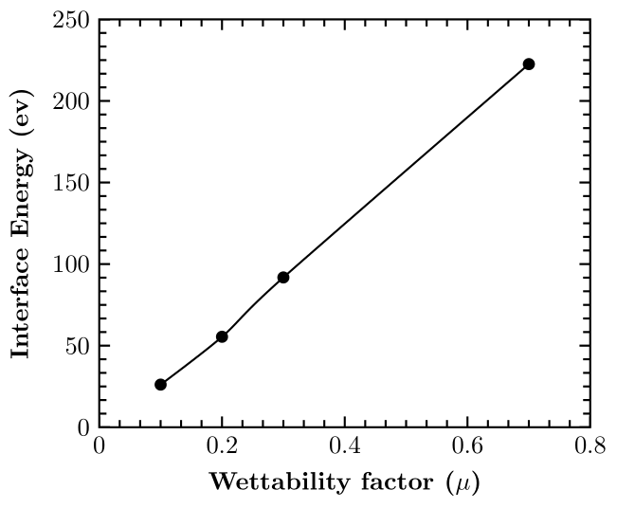

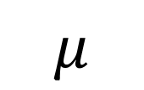
Change in Interface energy
Configuration with the highest interface energy has the highest heat capacity.
Hydrophilic surfaces have more interface energy than hydrophobic ones.
For μ = 0.1 lowest interface energy is generated so it also has the lowest value of heat capacity.
$$μ$$
$$IE$$
Cv

Slide 22
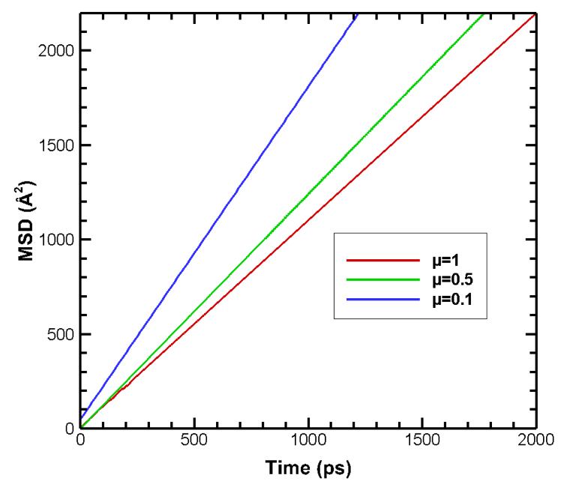
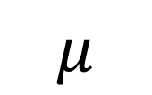

Mean Squared Displacement (MSD), Diffusion Co-efficient and Molecular Motion
MSD is less for hydrophilic surfaces due to the strong solid-liquid interaction
h <= 5 nm Diffusion coefficient value is lesser for hydrophilic surface (μ=1).h >= 5nm value of self-diffusion coefficient is greater for hydrophilic surface.
A higher self-diffusion coefficient value indicates higher molecular motion
$$μ$$
$$MSD$$

Slide 23
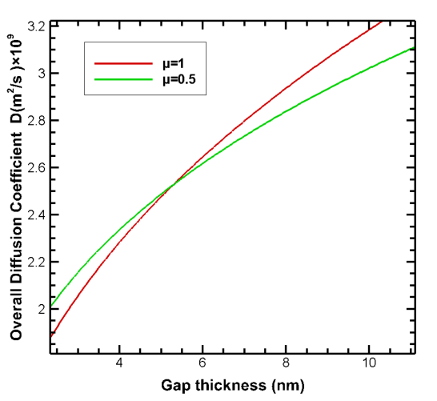

Mean Squared Displacement (MSD), Diffusion Co-efficient and Molecular Motion

Slide 24



Radial distribution function (RDF)
As wettability increases, the initial peak value of RDF. A greater initial peak value indicates that the Ar molecules are better organized.
Structured molecular distribution reduces heat
Transmission for liquids resulting in an increase in heat capacity for hydrophilic surfaces
$$μ$$
$$RDF$$

Slide 25


Guided Molecular Motion
The movement of argon atoms near the wall becomes more orderly and structured for more hydrophilic surface(μ = 0.7).
The more organized molecular motion under hydrophilic confinement reduces heat transportation thus increasing liquid heat capacity

Slide 26



Overall thermal conductivity of the system
Green Kubbo Method

Slide 27





Overall thermal conductivity of the system
Overall system thermal conductivity is
lesser in magnitude than the thermal conductivity of argon atoms in the bulk region and it both decrease with increasing wettability.
Reduced thermal conductivity yields increased thermal
resistance, resulting in poor heat transfer
Lower thermal conductivity implies higher heat retention capacity for a material
$$μ$$
$$κ$$
$$R_{th}$$
$$C_{v}$$

Slide 28

Key Findings
As wettability declines, the critical gap thickness (h/a)* (gap thickness at which maximal
heat capacity is obtained) decreases.
Maximum heat capacity, gap thickness, and surface wettability factor(solid-liquid inter-action strength (μ) all are correlated.
The variation of heat capacity with changing wettability of the surface is ascribed to the simultaneous changes of both configurational and non-configurational contributions of
the liquid under confinement.

Slide 29
“
Nano-Technology is an idea that most people simply didn’t believe
”
Ralph Merkle
THANK YOU

Slide 30
Future Recommendation
In our work Argon is used as a working fluid. However, Argon is not a real fluid. It
will be fascinating to watch how a real fluid, such as water, behaves when confined.
To understand surface effect on confined liquid performance, different nanostructured
surfaces and diverse patterns on the surface (microgroove, void, defect) can be modelled.
Nanostructures should have a realistic shape and size so that they may be made and used
in real-world circumstances.
Surface materials such as Pt, Ag, and Al can be utilized to study the effect of surface
material on the thermodynamic parameters of a nanoconfined liquid.
Simultaneous temperature and wettability effects can be used to determine the tempera-
ture and wettability at which maximal heat capacity is achieved.

