Slide 1
MOBILE PRICE CLASS
CLASSIFICATION AND
PREDICTION
GROUP NO. 1
Zareena Basheer Palakkal.
Revathy. R.
Shameer. S.

Slide 2
AGENDA
Introduction.
About Dataset.
Problem Statement.
Data Analysis Cycle.
1) Data Preprocessing.
2) Splitting and Standardizing Data.
3) Fitting Models.
a. Logistic Regression.
b. Decision Tree.
c. Random Forest.
d. Gradient Boosting.
e. Support Vector Machine.
f. KNN.
Prediction of price ranges.
Future goals.
Conclusions.

Slide 3
INTRODUCTION
Price is the most effective attribute of marketing and business. The very first question of costumer is about the price of items. All the costumers are first worried and thinks “If he would be able to purchase something with given specifications or not”. Our goal for this project was to use regression and classification techniques in order to estimate to which price class a mobile phone belongs according to some of the given features of the mobile. Along with that, we dealt with predicting the price range of some mobiles by using the best model.

Slide 4
ABOUT
DATASET
Our dataset consist of mobile phone features of different brand of mobiles.
The dataset has 22 features and 3000 rows in it.
The 21 feature set will act as the independent variables for predicting the dependent variable called ‘price_range’.
Among the 3000 rows, we have 1000 Nan values, which we need to predict.
We are planning to use 6 different classification models to train the 2000 observations and will select the one model which has highest accuracy score.
Then using that model we will predict the price range of those 1000 mobile phones.

Slide 5
To make a suitable machine learning algorithm to predict the price of a mobile phone (classify as price range 0, 1, 2, 3) using the given attributes or features of mobile phone.
Data set Introduction: Dataset has 22 features and 3000 entries. The meanings of the features:
PROBLEM STATEMENT
px_height: Pixel Resolution Height
px_width: Pixel Resolution Width
ram: Random Access Memory in Mega Bytes
sc_h: Screen Height of mobile in cm
sc_w: Screen Width of mobile in cm
talk_time: longest time that a single battery charge will last when you are
three_g: Has 3G or not
touch_screen: Has touch screen or not
wifi: Has wifi or not
price_range: This is the target variable with value of 0(low cost), 1(medium cost), 2(high cost) and 3(very high cost)
Id: ID
battery_power: Total energy a battery can store in one time measured in mAh
blue: Has bluetooth or not
clock_speed: speed at which microprocessor executes instructions
dual_sim: Has dual sim support or not
fc: Front Camera mega pixels
four_g: Has 4G or not
int_memory: Internal Memory in Gigabytes
m_dep: Mobile Depth in cm
mobile_wt: Weight of mobile phone
n_cores: Number of cores of processor
pc: Primary Camera mega pixels

Slide 6
DATA PREPROCESSING
Since the dataset consist of 1000 Nan values in price range column, we need to remove those rows first.
Otherwise, the dataset need no modification because, it is a very good dataset.
Then, we did find out the relationship between different features and price range.
Since the id feature has nothing to do with the price range we removed it from the dataset for further processes.

Slide 7
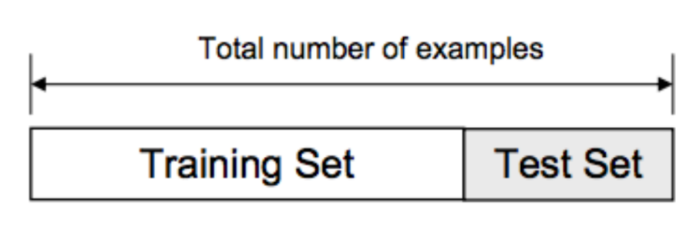
SPLITTING AND STANDARDIZING DATA
The dataset usually split into train and test data
The training set contains a known output and the model learns on this data in order to be generalized to other data later on.
Test dataset (or subset) in order to test our model’s prediction on this subset.
We’ll do this using the Scikit-Learn library and specifically the train_test_split method.
Before for implementing models all the values in the data should be standardized.
Standardization refers to shifting the distribution of each attribute to have a mean of zero and a standard deviation of one (unit variance).

Slide 8
FITTING MODELS
In this work implemented four different model
a) Logistic Regression.
Logistic regression is a statistical model that in its basic form uses a logistic function to model a binary dependent variable
b) Random Forest Classifier.
Random forests are an ensemble learning method for classification, regression. It can be say that a group of decision trees.
c) Decision Tree Classifier.
A decision tree is a flowchart-like structure in which each internal node represents a "test" on an attribute (e.g. whether a coin flip comes up heads or tails), each branch represents the outcome of the test, and each leaf node represents a class label (decision taken after computing all attributes).
d) SVM.
In machine learning, support-vector machines (SVMs, also support-vector networks) are supervised learning models with associated learning algorithms that analyze data used for classification and regression analysis.
e) Gradient Boosting Classifier.
Gradient boosting is a machine learning technique for regression and classification problems, which produces a prediction model in the form of an ensemble of weak prediction models, typically decision trees.
f) KNN. is a non-parametric use for classification and regression. The input consists of the k closest training examples in the feature space. The output depends on whether k-NN is used for classification or regression.

Slide 9
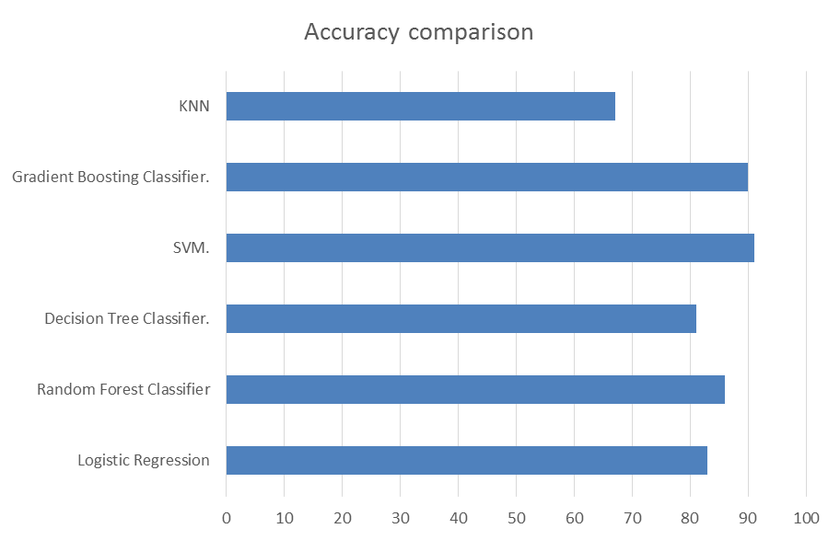
Accuracy comparison for the different models.

Slide 10
PREDICTION OF PRICE RANGES.
Since the dataset is trained and tested different models, SVM giving best accuracy results as compared to the other models.
We predicted price range (0, 1, 2, 3) of 1000 test data set using the SVM.

Slide 11
FUTURE GOALS
This kind of techniques of predicting the price range can be extended to different business areas like sales of cars, houses, computers etc.
Software or Mobile app can be developed that will predict the market price of any new launched product.

Slide 12
CONCLUSION
What is the hidden reason behind the classification of the mobile phones into different price ranges of 0(low cost), 1(medium cost), 2(high cost) and 3(very high cost) ?
What features do we get most in each price range?

Slide 13
What is the hidden reason behind the classification of the mobile phones into different price ranges of 0(low cost), 1(medium cost), 2(high cost) and 3(very high cost) ?
It is simply due to the phone’s performance indicator called Random Access Memory (RAM).
RAM is what performs processes and tasks requested to be done by the user.
With more RAM or memory for short, one can open and use more and more apps at same instant.
We can easily switch / flick between these apps without slowing down the device.
RAM tells us that, any part of the information can be taken out randomly. It is an instant access.
So this memory allows us to do things instantly and simultaneously on our mobile phones.
For e.g. use of multiple apps to get the live cricket score, book a movie, see the reviews and ratings of an electronic gadget, watch the trends in the share market and to top these activities with some calculations in excel sheet and at the same time make a phone call.

Slide 14
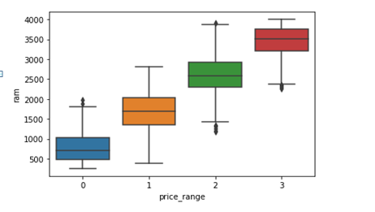
Thus, our foremost and prominent insight is that, as the RAM memory increases, the cost of mobile price also increases and vice versa.
That means, the highest price range ‘3’ mobile phones has the highest RAM which implies the best performance.

Slide 15
What features do we get most in each price range?
Our, next important feature is battery power : the energy which keeps your phone working or on.
Here, we vouch for mobile phones of ‘0’ class, we find that they have a really good and attractive battery power when compared to higher price ranges ‘1’, ‘2’. Though they are much higher in price ranges, but they offer only a slight increase in the battery power.
Next, we can see is internal memory of the device : which where the storage area of the mobile phones.
Price range ‘0’ has a total internal memory is as same as that of price range ‘2’. This is again a supporter for price range’0’ mobile phones.
Also, for price range ‘1’, the internal memory is higher than that of price range ’2’. Which is an attractive quality of price range ‘1’.
At last, the king of price ranges, that is price range ‘3’, has all the features in a very high manner, which makes those mobile phones the best performers.

Slide 16
Cost prediction is the very important factor of marketing and business. To predict the cost or price range, same procedure can be performed for all types of products for example Cars, Foods, Medicine, and Laptops etc.
By specifying economic range a good product can be suggested to a costumer. I.e. it is useful for the costumers to verify that they are paying best price for the mobile according to their desire.

