Slide 1
Design of Arithmetic Circuit
Presented By:
Zarin Tasnim Promi

Slide 2
Outline
What is arithmetic logic unit?
Design of arithmetic circuit
Effect of output carry in arithmetic circuit
Example of design of arithmetic circuit

Slide 3
What is Arithmetic Logic Unit ?
Combinational circuit
Performs arithmetic and logical operations.

Slide 4
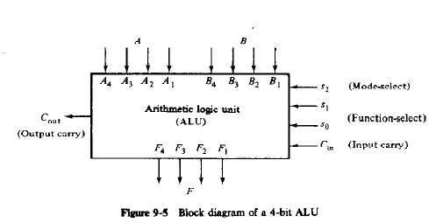
Block Diagram of ALU

Slide 5
Design of Arithmetic Circuit
The basic component is a parallel adder
By controlling the data input, it is possible to obtain various arithmetic operations.

Slide 6
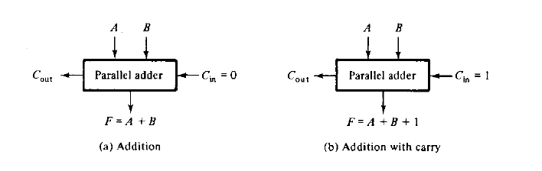
Design of Arithmetic Circuit

Slide 7
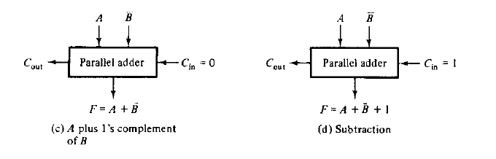
Design of Arithmetic Circuit

Slide 8
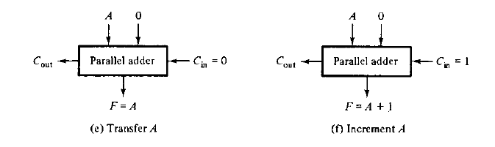
Design of Arithmetic Circuit

Slide 9
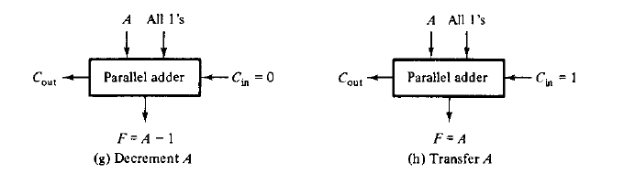
Design of Arithmetic Circuit

Slide 10
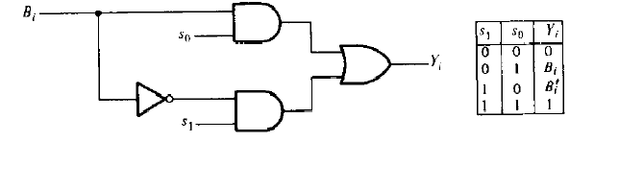
Design of Arithmetic Circuit Controlling input B

Slide 11
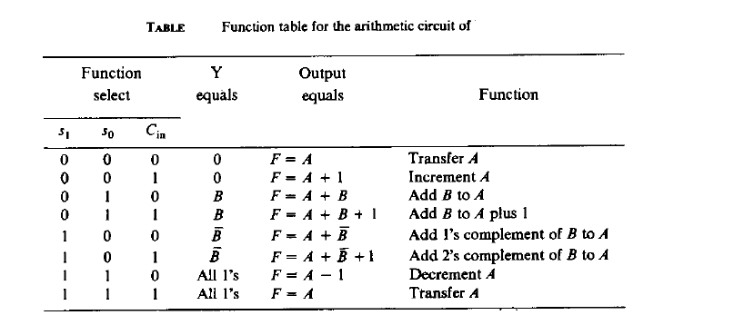
Design of Arithmetic Circuit

Slide 12
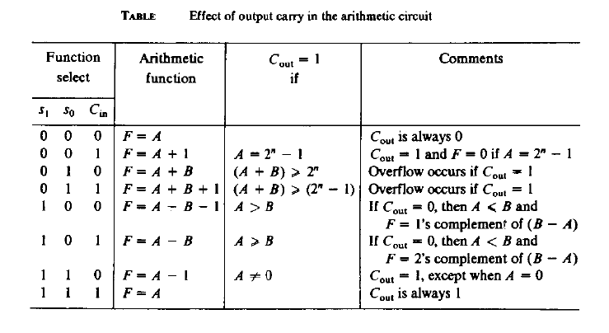
Effect of Output Carry

Slide 13
Example of Design of Arithmetic Circuit
Design an adder/substractor with one selection variable s and two input A and B. When s=0 the circuit performs A+B. When s=1 the circuit performs A-B by taking 2’s compliment of B.

Slide 14
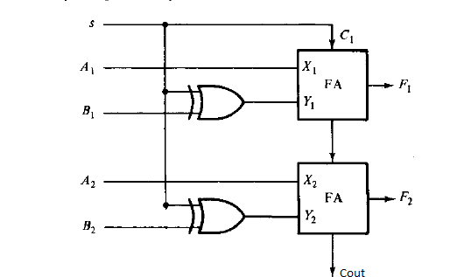
Example of Design of Arithmetic Circuit

Slide 15
THANK YOU!
Questions?

