Slide 1
CAMPUS ENERGY
CONSUMPTION ANALYTICS
Exploratory Analysis • Forecasting • Scenario Analysis • Business Recommendations
Final Project Presentation
Public I-BLEND dataset | IIIT-Delhi | Historical period: 2013–2017
Historical public-data case study — not measurements from Heritage Institute of Technology.

Slide 2
Project overview
A reproducible workflow from raw meter readings to cautious operational recommendations
38,520
87.41%
9,370
5 models
processed hourly records
valid campus-total coverage
hours in selected forecasting segment
compared on chronological test data
Scope: historical energy patterns, data quality, forecasting performance, hypothetical energy-saving scenarios and evidence-based recommendations.

Slide 3
Dataset and scope
I-BLEND: Indian Buildings Energy Consumption Dataset
• Public dataset associated with IIIT-Delhi; seven commercial/residential campus buildings in the original data descriptor.
• Original electrical data sampled at one-minute intervals; this project aggregated readings to hourly observations.
• Processed analysis period: 10 August 2013 to 31 December 2017.
• Occupancy is Wi-Fi-derived estimation, not an exact headcount.
• 2018 supplementary weather was not treated as contemporaneous with 2013–2017 energy.

Slide 4
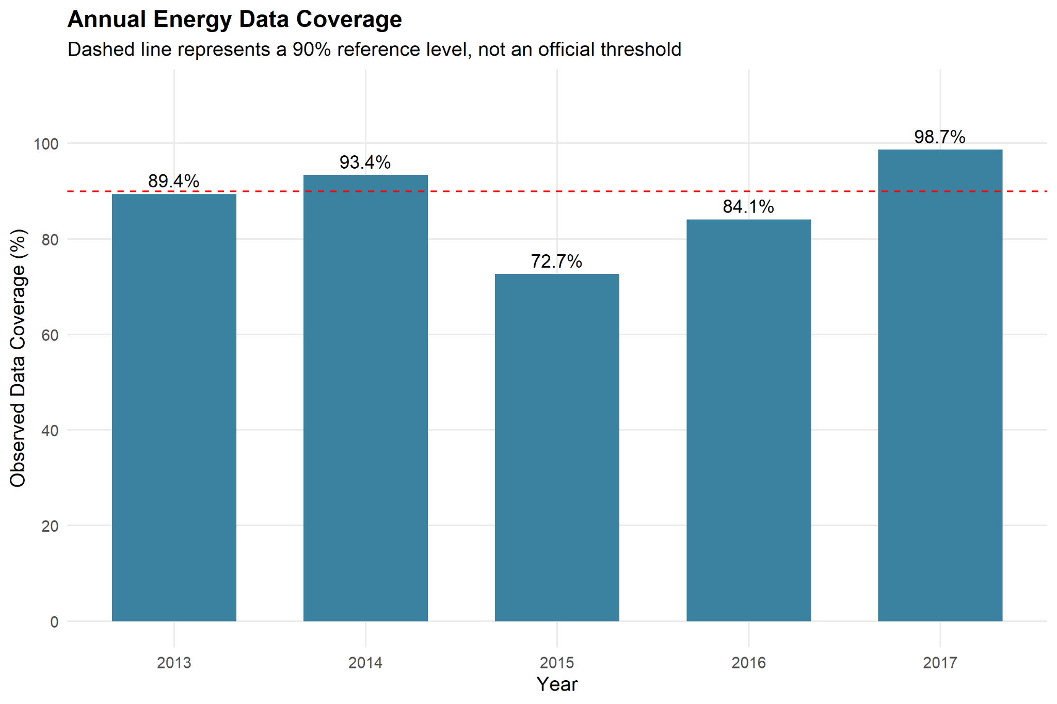
Data quality matters
Observed campus-total energy coverage
33,671 valid hourly records
4,849 missing or invalid records
87.41% observed coverage
Missing readings were preserved rather than treated as zero. Annual sums therefore represent observed values, not necessarily complete calendar-year consumption.

Slide 5
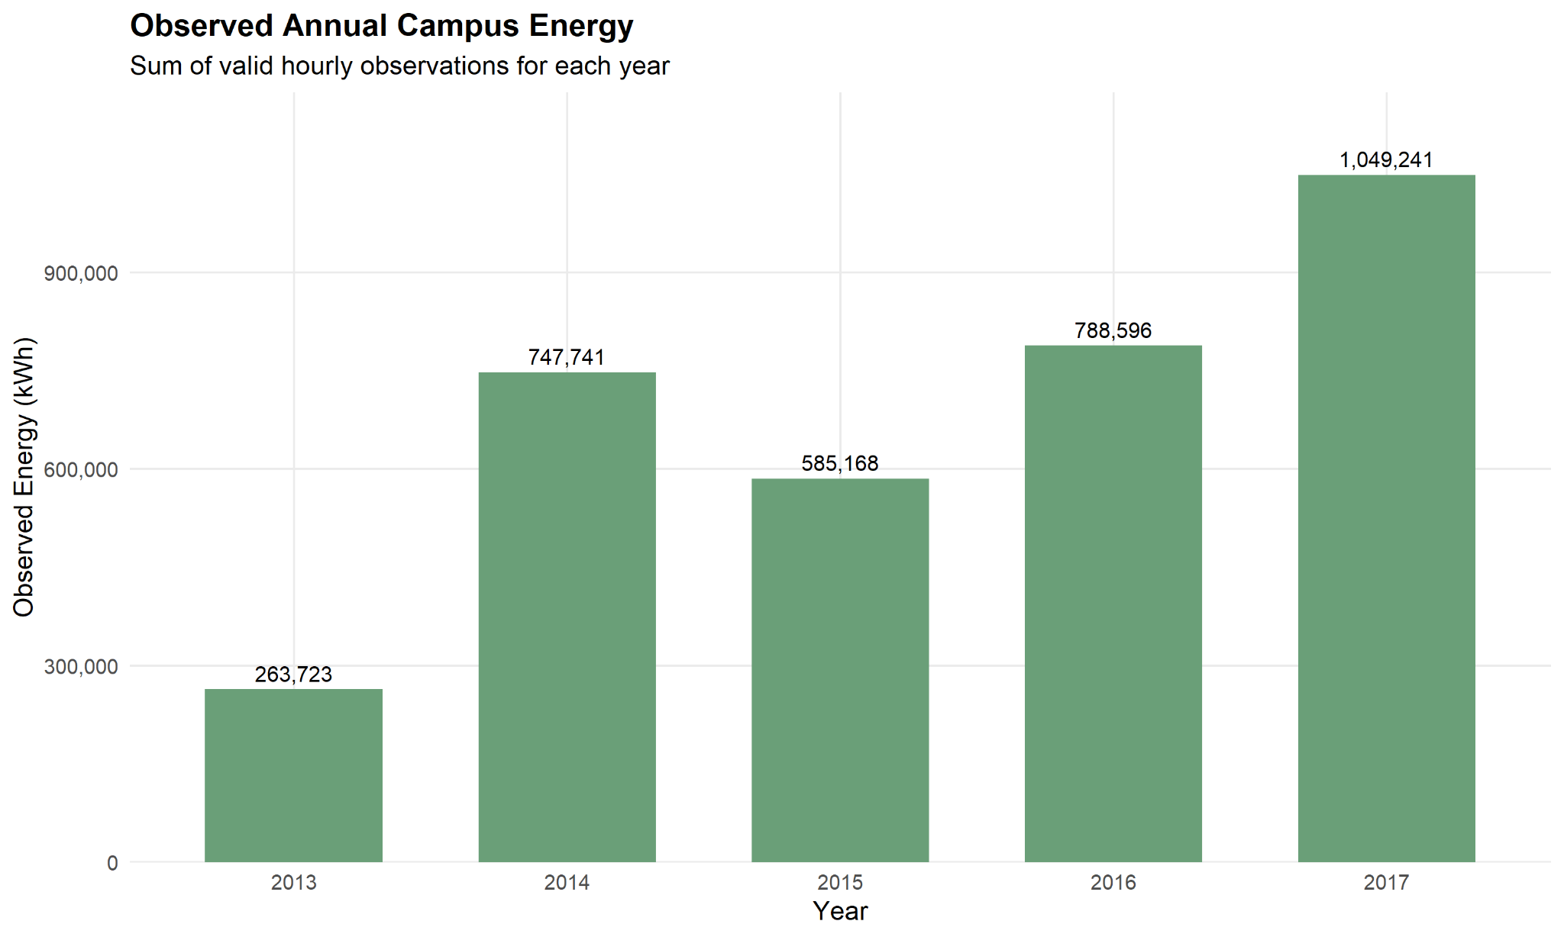
Annual observations require caution
Coverage and observation windows differ across years
2013 is a partial year; 2015 has the lowest coverage (72.67%); 2017 has the highest (98.72%).
Do not interpret annual observed sums as a clean year-over-year consumption trend.

Slide 6
Forecasting design
Chronological split and rolling one-step-ahead evaluation
9,370
7,496
1,874
continuous hourly observations
training observations (80%)
testing observations (20%)
Training ended 18 April 2017 at 16:00; testing began at 17:00. Actual previous observations within the test period were used for subsequent one-step predictions.

Slide 7
Forecast model comparison
MAE and RMSE in kWh; lower is better
Lag-Based Regression achieved the lowest MAE and RMSE among the five evaluated models.
Model | MAE | RMSE
Lag-Based Regression | 8.822 | 12.099
Naive Previous Hour | 9.188 | 13.438
Seasonal Naive (24h) | 16.467 | 24.480
Calendar Regression | 28.905 | 34.279
Linear Trend Regression | 30.227 | 36.573

Slide 8
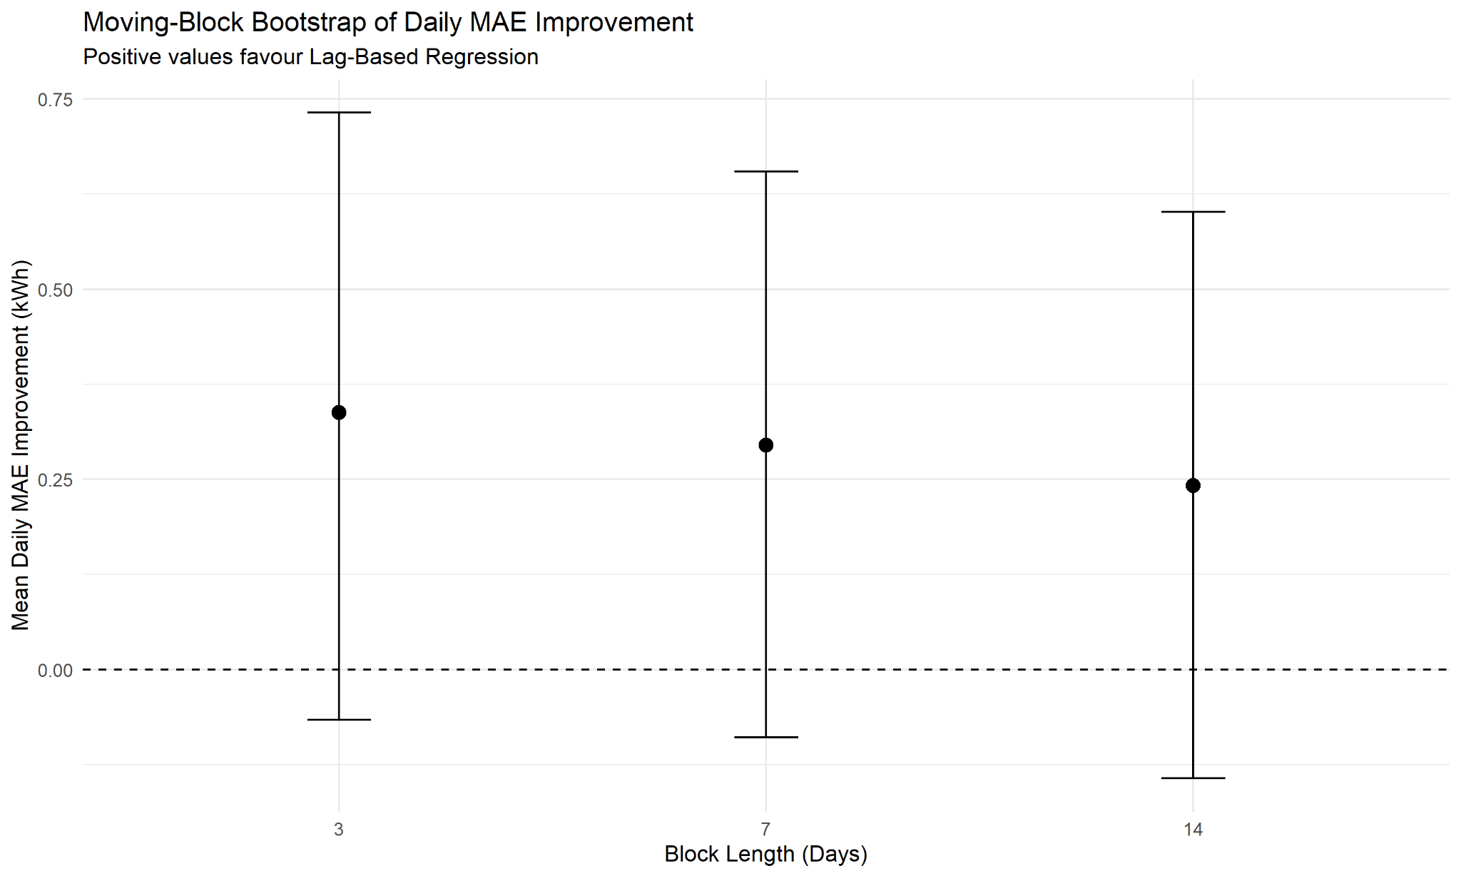
Forecasting: interpret the gain honestly
Better average error does not mean a proven universally superior model
3.98%
The moving-block bootstrap confidence intervals for 3-, 7- and 14-day blocks included zero. The improvement is modest and not statistically conclusive.
MAE reduction vs previous-hour baseline

Slide 9
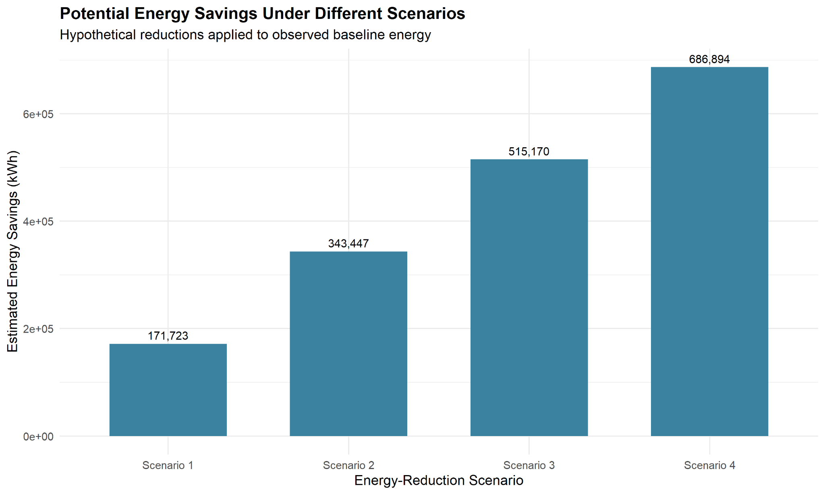
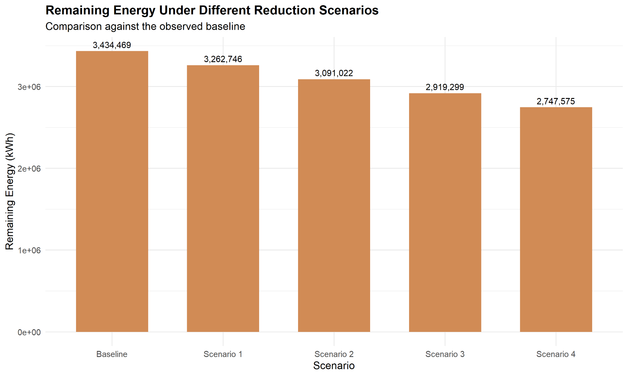
Energy-saving scenarios
Hypothetical reductions applied to 3,434,469 kWh of observed baseline energy
Scenario values are hypothetical, not achieved savings or technically verified targets.

Slide 10
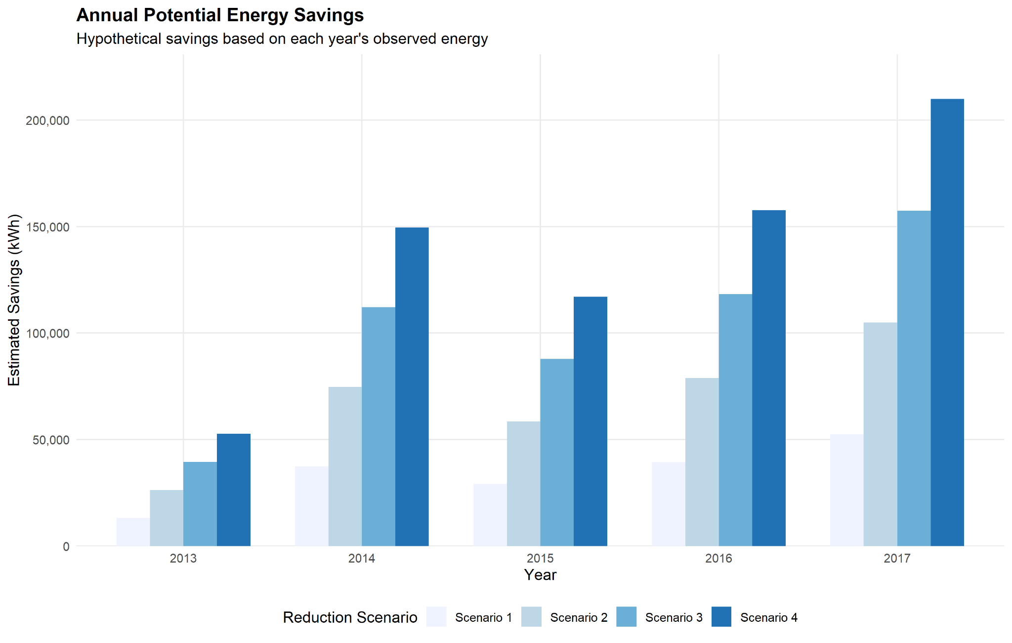
Annual scenario analysis
Annual savings are calculated from each year's observed energy
Annual values inherit the coverage and partial-year limitations of the observed data.

Slide 11
Business insights
What the analysis supports
1. Improve meter-data completeness and missing-data alerts.
2. Investigate missing readings, particularly low-coverage periods.
3. Establish regular energy monitoring and monthly reviews.
4. Pilot efficiency measures and measure actual kWh changes.
5. Use forecasting experimentally, alongside a simple baseline.
6. Investigate high-consumption periods with operating schedules.

Slide 12
Limitations and responsible interpretation
What this project does not claim
• Not a measurement of Heritage Institute of Technology.
• Incomplete meter coverage; annual sums are not fully comparable.
• Wi-Fi occupancy estimates are not exact headcounts.
• Forecast gain is modest and bootstrap intervals include zero.
• Savings scenarios are hypothetical; no tariff-based cost savings calculated.
• No building-specific intervention claims without verified building evidence.

Slide 13
Conclusion and next steps
From historical analysis to measurable campus action
The strongest next actions are to improve data quality, review energy regularly, and test efficiency measures through measured pilots.
For a real campus deployment:
1. Collect verified meter data with consistent coverage.
2. Establish a documented baseline and operational context.
3. Pilot one intervention at a time.
4. Compare measured energy before and after, adjusting for operating conditions.
Thank you

Slide 14
References
Dataset source and software
Rashid, H., Singh, P., & Singh, A. (2019). I-BLEND, a campus-scale commercial and residential buildings electrical energy dataset. Scientific Data, 6, 190015.
https://doi.org/10.1038/sdata.2019.15
Dataset collection: https://doi.org/10.6084/m9.figshare.c.3893581
R: https://www.r-project.org/ | Tidyverse: https://www.tidyverse.org/
Dataset publication details verified against Scientific Data and the associated figshare data citation.

