Slide 1



Starting day of the calendar, which can be changed
Starting Date Jan 12, 2020
< Today > 1d 2d 3d 1w 2w
Utilization
Just put the button.
Leave onClick empty
Resource
8 9 10 11 12 13 14 15
Change starting date to tomorrow
CK
Chuck Kohler
Change starting date to yesterday
Clicking will change auto adjust starting date to today and calendar view will be for 1 day
AB
Amber Bolton
Scrollable window
Two third of screen area
BK
Amber Bolton
1 day hourly calendar
Amber Bolton is scheduled for 12:30 to 13:30. Order number is shown.
S76123
RESOURCE OBJECTS
SCHEDULE OBJECTS
Given:
start time and end time can be configured. It should be in between 0 to 23. It can be start: 22 and end: 8 for night shift
Schedule granularity are: 15 min, 30 min or 60 min. If 15 min, then a schedule can be from 9:15 to 9:30
Search customer
Order # Customer City Detail Status Priority Type Start Date End Date
One third of screen area
S90876 Ducker and Bendy San Jose Air conditioning stop working… New Medium Maintenance Jan 20, 19 Jan 20, 19
ORDER OBJECTS
Clickable. Leave onClick empty.
< 1 2 3 4 >
It can be drag to another location. Every drag changes start/end date. It can be expanded left or right. This will also change start/end time.
Color scheme: status = 2, then gray. Otherwise:
startdate >= today then green
startdate < today then red

Slide 2
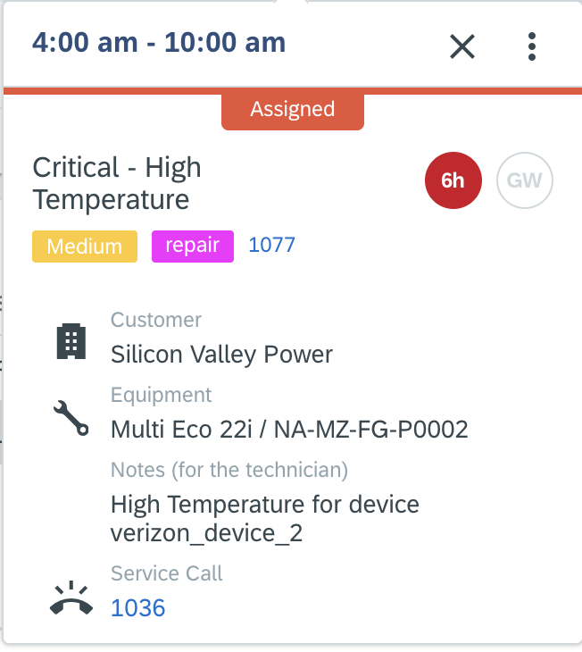



In any views clicking a schedule will show up a popovers as shown
Starting Date Jan 12, 2020
< Today > 1d 2d 3d 1w 2w
Utilization
Technicians
12 Jan 13 14 15 16 17 18
CK
Chuck Kohler
AB
Amber Bolton
S76123
Just put the links. Leave onClick empty.
Notify
Completed
Reschedule
Team members
7 days daily calendar
123 Rodeo Dr, Dublin
BK
Amber Bolton
Search customer
Order # Customer City Detail Status Priority Type Start Date End Date
Just put the links. Leave onClick empty.
Request
Add technicians
S90876 Ducker and Bendy San Jose Air conditioning stop working… New Medium Maintenance Jan 20, 19 Jan 20, 19
< 1 2 3 4 >
You can hard code the text to display - will be changed later
Put the Order number

