Slide 1
GASES

Slide 2
KINETIC INTERPRETATION OF TEMPERATURE AND PRESSURE
TEMPERATURE ACCORDING TO KMT
Particlesofanygasmoverandomlyinallthepossibledirectionsatanaveragevelocity.Anyobjectthatismovinghaskineticenergythatisproportionaltothetemperature(measuredinkelvins)
⬆particles´speed→⬆kineticenergy→⬆T
Absolutetemperaturein a gasisameasurementoftheaveragekineticenergyoftheparticles.
Absolutzero:Thepointwhereatwhichallmolecularmotionceases

Slide 3
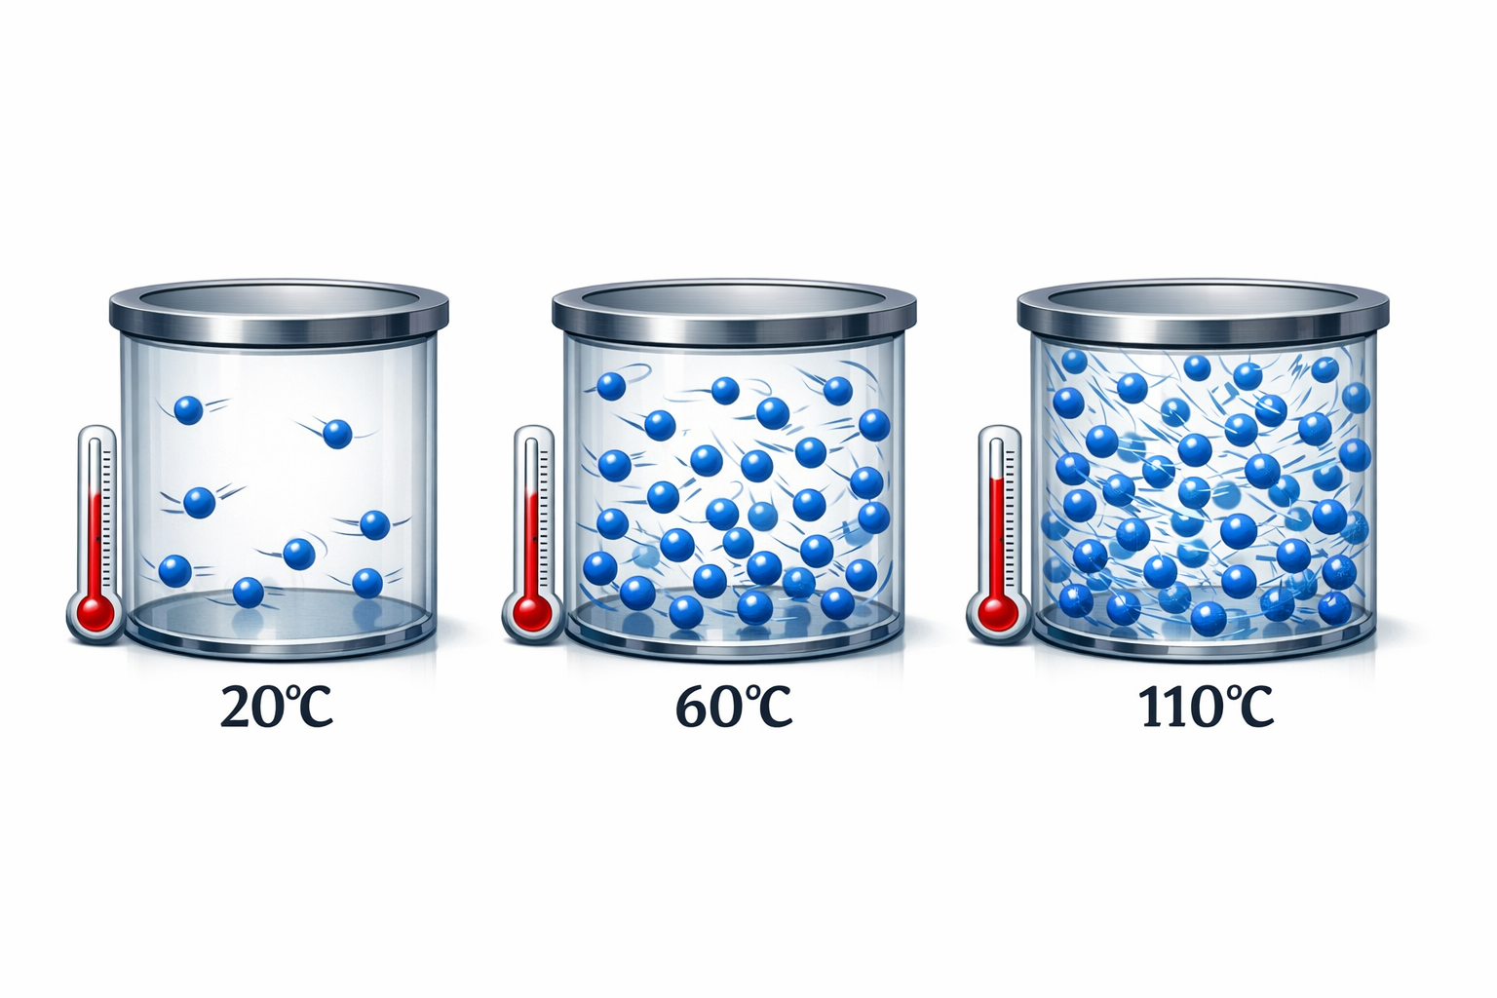

Slide 4
PRESSURE ACCORDING TO KMT
P= F/S
AccordingtoKMT,pressurein a gasiscausedbythecolisionsoftheparticlesofthegasagainstthecontainer.
Drawing1:⬇volume→⬆frequencyofcollision→⬆P
Drawing2:⬆T→⬆kineticenergy→⬆frequencyofcollisions→⬆P

Slide 5
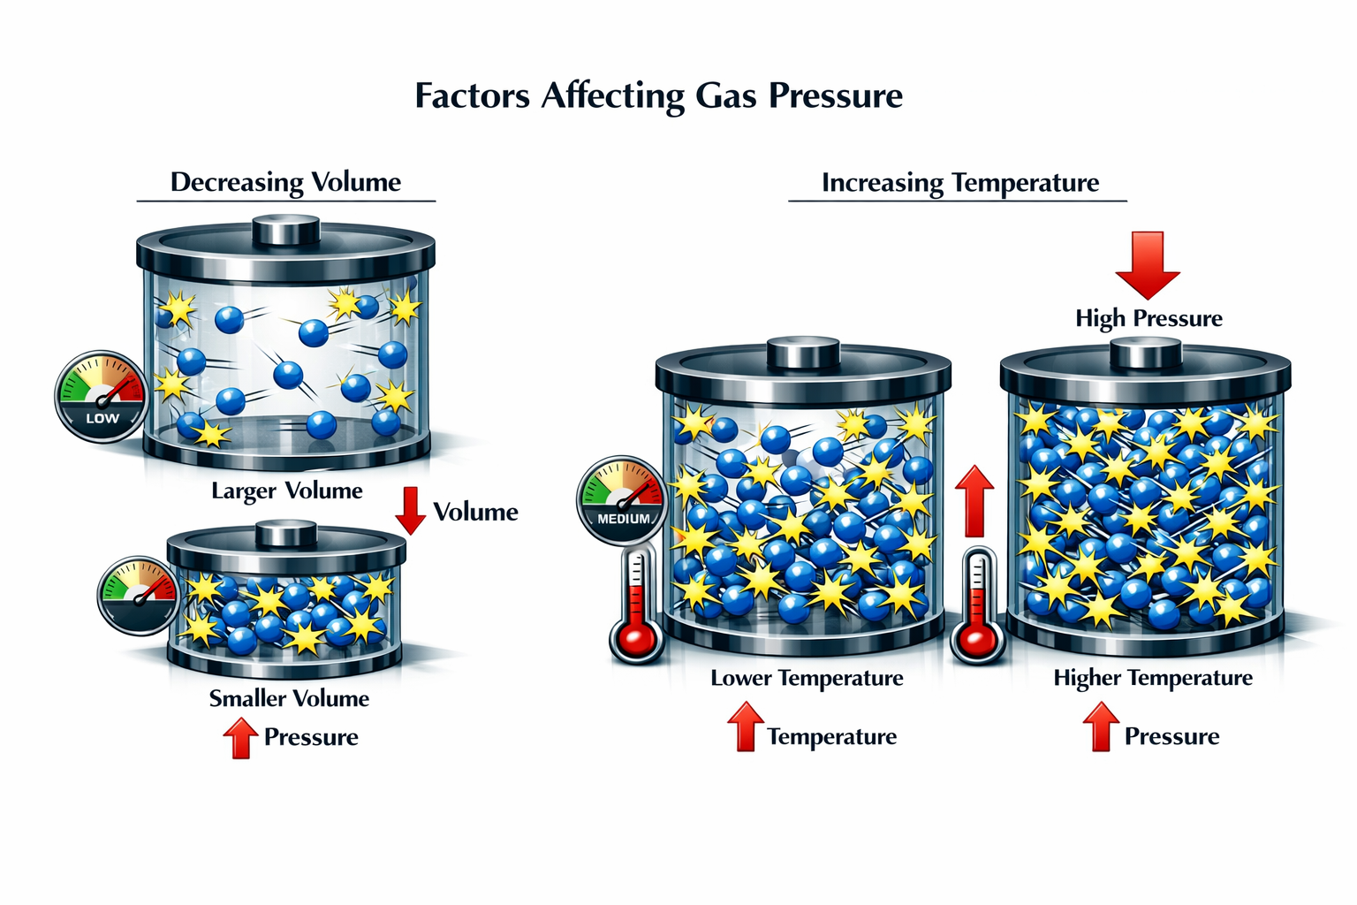

Slide 6
Videoaboutpressureandtemperaturein gases
https://www.youtube.com/watch?v=NzKAJWTmlwg
https://www.youtube.com/shorts/UjObv6S0SOY

Slide 7
RELATIONSHIP BETWEEN P,V and T
P, V and T in gases are closely related. If you change one of these quantities, you will change the others as well.
Scientists discovered that the relationships between these variables are governed by simple laws. Each of these laws are known by the name of the scientists who discovered the law.
The gas laws describe the mathematical relationship between 2 variables while the third remain constant (control variable), as long as the amount of gas remain constant.

Slide 8
BOYLE-MARIOTTE LAW
B-M Law describes the relationship between P and V while T is kept constant.
If T=ct, the relationship between P and V is inversely proportional.
PxV=ct
Home-made experiments about the lawhttps://www.youtube.com/watch?v=eR49g3ubTBg

Slide 9
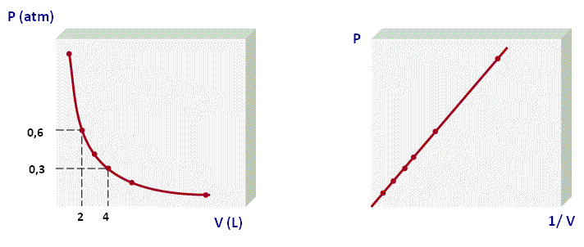

Slide 10
GAY-LUSSAC LAW
Describes the relationship between P and T of a gas when T is constant.
If V=ct, P and T are directly proportional.
P/T=ct
In order to this law to hold, T must be expressed in K

Slide 11
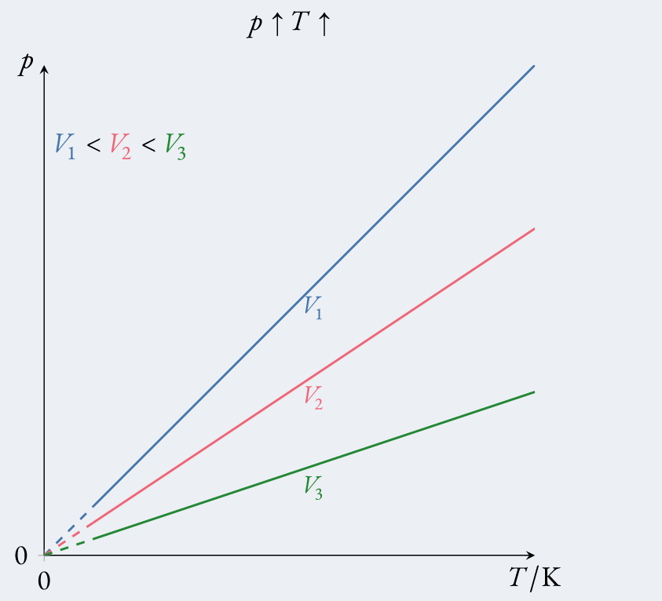

Slide 12
VIDEO GAY-LUSSAC
https://www.youtube.com/shorts/OGiEszgRE_g
Combustion heats the air, increasing pressure.
When the flame extinguishes, temperature drops, so pressure drops.
The outside pressure becomes greater than the inside pressure → water is pushed up into the glass.
This is a classic demonstration of pressure–temperature relationship in gases.

Slide 13
CHARLES AND GAY-LUSSAC LAW
Describes the relationship between the volume of a gas and its temperature when they are measured at the same pressure.
V/T=ct ; in order this law to hold, the temperature must be expressed using the Kelvin scale.

Slide 14
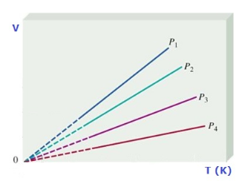

Slide 15
https://www.youtube.com/watch?v=NplVuTrr59U
In hot water
The air inside the bottle heats up.
Hot air particles move faster and spread out.
The air takes up more space, so the balloon inflates.
In cold water
The air inside the bottle cools down.
Cold air particles move more slowly and take up less space.
The balloon deflates because the air volume decreases.

Slide 16
