Slide 1
Inventory optimization
The Payzants case

Slide 2
The Problem
“A stochastic multiple period inventory optimization problem.”
Stochastic: The lead time, daily demand are random variables.
Multiple period: System operates continuously with many repeating periods of cycles, inventory can be carried from one period to the next.

Slide 3
The solution
Objective:
to keep inventory levels as low as possible
to sell inventory as quickly as possible
Inventory optimization models:
fixed quantity model:
fixed period model:

Slide 4
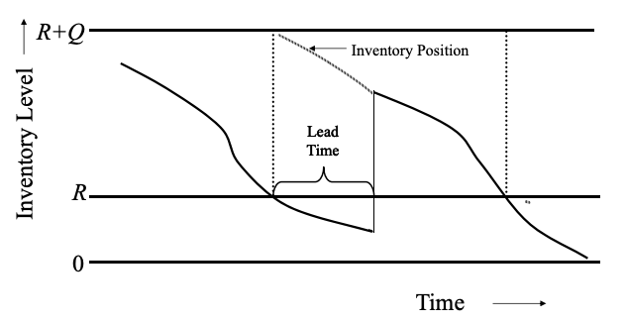
Fixed quantity model
Whenever the inventory level reaches the reorder point R, place an order of fixed quantity Q to bring the inventory position to the order-up-to level R + Q.
L

Slide 5
Fixed Quantity model
When to order?
whenever inventory reaches order point R
How much to order?
a fixed quantity Q

Slide 6
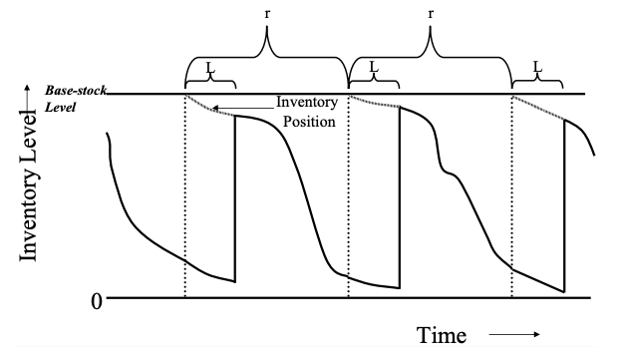
Fixed period model
Similar to fixed quantity model except that it is triggered by a fixed time period instead of the inventory level reaching a specific point.
S
S - QoH

Slide 7
Fixed Quantity model
When?
a fixed time period r
How much?
replenish level S - Quantity on Hand QoH
must have stockout protection until the next order arrives

Slide 8
 | Fixed Quantity Model | Fixed Period Model
advantage | good for expensive items (Not large safety stock) | good for inexpensive items (Ease of coordination, less work )
Safety stock | R - 𝝻_{L}, usually smaller | M - 𝝻_{r+L}, larger
Average inventory | 1/2 Q | 1/2 𝝻r
Order quantity | Q | S - QoH
Reorder point | R = 𝝻_{L} + z𝞂_{L}
Replenishment level |  | S = 𝝻_{r+L} + z𝞂_{r+L}
Annual number of orders | D/Q | 1/r

Slide 9
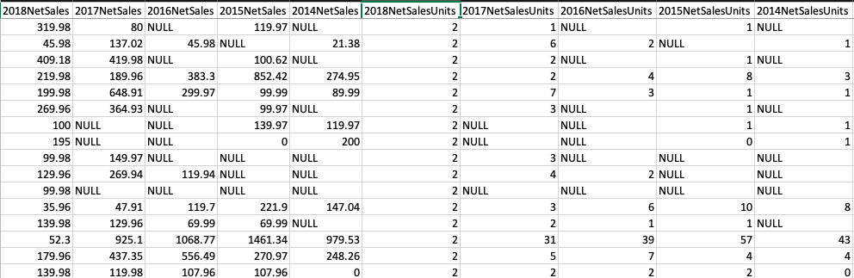
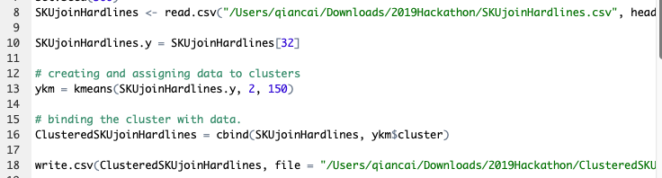
Model decision

Slide 10
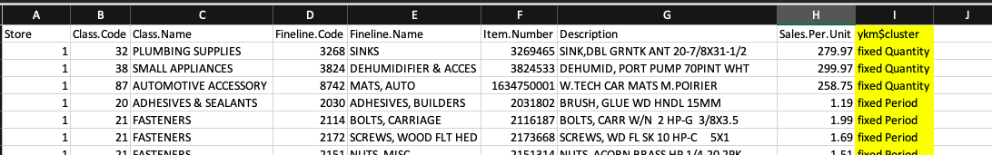
results

Slide 11
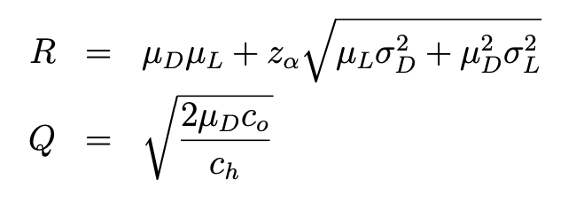
When & How much
For fixed quantity order items:
When:
How much:

Slide 12

Fixed quantity items

Slide 13
Fixed quantity items
Forcast_dayly_demand = 0.58,
Assume annual workday = 250,
Annual demand = 0.58*250 = 145,
Q = SQRT(2*145*Co/Ch) = 17.03

Slide 14
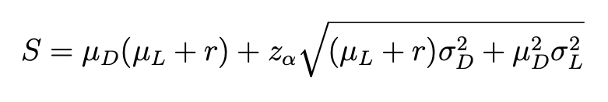
When & How much
For fixed period order items:
When: r
How much: - QoH

Slide 15
Fixed period items

Slide 16
Fixed period items
𝜇_{year} = 51107.6, 𝜇_{week} = 982.8
𝜎_{year} = 3486.13, 𝜎_{week} = 483.4
r = 1,
assume 𝜇_{L} = 1
S = 982.8*(1+1)+1.64*SQRT((1+1)*483.4²) = 3086.75
How much to order? S - QoH

Slide 17
Conclusion
Inventory optimization answers the “when and how much to order” question for every single item.
If given the volume data of items, clustering should take volume of items into consideration.

