Slide 1

CANCER DETECTION USING DEEP LEARNING
Submitted by:
Ankush Gupta Qian Cai Rahul Nomula Shahzan Magray Sunil Kumar C

Slide 2

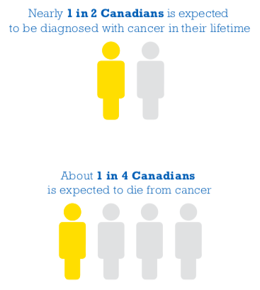

Slide 3
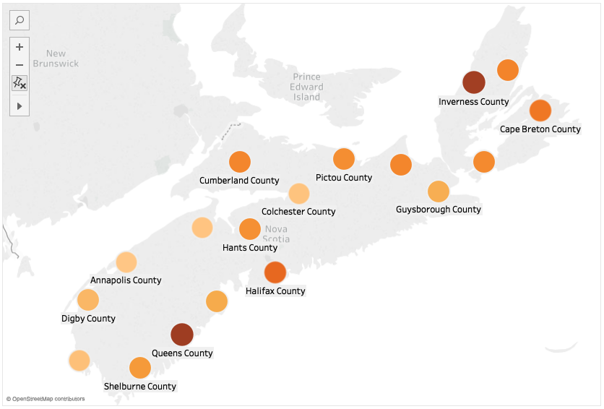
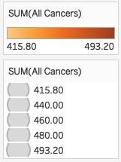

Slide 4
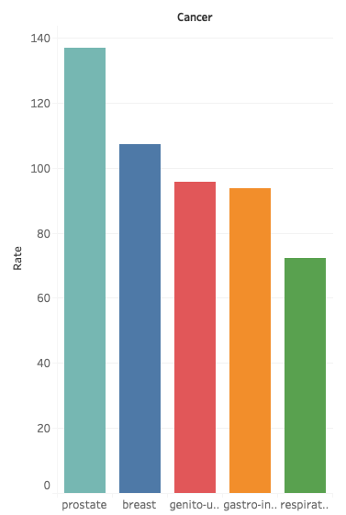
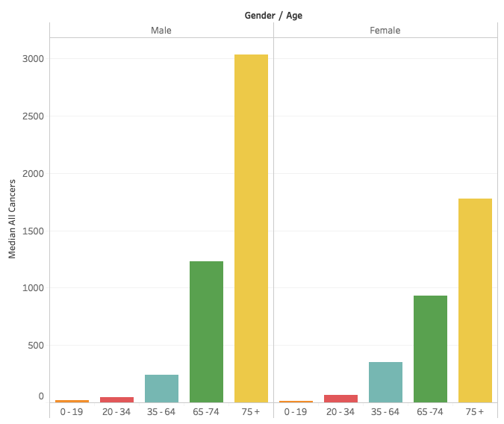
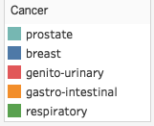
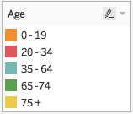
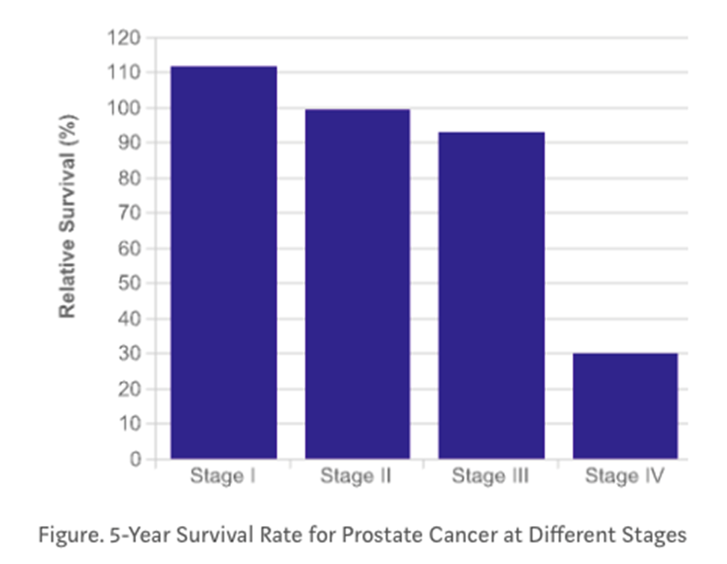

Slide 5
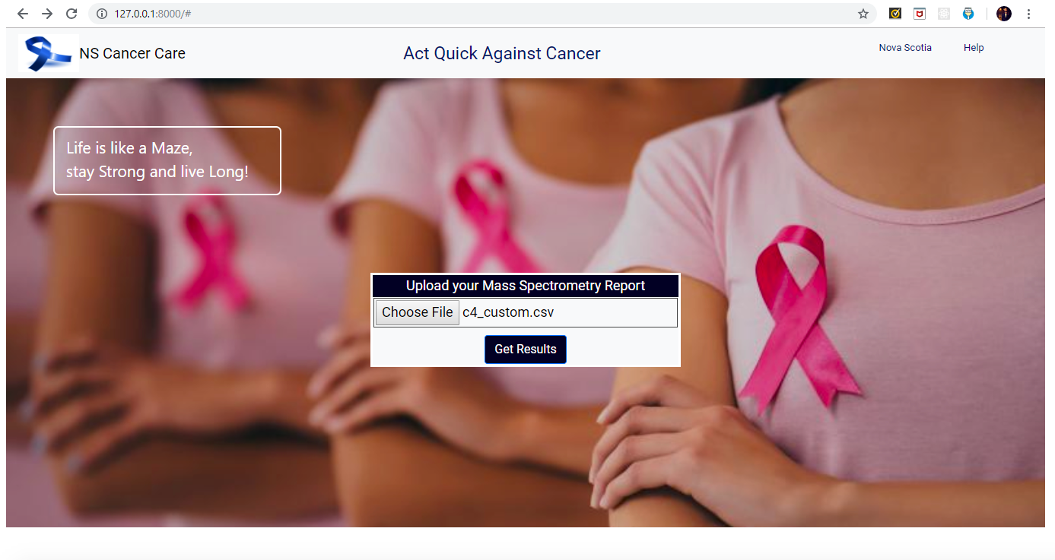

Slide 6
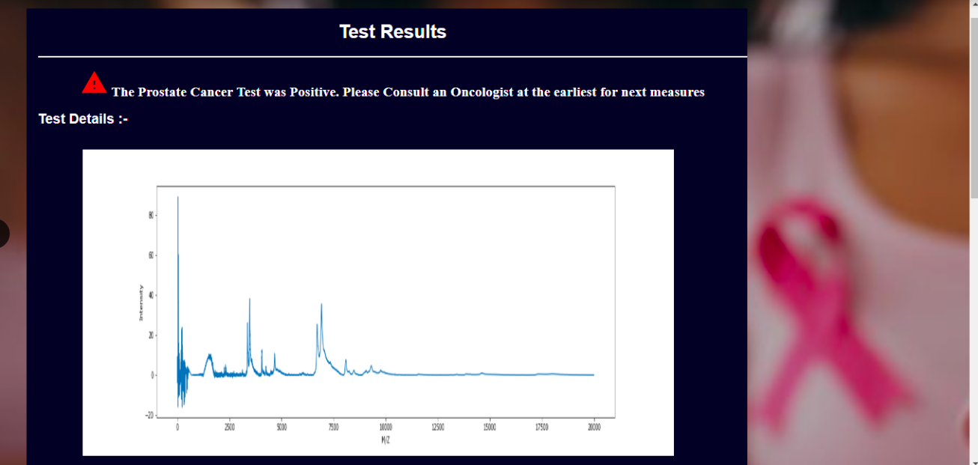

Slide 7
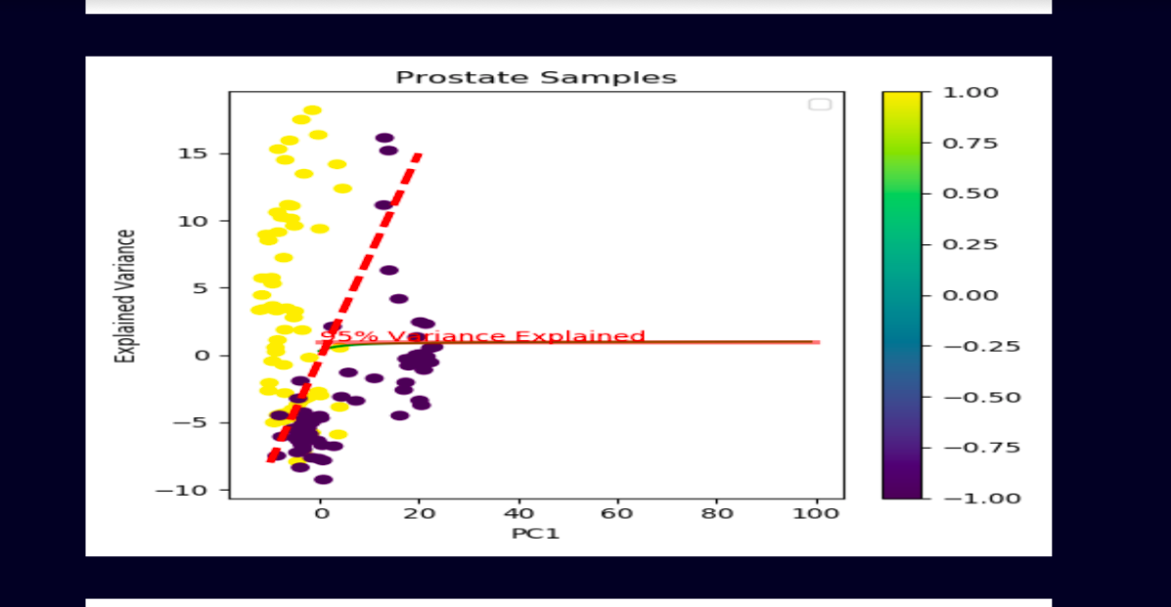

Slide 8
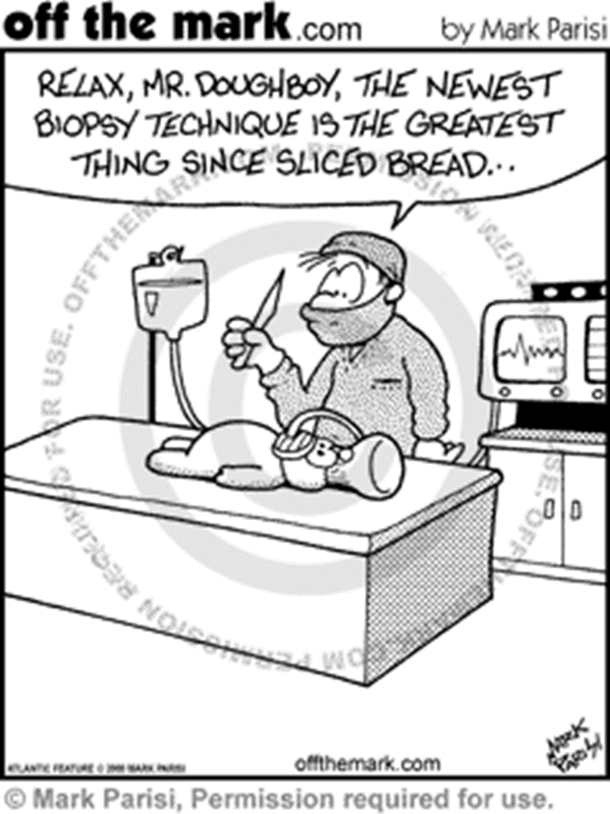
Conclusion
A cancer diagnosis web app based on the deep learning analysis of the mass spectrum data is accurate and beneficial for the users.
Government should give policies to mandate a process for male over 35 and female over 21 to ask for routine check-ups for cancer screening.
The web application does not violate any privacy of the user since it is a kiosk application.
Dependencies
The Mass Spectrometry data should be made available to the users for using the application

