Slide 1
FASHIONEASE
PRESENTED by
Zarlish Abid
Humna Abid

Slide 2
PURPOSE
Main goal of the project is to make a centralized platform that will compare the clothes of different brands.
The purpose of a Fashion Ease is to sell clothing online.
Customers can browse and purchase items from the store's website, which is typically open 24/7, and the items are shipped to the customer's home or another designated location.
This will be first platform to compare the products.

Slide 3
Product Perspective
Fashion Ease will provide an easy way for customers to find and purchase the products they are looking for.
This typically involves a search function and product categories.
A Fashion Ease will also allow customers to add products to their shopping cart and proceed to checkout to complete their purchases.
In addition, the website should make it easy for customers to view and compare different products

Slide 4
Product Functions
Product catalog: A list of all the products available for purchase on the website.
Product pages: Individual pages for each product that provide detailed information, including descriptions, images, and pricing.
Product reviews: Customers can leave reviews and ratings for products they have purchased.
Product compare: The user can compare the product between there prices and quality.

Slide 5
User Classes
Admin.
Vendor.
Customer.

Slide 6
ADMIN FUNCTINALITY
Login
View Vendor
Approve Vendor Login
View registered user
Delete Abuse Feedback

Slide 7
USER FUNCTIONALITY
Register
Login
Manage Wallet Balance
Search brand items
View item details
Compare Product
Add to Cart
Add/Update shipping address
Place Order
View Order Status
Feedback
Ratings

Slide 8
VENDOR FUNCTIONALITY
Login
Register
Add Product
Manage Product
Manage Orders
Update Order Status

Slide 9
Hardware Interfaces
The website will run on any device running on iOS, Android, PC and laptop.

Slide 10
TECHNOLOGY
ASP.NET
SQL SERVER

Slide 11
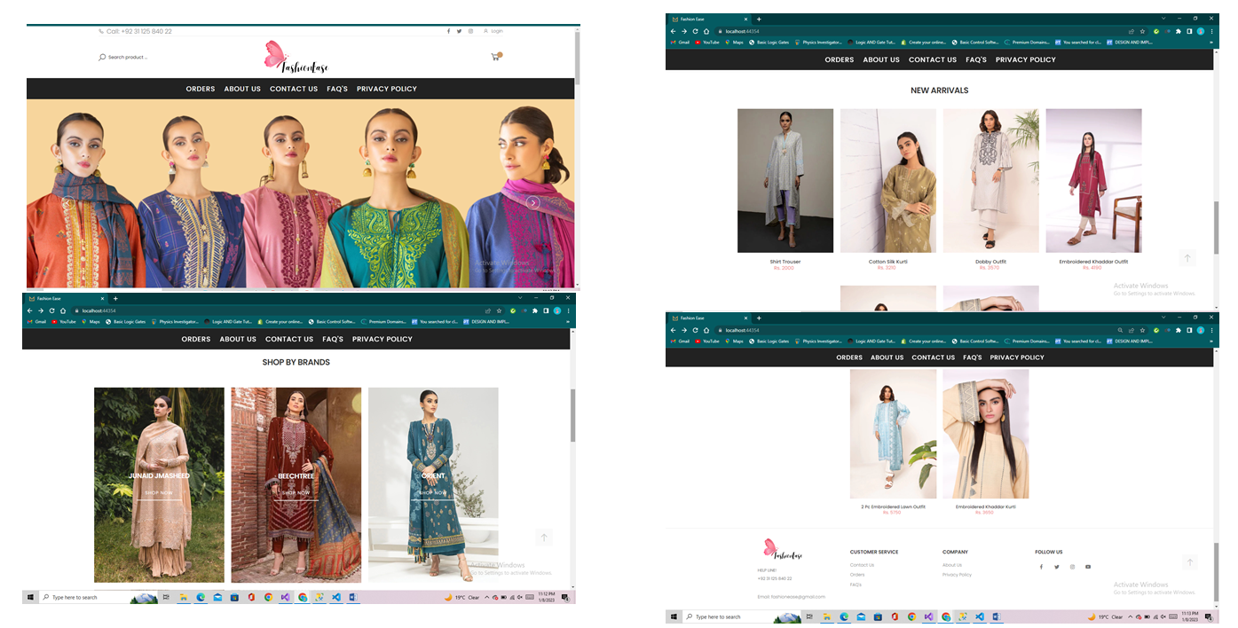
DETAILS WITH MOCUPS
Home page where user can view different brand pages and all the products added by the brand owners and through multiple options and could move to different pages.

Slide 12
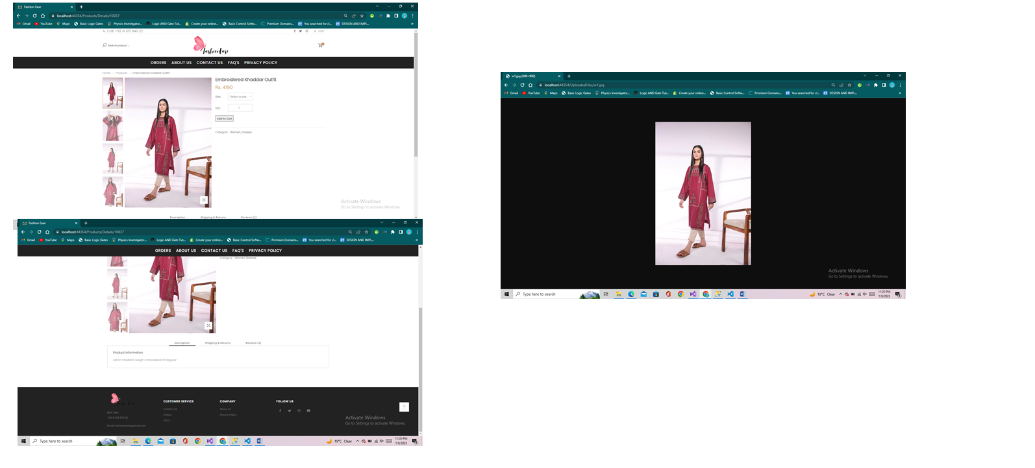
Product Details
Detail of every product with its price and reviews

Slide 13
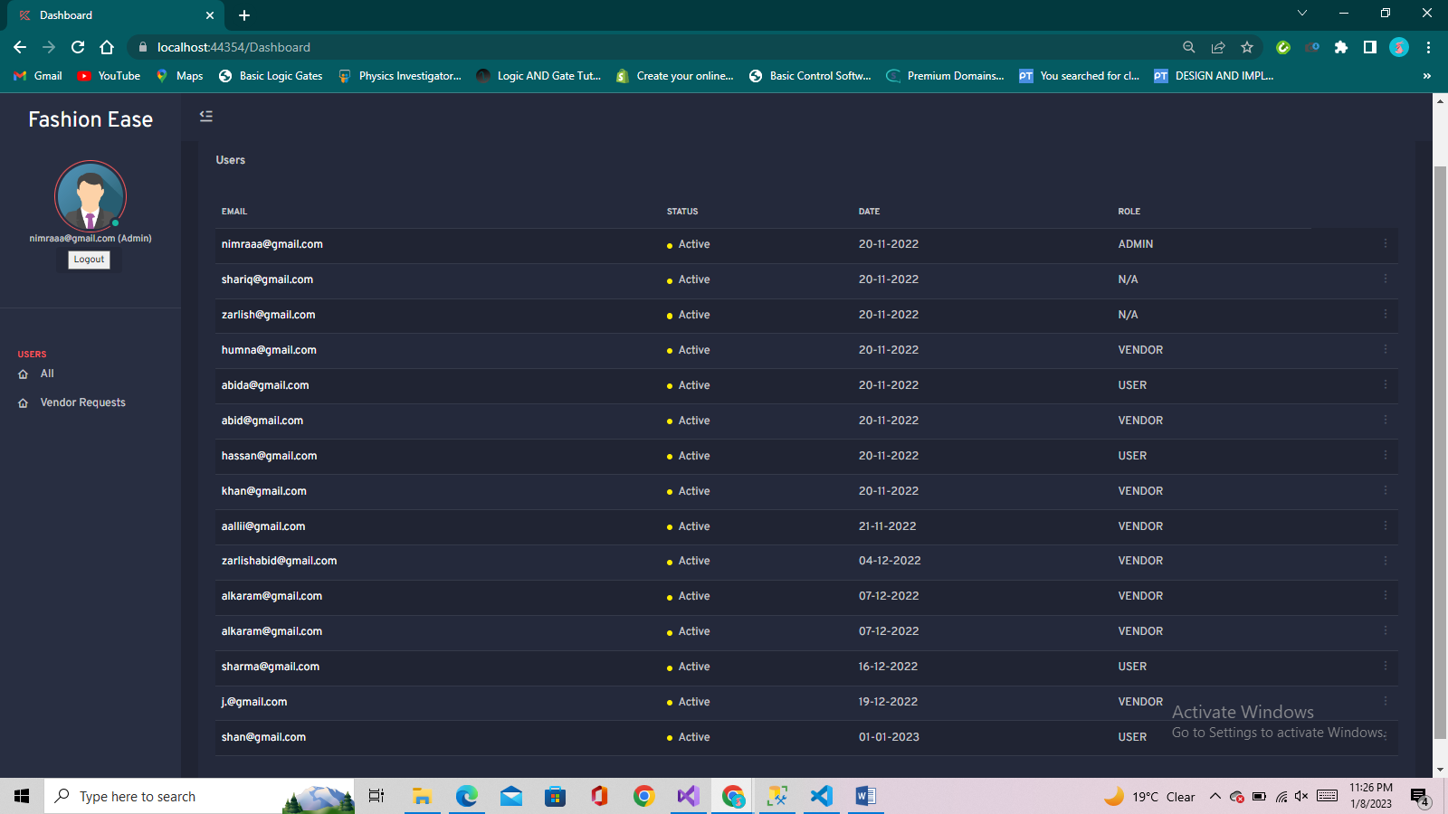
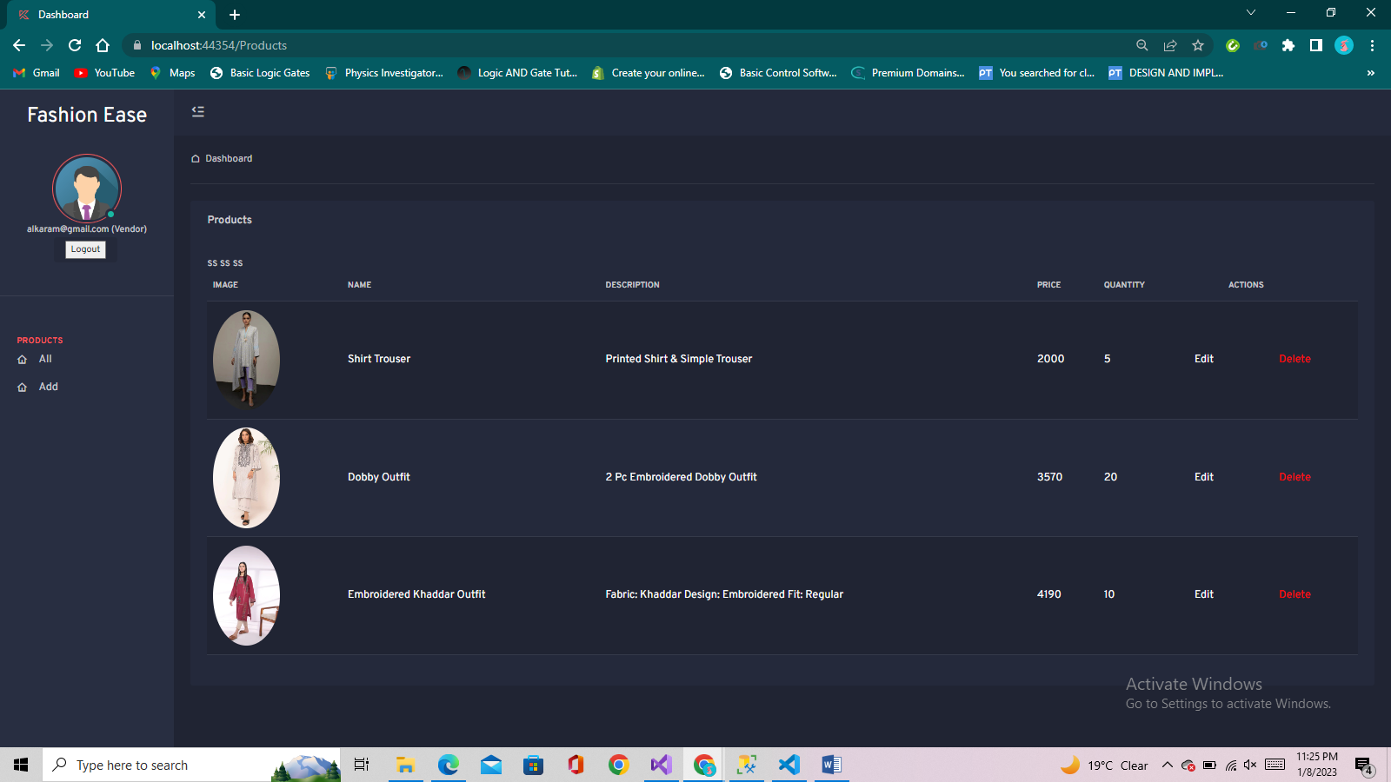
Dashboards
Admin
Vendor

Slide 14
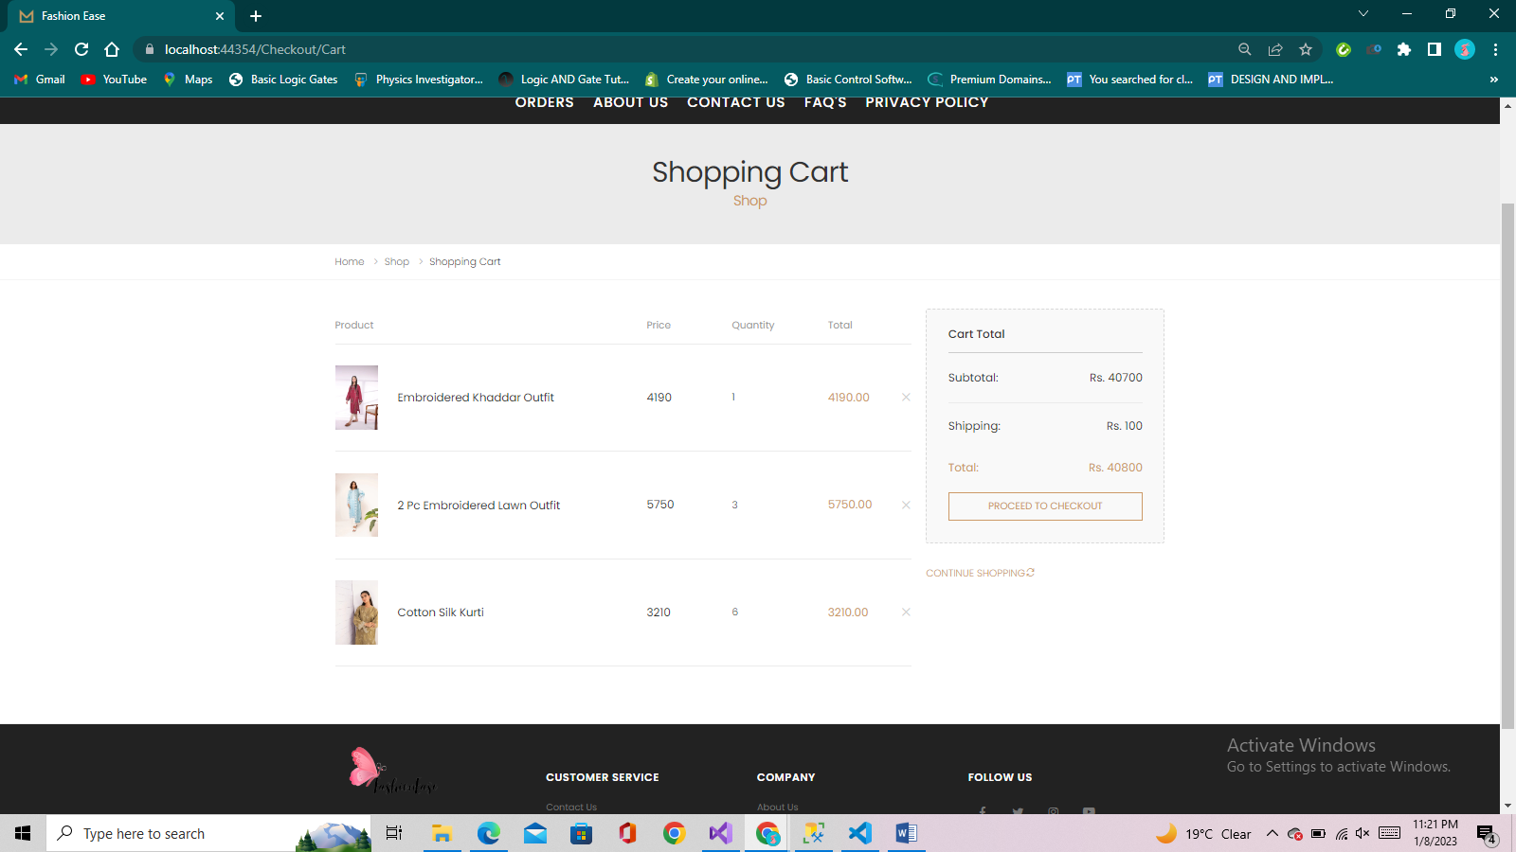
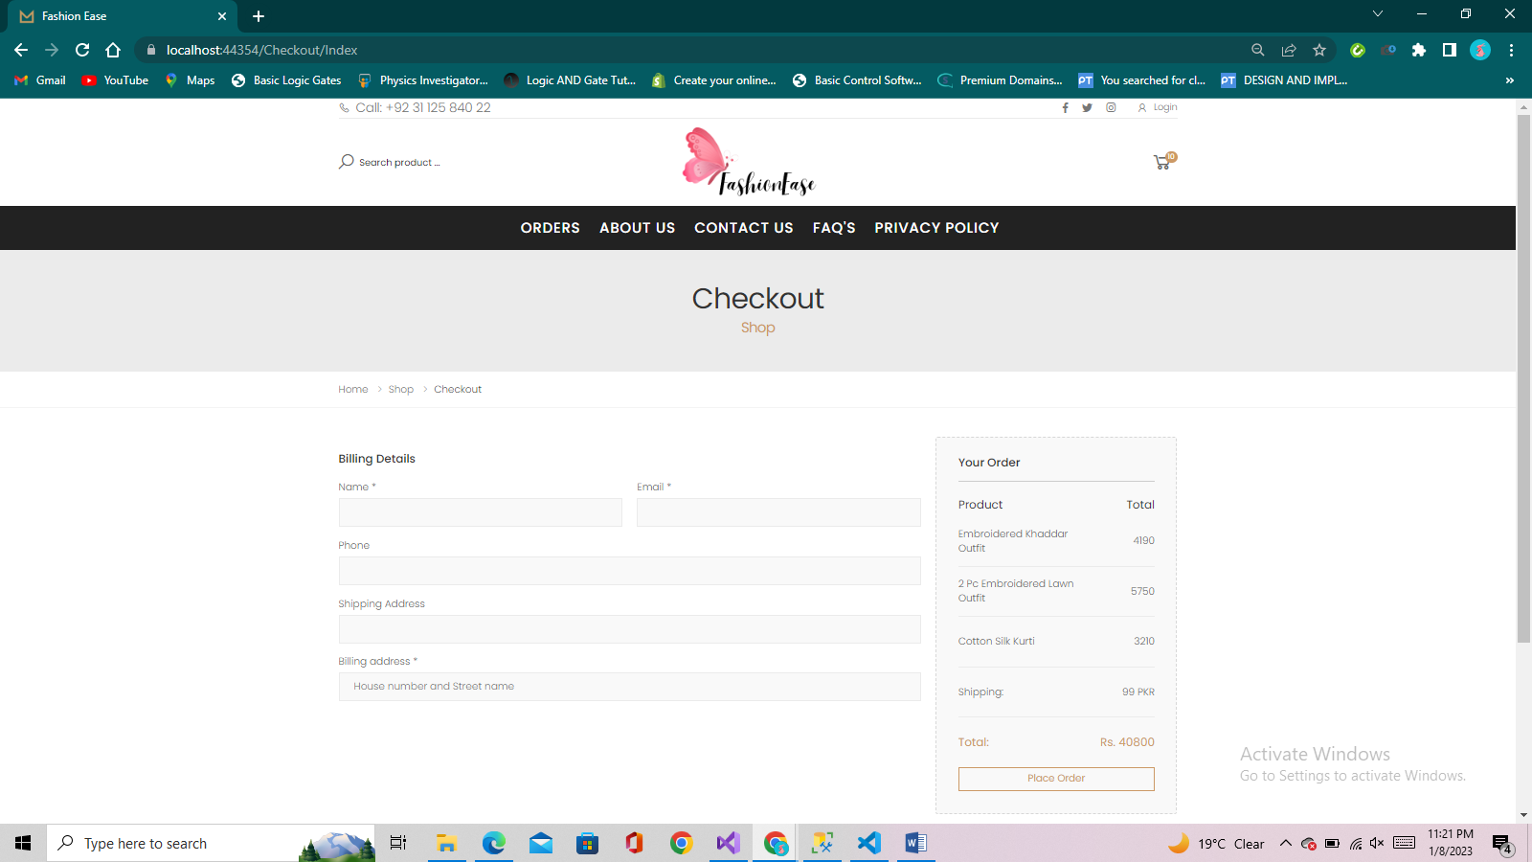
Cart and Checkout
User can add items to carts and could proceed to checkout
A checkout page where user need to provide the shipping details and place orders.

Slide 15
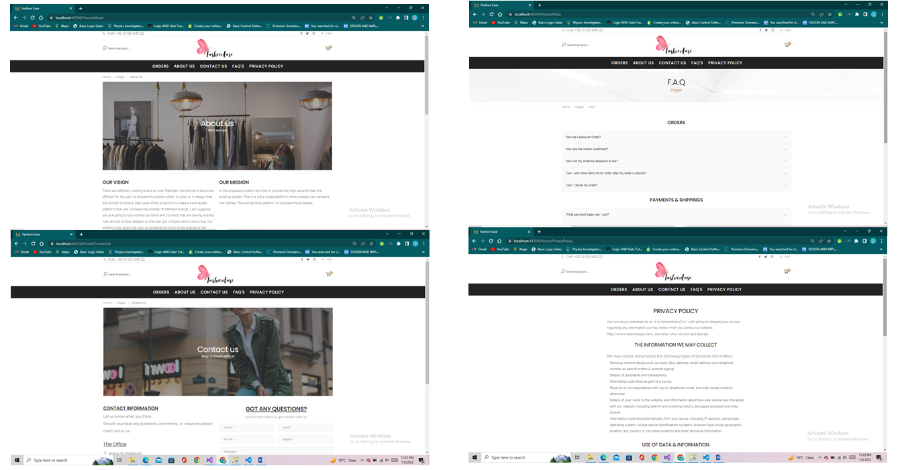
Other Pages

Slide 16
THANK YOU!
PRESENTED TO
SIR SOHAIL IMRAN
SIR ARABI TAYYAB
SIR SAJAY KUMAR

