Slide 1
Collection Selection
Afshan Ejaz

Slide 2
Conventional Retrieval Systems
Conventional retrieval systems based on a single centralized index are subject to several limitations
Among these is the very critical limitation due to the exponential growth in available information on the Internet.
Even though search engines have currently increased their coverage of the content of the Web, They are still a long way from full coverage of the entire Web.
Moreover, other limitations inherent to centralized approach might surface such as insufficient bandwidth server overloading and failures.
The two major limitation are query throughput and query response time.
Given these facts, it thus seems more appropriate to turn to the DIR approach for storage and search processing.

Slide 3
Distributed Information Retrieval
IR is usually viewed as searching a single collection of documents
• What is a collection?
– A single source, e.g., Wall Street Journal? (What time period?)
– A single location, e.g., the UMass Physical Sciences Library?
– A set of libraries, e.g., all UMass Amherst libraries?
Distributed IR: searching when there is more than one collection – Local environments, e.g., a large collection is partitioned – Wide-area environments, e.g., corporate network, Internet.
• Partition large collections across processors

Slide 4
Distributed Information Retrieval
Distributed Information Retrieval (DIR) system architecture in its simplest form consists of various collection servers and a broker.
Typically, the broker receives the user's query, forwards it to the carefully selected collection server subset most likely to contain relevant documents responding to this query (e.g., based on search keywords, collection statistics, query language or a subset of servers pre-selected by the user).
Finally, the broker combines the individual result lists (submitted by each selected collection) in order to produce a single ranked list.

Slide 5
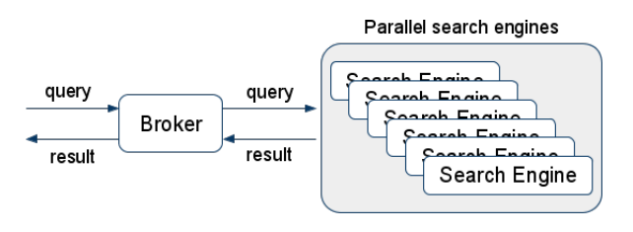
Improving query throughput
Broker == Load Balancer
Search Engines either share search index or have their own copy of one.

Slide 6
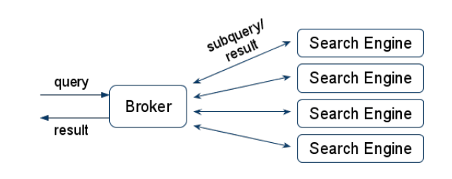
Improving Query response time
Broker splits query to sub-queries and sends them to multiple search engines.

Slide 7
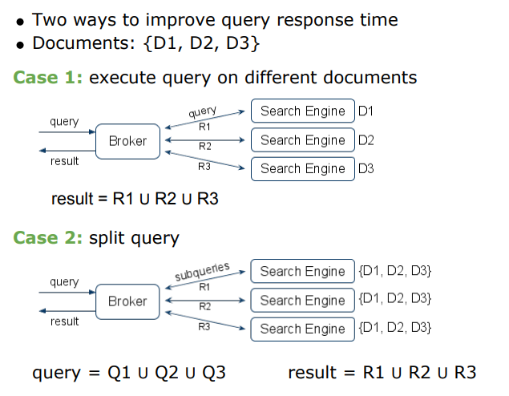

Slide 8
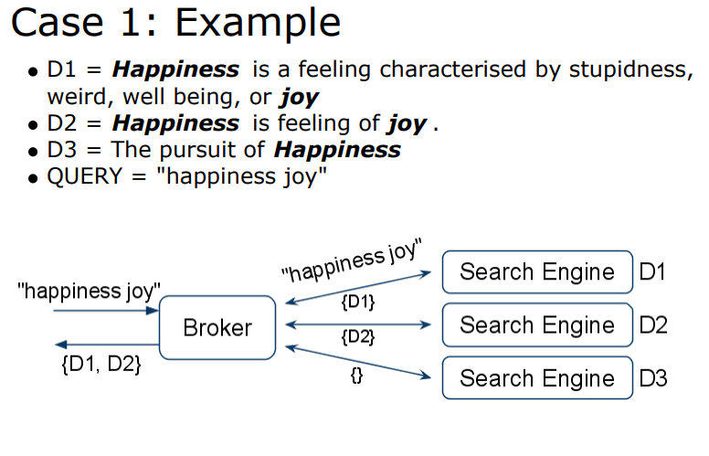

Slide 9
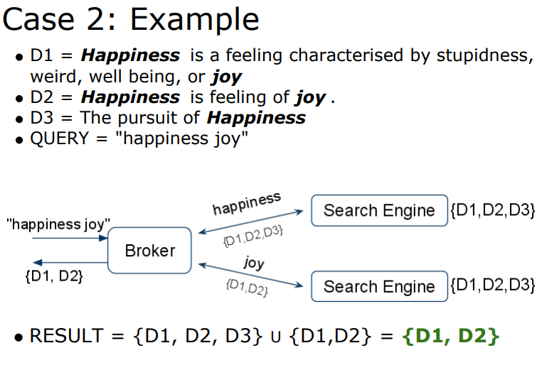

Slide 10
Collection selection
Collection selection refers to automatic or manual selection of a subset of collections (or servers) most likely to contain relevant documents for a given query.
The goal of collection selection is to reduce the number of collections searched as much as possible, without decreasing retrieval effectiveness.
In automatically selecting a subset of servers, most collection selection techniques compute a score for each collection, based on its usefulness to the query submitted.
The collections are then ranked according to these scores, and the system might select either the N highest ranking collections or those collections with a score exceeding a given threshold.
In order to calculate these collection scores however, the broker must have access to some information about a collection's contents, and the various approaches suggested differ, be it in the nature of the global information or in the manner in which it is acquired.

Slide 11
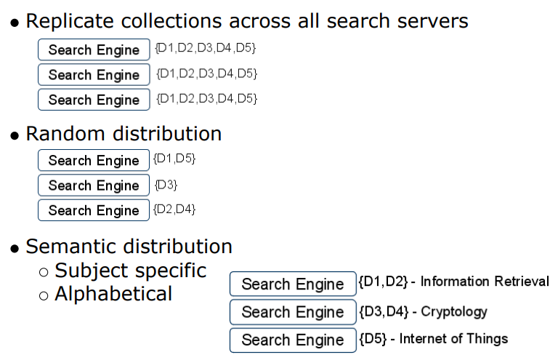
Collection Partitioning

Slide 12
Previous work
Xu & Croft suggested selecting documents according to their topics, and also a language model associated with each of these topics.
Callan et al. or Xu & Callan described a Collection Retrieval Inference network (CORI), in which each collection is considered as a single gigantic document. Ranking these collection documents used methods similar to those employed in conventional information retrieval systems.
Larkey et al. found that CORI works well when collections are organized topically.
Several methods were developed by Zobel to calculate collection scores, while Moffat & Zobel suggested decomposing each collection into blocks of documents, where the blocks were indexed by the broker.
The resulting index was then used to find blocks having high-ranking scores with respect to the query, and then collections were selected to match these blocks.

Slide 13
Previous work
The GlOSS system ranked collections according to their appropriateness to the query submitted, estimating the number of documents in each collection for which query similarity was greater than a predefined threshold, and creating a collection score through summing these similarities.
Yuwono and Lee proposed an approach to the broader problem of distributed search, considering collection selection, query forwarding and results merging. They referred to the collection selection portion of their work as the Cue Validity Variance (CVV) ranking method. CVV refers both to the ranking method and to a component in their calculation of a collection’s estimated merit or score.

Slide 14
How to select the subset of collection server which is most likely to be relevant to a given query ? And then how to merge the result list in order to obtain improve retrieval effectiveness ?

