Slide 1
FOCUSED CRAWLERS
By
Masood Alam Abbasi
Ph.D (CS) Scholar

Slide 2
FOCUSED CRAWLERS
REFERENCES
Focused Crawling: A New Approach To Topic-specific Web Resource Discovery by Soumen Chakrabarti -1999
URL Rule Based Focused Crawlers by Xiaolin Zheng -2008
A Focused Crawler Based on Naive Bayes Classifier by Wenxian Wang – 2010
Improving the Performance of Focused Web Crawlers by Sotiris Batsakis-2012
Focused and Deep Web Crawling-A Review by Saloni Shah -2014
Focused Crawler for the Acquisition of Health Articles by Amalia – 2016
Smart Crawler For Hidden Web Interfaces by Sunita Sundarde -2016
Focused Web Crawling Algorithms by Andas Amrin -2015
Website for crawlers/ focused crawlers information “http://www.botreports.com”

Slide 3
FOCUSED CRAWLERS
DEFINITION
A focused crawler is a web crawler that collects Web pages that satisfy some specific property
PROPERTY
The property can be described in various ways:
A crawling strategy may be to crawl pages from only a specific domain eg. From “.pk”” domain
Crawl pages about some specific topic like “cricket”
Crawl pages with large PageRank
The focused crawlers usually relie on a general web search engine/ base URL for providing starting points

Slide 4
FOCUSED CRAWLERS
History-Early Development

Slide 5
FOCUSED CRAWLERS
HISTORY
The term “Focused Crawlers” was first coined by Mr Soumen Chakrabarti in the paper published in 1999, titled
“Focused Crawling: A New Approach to Topic-Specific Web
Resource Discovery”
It was a Taxonomy based focused crawler. Following hypertext mining programs were developed for guiding the crawlers:
A classifier that evaluates the relevance of a hypertext document with respect to the focused topics
A distiller that identifies hypertext nodes that are great access points to many relevant pages within a few links
A crawler with dynamically reconfigurable priority controls which is governed by the classifier and distiller. It then downloads the documents.

Slide 6
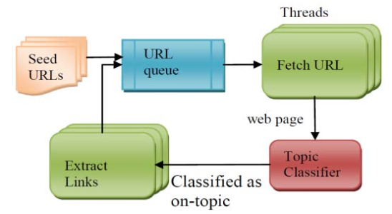
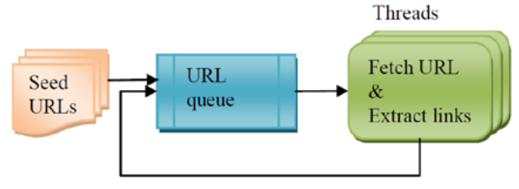
FOCUSED CRAWLERS
BLOCK DIAGRAM
The following diagram has been depicted in paper paper published in 2015 by Mr. Dvijesh Bhatt titled ” Focused Web Crawler”

Slide 7
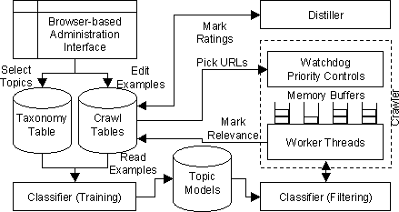
FOCUSED CRAWLERS
ARCHITECTURE

Slide 8
FOCUSED CRAWLERS
CATEGORIES
In the research paper by Mr Sotiris Batsakis published in 2012, titled
“Improving the Performance of Focused Web Crawlers”
following categories have been defined:
Classic Focused Crawlers take as input a user query that describes the topic, a set of starting (seed) page URLs and they guide the search towards pages of interest. They incorporate criteria for assigning higher download priorities to links based on their likelihood to lead to pages on the topic of query. Pages pointed to by links with higher priority are downloaded first. The crawler proceeds recursively on the links contained in the downloaded pages.
Typically, download priorities are computed based on the similarity between the topic and the anchor text of a page link or between the topic and text of the page containing the link (most likely, they are related to pages on the topic of the query). Text similarity is computed using an information similarity model such as the Boolean or the Vector Space Model.

Slide 9
FOCUSED CRAWLERS
CATEGORIES
Semantic Crawlers are a variation of classic focused crawlers. Download priorities are assigned to pages by applying semantic similarity criteria for computing page-to-topic relevance.
Learning Crawlers apply a training process for assigning visit priorities to web pages and for guiding the crawling process .
Typically, a learning crawler is supplied with a training set consisting of relevant and not relevant web pages which is used to train the learning crawler. Higher visit priority is assigned to links extracted from web pages classified as relevant to the topic.
Hybrid methods are also incorporated in crawlers that suggest combining ideas from learning crawlers and classic focused crawlers

Slide 10
FOCUSED CRAWLERS
ALGORITHMS USED
The Best-First Search algorithm is based on a heuristic function F(n) . The value of the function is evaluated for each URL present in the queue and the URL with the most optimal value of the function is given the highest priority and thus priority list is formed for fetching URL priority wise.
The Fish-Search approach assigns binary priority values (1 for relevant, 0 for not relevant) to pages (candidate) for downloading by means of simple keyword matching. Therefore, all relevant pages are assigned the same priority value.
The Shark-Search method suggests using Vector Space Model for assigning non binary priority values (Fuzzy values) to candidate pages. The priority values are computed by taking into account page content, anchor text, text surrounding the links and the priority value of parent pages (pages pointing to the page containing the links).
InfoSpiders use Neural Networks for learning and navigating to paths.

Slide 11
FOCUSED CRAWLERS
ALGORITHMS USED
The Page Rank algorithm
It works by counting the number and quality of links to a page to determine a rough estimate of how important the website is. The underlying assumption is that more important websites are likely to receive more links from other websites
Hyperlink-Induced Topic Search (Hits) algorithm.
Here first step is to form root set (retrieve the most relevant pages to the search query) then a base set is generated by augmenting the root set with all the web pages that are linked from it and some of the pages that link to it. HITS computation is performed only on this focused set.
Several machine learning algorithms are also used in focused web crawlers

Slide 12
FOCUSED CRAWLERS
CHALLENGES
Collaborative Web Crawling
Crawling the large repository on web
Crawling Multimedia Data
Execution time
No central control of web pages/ Millions of pages on web / Large number of web pages emerging daily

Slide 13
FOCUSED CRAWLERS
COMPARISION
Crawler Type | Standard Web Crawler | Focused Web Crawler
Introduced by | Various contributions | Chakrabarti, Berg and Dom (1999)
Definition | Traverses the internet in an automated and pre-defined manner with random web pages collection | Traverses the same way as standard web crawler, but it only collects pages similar to each other based on the domain, application, inserted query, etc…
Path Searching | Random search and may lose its way while traversing the web | Narrowed searching path with steady performance
Web Pages | Not necessarily related or linked to each other | Must be related to a particular criteria
Starting Seed | Root seed | Root seed with dependency on the web search engine to provide the starting point

Slide 14
FOCUSED CRAWLERS
COMPARISION
Crawler Type | Standard Web Crawler | Focused Web Crawler
Ending Seed | Some random seed | Relevant to the traversed seeds
Robustness | Prone to URL distortions | Robust against any distortions because it follows a relevant URL path
Discovery | Wide radius but less relevant web pages | Narrow radius with relevant web pages
Resource Consumption | Less resource consumption because of the basic path traversing algorithms | High resource usage especially with distributed focused crawlers that run on multiple workstations

Slide 15
FOCUSED CRAWLERS
COMPARISION
Crawler Type | Standard Web Crawler | Focused Web Crawler
Page weight | Assigns value to the web page for priority reasons | Assigns value to the web page for priority and relativity reasons
Performance Dependency | Crawling is independent | Crawling is dependent on the link richness within a specific domain
Classifier | No classification involve but rely heavily on traditional graph algorithms like depth-first traversal or breadth-first | Calssifiers are used for classification of relevant or not relevant pages like Naïve Bayesian, Decision Trees, Breadth-First, Neural Network, etc
Overall | Less resource consumption and performance | Higher resource consumption and performance with high quality collections of web pages

Slide 16
FOCUSED CRAWLERS
Recent Developments – 2009-2016

Slide 17
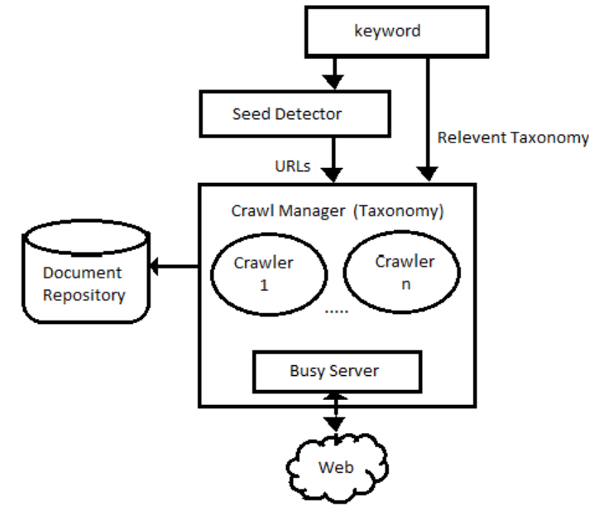
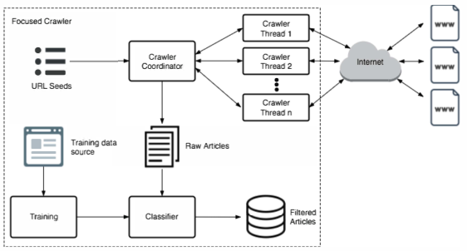
FOCUSED CRAWLERS
ARCHITECTURAL-CHANGES
New Architecture
Old Architecture

Slide 18
FOCUSED CRAWLERS
ARCHITECTURAL-CHANGES
The functionality of the Seed detector is to determine the seed URLs for the specific keyword by retrieving the first n URLs. The seed pages are detected and assigned a priority based on the any chosen algorithm
The Crawler Manager is a significant component of the system. It is provided with a URL buffer (a priority queue) and based on the size of the URL buffer, the Crawler Manager dynamically generates instance for the crawlers, which will download the document.
Crawler manager can also create a crawler pool when high efficiency is required. It is also responsible for limiting the speed of the crawlers and balancing the load among them by monitoring the crawlers

Slide 19
FOCUSED CRAWLERS
ARCHITECTURAL-CHANGES
The crawler is a multi-thread program, which is capable of downloading the web pages from the web and storing the documents in the document repository. Each crawler has its own queue, which holds the list of URLs to be crawled. The server is synchronized keeping track of duplicate request for downloading same pages or downloaded pages. If the request for the URL has not been sent previously, the request is forwarded to the HTTP module. This ensures that the crawler doesn’t overload any server.
HTTP Protocol Module sends the request for the document whose URL has been received from the queue. Upon receiving the document, the URL of the document downloaded is stored in the URL fetched list along with the timestamp and the document is stored in the document repository.
Link Extractor extracts the link from the documents present in the document repository. It checks for the URL presence in the URL fetched list. If not found, the surrounding text preceding and succeeding the hyperlink, the heading or sub-heading under which the link is present, are extracted.
Hypertext Analyzer receives the keywords from the Link Extractor and finds the relevancy of the terms with the search keyword

Slide 20
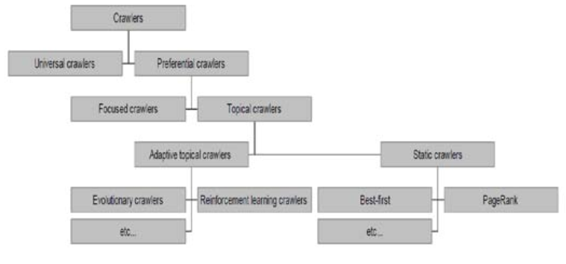
FOCUSED CRAWLERS
CATEGORIES
The following diagram has been depicted in paper paper published in 2015 by Mr. Dvijesh Bhatt titled “Focused Web Crawler”

Slide 21
FOCUSED CRAWLERS
CATEGORIES
The Universal crawlers support universal search engines. The Universal crawler first downloads the first website. It then goes through the HTML and finds the link tag and retrieves the outside link. The universal crawler crawls/downloads all the pages found
The Preferential crawlers are the topic based crawlers. They are selective in case of web pages. They are built to retrieve pages within a certain topic. Focused web crawlers and topical crawlers are types of preferential crawlers that search related to a specific topic and only download a predefined subset of web pages from the entire web
If a focused web crawler includes learning methods in order to adapt its behavior during the crawl to the particular environment and its relationships with the given input parameters, e.g. the set of retrieved pages and the user-defined topic, the crawler is named adaptive

Slide 22
FOCUSED CRAWLERS
CHALLENGES
Missing Relevant Pages: One issue with focused web crawlers is that they may miss relevant pages by only crawling pages that are expected to give immediate benefit.
Maintaining Freshness of Database: Many HTML pages consist of information that gets updated on daily, weekly or monthly basis. The crawler has to download these pages and updates them into the database to provide up-to-date information to the users. The crawling process becomes slow and puts pressure on the Internet traffic if such pages are large
Absence of Particular Context: The focused web crawler uses the best strategy to download the most relevant pages based on some criteria. The crawler focuses on a particular topic but in the absence of a particular context, it may download large number of irrelevant pages. Thus the challenge is to develop focused crawling techniques that focus on particular context also.

Slide 23
FOCUSED CRAWLERS
WEB PARTITIONING AND REPARTITIONING STRATEGIES
Partition by URL (Ensures even distribution of focused crawler workload)
Partition by Hostname
One focused crawler per hostname. https://www.yahoo.com/news/
https://www.yahoo.com/news/science/
https://www.yahoo.com/news/world
https://www.yahoo.com/news/us/
May lead to uneven crawler load distribution (Disadvantage)
Single point of failure: (Disadvantage)
Slight variation: X crawlers per hostname. (Workarround)
Repartitioning, simple technique that allows a crawler to redirect or pass on its assigned work to another crawler or to achieve fault tolerance and load balancing
Example: Partition by hostname
Crawler node responsible for google.com (red) dispatches work (by URL) to other crawler nodes to have load balancing and fault tolerance in the crawling system

Slide 24
FOCUSED CRAWLERS
DATA STRUCTURE
NoSQL Database is used as they provide high availability and
partition tolerance(as horizontal scalability) to meet the requirement of Internet application with huge data amount storage, high performance and low-cost scalability
Google’s BigTable
Apache’s HBase
FaceBook Cassandra[11],
10gen’ MongoDB,
Yahoo!’ PNUTS

Slide 25
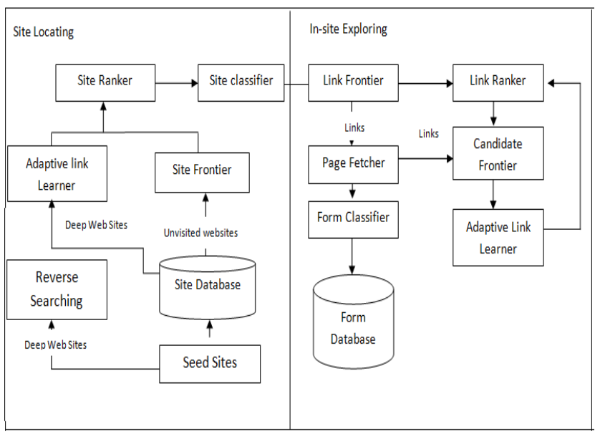
FOCUSED CRAWLERS
CRAWLER FOR HIDDEN WEB- ARCHITECTURE

Slide 26
FOCUSED CRAWLERS
RESEARCH WORK
URL Rule Based Focused Crawlers by Xiaolin Zheng -2008
UBFC is an URL regular expression learner, which is used to automatically learn and generalize the regular expressions of URLs of the sample webpages. The generated URL regular expressions are used to direct the UBFC
A Focused Crawler Based on Naive Bayes Classifier by Wenxian Wang - 2010 Maintaining
a focused crawler based on Naive Bayes classifier is proposed to get the pages relevant to a topic. From the experimental results, we can conclude that this approach has better performance than the PageRank crawler and BFS crawler
Semantic Focused Crawler Based On Q-Learning and Bayes Classifer by Dong Chen – 2010
Proposea a QBLP Algorithm which enable crawler adaptive with the changing environment. This feature makes it possible to change behavior of focused crawler according to the particular environment and its relationships with the given input parameters during the search

Slide 27
FOCUSED CRAWLERS
RESEARCH WORK
Focused Crawler for the Acquisition of Health Articles by Amalia -2016
Focused crawler is implemented in multithreaded programming environment with developed Larger-Sites-First algorithm and also NaIve Bayes classifer.

Slide 28
FOCUSED CRAWLERS
EXAMPLES
Googlebot : Google’s web crawler.
This is the bot that Google uses to visit and index websites
Yahoo! Slurp: Yahoo Search crawler.
Yahoo! Slurp is a web crawler based on search engine technology Yahoo! acquired when it purchased Inktomi. Slurp was the web crawler for Yahoo! Search until Yahoo! contracted with Microsoft to use bingbot
Bingbot: Microsoft's Bing web crawler.
Microsoft's bot used to index websites for inclusion in Bing Search

Slide 29
FOCUSED CRAWLERS
EXAMPLES
Googlebot : Google’s web crawler.
This is the bot that Google uses to visit and index websites
Yahoo! Slurp: Yahoo Search crawler.
Yahoo! Slurp is a web crawler based on search engine technology Yahoo! acquired when it purchased Inktomi. Slurp was the web crawler for Yahoo! Search until Yahoo! contracted with Microsoft to use bingbot
Bingbot: Microsoft's Bing web crawler.
Microsoft's bot used to index websites for inclusion in Bing Search

Slide 30
FOCUSED CRAWLERS
EXAMPLES
WebCrawler : Used to build the first publicly-available full-text index of a subset of the Web.
World Wide Web Worm : Used to build a simple index of document titles and URLs.
Web Fountain: Distributed, modular crawler written in C++.
Slug: Semantic web crawler

Slide 31
THANKYOU

