Slide 1
Tier Based Architecture

Slide 2
Commodity PCs to build a high end computing cluster
Designed for best aggregate request throughput and not peak server response time
Clusters are distributed worldwide
DNS based load balancing system select clusters geographically
Hardware based load balancing performs load balancing of request sent across servers

Slide 3
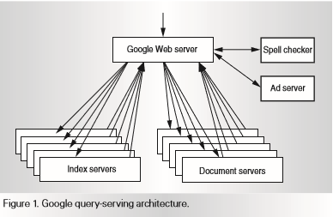

Slide 4
Query Processing Phase I
Index server consults inverted index.
Maps each word of query to matching set of documents (hit list)
Intersection of hit list and relevance scores of each document
Relevance score determines order
Query Processing Phase II
Computing actual title, urls along with query specific document summaries. Document servers handle this.

Slide 5
Index Sharding: randomly chosen documents from complete index
Round robin algorithm is used to give queries to clusters
Each query is divided into multiple streams each handled by a cluster. This reduces average latency
Fall through

Slide 6
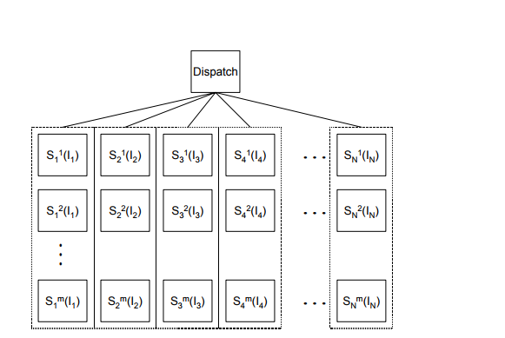

Slide 7
Map-Reduce
Split into m sets of documents
Each mapper takes a chunk of documents and emits key value pairs
Key: terms
Value: count or position
Hashes the keys and groups into R sets
Each reducer constructs index of each term
These index are then concatenated

Slide 8
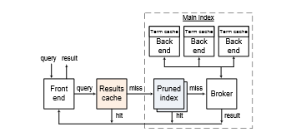
ResIn: Results Caching and Index Pruning

Slide 9
References
Web Search for a Planet: The Google Cluster Architecture – 2003
Search Engines and Web Dynamics –
Multi Tier Architecture for Web Search Engines – 2003
On the Feasibility of Multi-Site Web Search Engines – 2009
ResIn: A Combination of Results Caching and Index Pruning for High-performance Web Search Engines - 2008

