Slide 1
Opinion Mining
Maria Rahim and Zakia TURABEE

Slide 2
Definition
An opinion (or regular opinion) is a quintuple, (e_{i}, a_{ij} , oo_{ijkl}, h_{k}, t_{l})
e_{i} is the name of an entity
a_{ij} is an aspect of e_{i}
oo_{ijkl} is the orientation of the opinion about aspect a_{ij} of entity e_{i}, h_{k} is the opinion holder
h_{k} is the opinion holder
t_{l} is the time when the opinion is expressed by h_{k}

Slide 3
5 tasks of opinion mining
Task 1 : entity extraction and grouping
Task 2 : aspect extraction and grouping
Task 3 : opinion holder and time extraction
Task 4 : aspect sentiment classification
Task 5 : opinion quintuple generation

Slide 4
Sentence Subjectivity
An objective sentence presents some factual information about the world, while a subjective sentence expresses some personal feelings, views or beliefs

Slide 5
Types of sentiment classification
Document level
Sentence level
Aspect based

Slide 6
Document Sentiment Classification
It classifies an opinion document (e.g., a product review) as expressing a positive or negative opinion or sentiment
Can be done in two ways: supervised learning and unsupervised learning

Slide 7
Classification based on supervised learning
Any existing supervised learning methods can be applied to sentiment classification, e.g., naive Bayesian classification, and support vector machines (SVM)
Main task to engineer an effective set of features
Terms and their frequencies
Part of speech
Opinion words and phrases
Negations

Slide 8
Classification based on unsupervised learning
Algorithm as defined by Peter D. Turney
Step 1: extracts phrases containing adjectives or adverbs
Step 2: estimates the semantic orientation of the extracted phrases using the pointwise mutual information (PMI)

Slide 9


Step 3: classifies the review as recommended if the average SO is positive, not recommended otherwise.

Slide 10
Advantage: provides a prevailing opinion on an entity, topic or event
Shortcoming: it does not give details on what people liked and/or disliked and it is not easily applicable to non-reviews, e.g., forum and blog postings

Slide 11
Sentence Subjectivity and Sentiment Classification
Given a sentence s, two sub-tasks are performed:
1. Subjectivity classification: Determine whether s is a subjective sentence or an objective sentence,
2. Sentence-level sentiment classification: If s is subjective, determine whether it expresses a positive, negative or neutral opinion.

Slide 12
for subjectivity classification, supervised learning is applied
For sentiment classification of each subjective sentence, similar method as unsupervised document classification but with many more seed words, and the score function is log-likelihood ratio.

Slide 13
not suitable for compound and complex sentences
strength of the opinions being expressed in individual clauses, down to four levels deep (neutral, low, medium, and high)
contextual sentiment influencers such as negation (e.g., not and never) and contrary (e.g., but and however) e.g., “Apple is doing very well in this terrible economy.”

Slide 14
Opinion Lexicon Expansion
Opinion words, phrases and idioms are collectively known as Opinion lexicon
manual approach, dictionary-based approach, and corpus-based approach
The manual approach is very time consuming and thus it is not usually used alone, but combined with automated approaches as the final check because automated methods make mistakes

Slide 15
Dictionary based approach
first collect a small set of opinion words manually with known orientations
then to grow this set by searching in the WordNet or thesaurus for their synonyms and antonyms
newly found words are added to the seed list after which the next iteration starts

Slide 16
This approach is unable to find opinion words with domain and context specific orientations
For example, for a speaker phone, if it is quiet, it is usually negative. However, for a car, if it is quiet, it is positive.

Slide 17
Corpus-based approach and sentiment consistency
syntactic or co-occurrence patterns and also a seed list of opinion words to find other opinion words in a large corpus
Uses constraints such as conjunction AND, conjoined adjectives usually have the same orientation
e.g: beautiful and spacious
also designed for other connectives, OR, BUT, EITHER-OR, and NEITHER-NOR
called sentiment consistency

Slide 18
Finally, clustering is performed on the graph to produce two sets of words: positive and negative
Instead of finding domain dependent opinion words, consider both possible opinion words and aspects together
“The battery life is long” (positive) and “The time taken to focus is long” (negative)

Slide 19
It can help find domain and context specific opinion words and their orientations using a domain corpus
is not as effective as the dictionary-based approach because it is hard to prepare a huge corpus to cover all English words

Slide 20
Aspect-Based Sentiment Analysis
Classifying opinionated texts at document level or sentence level does not provide necessary detail needed.
A positive/negative opinionated document about a particular entity does not mean that the author has positive/negative opinions on all aspects of the entity.
Steps for Aspect-Based Sentiment Analysis:
Aspect Extraction
Aspect Sentiment Classification

Slide 21
Aspect Extraction
Extract the aspect that have been evaluated
For example, in the sentence, “The picture quality of this camera is amazing,” the aspect is “picture quality” of the entity represented by “this camera”.
“this camera” does not indicate the GENERAL aspect because the evaluation is not about the camera as a whole, but about its picture quality.
However, the sentence “I love this camera” evaluates the camera as a whole, i.e., the GENERAL aspect of the entity represented by “this camera”.

Slide 22
Aspect Sentiment Classification
Determine whether the opinion on different aspect are positive, negative or neutral.
Can use lexicon-based approach

Slide 23
Lexicon-based approach for aspect sentiment classification
The approach work as follows:
Mark opinion words and phrases: +1 positive word -1 for negative word.
Handle opinion shifter: e.g. negation word like not, never, none, nobody, nowhere, neither etc.
Handle but-Clauses

Slide 24

Aggregating opinions:
Calculating opinion score to determine the final orientation of opinion on each aspect of sentence.
Let the sentence be s, which contains a set of aspects {a1 ...am} and a set of opinion words or phrases {ow1 . . . own}
The opinion orientation for each aspect ai in s is determined by the following opinion aggregation function:
where owj is an opinion word/phrase in s, dist(owj , ai) is the distance between aspect ai and opinion word owj in s. owj .oo is the opinion score of owi.

Slide 25
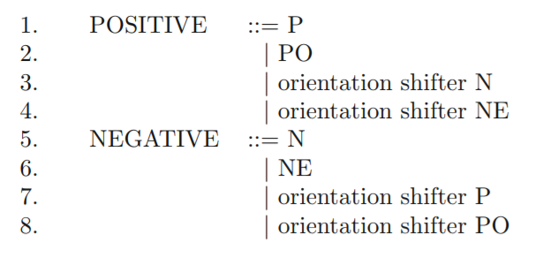
Basic Rule of opinion
An opinion rule expresses a concept that implies a positive or negative opinion

Slide 26
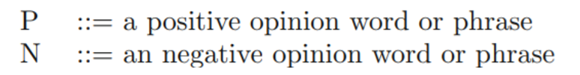
N, NE, P and PO, which contain no opinion shifters can be grouped into 6 conceptual categories based on their characteristics:
Opinion word or phrase:
This is the most commonly used category, in which opinion words or phrases alone can imply positive or negative opinions on aspects, e.g., “great” in “The picture quality is great”.

Slide 27

Desirable or undesirable fact:
The description uses no opinion words, but in the context of the entity, the description implies a positive or negative opinion.
For example: After I slept on it for two 4 weeks, I noticed a mountain in the middle of the mattress”
However, the word ”mountain” itself does not carry any opinion. Thus, we have the following two rules:

Slide 28
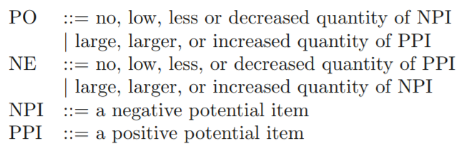
High, low of a positive or negative potential item:
For some aspects, a small value/quantity of them is negative, and a large value/quantity of them is positive, e.g., “The battery life is short” and “The battery life is long.” We call such aspects positive potential items (PPI).
For some other aspects, a small value/quantity of them is positive, and a large value/quantity of them is negative, e.g., “This phone costs a lot” and “Sony reduced the price of the camera.” We call such aspects negative potential items (NPI). “cost” and “price” are negative potential items.

Slide 29
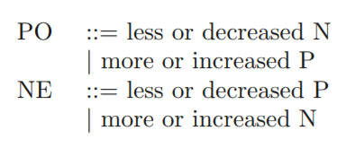
Decreased and increased quantity of an opinionated item:
Decreasing or increasing the quantity associated with an opinionated item (often nouns and noun phrases) can change the orientation of the opinion. For example, in the sentence “This drug reduced my pain significantly”, “pain” is a negative opinion word, and the reduction of “pain” indicates a desirable effect of the drug. Hence, decreased pain implies a positive opinion on the drug.

Slide 30
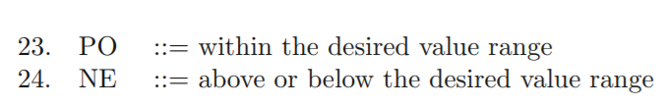
Deviation from the norm or some desired value range:
In some application domains, the value of an aspect may have a desired range or norm. If it is above or below the normal range, it is negative e.g. blood pressure.

Slide 31
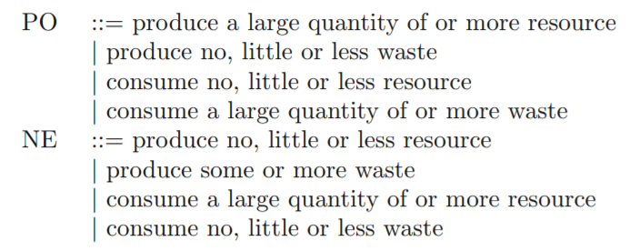
Producing and consuming resources and wastes:
If an entity produces a lot of resources, it is positive. If it consumes a lot of resources, it is negative. For example, water is a resource. The sentence, “This washer uses a lot of water” gives a negative opinion about the washer.
Likewise, if an entity produces a lot of wastes, it is negative. If it consumes a lot of wastes, it is positive.

Slide 32
Mining Comparative Opinions
Comparing the entity with some other similar entities.
For example The picture quality of Camera-x is better than that of Camera-y.”

Slide 33
Types of comparative relations
Non-equal gradable comparisons: Relations of the type greater or less than that express an ordering of some entities with regard to some of their shared aspects, e.g., “The Intel chip is faster than that of AMD”. This type also includes user preferences, e.g., “I prefer Intel to AMD”.
Equative comparisons: Relations of the type equal to that state two or more entities are equal with regard to some of their shared aspects, e.g., “The performance of Car-x is about the same as that of Car-y.”
Superlative comparisons: Relations of the type greater or less than all others that rank one entity over all others, e.g., “The Intel chip is the fastest”.

Slide 34
Non-gradable comparisons: Relations that compare aspects of two or more entities, but do not grade them. There are three main sub-types:
Entity A is similar to or different from entity B with regard to some of their shared aspects, e.g., “Coke tastes differently from Pepsi.”
Entity A has aspect a1, and entity B has aspect a2 (a1 and a2 are usually substitutable), e.g., “Desktop PCs use external speakers but laptops use internal speakers.”
Entity A has aspect a, but entity B does not have, e.g., “Phone-x has an earphone, but Phone-y does not have.”

Slide 35
Problems
Web users also write names of the same product brands in many ways. For example, “Motorola” may be written as “Moto” or “Mot”, and “Samsung” may be written as “Sammy”.
Objective expressions implying sentiments
Grouping aspect expressions indicating the same aspects
Coreference resolution: For example “The Sony camera is better than the Canon camera. It is cheap too.” It is clear that “It” means “Sony” because in the first sentence, the opinion about “Sony” is positive (comparative positive), but it is negative (comparative negative) about “Canon”, and A Survey of Opinion Mining and Sentiment Analysis 447 the second sentence is positive.
Cross lingual opinion mining

Slide 36
Spam Detection
Individual Spam:
Detect by:
Supervised Learning(Review Centric, Reviewer Centric and Product Centric Feature)
Abnormal Behavior
Group Spam:
Frequent pattern mining
Rank groups based on a set of group spam indicators:
Indicators including writing reviews together in a short time window, writing reviews right after the product launch, group content similarity, group rating deviation, etc

Slide 37
References
A survey of opinion mining and sentiment analysis -Bing Liu, Lei Zhang
Thumbs up or thumbs down?: semantic orientation applied to unsupervised classification of reviews - Turney, P
Opinion Mining and Sentiment Analysis - Challenges and Applications, Haseena Rahmath P
Opinion Mining and Sentiment Analysis on Customer Review Documents-: A Survey - Surya Prakash Sharma, Dr Rajdev Tiwari, Dr Rajesh Prasad
Contextual valence shifters - Contextual valence shifters

