Slide 1
Relational Data mining
Afshan Ejaz
Samreen kazi
Institute of Business Administration, Karachi

Slide 2
Problem Statement
21st century is called as the information science where the large organizations need useful knowledge. There are so many data sets which are in many different objects and linked together through different linkages. The data mining algorithms look for patterns in data. While traditionally most existing data mining approaches look for patterns in a single data table.

Slide 3
Solution
multi-relational data mining (MRDM) approaches look for patterns that involve multiple tables (relations) from a relational database.
It consist of multiple interconnected relations and each of which represents the specific objects or types of different relations. So far the existing algorithm cant handle the relational data until and unless the relational data is not transferred into single table

Slide 4
Approaches
Following approaches are available which are:
(I)Transformation of the data to Single –Table Schema and
applications of traditional data mining methods.
(II) By ILP (Inductive Logic Program: for decision making)
(III) Graph Mining
(IV) Multi-view learning

Slide 5
Approaches to relational mining
1. Inductive Logic Programming (ILP)
2. Statistical Relational Learning (SRL)
3. Graph Mining
4. Propositionalization
5. Multi-view learning

Slide 6
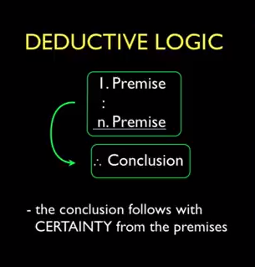
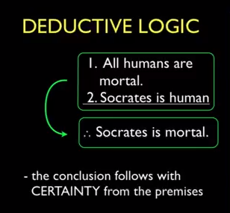
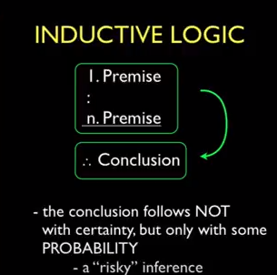
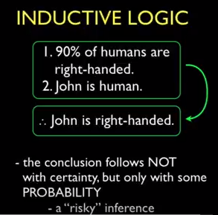
Logically valid arguments

Slide 7
What is ILP?
Inductive Logic Programming (ILP)
Automated learning of logic rules from examples and background knowledge
E.g., learn the rule for grandparents, given background knowledge of parents and examples of grandparents
Inductive Logic Programming (ILP) has been defined as the intersection of inductive learning and logic programming. Thus, ILP employs techniques from both machine learning and logic programming.
ILP can be used for classification and prediction
Notes:
Hypotheses are generated in ILP, unlike “black box” approach for classifiers such as SVM

Slide 8
Problems
Multi relational data mining requires the complex pre-processing of data.
The limited scalability of multi relational algorithms.
Their inability to explicitly handle noise and uncertainty.
Not suitable for use with spatial databases as database navigation is done on the basis of the existing spatial relationships that are not evidently modeled in the schema

Slide 9
PatriciaMine- MR-Radix
To bypass the scalability problem, the MR-Radix was proposed.
Discussion on an empirical study between PatriciaMine - an traditional algorithm - and its corresponding multi-relational proposed (MR-Radix MR-Radix: a multi-relational data mining algorithm Carlos Roberto Valêncio1*, Fernando Takeshi Oyama1 , Paulo Scarpelini Neto1 , Angelo Cesar Colombini2 , Adriano Mauro Cansian1 , Rogéria Cristiane Gratão de Souza1 and Pedro Luiz Pizzigatti Corrêa3 )
MR-Radix is a multi-relational data mining algorithm, which has a data structure called Radix-tree that compresses the database in the memory
Applying said algorithms to a central table which is made up of attributes that summaries or aggregate the information found in other tables. Nevertheless, this technique has the disadvantage of generating tables having many attributes and data repetitions

Slide 10
Challenges
Not suitable for use with spatial databases as database navigation is done on the basis of the existing spatial relationships that are not evidently modeled in the schema.
The presence of autocorrelation in spatial and relational phenomena brings in additional challenges
Large sets of data may be required in predictive tasks where inductive learning logarithms are used.

Slide 11
Graph Mining

Slide 12
From Data Mining To Graph Mining
Data Mining
Classification
Clustering
Association rule learning
Graph Mining
Powerful way to represent data
output: expressed as graphs

Slide 13
What Graphs are good for?
Most of existing data mining algorithms are based on Flat transaction representation, i.e., sets of items.
Datasets with structures, layers, hierarchy and/or geometry often do not fit well in this flat transaction setting.
For example:
Numerical simulations
3D protein structures
Chemical compounds
Generic XML files

Slide 14
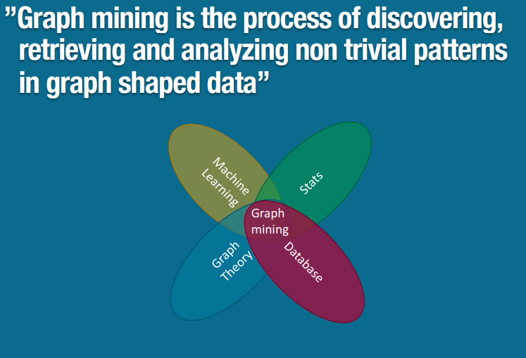
Why Graphs? Why now?

Slide 15
Domain of graph Mining
Internet Movie Database
Web Data
Social Networks Analysis
Bio-Informatics

Slide 16
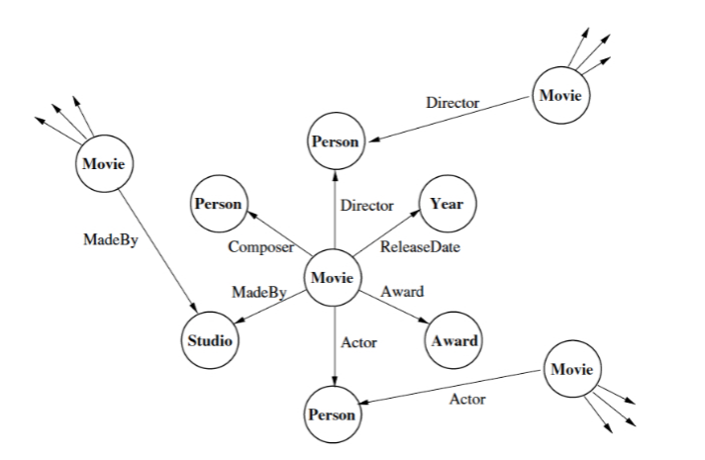
Internet Movie Database
Movie Recommendation
Community Detection
Prediction

Slide 17
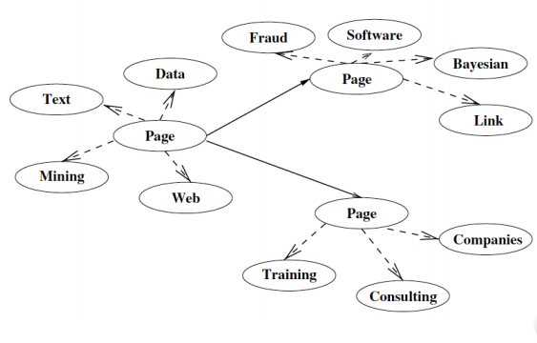
Web Data
Web Content Mining
Topic Prediction
Web Structure Mining
Community Mining
Web Usage Mining
Website Roadmap

Slide 18
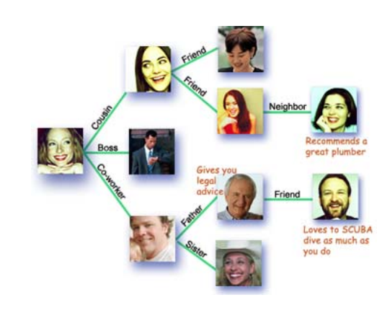
Social Networks Analysis
Relationships and flows between people
Technologies like Email, Blogs
Social Networking Software like Orkut, Facebook
Questions:
Who has control over what flows in the Network?
Who has best visibility of what is happening in the Network?
Customer Network Value

Slide 19
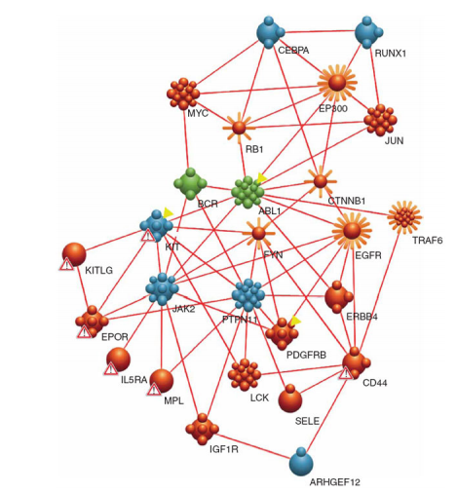
Protein-Protein Interaction(PPI) Network
Nodes: Proteins
Edges: Interaction among the Proteins
Open Problems: Function Prediction, Drug Discovery

Slide 20
What can we do with graph mining?
Compressing graphs without losing information
Finding complex structures fast
Recognizing communities and social patterns
Study the propagation of viruses
Predicting if two people will become friends
Understanding what are the important nodes
Showing how the network will evolve
Helping the visualization of complex structures
Finding roles, positive and negative influence prediction

Slide 21
What is involved in graph mining?
Basic graph algorithms (shortest paths, BFS, DFS, isomorphisms, traversals, random walks …)
Storage and indexing
Smart representations for compactness
Modeling of problems as graphs
Distance metrics and similarity measures
Exact, Approximate, and heuristic algorithms
Evolving structures
Interactivity and online updates
Complexity (most of the problems are not polynomially solvable)

Slide 22
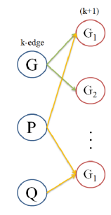
Apriori-based approach
The algorithm uses a level-wise search, where k-itemset are used to explore (K+1)item set.
(https://homes.cs.washington.edu/~pedrod/papers/ske03.pdf)
In this algorithm, frequent subset are extended one item at a time(this step is known as candidate generation process).
Then groups of candidate are tested against the data.
It identifies the frequent individual items in the database and extends them to larger and larger item sets as long as those itemset appear sufficiently often in database.
The algorithm determines frequent itemset that can be used to determine association rule which general trends in the database.
The Apriori-based approach has to use the breadth-first search (BFS) strategy because of its level-wise candidate generation

Slide 23
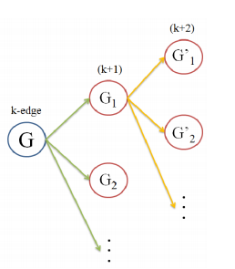
Pattern-growth approach
In contrast, the pattern-growth approach is more flexible regarding its search method.
It can use breadth-first search as well as depth-first search (DFS), the latter of which consumes less memory.
The pattern-growth mining algorithm extends a frequent graph by adding a new edge, in every possible position.
A potential problem with the edge extension is that the same graph can be discovered many times.

Slide 24
Refernces
http://citeseerx.ist.psu.edu/viewdoc/download?doi=10.1.1.278.6499&rep=rep1&type=pdf
https://link.springer.com/article/10.1186/2192-1962-2-4
https://link.springer.com/chapter/10.1007/978-3-319-11933-5_12
https://homes.cs.washington.edu/~pedrod/papers/ske03.pdf
http://citeseerx.ist.psu.edu/viewdoc/download?doi=10.1.1.278.6499&rep=rep1&type=pdf
http://web.engr.illinois.edu/~hanj/cs512/bk2chaps/chapter_9.pdf
http://www.cse.iitm.ac.in/~ravi/papers/Shivashankar_thesis.pdf
https://www.ethz.ch/content/dam/ethz/special-interest/bsse/borgwardt-lab/documents/slides/CA10_GraphMining.pdf

Slide 25
Thank You

