Slide 1
GIOSS & QUERY THROUGHPUT
Afshan Ejaz
Samreen kazi

Slide 2
Outline
Problem statement
Introduction
Motivation
GLOSS: Glossary of Servers Server
Distributed IR system
Query throughput

Slide 3
Problem statement
The dramatic growth of the Internet over the past few years has created a new problem: finding the right text databases to evaluate a given query.

Slide 4
text database discovery?????

Slide 5
Problem Description
There are thousands of sources available to the users on the Internet,
and it is practically impossible to query all of them when searching for information on a given topic: not only would such an exhaustive search take a long time to complete, but it could also be expensive, since some of the text databases on the Internet may charge for their use

Slide 6
Solutions with traditional approaches
Forwarding a user’s query to all known databases and merging the results obtained is not a feasible solution due to the enormous amount of traffic that would be generated and the load that would be received by the information sources
Also if the databases charge for their use this approach would be exceedingly expensive to the users since most likely lots of useless databases would be accessed when processing each query
The other obvious solution that of building a central full index for al l of the documents does not scale well either, As we know full indexes tend to be as large as the document collection itself.
Alternatively, many other tools index only a small part of each available document (e.g., its title). This approach fails to identify many useful sources because a signicant part of each document is simply discarded.
Similarly, other tools just keep concise summaries of the contents of each database. These summaries are sometimes manually written, are often out of date, and fail to capture the whole content of the databases.

Slide 7
Introduction
Motivation
– find a scalable solution to the text database discovery problem
– obvious solutions »
» forwarding the queries to all known databases
» central full index for all of the documents

Slide 8
solution
A generalized Glossary-Of-Servers Server, that keeps statistics on the available databases to estimate which databases are the potentially most useful for a given query.
– suggest potentially good databases to search
» present the query to server to select a set of promising databases
» evaluate the query at the chosen databases
– estimate by the word-frequency information for each database
» how many documents at that database actually contain each word

Slide 9
Advantages

Slide 10
Solution..
Given a query and a set of databases, the user may be interested in (at least) four different semantics for the query
– exhaustive search: (most expensive)
The user is interested in the set of all databases which contain any relevant documents.
– all-best search :
The user wants all the best databases for the query. The best databases are the ones which contain more relevant documents than any other database.
– only-best search:
The user is interested in any one best database (not necessarily in all of them).
– sample search (least expensive)
The user is interested in any one database which contains at least one relevant document (not necessarily in all such databases).
• Example 1. find Subject computer

Slide 11
GlOSS: Glossary Of Servers Server
Consider a query q that we want to evaluate over a set of databases DB. GlOSS (Glossary Of Servers Server) selects a subset of DB consisting of \good candidate" databases for actually submitting q.
To make this selection, GlOSS uses an estimator, which assesses how \good" each database in DB is with respect to the given query

Slide 12
GLOSS: Glossary of Servers Server
• Query representation
– atomic subquery is a keyword field-designation pair
– only consider Boolean `and` queries
» find Author Knuth and Subject computer
• Database histograms
– DBSize(db) : the total number of documents in database db
– freq(t, db) : the number of documents in db that contain t
• Estimate of the result size of a query
–ESize/Est(q, db) =max ESize/Est(q, db`), for all db` in DB }

Slide 13
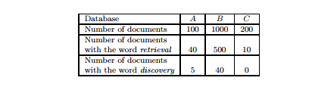
Working example
Consider three databases, A, B, and C, and suppose that bGlOSS has collected the statistics as given below. Suppose that bGlOSS receives a query q=retrieval ∧ discovery (this query searches for documents that contain both words, retrieval and discovery). Using the information in the figure, bGlOSS then estimates the number of matching documents in each of the databases

Slide 14
Indicators used by GLOSS to choose DB
the probability that a document in A contains the word retrieval is 40/100
Similarly, the probability that an A document contains the word discovery is 5/100 .
Under the assumption that words appear independently in documents, the probability that an A document has both words is 40 /100 × 5 100
Consequently, we can estimate the result size of query q in database A as Estimate(q, A) = 40/100 × 5 100 × 100 = 2 documents.
Similarly, Estimate(q, B) = 500/1000 × 40 1000 ×1000 = 20,
Estimate(q, C) = 10 200 × 0 200 ×200 = 0.
Therefore, the best database for q according to Ind is B, followed by database A. Database C is not included in the database rank, since it cannot have any matching document

Slide 15
Advantages
The statistical information kept by both bGlOSS and vGlOSS can be “compressed” in a variety of ways, for additional space savings.
The technique is based on a frequency threshold. If a database dbi has no more than threshold documents with a given keyword-field pair tj , then bGlOSS will not keep this information. Introducing thresholds reduces the storage cost of the estimator
The storage cost of GlOSS is relatively low. A small index means it is easier to replicate the discovery service, for improved load balancing and availability.

Slide 16
Improving GLOSS
Contributions
– a formal framework for the text database discovery problem
– concept of routing queries to appropriate information sources based on previously collected frequency statistics about sources
– some estimators that may be used to make decisions
– an experimental evaluation according to different semantics

Slide 17
Distributed IR System
A distributed IR system is made of two components:
The brokers
The Query servers
The brokers receive the queries from the users, distribute them to the query server, and send back the final results to the users
The Query server hold the distributed index, process the queries and send their partial result back to the brokers for final merging.

Slide 18
Query throughput
In computer science, Query Throughput (QthD) is a measurement used to determine the performance of a database system.
The throughput metric is a classical throughput measure characterizing the ability of the system to support a multi-user workload in a balanced way.
Notes:
Queries per second (QPS) is a common measure of the amount of search traffic an information retrieval system, such as a search engine or a database, receives during one second.^{[1]} The term is used more broadly for any request–response system, more correctly called requests per second (RPS).
High-traffic systems must watch their QPS in order to know when to scale the system to handle more load.

Slide 19
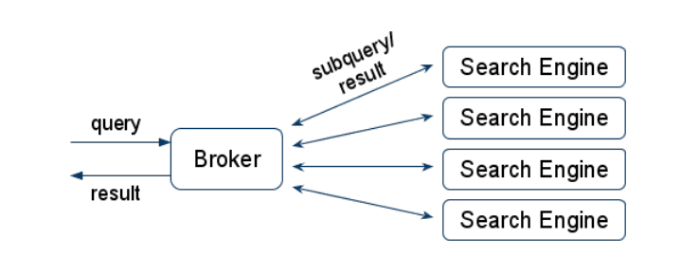
Improving query throughput
Broker == Load Balancer
Search Engines either share search index or have their own copy of one

Slide 20
Increase query throughput
The index distribution is necessary to deal with a high volume of data and to keep the response time low.
When the volume of queries handled by the system must be increased (e.g. because multiple users simultaneously send queries to a Web search engine), then the IR system must be parallelized to process multiple queries concurrently.
Two main type of system can be defined to increase the query throughput : replicated and clustered

Slide 21
