Slide 1
STARTS: Standard Proposal for Internet Meta-Searching
Maria Rahim and Zakia Turabee

Slide 2
Need for Meta-Searcher
Organizations use search engines of different vendors to index their internal document collection
They can benefit from metasearchers
Users have illusion of a single combined document source

Slide 3
Goals
Choosing the best sources to evaluate a query
Evaluating the query at these sources
Merging the query results from these sources

Slide 4
Companies who participated
Fulcrum
Infoseek
PLS
Verity
WAIS Microsoft Network
Excite
GILS
Harvest
Hewlett-Packard
Netscape

Slide 5
Challenges
Simple, yet powerful enough
Dealing with companies that have secret, proprietary algorithms for ranking documents

Slide 6
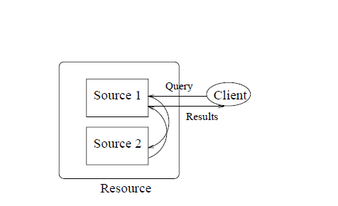
Metasearch Model

Slide 7
Internet has large number of resources
Each resource consist of one or more sources
A source is a collection of text documents with an associated search engine that accepts queries from clients and produces results

Slide 8
Few assumptions
Documents are flat i.e. not nested
Non-textual documents or data is not considered for e.g. geographical data
Sources may be small e.g. collection of papers written by university professor or large e.g. collection of World Wide Web pages indexed by a crawler

Slide 9
Function
Metasearcher issues queries to multiple sources
Chooses the best source to evaluate a query
Submits query to these sources
Merges the results from different sources and presents them

Slide 10
Problems
Text search engines:
Use different query languages
Rank documents in the query results using secret algorithms
Do not export information about the sources in a standard form

Slide 11
1. The query language problem
Interfaces and capabilities of these sources may vary dramatically
Some search engines support Boolean Retrieval Model while some follow vector space retrieval model
Example: distributed and systems -> query
Boolean model will return will return documents that contain both the words
Vector space model will return rank of documents typically based on number of occurrence of these words

Slide 12
Even if two sources support a same model:
their query syntax often differ
“distributed and systems” and “+distributed +systems”
Different fields are available for searching at different sources
(abstract “databases”)
Different stemming algorithms and stop-word list
Thus a metasearcher needs to know characteristics of each source

Slide 13
The Rank-Merging Problem
There are many ways to compute similarities
Algorithms are usually propriety to search engine vendors, and their details are not publicly available
Merging query results from different sources that use different and unknown ranking algorithm is hard
For example: source s1 might report that document d1 has a score 0.3 while source s2 might give it 1000

Slide 14
Even if the algorithm is same, it might rank differently based on collection where document appears

Slide 15
3. The Source-Metadata Problem
Some sources charge for their use
Some sources might have large response time
Therefore, metasearcher needs information about each source’s contents

Slide 16
Proposed Protocol: STARTS
This protocol is meant for machine to machine communication.
It deals with what information need to be exchanged between source and meta search and does not concern with how information is formatted or transported

Slide 17
Query Language
Query have both:
Boolean component: the filter expression
Vector space component: the ranking expression
Queries also have other associated properties that further specifies query result e.g. a query specifies maximum number of document that must be returned.

Slide 18
The Filter Expression
The filter expression specifies some condition that must be satisfied by every document in query result e.g. all documents in the answer must have “Ullman” as one of the author.

Slide 19
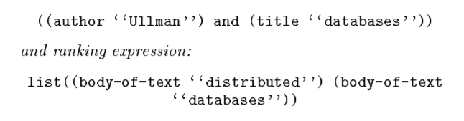
Ranking expression
It specifies words that are desired and imposes an order over the document in the query result e.g. documents in answer will be ranked according to how many times it contain the words “distributed” and “databases” in their body.

Slide 20
Basic-I
Set of attributes that are recommended to be supported by the sources.
They are:
Fields
Modifier

Slide 21
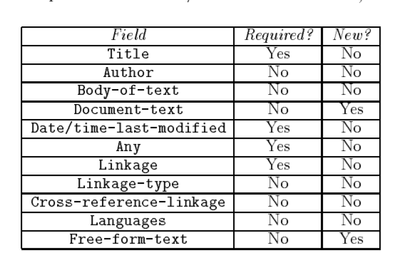
Fields
A field species what portion of the document text is associated with the term (e.g., the author portion, the title portion, etc.).
The Document-text field provides a way to pass documents to the sources as part of the queries, which could be useful to do relevance feedback . Relevance feedback allows users to request documents that are similar to a document that was found useful.

Slide 22
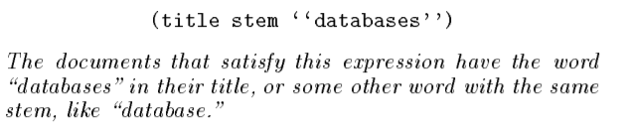
Modifier
A modifier species what values the term represents. Zero or more modifiers can be specified for each term.

Slide 23
Further Result Specification
Drop stop words: whether the source should delete the stop words from the query or not. A metasearcher knows if it can turn off the use of stop words at a source from the source's metadata
Default attribute set and language used in the query. This is optional, just for notational convenience, since queries may include attributes from attribute sets other than “Basic-1”, and terms may correspond to languages other than English.
Sources (in the same resource) where to evaluate the query in addition to the source where the query is submitted.
Answer specification:
Fields to be returned in the query answer (Default: Title, Linkage)
Fields to be used to sort the query results, and whether the order is ascending or descending
Documents to be returned:
Minimum acceptable document score
Maximum acceptable number of documents

Slide 24
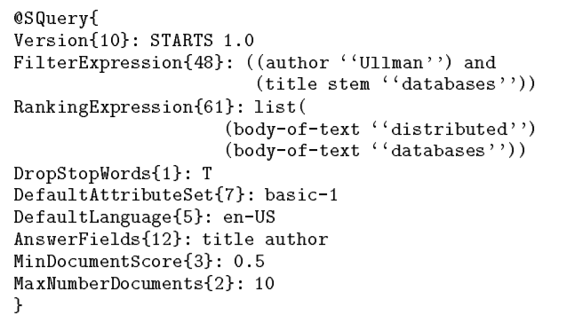

Slide 25
Problems in interpreting query results from multiple sources.
One is that each source may execute a different query, depending on its local query capabilities. Thus, a source might ignore parts of a query that it does not support, for example.
Another complication is that sources may use different algorithms to rank the documents in the query results. Furthermore, the sources do not reveal their ranking algorithms.
A third complication is that the ranking information by itself is insufficient for merging multiple query results, even if all the sources execute the same query using the same ranking algorithm.

Slide 26
Merging of Ranks
To merge the query results from multiple sources into a single, meaningful rank, a source should return the following information for each document in the query result:
The unnormalized score of the document for the query
The id of the source(s) where the document appears
Statistics about each query term in the ranking expression:
Term Frequency
Term Weight
Document Frequency
Document Size
Document Count

Slide 27
For example document from source 2 has a lower score than the document from Source-1. However, the Source-2 document might be a better match for the query than the Source-1 document, and the lower score could just be an artifact of the ranking algorithm that the sources use, or be due to the characteristics of the holdings of both sources. A metasearcher could then simply discard the sources' scores, and compute a new score for each document based on, say, the number of times that the words in the ranking expression appear in the documents. Then, such a metasearcher would rank the Source-2 document higher than the Source-1 document

Slide 28
Source Metadata
To select the right sources for a query and to query them we need information about the sources' contents and capabilities.
Every source is required to export:
a list of metadata attribute-value pairs, describing properties of the source,
a content summary of the source.

Slide 29
Source Metadata Attributes
Each source exports information about itself by giving values to the metadata attributes below. A metasearcher can use this information to rewrite the queries that it sends to each source, since each source may support different parts of the query language.

Slide 30
Content Summary
Content summaries help the metasearchers in choosing the most promising sources for a given query. These summaries could be manually generated. However, this approach usually yields outdated and incomplete summaries, and is a burden on the source administrators.
On the other end of the spectrum, a source summary could simply be the entire contents of the source. This approach is similar to the one taken by several World-Wide Web \crawlers."

Slide 31
Resource Definition
The proposed model allows several sources to be grouped together as a single resource
Each resource exports contact information about the sources that it contains.
More specifically, a resource simply exports its list of sources, together with the URLs where the metadata attributes for the sources can be accessed and the format of this data.
Using this information, a metasearcher learns how and where to contact each of the sources in the resource.

