Slide 1
Concept Based Video Retrieval Systems

Slide 3
MediaMill

Slide 4
Introduction
The main problem for any video retrieval methodology aiming for access is the semantic gap between image data representation and their interpretation by humans
A new paradigm of semantics is required when aiming for access to video archives.
Recent research efforts have concentrated on automatic detection of semantic concepts in video.

Slide 5
A lexicon-driven paradigm to video retrieval
Automatic learning of a large lexicon of concepts
When the lexicon is exploited for query-by-concept and combined with query-by-keyword, query-by-example, and interactive filtering using an advanced user interface, a powerful video search engine emerges, which we call the MediaMill semantic video search engine

Slide 6
Research question?
How this large lexicon of learned concepts can be combined with query-by-keyword, query-by-example, and interactive manipulation to achieve effective video retrieval?

Slide 7
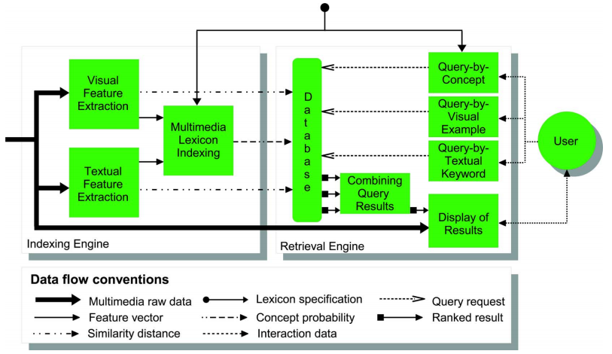
General framework for interactive video search engines

Slide 8
General framework for interactive video search engines
In the indexing engine, the system learns to detect a lexicon of semantic concepts.
In addition, it computes similarity distances. All indexes are typically stored in a database at the granularity of a video shot.
A retrieval engine then allows for several query selection methods.
The system combines requests and displays results to a user.
Based on interaction a user refines search results until satisfaction

Slide 9
MEDIAMILL SEMANTIC VIDEO SEARCH ENGINE
MediaMill has following major components
Indexing Engine
Retrieval Engine

Slide 10
INDEXING ENGINE
1. Textual & Visual Feature Extraction
To arrive at a similarity distance for the textual modality, words are first derived from automatic speech recognition results
A High dimensional vector space is then constructed based on all remaining transcribed words
When users exploit query-by-keyword as similarity measure, the terms of the query are placed in the same vector space. The most similar shots i.e the ones closest to the query in that space, are returned, regardless of whether they contain the original query terms.
In the visual modality the similarity query is by example. For all key frames in the video archive, color histogram is computed using 32 bins for each color channel. Users compare key frames with Euclidean histogram distance.

Slide 11
INDEXING ENGINE
2. Multimedia Lexicon Indexing

Slide 12
Multimedia Lexicon Indexing
Content analysis step:
In this stage, both the visual data and textual data is analyzed.
The percentage of pixels associated to each of the visual concepts is used as a visual content vector.
In the textual modality, the relation between uttered speech and concepts is learned.
For each concept, the text associated with each shot is compared yielding a text vector containing a histogram of words.
In the learning phase, the semantic pathfinder applies a support vector machine to learn concept probabilities.

Slide 13
Multimedia Lexicon Indexing
2. Style Analysis Step
This step analyzes a video by four related style detectors.
Layout detectors analyze the role of the editor, e.g., shot length, voice-over.
Content detectors analyze the role of production design, e.g., face location, frequent speaker.
Capture detectors analyze the role of the production recording unit, e.g., camera distance, camera motion.
Finally, context detectors analyze the role of the preproduction team, e.g., studio, outdoor.
All style detector results are combined using vector concatenation.
A support vector machine classifier is applied to learn optimized concept probabilities.

Slide 14
Multimedia Lexicon Indexing
3. Context analysis step
Goal of context analysis step is the reconstruction of the author’s intent by considering detected concepts in context
The probabilities obtained in the style analysis step are fused into a context vector. Then, a support vector machine classifier is again optimized to learn concepts.
The semantic pathfinder allows for generic video indexing by automatically selecting the best path of analysis steps on a per-concept basis.

Slide 15
Retrieval Engine
Users interact with the retrieval engine based on query selection methods.
Each query method acts as a ranking operator on the video archive.
After a user issues a query, it is processed and combined into a final result, which is presented to the user.
The elements of retrieval engine includes:
Query Selection
Combining Query Results
Display of Results

Slide 16
Query Selection

Slide 17
Combining Query Results
To rank results, query-by-concept exploits semantic probabilities, while query-by-keyword and query-by-example use similarity distances
Display of Results
The search engine supports two modes for displaying results.
In the traditional grid browser a ranked list of key frame results is visualized as a lattice of thumbnails ordered left to right, top to bottom

Slide 18
Displaying the Results

Slide 19
Reference
Snoek, Cees GM, et al. "A learned lexicon-driven paradigm for interactive video retrieval." IEEE Transactions on Multimedia9.2 (2007): 280-292.

Slide 20
IBM Multimedia Analysis and Retrieval System (IMARS)

Slide 21
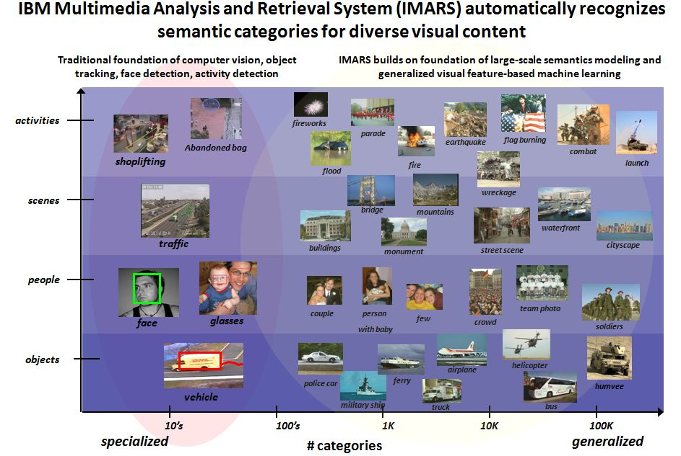

Slide 22
INTRODUCTION
IBM Multimedia Analysis and Retrieval System (IMARS) is a powerful system that can be used to automatically index, classify, and search large collections of digital images and videos.
Initially a desktop based system now it has become a Web-based technology that makes digital photos and video search-able through automated classification and indexing
IBM system is claimed unique as it is capable of learning from user interactions, helping users search immense multimedia content repositories faster and more effectively.
The system uses machine learning techniques for bridging the semantic gap for multimedia content analysis and retrieval

Slide 23
INTRODUCTION
IMARS works by applying computer-based algorithms that analyze visual features of the images and videos, and subsequently allows them to be automatically organized and searched based on their visual content.
It automatically interprets images and videos by recognizing the semantic entities-such as scenes, events, and people, that are depicted in the content
First launched in 2005
IMARS deprecated now its “Watson Visual Recognition”

Slide 24
FEATURES
In addition to search and browse features, IMARS also:
Automatically identifies, and optionally removes, exact duplicates from large collections of images and videos
Automatically identifies near-duplicates
Automatically clusters images into groups of similar images based on visual content
Automatically classifies images and videos as belonging or not to a pre-defined set (hereafter called taxonomy) of semantic categories (such as ‘Vehicle’,‘Landmark’, ‘infant’, etc.)
Performs content-based retrieval to search for similar images based on one or more query images
Tags images to create user defined categories within the collection
Performs text based and metadata based searches

Slide 25
WORKING PRINCIPLE
Components of IMARS (Early Design)
1. Multimedia Analysis Engine
The Multimedia Analysis Engine applies machine learning techniques to model semantic concepts in images and video from automatically extracted visual descriptors.
It automatically assigns labels (with associated confidence scores) to unseen content to improve searching, filtering, and categorization capabilities.
2. Multimedia Retrieval Engine
The Multimedia Retrieval Engine integrates multimedia semantics-based searching with other search techniques. It combines content-based, model-based, and text-based retrieval for more effective image and video searching

Slide 26
WORKING PRINCIPLE
Components of IMARS ( New Design )
IMARS is comprised of the IMARS extraction tool and the IMARS search tool.
IMARS Extraction tool
The IMARS extraction tool takes a collection of images and videos from the user, and produces indexes based on mathematical analyses of each piece of content. These indexes organize the results of the analyses for the IMARS search
The IMARS extraction functionality is enabled by two main categories of computer algorithms that work together to bridge the “semantic gap” for images and videos:
The first category is visual feature extraction, which works by using the computer to analyze the pixel-level contents of each image and video, and create a multi-dimensional vector description of its visual features. Since there are many important dimensions of visual contents, such as color, texture, shape and spatial layout, IMARS utilizes a large set of visual feature extraction algorithms that extract descriptors across a wide array of visual dimensions.
The second category is visual semantic extraction, which works by applying machine learning techniques to the extracted visual descriptors.

Slide 27
Working Principle Cont..
Components of IMARS (New Design )
IMARS Search tool
The IMARS search tool provides a graphical interface which allows the user to search, browse and navigate the collection based on the values produced by the analyses performed by the IMARS extraction tool.
The IMARS search tool presents the results of a query in different formats, among which the user can decide and switch according to his preferences, like consisting of tiled images or word-based representation.

Slide 28
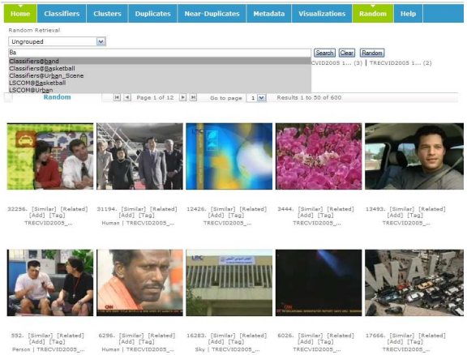
IMARS

Slide 29
IMARS DEMO
Visual Feature Detection
https://visual-recognition-demo.ng.bluemix.net
Image as input to detect features of the image
Trial Version is available for download
Extensive API for embedding functionality into web apps
https://www.ibm.com/watson/developercloud/visual-recognition/api/

Slide 30
Reference
Natsev, Apostol, et al. "IBM multimedia analysis and retrieval system." Proceedings of the 2008 international conference on Content-based image and video retrieval. ACM, 2008.
http://researcher.ibm.com/researcher/view_group.php?id=877
https://www.ibm.com/watson/developercloud/visual-recognition/api
https://www.ibm.com/developerworks/community/groups/service/html/communityview?communityUuid=7dc62548-8bc8-42c4-b2e9-150dde7c649a

