Slide 1
VAST MM: Multimedia Browser for Presentation Video
Maria Rahim and Zakia Turabee

Slide 2
Video is a versatile medium
Their value as a study tool is very promising
Can be effectively used to record team interaction, student performance during presentation or project work progress

Slide 3
However,
Significant time commitment required for production of such videos
Equipment and camera operator expenses
Means of finding information quickly do not exist
Thus, it is necessary to facilitate search and retrieval in videos

Slide 4
VAST MM
It applies visual segmentation techniques on unedited video to determine likely changes of topics.
Speaker segmentation methods are employed to determine individual student appearances
Videos are augmented with time-aligned filtered keywords and phrases from highly inaccurate speech transcripts
VAST MM Browser (Video Audio Structure Text Multi Media Browser), combines streaming videos, visual, and textual indices for browsing and searching

Slide 5
Structuring and indexing of content is performed using visual cues and textual cues
Focused on student presentation videos in a large university-level engineering course with more than 150 students per semester
Using our automatic video indexing tools, we make available all presentations to students in the course

Slide 6
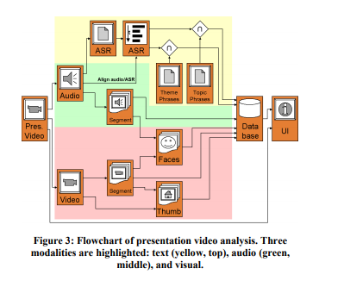

Slide 7
Characteristics of these videos
Low quality production
Does not require elaborate setup or post editing
Lighting and acoustics of classroom remain unmodified
Quality occur with varying student speaking skills, volume etc

Slide 8
Useful indices
visual summaries of scenes
words and phrases indicative of content
means of locating speakers.

Slide 9
Visual Segmentation
Unedited presentation videos do not feature production cues, such as scene cuts or fades
Presenter and audience appear in same camera shot
Cues for visual segmentation of such noisy video data should be sensitive to the recording environment

Slide 10
For abrupt changes
slide changes are used as a cue to indicate an interesting visual change
divided a video frame into a 10x10 grid and compute consecutive frame differences using pixel intensity change between sub-regions of two frames
Intensity change is defined by a threshold value of 30 (out of 255) beyond which the difference contributes a unit amount

Slide 11

Significant visual change is detected between two video frames (point P) when their value deviates significantly from the visual change prior to or after P
Significant visual change is detected when:

Slide 12
For gradual changes
gradually changing content in the video, such as camera pans, zooms, entering and/or leaving of a person with respect to the camera view
comparing histogram differences between more distant frames
color histogram with 2 bits per color resulting in 64 bins is sufficient in capturing visually significant events
significant drop in the similarity measured between the left and right windows. Such a point characterizes the start of calm visual activity after a sequence of motion

Slide 13
Final Step
visual activity from both methods is combined to produce an aggregate set of visual events
Using a windowed approach, gradual and abrupt changes are merged

Slide 14
VISUAL SPEAKER INDEX
A common task for users of video summaries is to locate the appearance of a particular individual, whether by name or visual cues
first extract mel frequency cepstral coefficients (MFCC0 - MFCC12) from the audio track
determine change in speakers by applying the Bayesian Information Criterion (BIC)

Slide 15
manually extract regions from video keyframes, which best portrait the individual presenters
apply contrast normalization to adjust the highly varying lighting conditions in the recorded video
intend on using low-level motion detection in a sequence of frames to localize potential speakers, and applying face detection in those areas to extract speaker faces

Slide 16
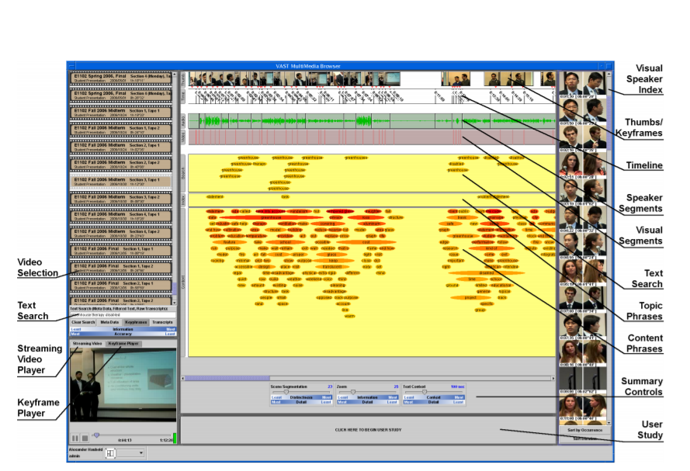
USER INTERFACE

Slide 17
Keyword and key phrase indices
Keywords and phrases are represented by horizontal blips, whose background color and vertical position denotes their importance. Words and phrases with stronger meaning are colored red and are located closer to top.
Importance is measured by several factors such as
Meaning and descriptiveness of a phrase increases with the number of words
The more noun senses a phrase has, the more descriptive it is of an object
Verb senses are weighted less than noun senses
Distance from the root sense in WordNet helps to determine how uniquely descriptive a phrase is
Overall number of senses is inversely proportional to uniqueness.

Slide 18
Video Indices
“Scene Segmentation” varies the granularity of visual segmentation, which also drives the number of displayed summary thumbnails. A lower value decreases distinctiveness of scenes, but increases detail.
“Zoom” allows the user to vary the duration of the video summary visible per unit screen space. A lower value decreases the duration of video summary and amount of information visible on the screen, but increases the level of detail. Higher values are preferred for obtaining a superficial overview of video content, while a lower value is more useful for exploring sections of the video, for example short presentations.

Slide 19
Experiment
They periodically administer user studies in our large engineering design course to evaluate the usefulness of our tools
They have designed a set of 5-7 tasks related to search and summarization of video content, which students must complete.
Overall task completion rates have improved from 81% to 92% over 3 semesters. For the most characteristic search task of locating an unfamiliar presentation in a set of several videos, the completion rate has improved from 53% to 73%.

Slide 20
5-7 Task
1. Find your own appearance in the video
2. Locate the portion of the video in which your team discusses topic XYZ.
3. Find the beginning of your team’s presentation.
4. Find the presentation on subject XYZ (titled ABC).
5. Using the available keywords for the presentation located between TIME1 and TIME2, summarize the project’s goals as best as possible.

