Slide 1
Video Search & Retrieval
Afshan Ejaz
Samreen Kazi

Slide 2
Papers
Large-Scale Video Retrieval Using Image Queries by Andre Araujo
Deep Learning Based Semantic Video Indexing and Retrieval by
Anna Podlesnaya, Sergey Podlesnyy

Slide 3
Outline
Problem statement
Introduction
Motivation
GLOSS: Glossary of Servers Server
Distributed IR system
Query throughput

Slide 4
Problem Statement
Today its estimated that around 85% of data is multimedia, and its called dark matter of digital age. Fundamental challenge is to make sense of that data; as these data show us what's going on at personal level and what's going on with society as well
Well-established methods for searching, navigating, and retrieving broadcast quality video content rely on transcripts obtained from manual annotating, close captioning and/or speech recognition

Slide 5
Continued….
Need for Visual Information Retrieval Systems has become apparent when
digital archives were released.
distribution of image and video data though large-bandwidth computer networks emerged
more prominent as we progress to the wireless era!

Slide 6
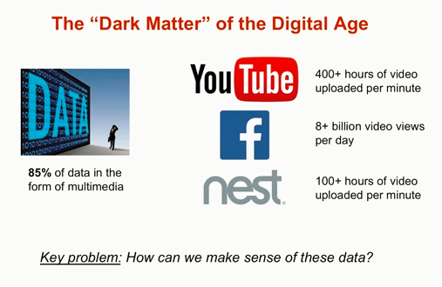

Slide 7
Introduction

Slide 8
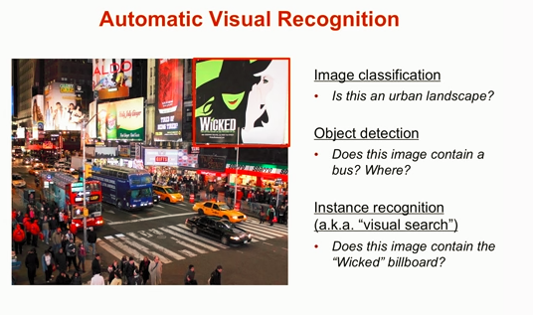
Recognition Problems Addressed Already
Many other recognition problems exist such as Pose estimation, Activity recognition etc

Slide 9
Retrieval systems for video
Video conveys information from multiple planes of communication
How the frames are linked together using editing effects (cuts, fades, dissolves, etc).
What is in the frames (characters,story content, etc.)
Each type of video (commercials, news, movies, sport) has its own peculiar characteristics.
Basic Terminology
Frame: basic unit of information usually samples at 1/25 or 1/30 of a second.
Shot: A set of frames between a camera turn-on and a camera turn-off
Clip: A set of frames with some semantic content
Episodes: An hierarchy of shots;
Scene: A collection of consecutive shots that share simultaneity is space, time, and action (e.g. a dialog scene).
Video is accessed through browsing and navigation

Slide 10
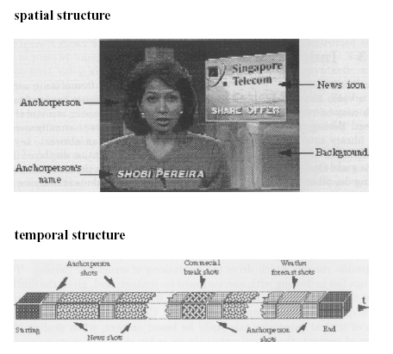
Retrieval systems for video

Slide 11
MPQF( MPEG Query Format)
The MPEG Query Format (MPQF) is an XML-based query language that defines the format of the queries and replies exchanged between clients and servers in a distributed multimedia search and retrieval system. The two main benefits of standardization of such a language are
Interoperability between parties in a distributed scenario (e.g. content providers, aggregators and clients) and
platform independence (which also offers benefits for non-distributed scenarios)

Slide 12
Query Types for Video Search and Retrieval
QueryByMedia: specifies a similarity or exact-match query by example retrieval where the example media can be an image, video, audio or text.
QueryByFreeText: specifies a free text retrieval where optionally the focused or to be ignored fields can be declared.
SpatialQuery: specifies the retrieval of spatial elements within media objects (e.g., a tree in an image), which may be connected by a specific spatial relation
TemporalQuery: specifies the retrieval of temporal elements within media objects (e.g., a scene in a video), which may be connected by a specific temporal relation.

Slide 13
Related Work
Image description approach involves generating natural text annotations based on video frame content. In this approach deep neural network architecture matching image regions with natural language sentence parts is proposed, and multimodal recurrent neural network is proposed that takes images as input and generates their textual descriptions. Using this architecture one can for e.g. generate text descriptions for key frames extracted from video stream and build a searchable index. Since the proposed architecture is capable to generate sentences describing image regions defined by bounding boxes it is possible to apply complex search queries with spatial relations between objects within a key frame

Slide 14
Related Work Continued…
In this paper text descriptions are generated for video shot i.e. a sequence of frames, using features extracted by CNN (similarly to [9]) and applying soft attention mechanism to generate a description for the shot in the whole.

Slide 15
Methdology
1. Video Segmentation
use of GoogLeNet network structure as primary source of semantic features extraction.
Video Indexing
Graph-based database for temporal, spatial and semantic properties indexing is proposed
Search by Examples
Video retrieval by sample video clip @0.86 precision

Slide 16
Google’s contribution
Google Image Labeler. this game invited humans to pair up with another player over the web and simultaneously suggest keywords that describe a random image.
TinEye :using Google Reverse Image Lookup: which uses image identification technology, rather than keywords, to find where images are being used on the web. This tool can be used to find similar images, and to discover how images have been modified

Slide 17
Video Segmentation with semantic feature
Semantic features extraction by deep neural network
Shots cut by vector distance spikes between frames
Temporal pooling for shot semantics summarizing

Slide 18
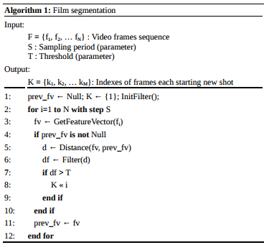
Film Segmentation Algorithm

Slide 19
Video Segmentation Algorithm
Sub-sampling period S was chosen as a tradeoff between accuracy and speed, found value 320 ms (1/8th frame for standard movie frame rate) to be optimal.
Then applied GetFeatureVector function to the frame to get the feature vector that is used throughout all further operations of indexing and searching. This function includes pre-processing: image re-scaling into 256x256 BGR, selecting single central crop 224x224 and applying the CNN calculation. The function returns an output of the last average pooling layer of network [6] which has the dimension 1024.
At step 5 distance between previous and current feature vectors. We are using squared Euclidean distance, however other choices are possible e.g. cosine distance.
We are using simple low-pass filter e.g. convolution of 4-window of last distance values with vector [0.1, 0.1, 0.1, 0.99]. Then at step 7 we check if filtered value of vector distance exceeds a threshold value, and add frame number to shot boundary list if it exceeds.
As a side product of Algorithm 1 we store feature vectors and classification vectors (CNN output) for every frame into a distributed key-value storage (Apache Cassandra)

Slide 20
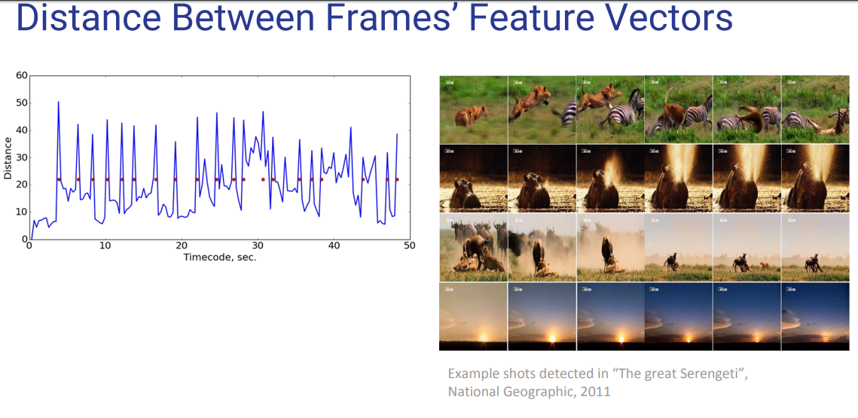
Feature Extraction

Slide 21
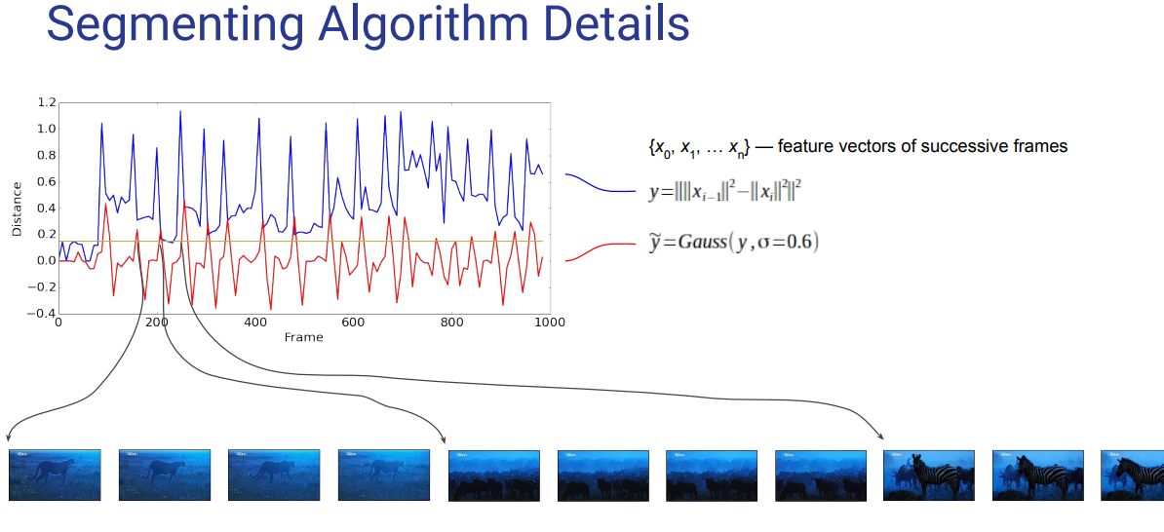
Segmentation Algorithm

Slide 22
Contribution
presenting a video indexing and retrieval architecture based on unified semantic features extracted from video by deep learning algorithms, namely by convolutional neural networks.
Implementation of said query types

Slide 23
Video indexing

Slide 24

Graph-oriented indexing
A graph structure for building a video index is introduce. This is partially due to the fact that trained model use predicts categories within ImageNet contest framework which uses Wordnet lexical database.
This opens wide possibilities for video retrieval by description e.g. by a query for videos where an object being part of some general category is required.
The Wordnet lexical database with graph is represented as:

Slide 25
They have used CNN trained for ILSVRC2014 competition [7]. It was trained for 1000 categories, majority of which were dogs and flowers species as well as many other animals.
The main unit of graph-based representation of videos is a shot. CNN classifier more accurately categorizes shots than single frames. From user experience point of view, retrieving shots is natural in case of video searching.
Therefore they chose BBC Natural World (2006) series of 102 movies, each approx. 45 minutes long for evaluating the proposed system.

Slide 26
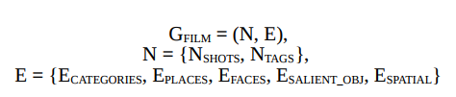
Video processing is simply represents as classifying every frame with single CNN.
In reality they could apply numerous classifiers e.g. place classifier, faces detector and classifier, salient objects detector and classifier.
Having applied all that classifiers they might obtain numerous tags for a frame.
Moreover, these tags may also have structure e.g. if we detect two salient objects we may consider spatial relationship between them: which object is atop or right to the second one.
Therefore it becomes natural to represent a film as a graph:

Slide 27
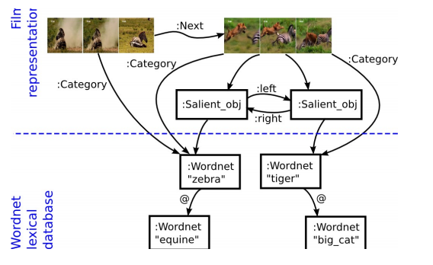

Slide 28
Neo4j Graph oriented database
World's leading graph database, with native graph storage and processing.(column, document oriented and key value oriented database.)
Property graph model and Cypher query language makes it easy to understand.
Described by its developers as an ACID-compliant transactional database with native graph storage and processing.
Neo4j is the most popular graph database according to DB-Engines ranking.
Notes:
ACID (Atomicity, Consistency, Isolation, Durability) is a set of properties of database transactions intended to guarantee validity even in the event of errors, power failures, etc. In the context of databases, a sequence of database operations that satisfies the ACID properties, and thus can be perceived as a single logical operation on the data, is called a transaction. For example, a transfer of funds from one bank account to another, even involving multiple changes such as debiting one account and crediting another, is a single transaction.

Slide 29
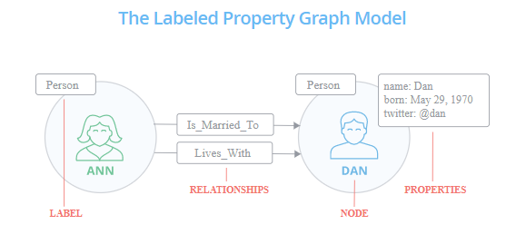
Neo4j basic structure

Slide 30
Searching by Structured Queries

Slide 31

Basic Cypher syntax rules denote graph nodes in round brackets and edges in square brackets.
Thus query (3) matches nodes of type Shot: NSHOTS, see (2) linked to nodes of type Wordnet: NNOUNS, see (1) having synset zebra with edge of type Category having weight greater than 0.1.
Edge of type Category corresponds to ECATEGORIES in (2). Neo4j provides indexing by nodes/edges attributes

Slide 32
Searching by Sample Video

Slide 33
Searching by Sample Video
Video retrieval by sample clip is important in content production (finding footage in archives) and in duplicates finding (for legal purposes and for archives deduplication).
A brute force solution involves comparing distance between sample clip feature vector and every other shot’s feature vector with some threshold, and including the shots having smaller distance to the sample into the search results.
Another solution Fisher vector
The FV is an image representation obtained by pooling local image features. It is frequently used as a global image descriptor in visual classification.

Slide 34
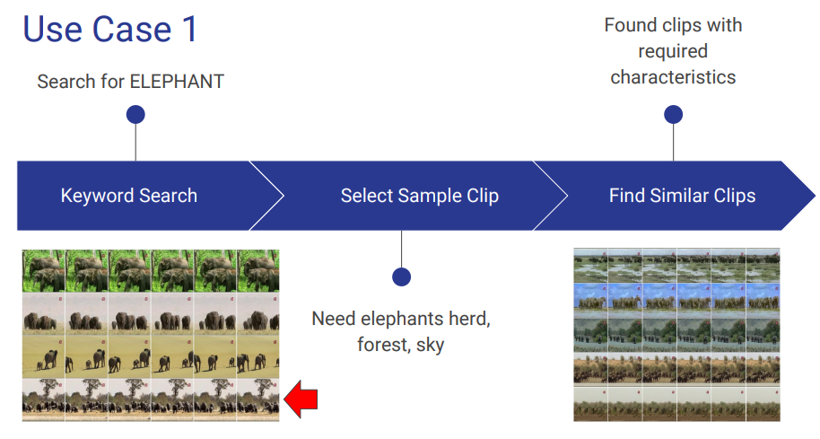
Searching by Sample Video

Slide 35
Conclusion
We showed in this work that feature vector fv extracted by CNN contains enough semantic information for segmenting raw video into shots;
Retrieving video shots by keywords
Retrieving videos by sample video clip
All that is needed for indexing is a single pass of feature vector extraction and storing into the database.

