Slide 1

NEXAGEN STUDENT HUB
Presented by :
Ayesha
Samiya
Zarnab

Slide 2

NEXAGEN STUDENT-HUB SYSTEM
NexaGen is a student-centric platform designed to simplify academic management by providing quick access to essential information such as schedules, deadlines, teacher contacts, and more. It bridges the gap between students and university administration for efficient communication and resource management.
.

Slide 3

TECHNOLOGIES AND DESIGN PRINCIPLES(GRASP):
Information Expert: Each manager class (e.g., DeadlineManager, TeacherContactManager) handles its specific responsibilities to ensure modularity.
Controller: The UserInterface class acts as the central coordinator, managing user interactions and delegating tasks to the BusinessLogic layer
Frontend: Java Swing for a user-friendly interface.
Backend: Java classes using OOP for scalability and maintainability.
Database: MySQL for managing schedules, deadlines, and teacher contacts.
Integration: JDBC ensures efficient database communication.

Slide 4
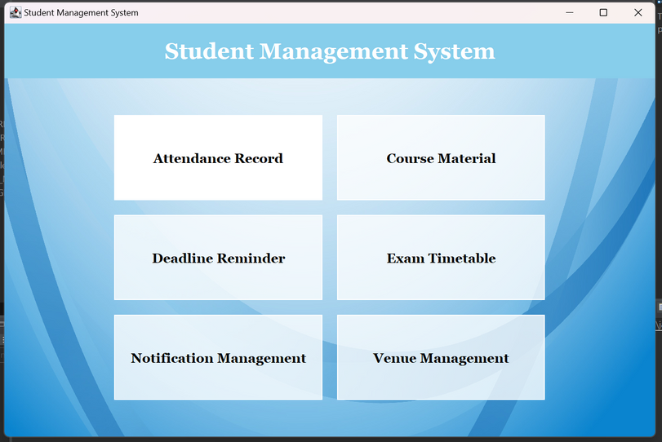
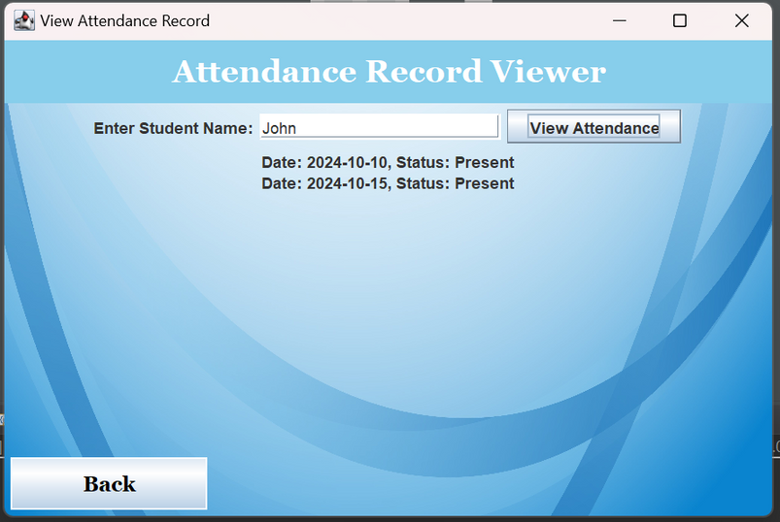
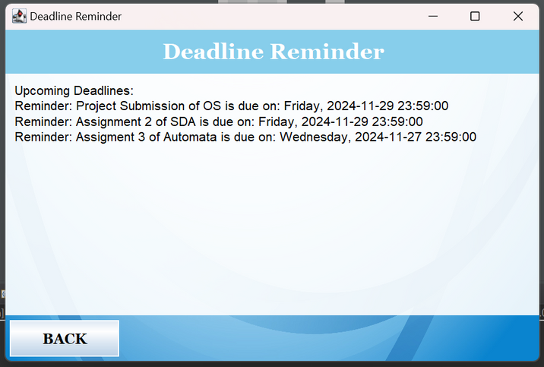
SYSTEM INTERFACE OVERVIEW

Slide 5
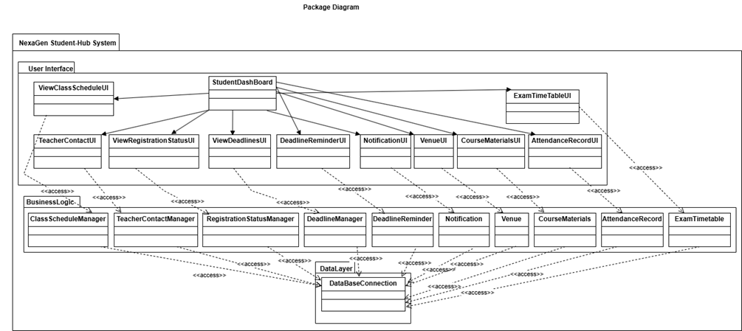
PACKAGE DIAGRAM

Slide 6
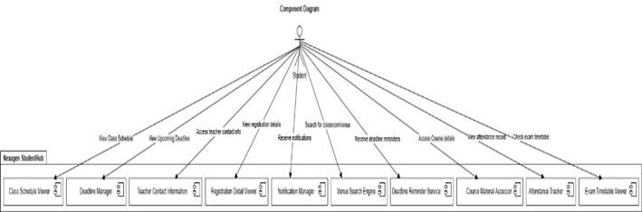
COMPONENT DIAGRAM

Slide 7
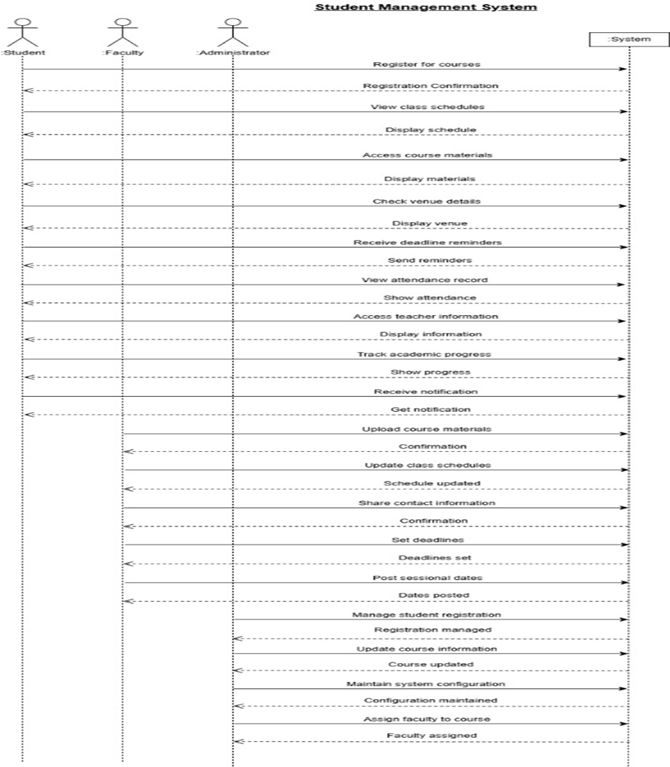
SYSTEM SEQUENCE DIAGRAM

Slide 8
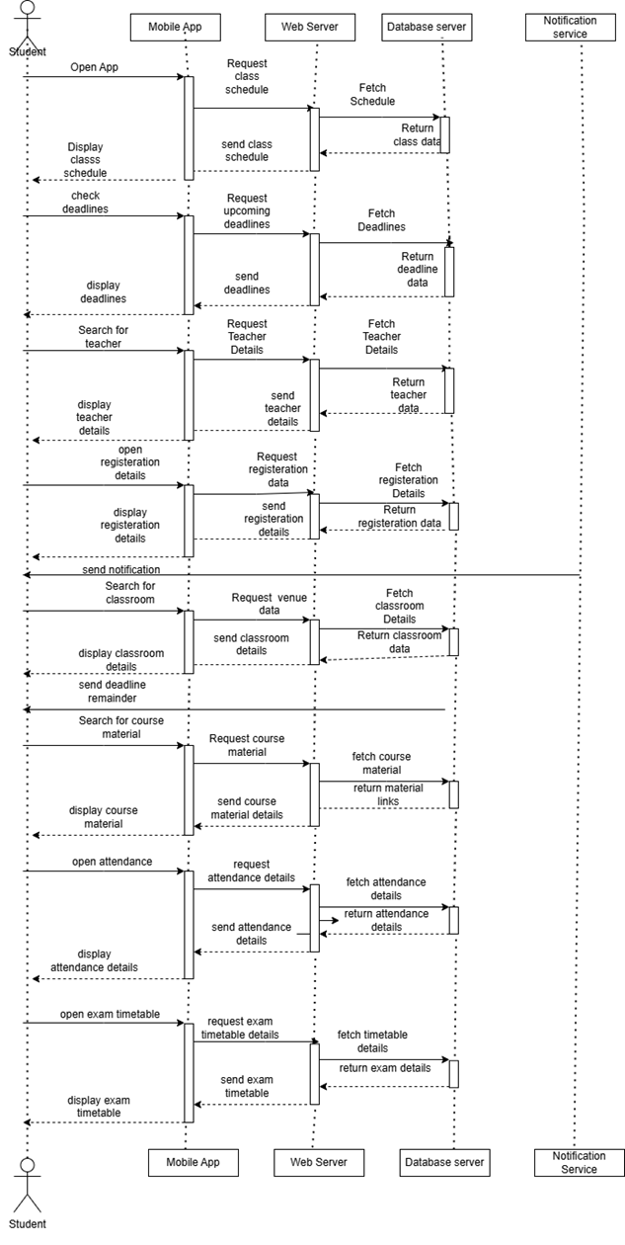
SEQUENCE DIAGRAM

Slide 9
THANK YOU

