Slide 1
Index
Project Overview
Scope
Functionalities
Use-case diagram
Development Tools
Screenshots of project
Conclusion

Slide 2
Project overview
The “Online Shopping System” has been developed to override the problems prevailing in the practicing manual system.This software is supported to eliminated and in some cases reduce the hardships faced by this existing system.Moreover this system is designed for the particular need of the company to carry out operations ina smooth and effective manner .
The application is reduce as much as possible to avoid while entering the data .It also provide all error message while entering invalid data..No formal knowledge is needed for the user to use the this system.Thus by this all its proves it is user-friendly.Online shopping System ,as described above ,can lead to to error free ,secure,reliable and fastr management system.It can assist the user to concentrate on their other activities rather to concentrate on the record keeping ,Thus it will help organization in utilizationof resources

Slide 3
Scope
Our project aims at Business process automation, i.e. we have tried tocomputerize various processes of Online Shopping System.
• In computer system the person has to fill the various forms & number of copies of the forms can be easily generated at a time.
• In computer system, it is not necessary to create the manifest but we can directly
print it, which saves our time.
• To assist the staff in capturing the effort spent on their respective working areas.

Slide 4
To utilize resources in an efficient manner by increasing their productivity through
automation
• The system generates types of information that can be used for various
purposes.
• It satisfy the user requirement
• Be easy to understand by the user and operator
• Be easy to operate
• Have a good user interface
• Be expandable

Slide 5
Functionalities provided by Online Shopping System are as follows:
Provides the searching facilities based on various factors. Such as Product, Stock,
Order, Payment
• Online Shopping System also manage the Type details online for Order details,
Payment details, Product
• It tracks all the information of Customer, Type, Order etc
• Manage the information of Customer
• Shows the information and description of the Product, Stock
• Editing, adding and updating of Records is improved which results in proper

Slide 6
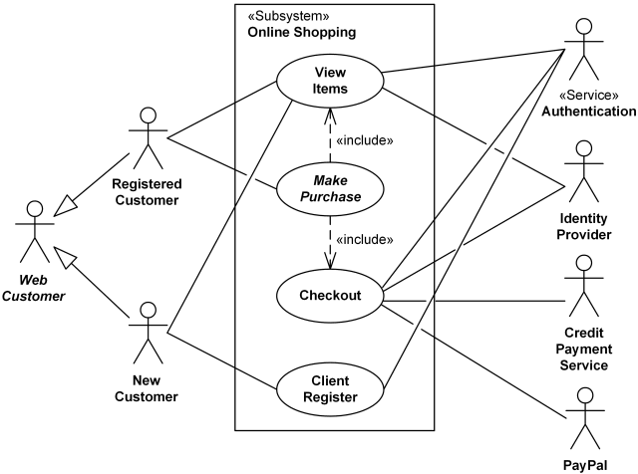
Use case diagram:

Slide 7
Tools/Platform, and Software Requirement specifications:
Name of component | Specification
Operating System | Windows 10
Language | Java 2 Runtime Environment
Database | MySQL Server
Browser | Any of Mozilla, Opera, Chrome etc
Web Server | Tomcat 9
Software Development Kit | Java JDK 1.7 or Above
Scripting Language Enable | JSP (Java Server Pages) servlet
Database JDBC Driver | MySQL Jconnector

Slide 8
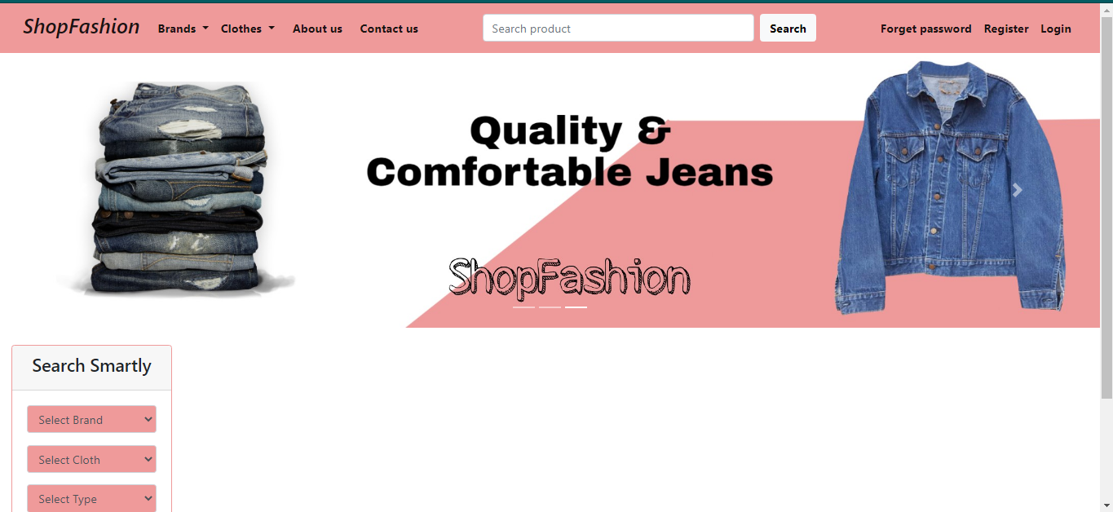
Screenshots of the Project Online Shopping System

Slide 9
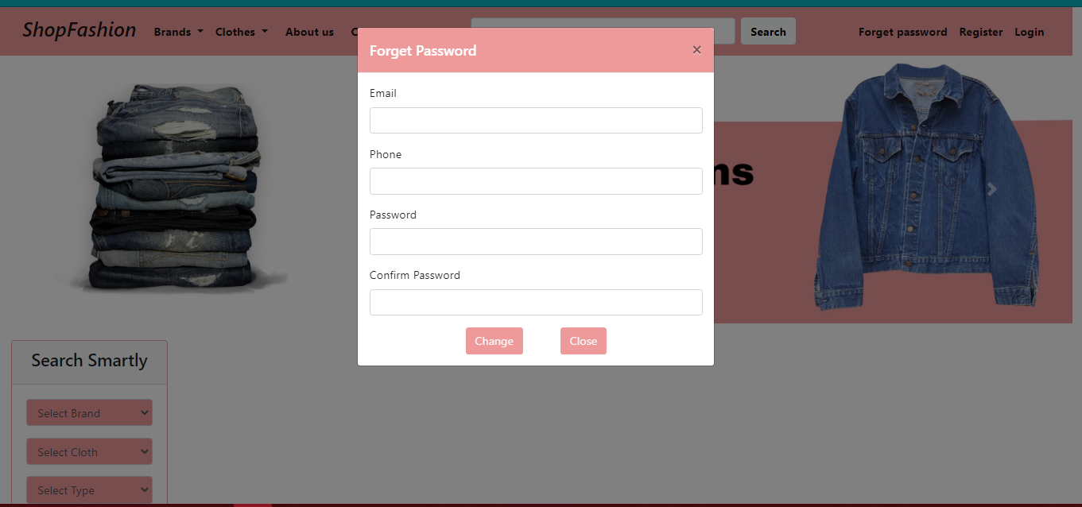

Slide 10
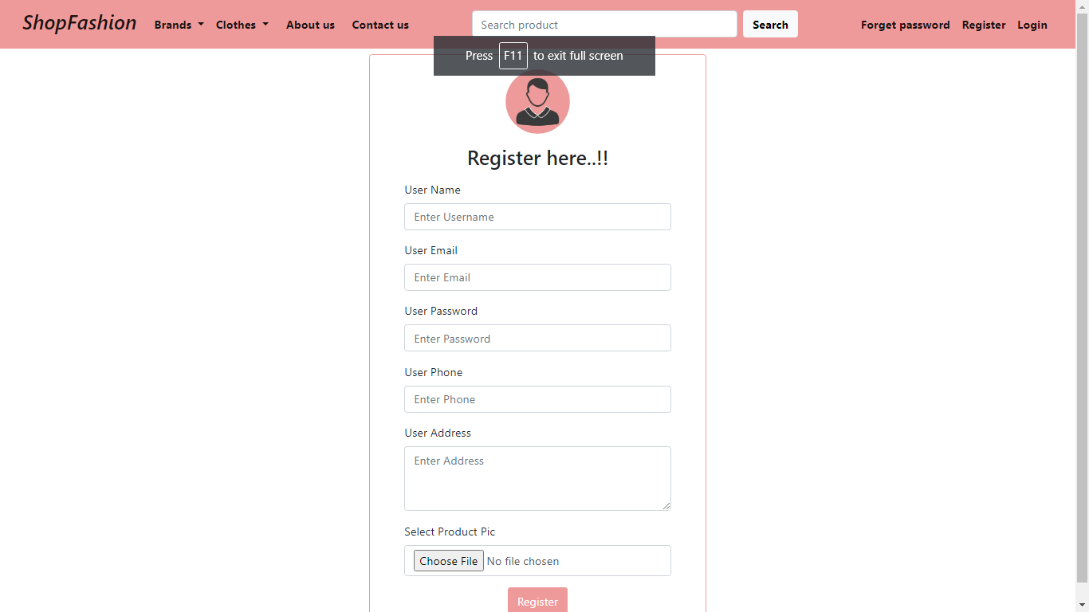

Slide 11
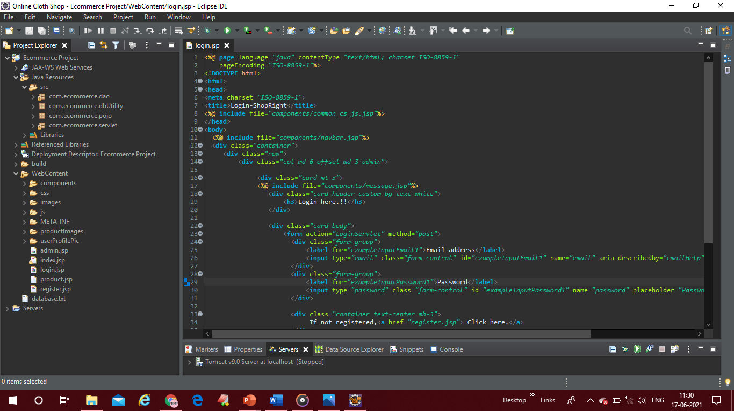

Slide 12
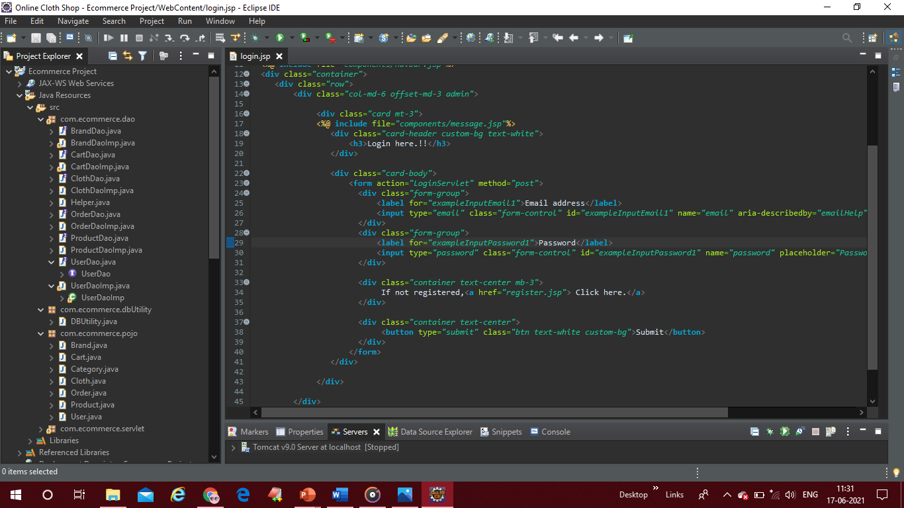

Slide 13
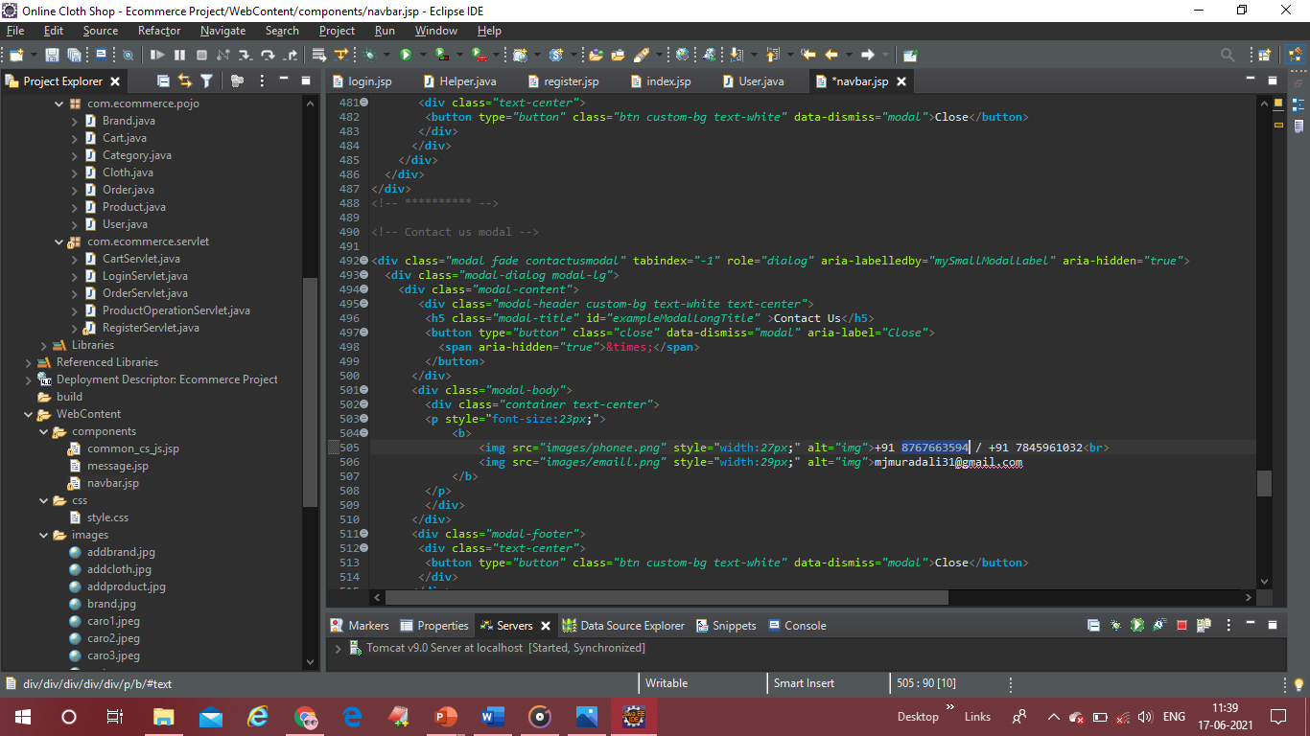

Slide 14
Conclusion
Our project is only a humble venture to satisfy the needs to manage the project
work. Several user friendly coding have also adopted. This package shall prove to be a
powerful package in satisfying all the requirements of the school. The objective of
software planning is to provide a frame work that enables the manger to make
reasonable estimates made within a limited time frame at the beginning of the software
project and should be updated regularly as the project progresses.

