Slide 1
Capstone presentation - Tokyo

Slide 2
Introduction
Problem:
Where should I stay in Tokyo for a vacation?
Constituency:
Tourists
Japanese tourism bureaus
Travel services
Questions:
What is the layout of Tokyo and its neighborhoods?
What places might be interesting to visit
What areas have hotels and trains?

Slide 3
Data
Ward | Population | Density
Chiyoda | 59441 | 5100
Chuo | 147620 | 14460
Minato | 248071 | 12180
Shinjuku | 339211 | 18620
The populations and population densities of Tokyo’s wards
The major districts associated with each ward
The latitude and longitude of each district
Geojson file of Toyko from Github
Foursquare venue data
District | Ward | Longitude | Latitude
Akabane | Kita | 139.7208 | 35.77814
Akihabara | Chiyoda | 139.7713 | 35.69974
Aobadai | Meguro | 139.6943 | 35.6509
Aomi | Koto | 139.7812 | 35.62478

Slide 4
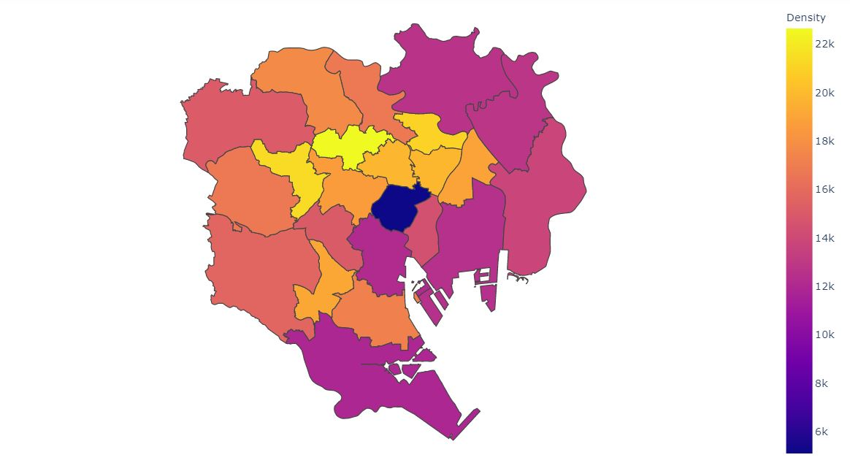
Methodology
Wards colored by population density

Slide 5
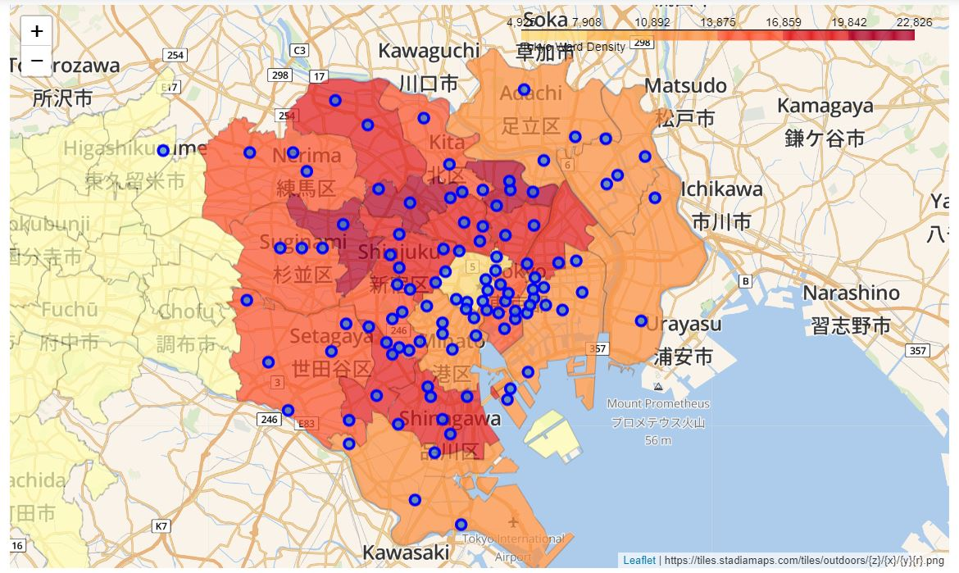
Districts Locations in the wards

Slide 6
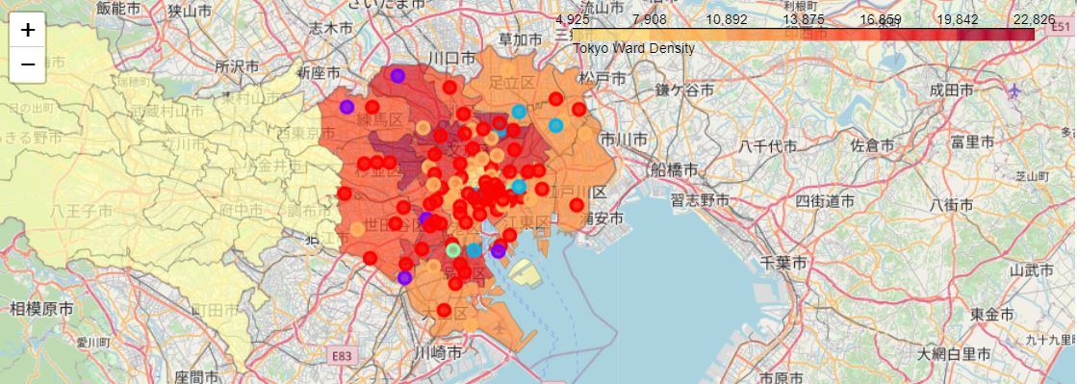
Kmeans 5 clusters

Slide 7
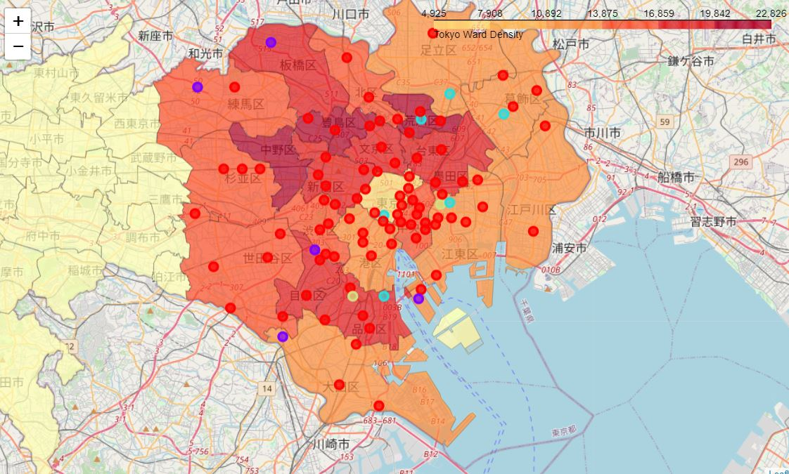
Kmeans 4 clusters

Slide 8
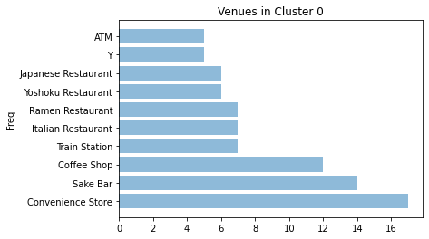
Two most common venues for each district in each cluster

Slide 9
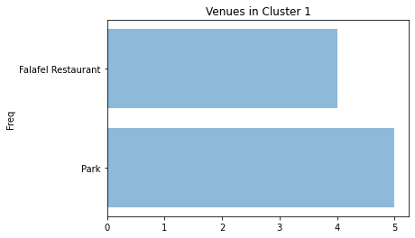

Slide 10
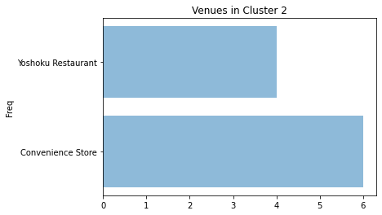

Slide 11
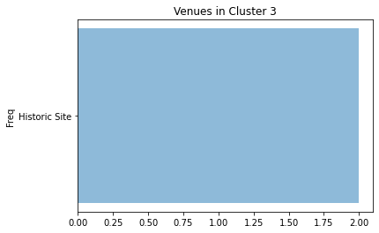

Slide 12
Results
Using cluster 0 as an example, hotels and transport can be discovered
Hotels are in Ariake, Omori, Shinbashi, Atemachi, Marunouchi, Hatchobori, Aoto, Asagaya, Koenji, and Ogikubo
Train stations are in Etchujima, Hatadodai, Oji, Shinagawa, Machiya, Shibamata, Tabata, and Ariake
The only district in common is Ariake

Slide 13
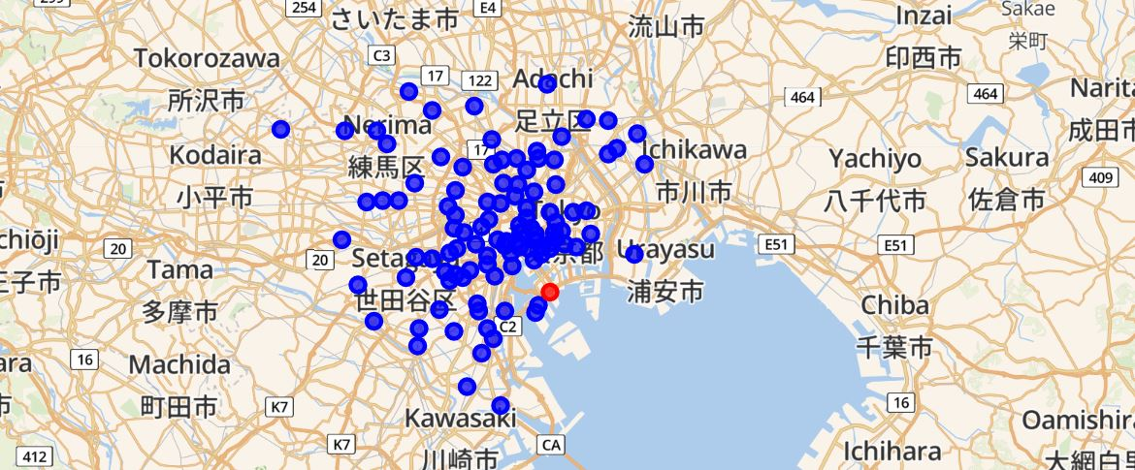
Location of Ariake

Slide 14
Discussion
The clustering did not pick up places that were less frequent, but possibly more interesting
For accommodations, I could also look at Airbnb and hostels
For transport, given the distance I could also just walk or bike

Slide 15
Conclusions
I learned the layout of Toyko, Japan
After clustering the districts, I found the most common venues and of the districts, the best to stay at is Ariake
Further work could be done to find other suitable places to stay

