Slide 1


AI Resume Personalization
By: Limitless
Personalized your resume in click

Slide 2
The Challenge of Job Applications
There are many websites that offer built-in resumes.
None of them offer the level of customization needed to fit specific job descriptions.

Slide 3
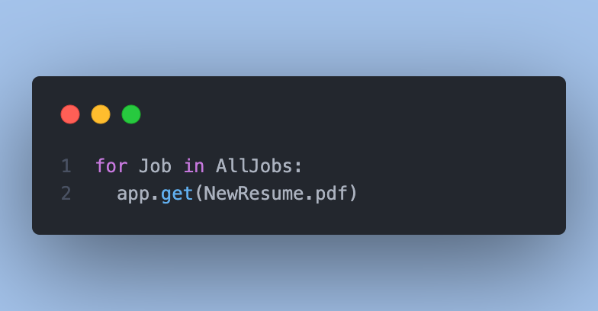
The Solution: AI Resume Personalization
- Building personalized resumes and cover letters that are tailored to fit each job application

Slide 4
The Key Features of Our System
Using GPT-3.5 API for analyzing job descriptions and user data.
User-friendly interface.
Customized feature that fit job description.
Providing users with a fast and responsive experience.
Saves users time by eliminating the need to rewrite.

Slide 5
Thank you!

