Slide 1
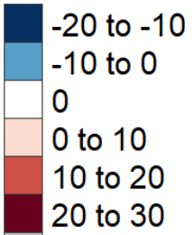
Metis GCAM USA
Subregional multi-sector analysis
Temporal
Spatial
Multi-Scenario
Multi-Sector
%
Water Scarcity Index ( % Diff SSP5 – SSP2)

Slide 2
Agenda
Updated Results
Project Timeline and Next Steps

Slide 3
Updated Results

Slide 4
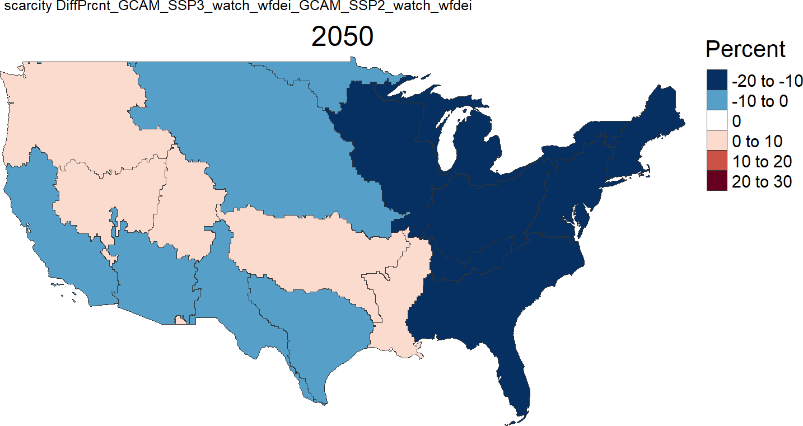
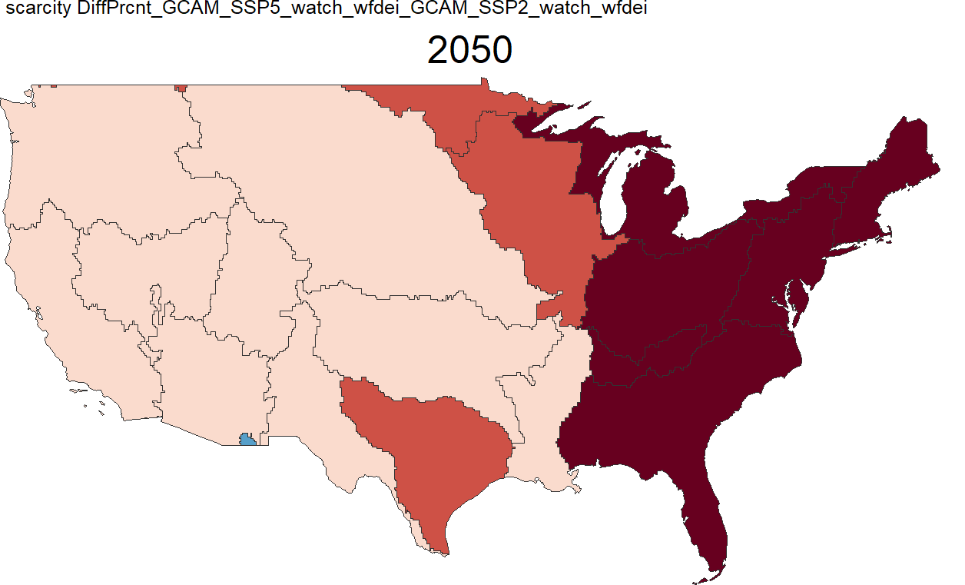
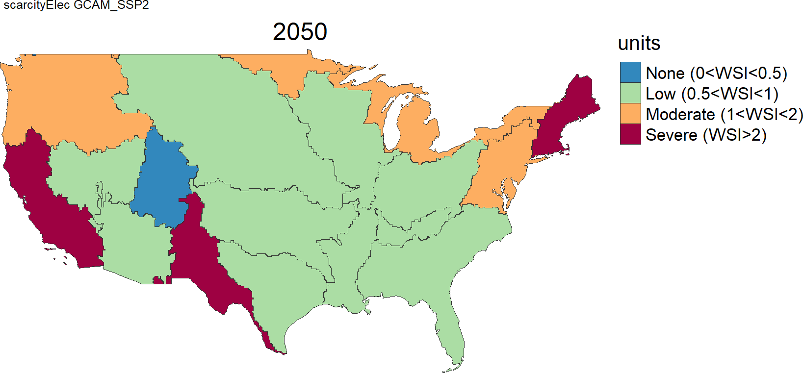
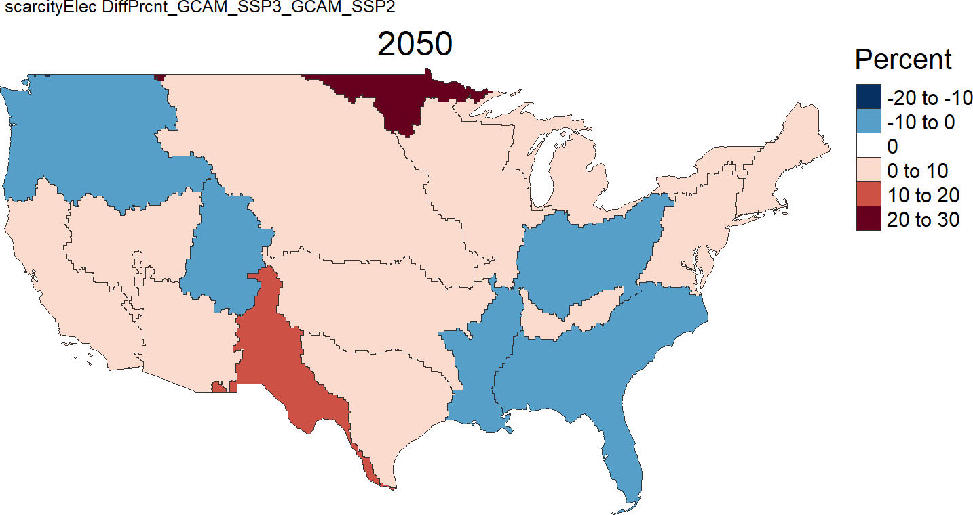
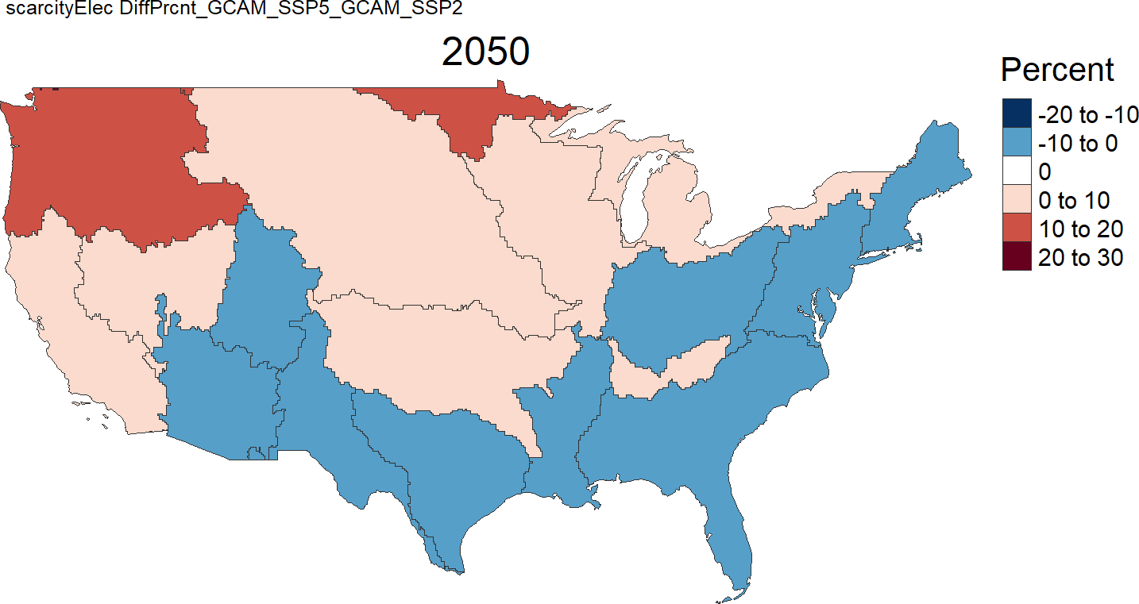
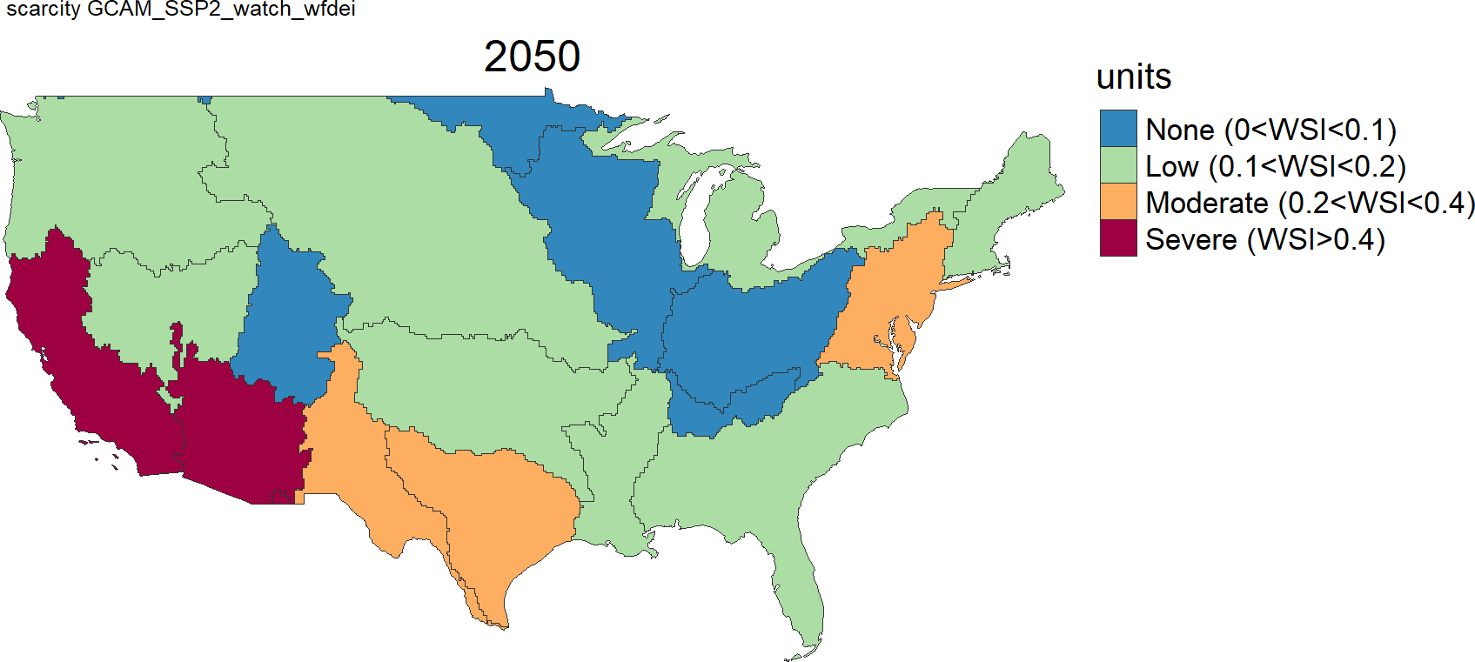
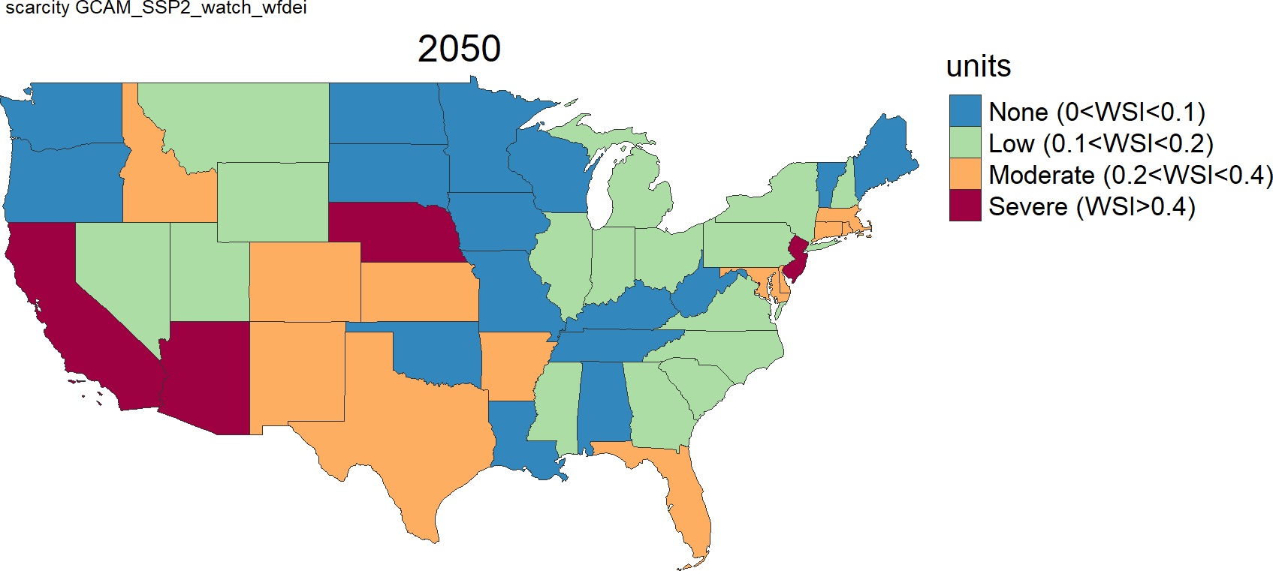
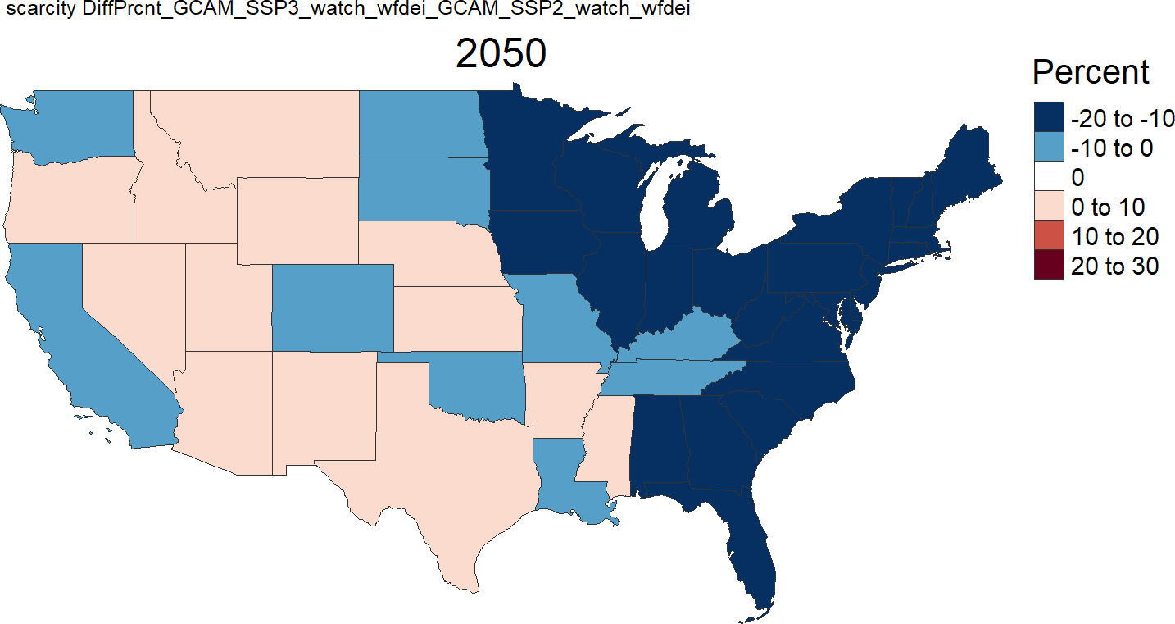
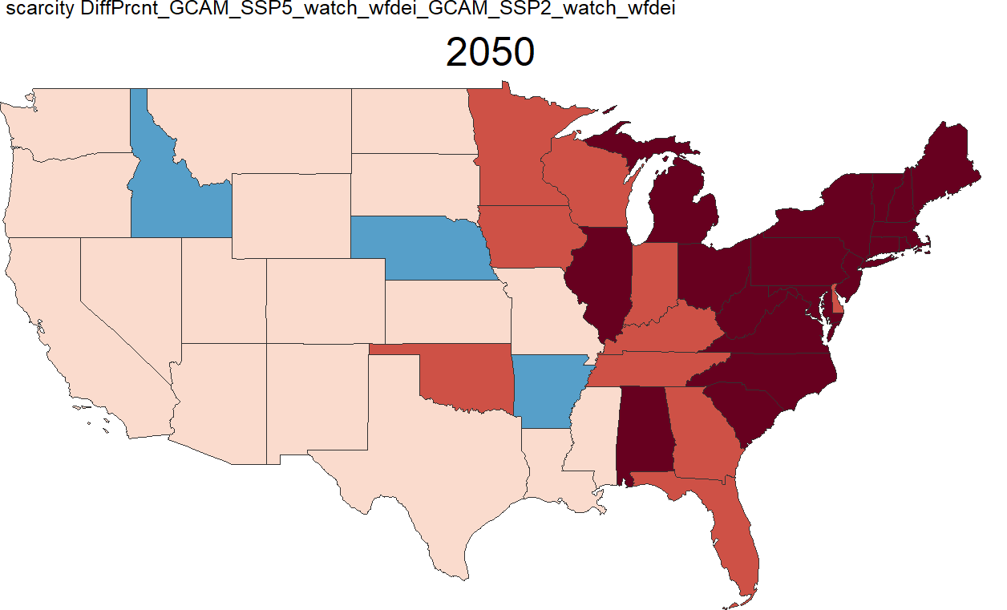
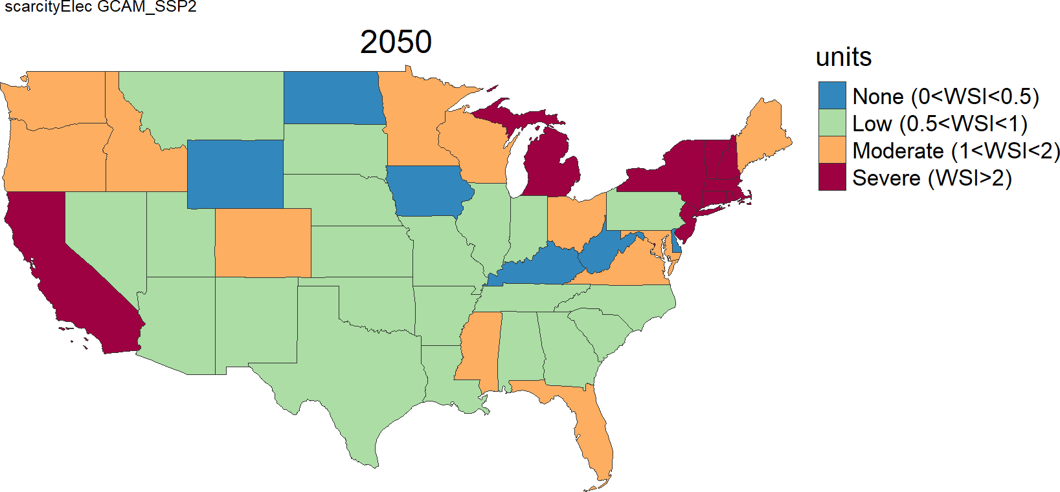
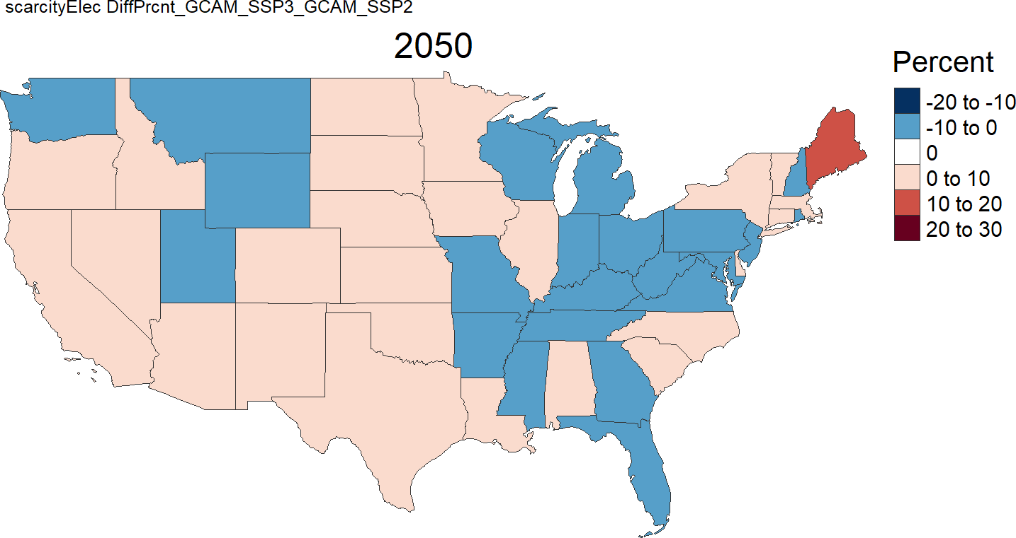
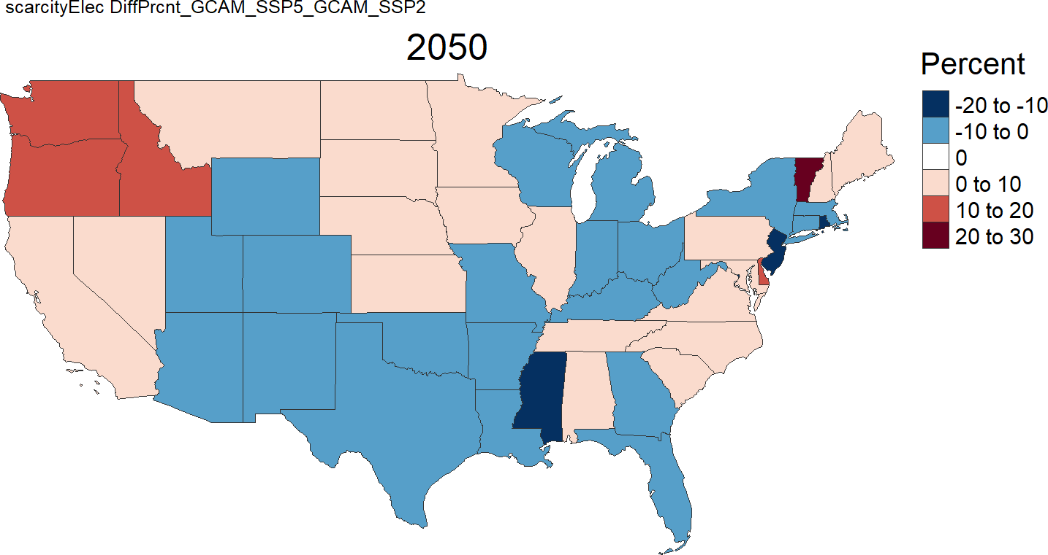
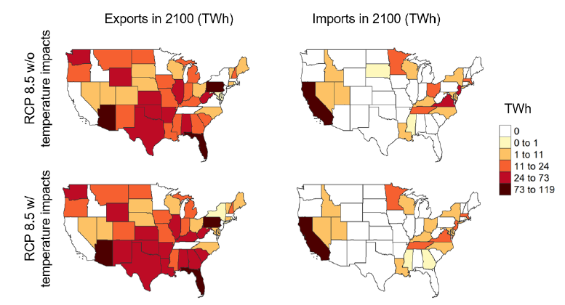
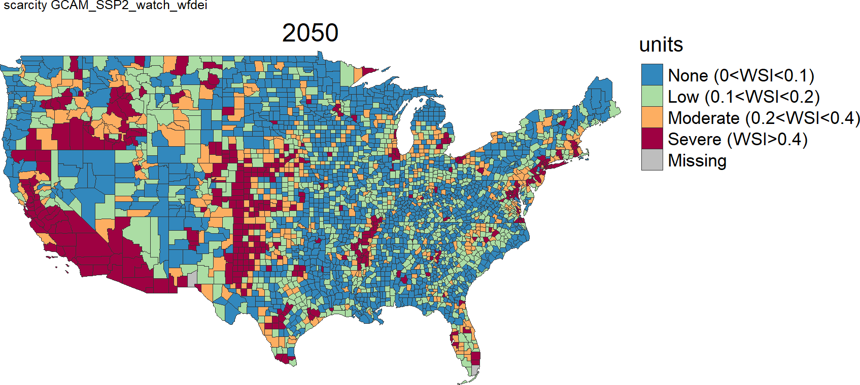
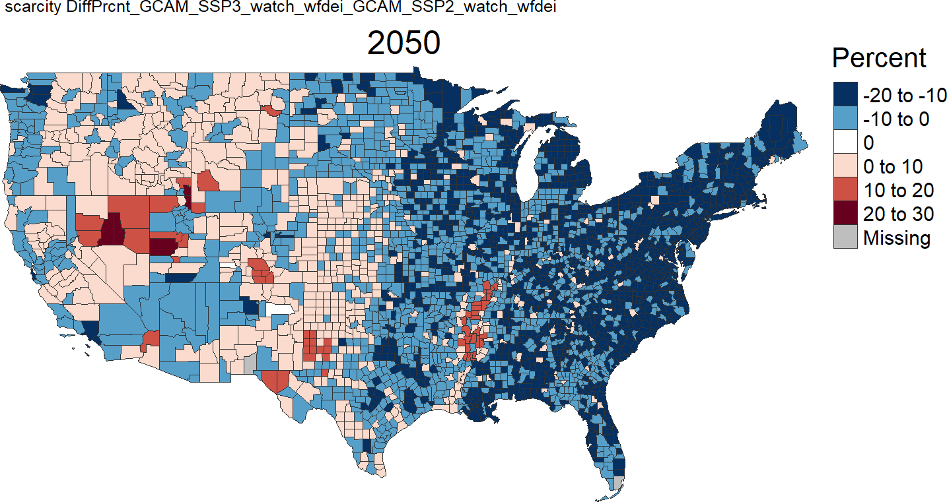
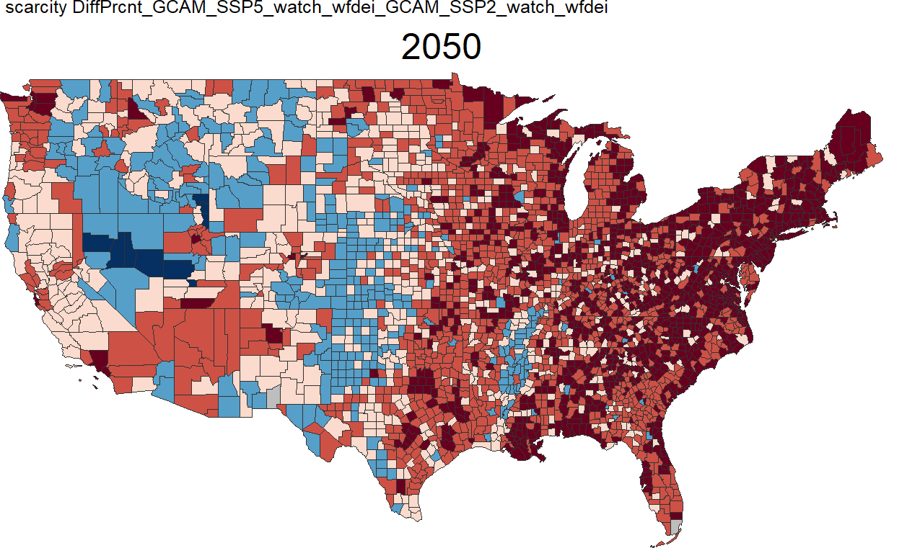
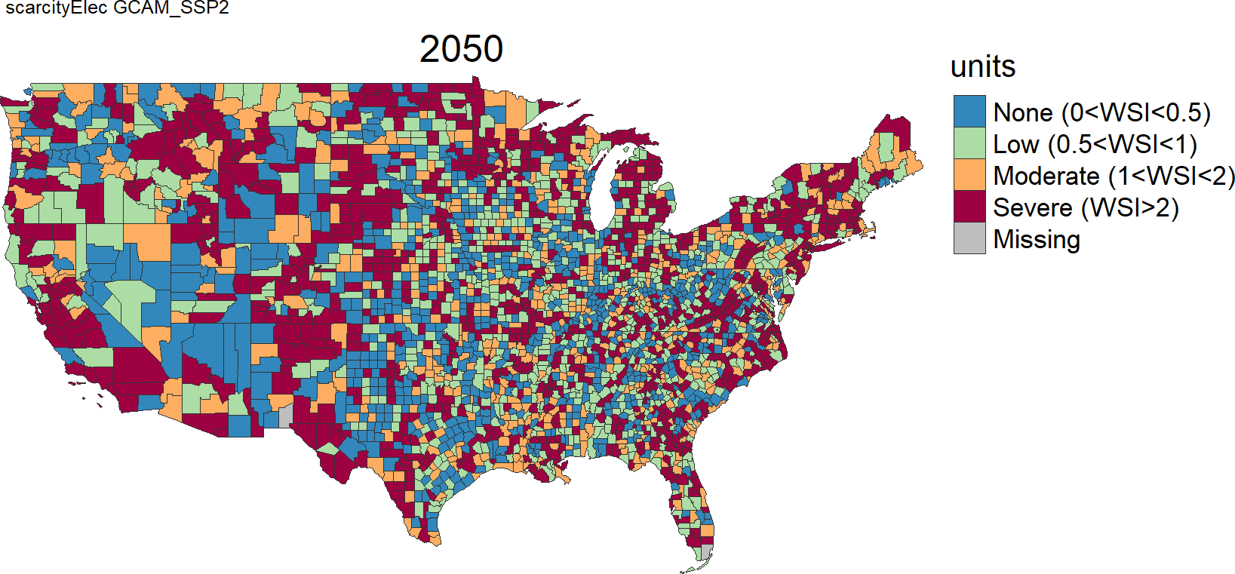
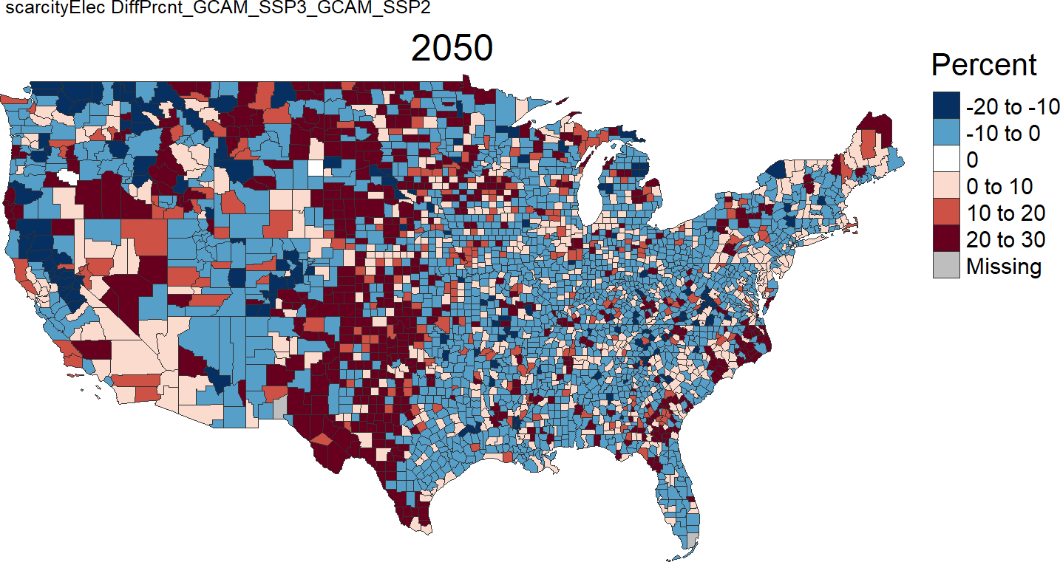
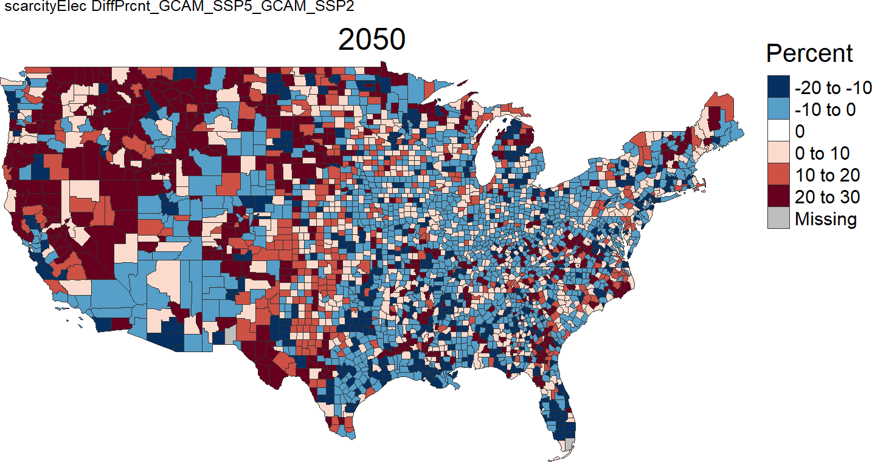
Demand/Supply Ratio - 2050
WATER
ELECTRICTY
Discussion
FOOD
Diff SSP5
Diff SSP3
Diff SSP5
Index
Index bins
Water (SE) – Energy (E & NE)
Energy Counties more spread
SSP2
Diff SSP3
SSP2
SSP2
Diff SSP3
Diff SSP5
Scenarios Diffs
Water impacts in East
Elec impacts in NW
Other
Time Dimension
Resiliency (FEWSION project)
Adam Schlosser (Risk Indicator)
%
%

Slide 5
Extra Results

Slide 6
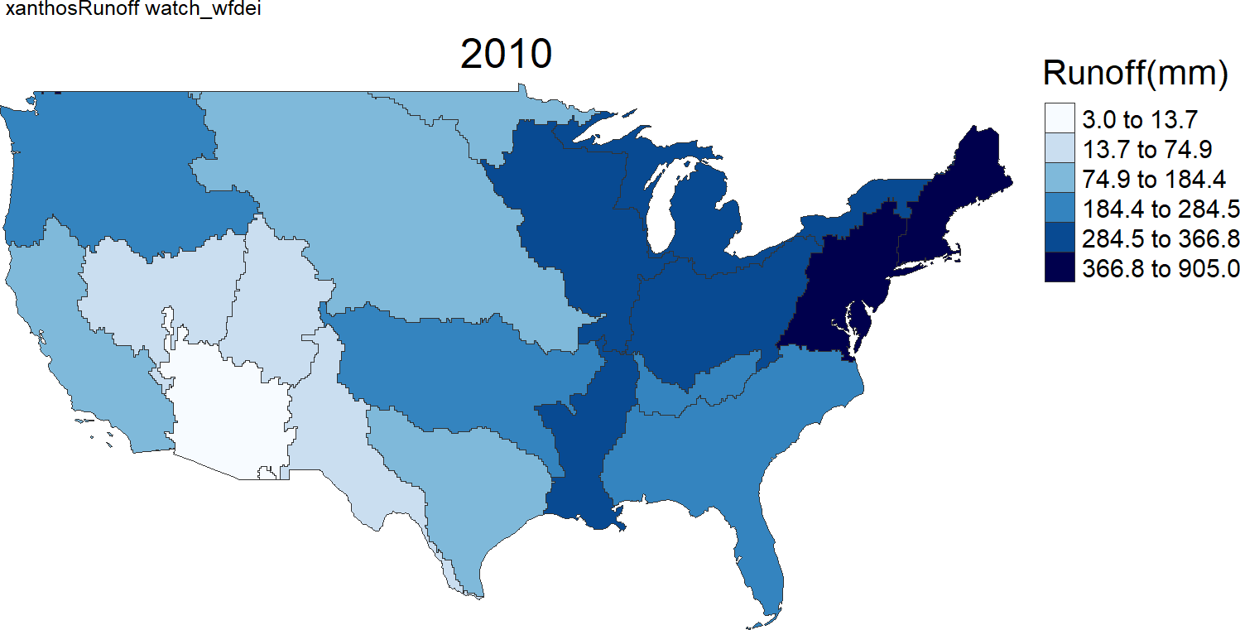
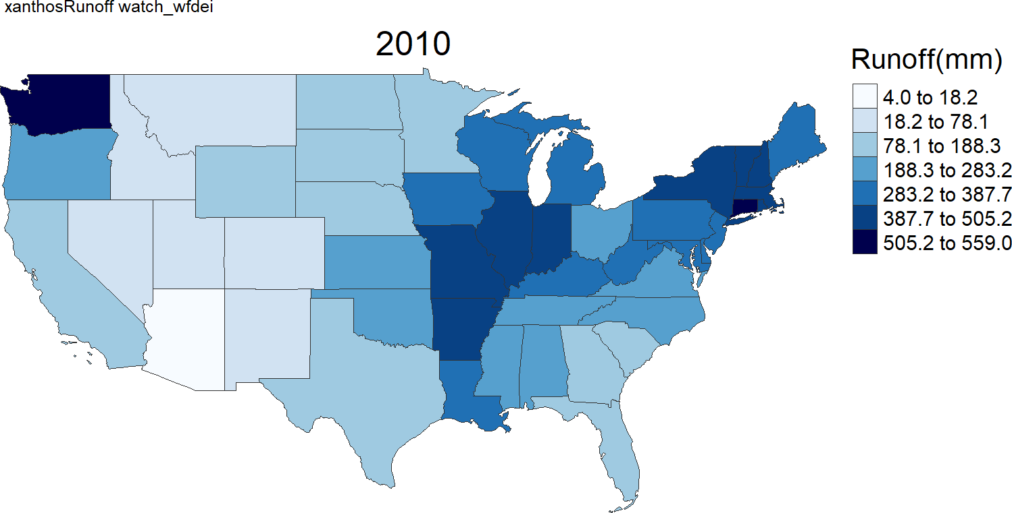
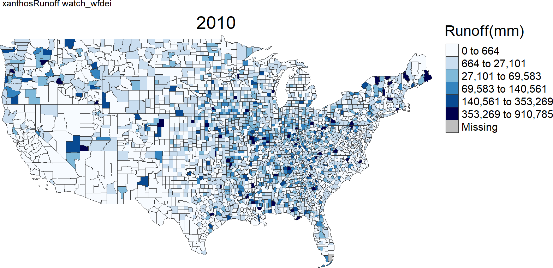
Water – Absolute Supply, Demand & Ratio 2050
SSP2
SSP3
SSP5
Supply
Demand
Ratio
Supply
Demand
Ratio
Supply
Demand
Ratio

Slide 7
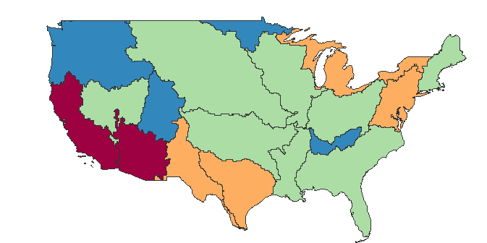
Water - Difference Demand, Supply & Ratio 2050
SSP2
SSP3 – SSP2
SSP5 – SSP2
Supply
Demand
Ratio
Supply
Demand
Ratio
Supply
Demand
Ratio

Slide 8
Electricity – Absolute Supply, Demand & Ratio 2050
SSP2
SSP3
SSP5
Supply
Demand
Ratio
Supply
Demand
Ratio
Supply
Demand
Ratio

Slide 9
Electricity - Difference Demand, Supply & Ratio 2050
SSP2
SSP3 – SSP2
SSP5 – SSP2
Supply
Demand
Ratio
Supply
Demand
Ratio
Supply
Demand
Ratio

Slide 10
Project Timeline and Next Steps

Slide 11
