Slide 1
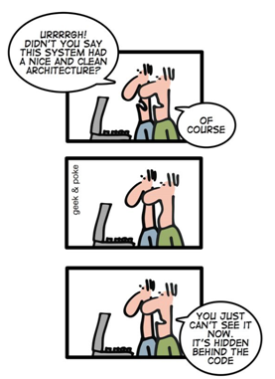
Software & Data Evolution www.cs.uoi.gr/~zarras/software-data-evol.html
Includes material from OO Reengineering Patterns by Demeyer, Ducasse, Nierstrasz

Slide 2

Focus of this course
Methods, techniques and patterns for software and data evolution, with a particular in-depth analysis of re-engineering of legacy software.

Slide 3

Target skills & knowledge
Target skills & knowledge:
Understand the critical steps in the process of re-engineering.
  Understand the role of re-engineering patterns in the process of re-engineering.
Re-engineer an existing system:
  Produce (a) an abstract model of the system and (b) the appropriate documentation that goes along with the abstract model.
  Identify symptoms of bad design and rigidity and prioritize them in terms of re-engineering.
  Design specific solutions for the identified problems.

Slide 4

Scoring
The score is based on two factors:
  (Team) Project: 50%
  (Atomic) Participation to lectures, discussions, individual activities, tests: 50%
    The team project will be carried out in groups of 2 or 3 persons, and it is detailed in the sequel.

Slide 5
What do we mean by legacy system?

Slide 6
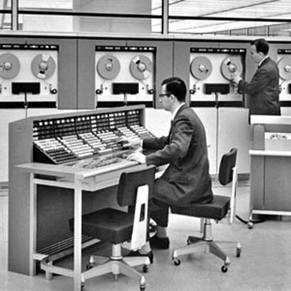
What do we mean by legacy software?
“legacy”
  A sum of money, or a specified article, given to another by will; anything handed down by an ancestor or predecessor.
  Oxford English Dictionary.
A legacy system is a piece of software that we have inherited, and is valuable to us.

Slide 7
Why do we reengineer?

Slide 8
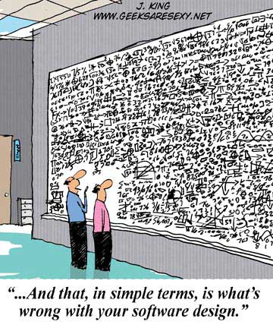
Why do we reengineer?
A classic study by Lehman and Belady identified several “laws” of system change.
Continuing change
A program that is used in a real-world environment must change, or become progressively less useful in that environment.
Increasing complexity
As a program evolves, it becomes more complex, and extra resources are needed to preserve and simplify its structure.
We reengineer so that the legacy system can continue to be used and adapted at an acceptable cost.

Slide 9
Lehman’s laws of software evolution
Law of Continuing Change. An E-type system must be continually adapted or else it becomes progressively less satisfactory in use.
Law of Increasing Complexity. As an E-type system is changed its complexity increases and becomes more difficult to evolve unless work is done to maintain or reduce the complexity.
Law of Self Regulation. Global E-type system evolution is feedback regulated.
Law of Conservation of Organizational Stability. The work rate of an organization evolving an E-type software system tends to be constant over the operational lifetime of that system or phases of that lifetime.
Law of Conservation of Familiarity. In general, the incremental growth (growth ratio trend) of E-type systems is constrained by the need to maintain familiarity.
Law of Continuing Growth. The functional capability of E-type systems must be continually enhanced to maintain user satisfaction over system lifetime.
Law of Declining Quality. Unless rigorously adapted and evolved to take into account changes in the operational environment, the quality of an E-type system will appear to be declining.
Law of Feedback System. E-type evolution processes are multi-level, multi-loop, multi-agent feedback systems.
Lehman and his colleagues identified several “laws” of system change
Notes:
An S-program is written according to an exact specification of what that program can do
A P-program is written to implement certain procedures that completely determine what the program can do (the example mentioned is a program to play chess)
An E-program is written to perform some real-world activity; how it should behave is strongly linked to the environment in which it runs, and such a program needs to adapt to varying requirements and circumstances in that environment

Slide 10
Why do we reengineer?
The specific reasons can vary significantly.
You might want to unbundle a monolithic system so that the individual parts can be more easily marketed.
You might want to improve performance.
You might want to port the system to a new platform.
  Before you do that, you may need to rework the architecture to clearly separate the platform-dependent code.

Slide 11
Why do we reengineer?
You might want to reduce human dependencies by documenting knowledge about the system and making it easier to maintain.
You might want to extract the design as a first step to a new implementation.
You might want to exploit new technology, such as emerging standards or libraries, as a step towards cutting maintenance costs.

Slide 12
How do we know that a legacy should be re-engineered ?

Slide 13
Reengineering problems
Original developers or users have left.
Inside knowledge about system has disappeared.
Limited understanding of the entire system.
Too long to turn things over to production.
Too much time to make simple changes.
Need for constant bug fixes.
Maintenance dependencies.
Increased complexity.
Duplicated code & other code smells.

Slide 14
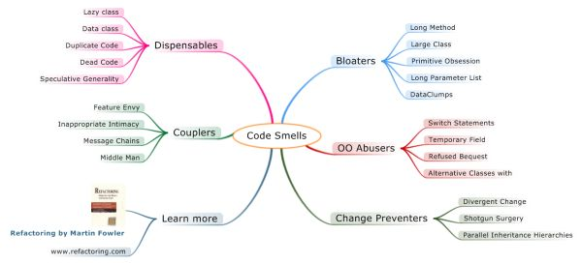
Reengineering problems

Slide 15
Which are the basic reengineering phases/activities?

Slide 16
The Reengineering Life-Cycle
(0) requirement
analysis
Requirements
(2) problem
detection
(3) problem
resolution
Designs
(1) model
capture
Code
(4) program transformation
OORPT — Introduction
© Stéphane Ducasse, Serge Demeyer, Oscar Nierstrasz

Slide 17


Some Terminology
“Reverse Engineering is the process of analyzing a subject system to identify the system’s components and their interrelationships and create representations of the system in another form or at a higher level of abstraction.”
“Reengineering ... is the examination and alteration of a subject system to reconstitute it in a new form and the subsequent implementation of the new form.”
“Forward Engineering is the traditional process of moving from high-level abstractions and logical, implementation-independent designs to the physical implementation of a system.”
— Chikofsky and Cross [IEEE Software, 1990]
OORPT — Introduction
© Stéphane Ducasse, Serge Demeyer, Oscar Nierstrasz

Slide 18
What is the role of patterns in a re-engineering project?

Slide 19



Reverse engineering Patterns
Reverse engineering patterns encode expertise and trade-offs in extracting design from source code, running systems and people.
Example: Interview During Demo
OORPT — Introduction
© Stéphane Ducasse, Serge Demeyer, Oscar Nierstrasz

Slide 20
Reengineering Patterns
Reengineering patterns encode expertise and trade-offs in transforming legacy code to resolve problems that have emerged.
Example: Move Behavior Close to Data
OORPT — Introduction
© Stéphane Ducasse, Serge Demeyer, Oscar Nierstrasz

Slide 21
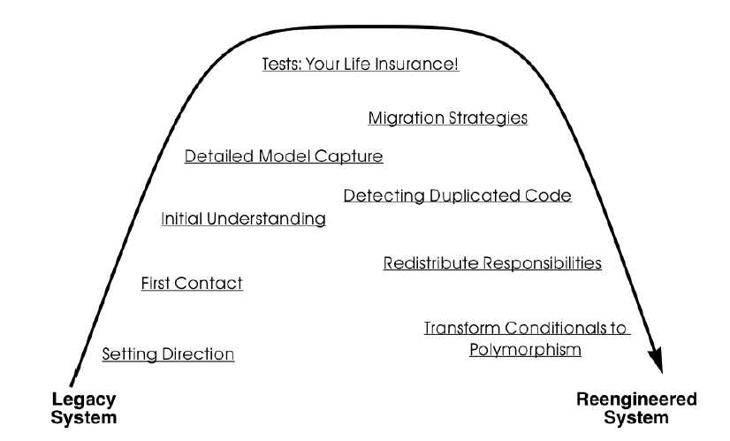
A Map of Reengineering Patterns
OORPT — Introduction
© Stéphane Ducasse, Serge Demeyer, Oscar Nierstrasz

Slide 22



Attribution-ShareAlike 2.5
You are free:
to copy, distribute, display, and perform the work
to make derivative works
to make commercial use of the work
Under the following conditions:
  Attribution. You must attribute the work in the manner specified by the author or licensor.
  Share Alike. If you alter, transform, or build upon this work, you may distribute the resulting work only under a license identical to this one.
For any reuse or distribution, you must make clear to others the license terms of this work.
Any of these conditions can be waived if you get permission from the copyright holder.
Your fair use and other rights are in no way affected by the above.

