Slide 1
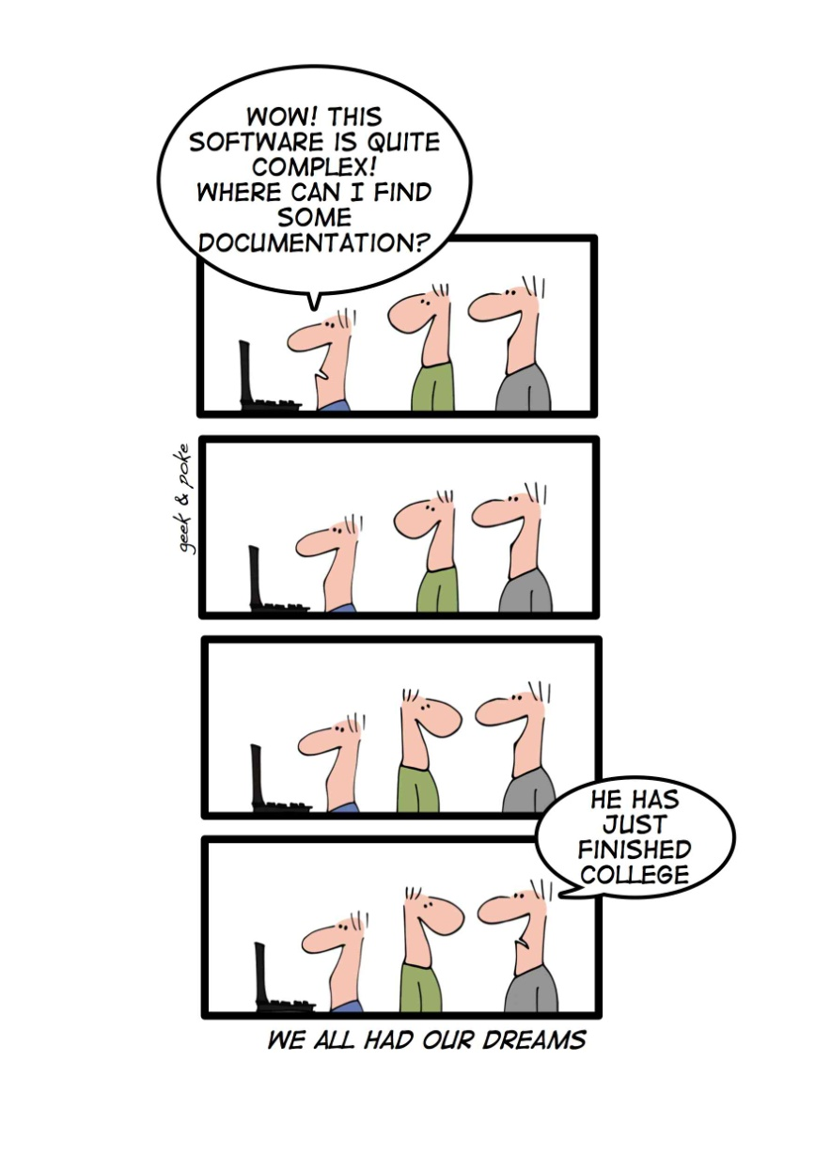
Reverse Engineering www.cs.uoi.gr/~zarras/software-data-evol.html
Reused slides material from OO Reengineering Patterns by Demeyer, Ducasse, Nierstrasz

Slide 2
The Reengineering Life-Cycle
(0) requirement
analysis
Requirements
(2) problem
detection
(3) problem
resolution
Designs
(1) model
capture
Code
(4) program transformation
OORPT — Introduction
© Stéphane Ducasse, Serge Demeyer, Oscar Nierstrasz

Slide 3
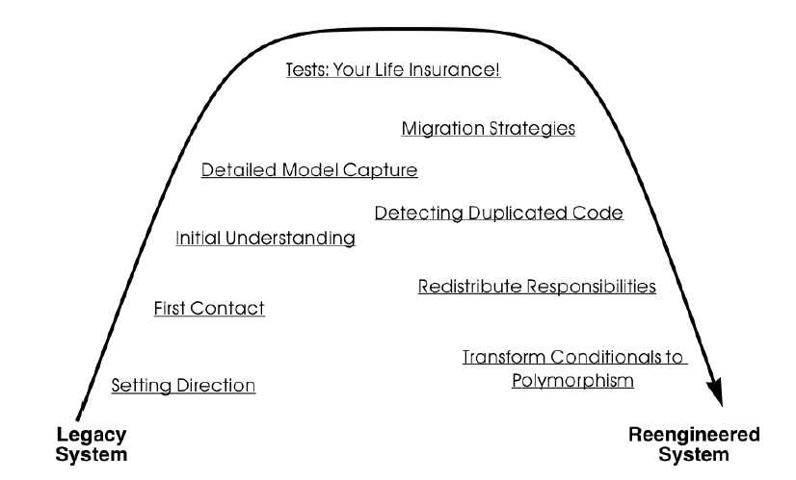
A Map of Reengineering Patterns
OORPT — Introduction
© Stéphane Ducasse, Serge Demeyer, Oscar Nierstrasz

Slide 4
First Contact

Slide 5
Forces — First Contact
Legacy systems are large and complex.
  Split the system into manageable pieces.
Time is scarce.
  Apply lightweight techniques to assess feasibility and risks.
First impressions are dangerous.
  Always double-check your sources.
People have different agendas.
  Build confidence; be wary of skeptics.
OORPT — Reverse Engineering
© Stéphane Ducasse, Serge Demeyer, Oscar Nierstrasz
Notes:
3-5 people for 500Kloc
A week to get to know with people and system and make a rough project plan

Slide 6
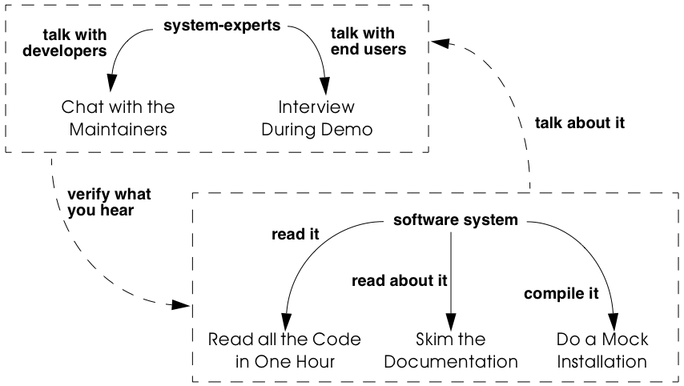
First Contact
OORPT — Reverse Engineering
© Stéphane Ducasse, Serge Demeyer, Oscar Nierstrasz
Notes:
1 week for these patterns

Slide 7
How do you get an idea of the history and politics of the legacy system?

Slide 8
Chat with the Maintainers
Problem:
How do you get an idea of the history and politics of the legacy system?
Solution:
Discuss with the system maintainers.
OORPT — Reverse Engineering
© Stéphane Ducasse, Serge Demeyer, Oscar Nierstrasz
Notes:
?

Slide 9

Chat with the Maintainers
Treat them like brothers in arms
Questions to ask:
Easiest/hardest bug to fix in recent months?
How are change requests made and evaluated?
How did the development/maintenance team evolve during the project?
How good is the code? The documentation?
Why was the reengineering project started? What do you hope to gain?
OORPT — Reverse Engineering
© Stéphane Ducasse, Serge Demeyer, Oscar Nierstrasz

Slide 10

Chat with the Maintainers
Obtains information effectively. Most significant events are passed on orally.
Get acquainted with your colleagues.
Provides anecdotal evidence only. Worse, the information may be incomplete.
People protect their jobs. Some maintainers may not be willing to provide you with the information you need.
Teams may be unstable. Software maintenance is generally considered a second-class job.
OORPT — Reverse Engineering
© Stéphane Ducasse, Serge Demeyer, Oscar Nierstrasz

Slide 11
How can you get a first impression of the quality of the source code?

Slide 12
Read all the Code in One Hour
Problem:
How can you get a first impression of the quality of the source code?
Solution:
Scan all the code in single, short session.
OORPT — Reverse Engineering
© Stéphane Ducasse, Serge Demeyer, Oscar Nierstrasz
Notes:
Do not delay this too much…

Slide 13
Read all the Code in One Hour
Identify coding styles – will help to scan code quickly.
Identify smells.
Look for functional tests and unit tests.
Look for abstract classes and methods; they introduce design intentions and variations.
Look for classes high in the hierarchy; they define domain abstractions.
Occurrences of the singleton pattern may represent information that is constant and global.
Beware of comments.
Log all your questions!
OORPT — Reverse Engineering
© Stéphane Ducasse, Serge Demeyer, Oscar Nierstrasz
Notes:
??? What to look for??

Slide 14
Read all the Code in One Hour
Produce a small report with:
  General assessment of whether reengineering is feasible.
  Entities and other information that seem important.
  Smells.
  Parts that need further investigation.
OORPT — Reverse Engineering
© Stéphane Ducasse, Serge Demeyer, Oscar Nierstrasz

Slide 15
Read all the Code in One Hour
Start efficiently.
Judge sincerely.
Learn the developers vocabulary.
Obtain low abstraction.
Does not scale well
OORPT — Reverse Engineering
© Stéphane Ducasse, Serge Demeyer, Oscar Nierstrasz

Slide 16
How to identify those parts of the documentation that might be of help?
Notes:
Time is scarce… want to know which parts and how up to date are they

Slide 17
Skim the Documentation
Problem:
How to identify those parts of the documentation that might be of help?
Solution:
Prepare a list summarizing those aspects of the system that seem interesting for your reengineering project.
Match this list against the documentation and meanwhile make a crude assessment of how up to date the documentation seems.
OORPT — Reverse Engineering
© Stéphane Ducasse, Serge Demeyer, Oscar Nierstrasz

Slide 18
Skim the Documentation
The fact that you are limited in time should force you to think how you can extract the most useful information:
  A table of contents gives you a quick overview of the information.
  Version numbers and dates tell you how up to date that part of the documentation is.
  Figures are a good means to communicate information. A list of figures, if present, may provide a quick access path to certain parts of the documentation.
  Screen-dumps, sample print-outs, sample reports, command descriptions, reveal a lot about the functionality provided by the system.
  Formal specifications (e.g., state-charts), if present, usually correspond with crucial functionality.
  An index, if present contains the terms the author considers significant.
OORPT — Reverse Engineering
© Stéphane Ducasse, Serge Demeyer, Oscar Nierstrasz
Notes:
??? How can we make this fast??

Slide 19
Skim the Documentation
Summarize your findings in a short report, including:
  A general assessment of whether the system documentation will be useful and why (not).
  A list of those parts of the documentation that seem useful and why (e.g., requirement specifications, desired features, important constraints, design diagrams, user and operator manuals).
  For each part, an impression of how up to date the description is.
OORPT — Reverse Engineering
© Stéphane Ducasse, Serge Demeyer, Oscar Nierstrasz

Slide 20
Skim the Documentation
Provides a high abstraction level. Documentation is supposed to be read by humans.
Focus on relevant, and up to date parts.
You may miss crucial facts.
You may find irrelevant information only.
Information may be inconsistent
OORPT — Reverse Engineering
© Stéphane Ducasse, Serge Demeyer, Oscar Nierstrasz

Slide 21
What are the typical usage scenarios?
Notes:
Via interview or via demo
The catch is that it is most effective to do both! + with various stakeholders

Slide 22
Interview during Demo
Problem:
What are the typical usage scenarios?
Solution:
Observe the system in operation by seeing a demo and interviewing the person who is demonstrating.
Note that the interviewing part is at least as enlightening as the demo.
OORPT — Reverse Engineering
© Stéphane Ducasse, Serge Demeyer, Oscar Nierstrasz

Slide 23
Interview during Demo
An end-user should tell you how the system looks like from the outside and explain some detailed usage scenarios based on the daily working practices.
A manager should inform you how the system fits within the rest of the business domain.
A person from the sales department ought to compare your software system with competing systems.
A person from the help desk should demonstrate you which features cause most of the problems.
A system administrator should show you all that is happening behind the scenes of the software system.
A maintainer/developer may demonstrate you some of the subsystems. Use the opportunity to get insight in the architecture.
OORPT — Reverse Engineering
© Stéphane Ducasse, Serge Demeyer, Oscar Nierstrasz

Slide 24
Interview during Demo
Summarize your findings in a short report, including:
  Some typical usage scenarios.
  The main features offered by the system and whether they are appreciated or not.
  The system components and their responsibilities.
  Bizarre anecdotes that reveal the folklore around using the system.
OORPT — Reverse Engineering
© Stéphane Ducasse, Serge Demeyer, Oscar Nierstrasz

Slide 25
Interview during Demo
Focuses on valued features.
Provides lots of qualitative data.
Increases your credibility.
Provides anecdotal evidence only.
Time may be lacking.
OORPT — Reverse Engineering
© Stéphane Ducasse, Serge Demeyer, Oscar Nierstrasz

Slide 26
How can you be sure that you will be able to (re)build the system?

Slide 27
Do a Mock Installation
Problem:
How can you be sure that you will be able to (re)build the system?
  Solution:
Try to install and build the system in a clean environment during a limited amount of time (at most one day). Run the self test if the system includes one.
OORPT — Reverse Engineering
© Stéphane Ducasse, Serge Demeyer, Oscar Nierstrasz

Slide 28
Do a Mock Installation
Log all small failures during the build and installation process and the way you solved them, because this will tell you about the configuration of the system and its dependencies on libraries, frameworks ....
After this build and install experiment, prepare a report containing:
  Version numbers of libraries, frameworks and patches used.
  Dependencies between the infrastructure (database, network toolkits, ports,…).
  Problems you encountered and how you tried to solve them.
  Suggestions for improvement.
  In case of incomplete installation or build your assessment of the situation, including possibilities for solutions and workarounds.
OORPT — Reverse Engineering
© Stéphane Ducasse, Serge Demeyer, Oscar Nierstrasz

Slide 29
Do a Mock Installation
Essential prerequisite.
Demands precision.
Increase your credibility.
Tedious activity.
No certainty.
Easy to get carried away.
OORPT — Reverse Engineering
© Stéphane Ducasse, Serge Demeyer, Oscar Nierstrasz

Slide 30
Singleton

Slide 31
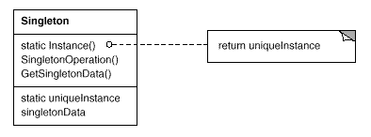
Singleton
Intent
Ensure a class only has one instance, and provide a global point of access to it.
Applicability
Use the Singleton pattern when there must be exactly one instance of a class, and it must be accessible to clients from a well-known access point
Structure

Slide 32



Attribution-ShareAlike 2.5
You are free:
to copy, distribute, display, and perform the work
to make derivative works
to make commercial use of the work
Under the following conditions:
  Attribution. You must attribute the work in the manner specified by the author or licensor.
  Share Alike. If you alter, transform, or build upon this work, you may distribute the resulting work only under a license identical to this one.
For any reuse or distribution, you must make clear to others the license terms of this work.
Any of these conditions can be waived if you get permission from the copyright holder.
Your fair use and other rights are in no way affected by the above.

