Slide 1
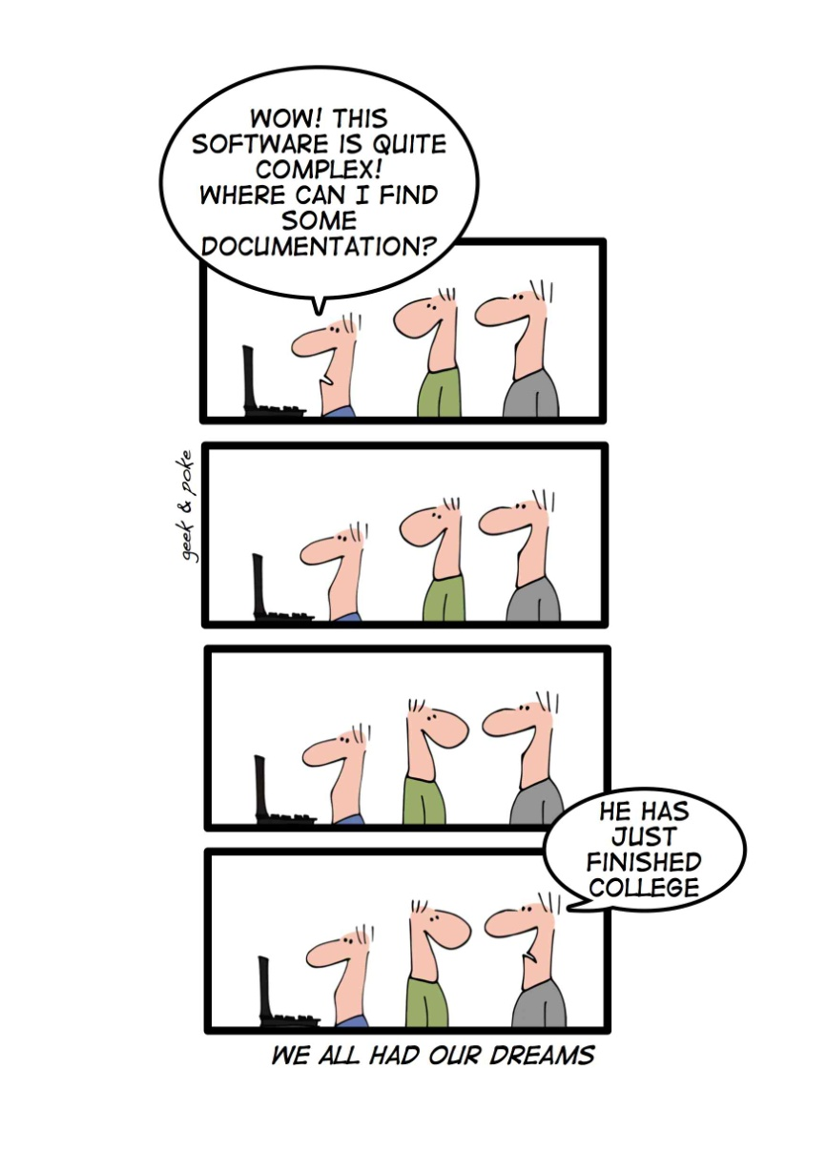
Reverse Engineering www.cs.uoi.gr/~zarras/software-data-evol.html
Reused slides material from OO Reengineering Patterns by Demeyer, Ducasse, Nierstrasz

Slide 2
The Reengineering Life-Cycle
(0) requirement
analysis
Requirements
(2) problem
detection
(3) problem
resolution
Designs
(1) model
capture
Code
(4) program transformation
OORPT — Introduction
© Stéphane Ducasse, Serge Demeyer, Oscar Nierstrasz

Slide 3
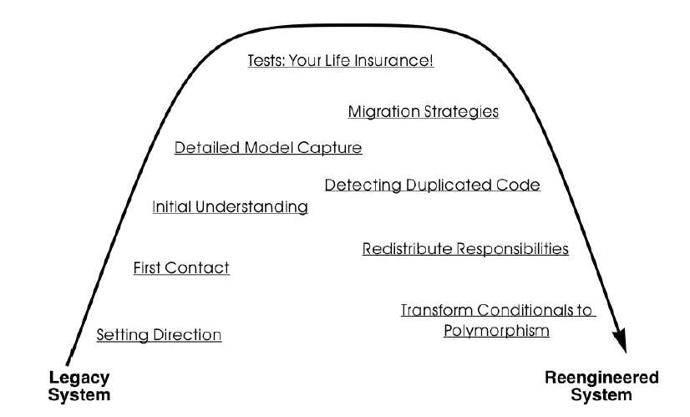
A Map of Reengineering Patterns
OORPT — Introduction
© Stéphane Ducasse, Serge Demeyer, Oscar Nierstrasz

Slide 4
Initial Understanding

Slide 5
Forces — Initial Understanding
Data is deceptive.
  Always double-check your sources.
Understanding entails iteration.
  Plan iteration and feedback loops.
Knowledge must be shared.
  “Put the map on the wall”.
Teams need to communicate.
  “Use their language”.
OORPT — Reverse Engineering
© Stéphane Ducasse, Serge Demeyer, Oscar Nierstrasz

Slide 6
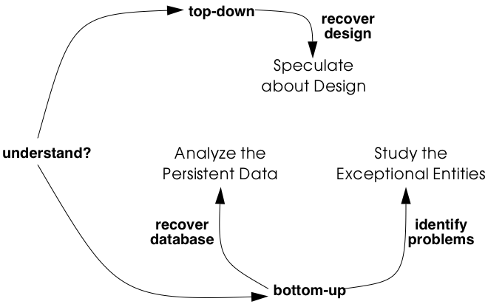
Initial Understanding
OORPT — Reverse Engineering
© Stéphane Ducasse, Serge Demeyer, Oscar Nierstrasz

Slide 7
Which object structures represent the valuable data ?
Notes:
Have to discover/understand the data/domain model

Slide 8
Analyze the Persistent Data
Problem:
Which object structures represent the valuable data?
Solution:
Analyze the schema of the persistent data and filter out which structures represent valuable data. Derive a class diagram representing those entities
OORPT — Reverse Engineering
© Stéphane Ducasse, Serge Demeyer, Oscar Nierstrasz
Notes:
Q: how can we do this in practice??? Suppose we have a schema can we derive a class diagram?

Slide 9

Analyze the Persistent Data
Enumerate all table names and for each one, create a class with the same name.
For each table, collect all column names and add these as attributes to the corresponding class.
For each table, determine candidate keys.
  Some of them may be read directly from the schema, but usually a more detailed analysis is required.
Collect all foreign keys relationships between tables and create an association between the corresponding classes.
  Foreign key relationships may not be maintained explicitly in the database schema and then you must infer these from column types and naming conventions.
OORPT — Reverse Engineering
© Stéphane Ducasse, Serge Demeyer, Oscar Nierstrasz
Notes:
“An association defines a semantic relationship between classifiers. The instances of an association are a set of tuples relating instances of the classifiers.”

Slide 10
Analyze the Persistent Data
Note multiplicities for the associations.
  Since all associations are derived from foreign key relationships, all associations are by construction optional 1-to-many associations.
Merge complementary associations.
  Sometimes a class A will have a foreign key association to class B and class B an inverse foreign key to class A.
  In that case, merge the two associations into a single association navigable in both directions.
OORPT — Reverse Engineering
© Stéphane Ducasse, Serge Demeyer, Oscar Nierstrasz
Notes:
Course has FK on Department
Department 1 --- * Course

Slide 11
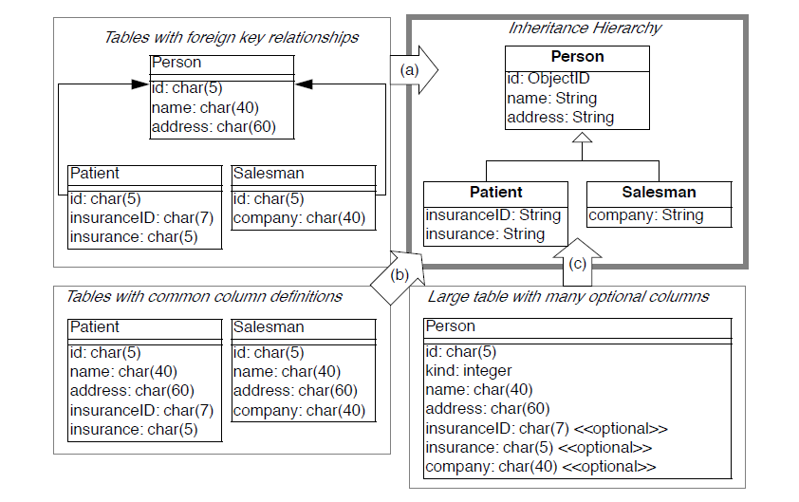
Analyze the Persistent Data
One to one inheritance.
  Check tables where the primary key also serves as a foreign key to another table, as such foreign keys may represent inheritance relationships.
  Analyze the table names and the corresponding source code to verify whether this foreign key indeed represents an inheritance relationship.
OORPT — Reverse Engineering
© Stéphane Ducasse, Serge Demeyer, Oscar Nierstrasz

Slide 12
Analyze the Persistent Data
Rolled down inheritance.
  Check tables with common sets of column definitions.
  Define a common superclass for each cluster of duplicated column definitions and move the corresponding attributes inside the new class.
  Check the source code for the name applicable for the newly created classes.
OORPT — Reverse Engineering
© Stéphane Ducasse, Serge Demeyer, Oscar Nierstrasz
Notes:
If rolled down inheritance is present this may imply duplication at the level of application source code

Slide 13
Analyze the Persistent Data
Rolled up inheritance.
  Check tables with many columns and lots of optional attributes as these may indicate a situation where a complete class hierarchy is represented in a single table.
  If SELECT statements explicitly request for subsets of the columns, then you may break this one class into several classes.
OORPT — Reverse Engineering
© Stéphane Ducasse, Serge Demeyer, Oscar Nierstrasz
Notes:
If rolled upinheritance is present this may imply god class at the level of application source code

Slide 14

Analyze the Persistent Data
Improves team communication.
Focus on valuable data.
Has limited scope.
Junk data.
Requires database expertise.
Lacks behavior.
OORPT — Reverse Engineering
© Stéphane Ducasse, Serge Demeyer, Oscar Nierstrasz

Slide 15
How do you recover the way design concepts are represented in the source-code?
Notes:
Why not use object aid ?? ☺ → there may be not tool the point is the learning process not getting a diagram per se →
here you build understanding and prepare a solution at the same time
A “huge” class diagram generated wont be of much help….once s/o did this for hecateos and could not even print it ☺
What do we know about UML ?? Maybe make quick test questions

Slide 16
Speculate about Design
Problem:
How do you recover the way design concepts are represented in the source-code?
Solution:
Develop hypotheses and check them
OORPT — Reverse Engineering
© Stéphane Ducasse, Serge Demeyer, Oscar Nierstrasz
Notes:
In the book -> verify the uml output of this later in speculate the design (along with everything else added in the diagram)

Slide 17
Speculate about Design
With your understanding of the system, develop a class diagram that serves as your initial hypothesis of what to expect in the source.
Enumerate the names in the class diagram (that is, names of classes, attributes and operations) and try to find them in the source code,
  Take care as names inside the source-code do not always match with the concepts they represent.
OORPT — Reverse Engineering
© Stéphane Ducasse, Serge Demeyer, Oscar Nierstrasz

Slide 18
Speculate about Design
Keep track of the names that appear in source code (confirm your hypothesis) and the names which do not match with identifiers in the source code (contradict your hypothesis).
  Mismatches are positive, as these will trigger the learning process that you must go through when understanding the system.
OORPT — Reverse Engineering
© Stéphane Ducasse, Serge Demeyer, Oscar Nierstrasz

Slide 19
Speculate about Design
Adapt the class diagram based on the mismatches.
  Renaming, when you discover that the names chosen in the source code do not match with your hypothesis;
  Remodeling, when you find out that the source-code representation of the design concept does not correspond with what you have in your model.
    For instance, you may transform an operation into a class, or an attribute into an operation.
  Extending, when you detect important elements in the source-code that do not appear in your class diagram.
  Seeking alternatives, when you do not find the design concept in the source-code.
Repeat until you obtain a class diagram that is satisfactory.
OORPT — Reverse Engineering
© Stéphane Ducasse, Serge Demeyer, Oscar Nierstrasz

Slide 20
Speculate about Design
Scales well for large projects.
Investment pays off in terms of resources.
Requires expertise.
Consumes much time.
Maintain consistency.
OORPT — Reverse Engineering
© Stéphane Ducasse, Serge Demeyer, Oscar Nierstrasz

Slide 21
How can you quickly identify design problems?
Notes:
What do we know about metrics ?
Maybe make a couple of quick questions…

Slide 22
Study the Exceptional Entities
Problem:
How can you quickly identify design problems?
Solution:
Measure software entities and study the anomalous ones
OORPT — Reverse Engineering
© Stéphane Ducasse, Serge Demeyer, Oscar Nierstrasz

Slide 23
Study the Exceptional Entities
Use simple metrics.
  Metrics variants usually do not make much difference.
  Better do not use thresholds.
An anomaly is not necessarily problematic.
  It is a good idea to simultaneously inspect different measurements for the same entity.
Visualize metrics to get an overview.
Browse the code to get insight into the anomalies.
Careful !! - Exceptional entities are quite often irrelevant as truly important code would have been refactored.
OORPT —
© Stéphane Ducasse, Serge Demeyer, Oscar Nierstrasz
Notes:
e.g. of mupliple metrics loc + lcom

Slide 24
Study the Exceptional Entities
Scales well.
Overview mode is appealing.
Results are inaccurate.
Missing priorities wrt severity of the problem.
Requires expertise.
OORPT — Reverse Engineering
© Stéphane Ducasse, Serge Demeyer, Oscar Nierstrasz

Slide 25



Attribution-ShareAlike 2.5
You are free:
to copy, distribute, display, and perform the work
to make derivative works
to make commercial use of the work
Under the following conditions:
  Attribution. You must attribute the work in the manner specified by the author or licensor.
  Share Alike. If you alter, transform, or build upon this work, you may distribute the resulting work only under a license identical to this one.
For any reuse or distribution, you must make clear to others the license terms of this work.
Any of these conditions can be waived if you get permission from the copyright holder.
Your fair use and other rights are in no way affected by the above.

