Slide 1
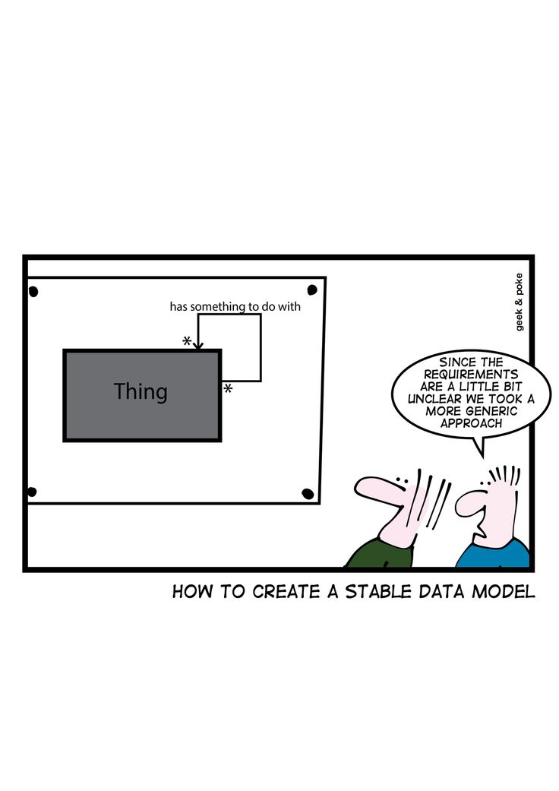
Software Modeling – UML www.cs.uoi.gr/~zarras/http://www.cs.uoi.gr/~zarras/se.htm
Slides material sources:
Lethbridge and Laganiere, Object-Oriented Software Engineering Practical Software Development using UML and Java, 2005

Slide 2
Use case diagrams

Slide 3
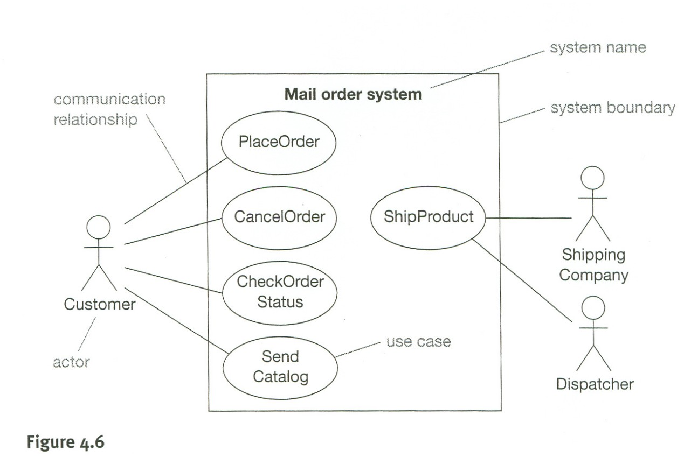

Slide 4
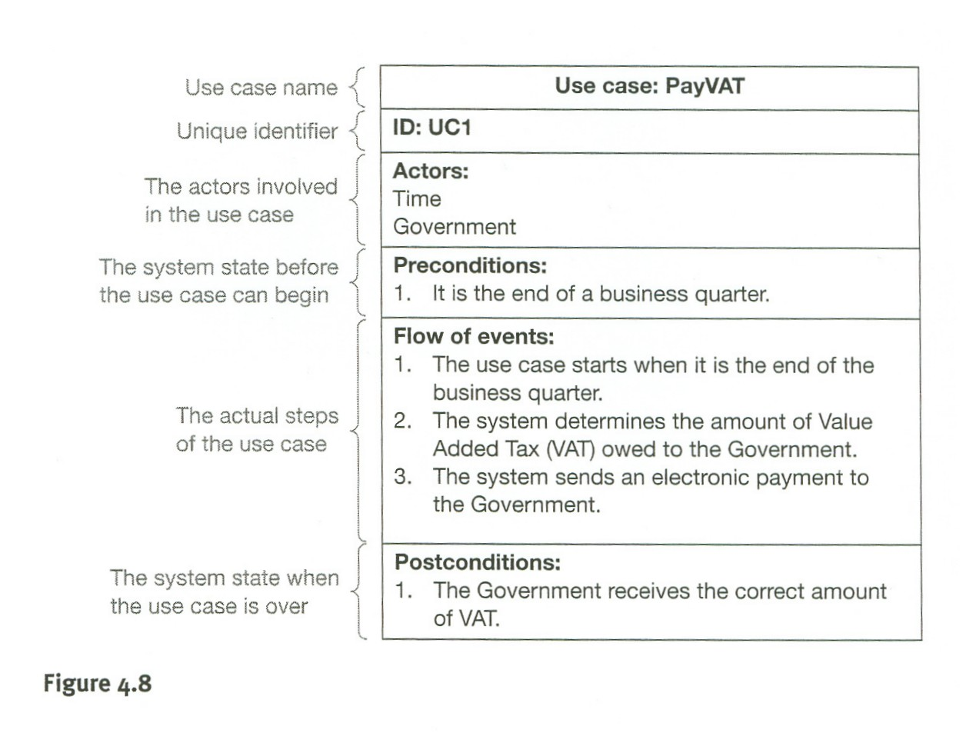
Company
Starts by the company at the end of a business quarter

Slide 5
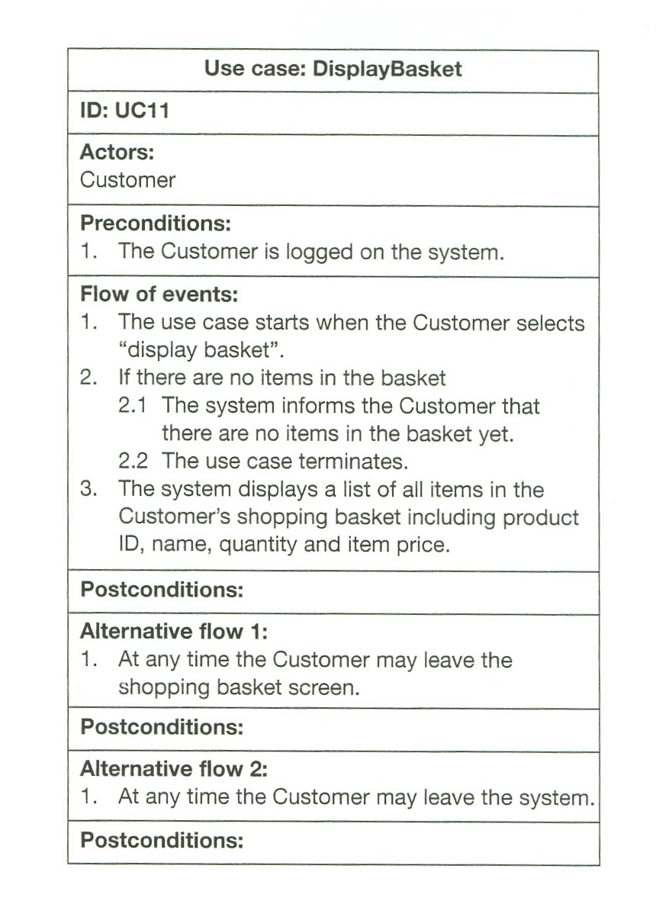
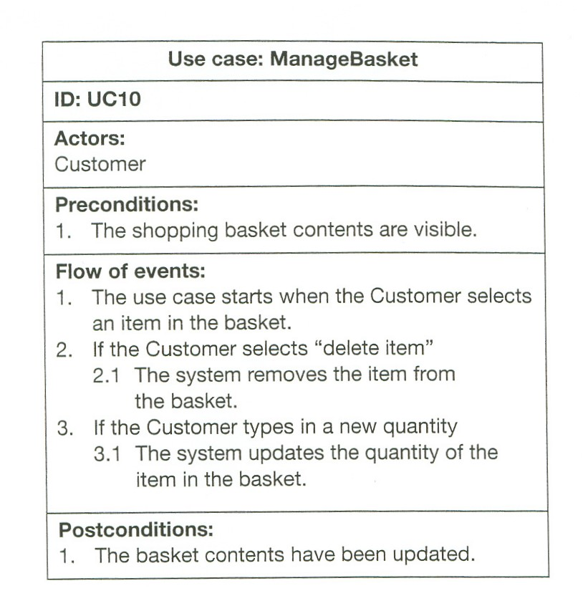
Branching in two ways
Branch that can happen sometime during the normal process – could be exceptional cases
Branch in the normal process
…..
…..
No change in the internal state.

Slide 6
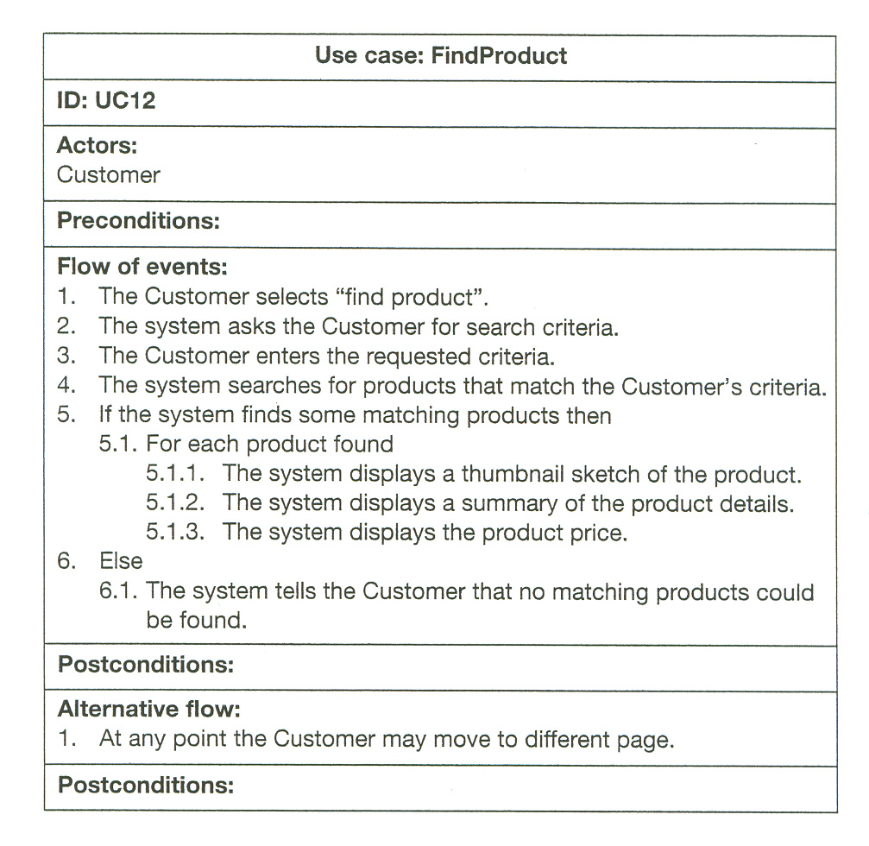
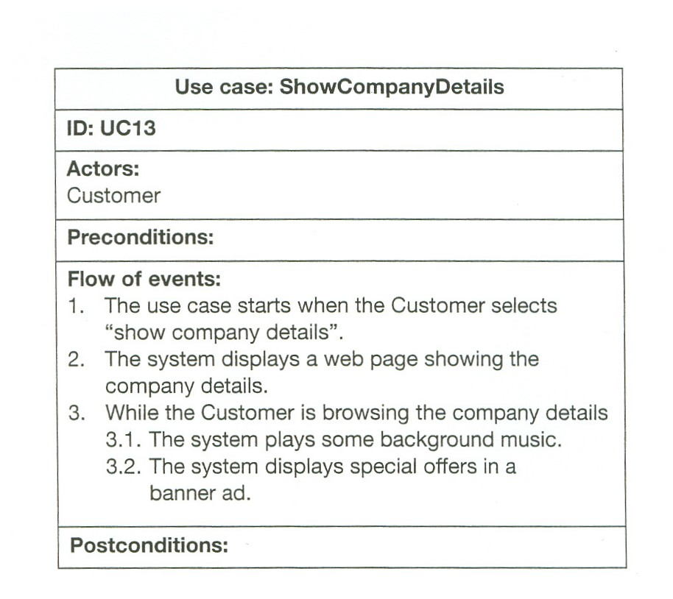
For and While within use cases (rarely, however)
The system is up and running
The system is up and running
No change in system state.
No change in the internal state of the system
No change in the internal state of the system

Slide 7
Package diagrams

Slide 8
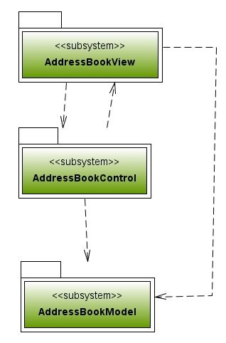
Packages logically group other elements (packages, classes, etc.)
A dependency from A to B means that A is based on functionality provided by B.
I also means that changing B may affect A.

Slide 9
Class diagrams

Slide 10
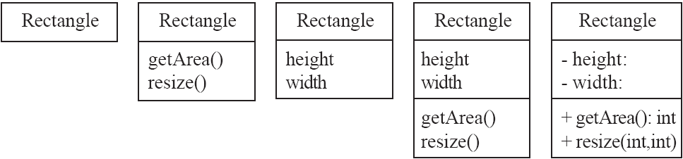
Classes
  operationName(parameterName: parameterType …): returnType
© Lethbridge/Laganière 2005

Slide 11
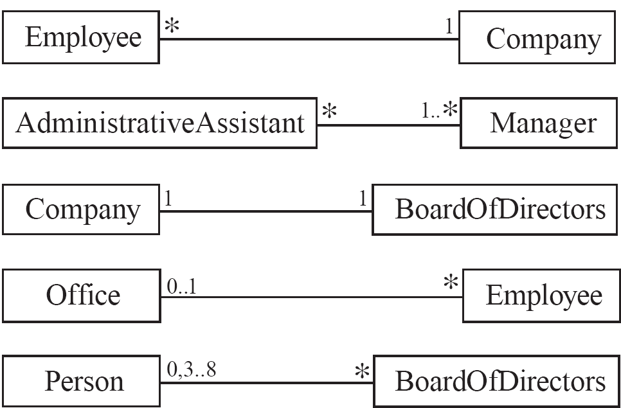
Associations & Multiplicity
An association is used to show how instances (objects) of two classes are related/collaborate to/with each other
  Symbols indicating multiplicity are shown at each end of the association
  *** in the implementation this relation could represent any form of interaction between objects that are created by other objects, passed as parameters to other objects etc.
© Lethbridge/Laganière 2005

Slide 12
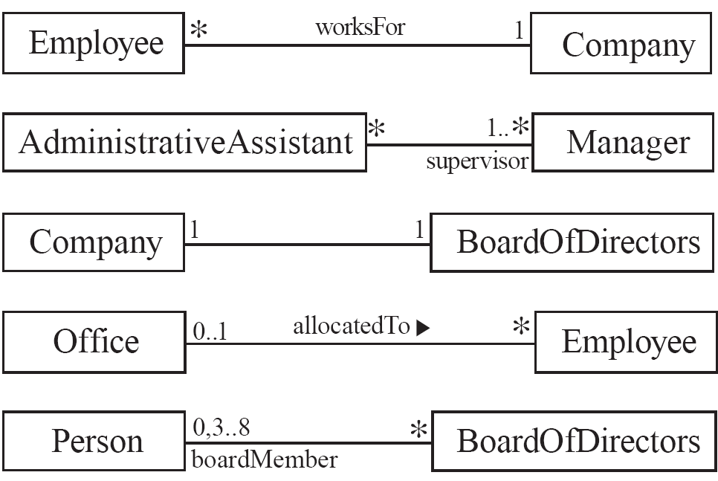
Labelling associations
  Each association can be labelled, to make explicit the nature of the association and the roles of the classes. Association name is in the middle, roles are depicted near the classes.
© Lethbridge/Laganière 2005

Slide 13
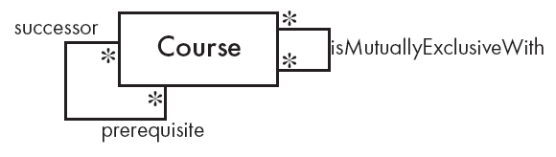
Reflexive associations
  It is possible for an association to connect a class to itself
© Lethbridge/Laganière 2005

Slide 14

Directionality in associations
Associations are by default bi-directional
It is possible to limit the direction of an association by adding an arrow at one end
It determines in more detail how instances refer to each other, Day objects refer to Note objects
© Lethbridge/Laganière 2005

Slide 15
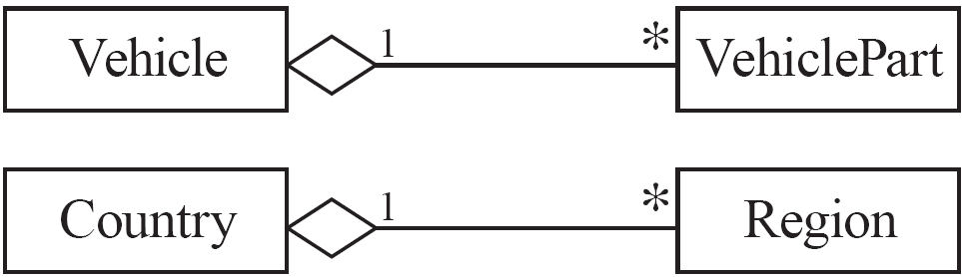
Aggregation
  Aggregations are special associations that represent ‘part-whole’ relationships.
  *** in the implementation the “parts” are typically class attributes of the “whole” class
    The ‘whole’ side is often called the assembly or the aggregate
    This symbol is a shorthand notation association named isPartOf
    In general, the parts may be shared among different assemblies/aggregates
    Technically the aggregate class has fields/attributes of the part class
Order
*
1
Address
Company
*
1
Address
© Lethbridge/Laganière 2005

Slide 16
class Order {
private Address addr;
private ……
……..
public Order(Address a) {
addr = a;
}
…..
}
class Address {
…….
……
}
main() {
Address a = new Address();
// two orders with a shared address
Order o1 = new Order(a);
Order o2 = new Order(a);
}

Slide 17

Composition
  A composition is a strong kind of aggregation
    The parts cannot be shared among different assemblies/aggregates
  *** in the implementation the “parts” are typically class attributes of the “whole” class
  How can we tell if not shared?
  The “parts” objects are created by the “whole”
  The “whole” does not provide ways (e.g. getters) for getting references to the “parts”
© Lethbridge/Laganière 2005

Slide 18
class Building {
private Room livingRoom;
private ……
……..
public Building() {
// creates its own rooms
livingRoom = new Room();
}
// buildings cant share references to the same rooms via getters/setters
…..
}
main() {
// Buildings can not have common rooms
Building b1 = new Building ();
Building b2 = new Building ();
}
class Room {
…….
……
}

Slide 19
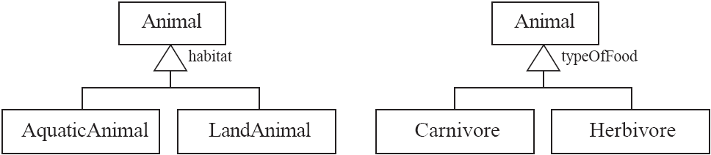
Generalization
Specializing a superclass into two or more subclasses
  A generalization set is a labelled group of generalizations with a common superclass
  The label (sometimes called the discriminator) describes the criteria used in the specialization
  *** in the implementation this is done by extension/inheritance
© Lethbridge/Laganière 2005

Slide 20
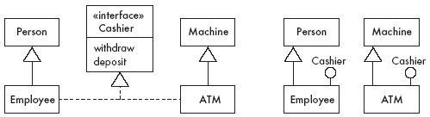
Interfaces
An interface describes a portion of the visible behaviour of a set of objects.
Note that conceptually ATM and Employee are not related somehow we have machines vs people … However with the interface we specify that some of the functionalities (a specific contract) they provide are the “same” and people and machines can play the same role – “cashier”
© Lethbridge/Laganière 2005

Slide 21
Sequence diagrams

Slide 22
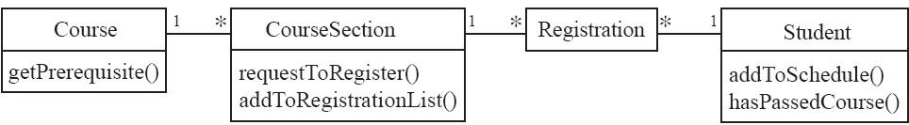
A class diagram does not tell us how do the class objects collaborate to realize a particular functionality/use case
© Lethbridge/Laganière 2005

Slide 23
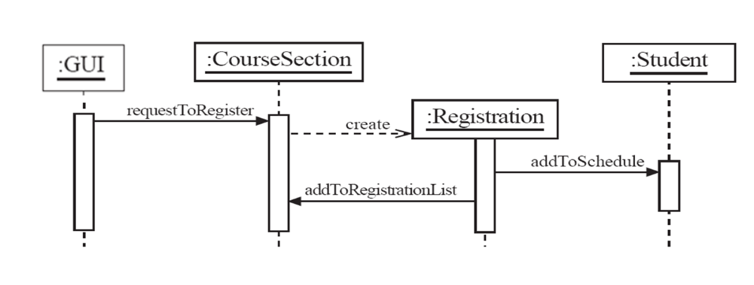

Basic interactions
Happen during execution of requestToRegister()
Rectangle represents the method execution
© Lethbridge/Laganière 2005

Slide 24
Basic interactions
Is it correct with respect to the class diagram???
© Lethbridge/Laganière 2005

Slide 25
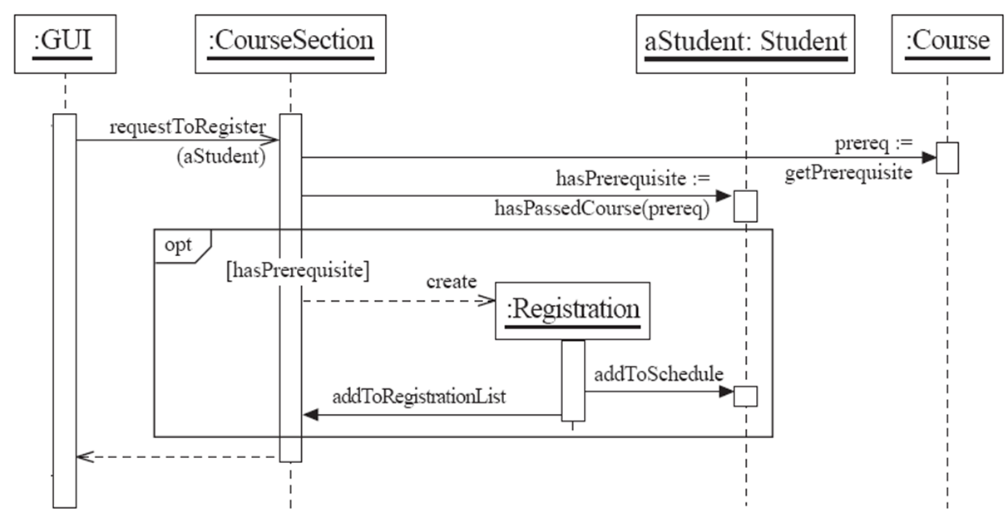
Alternative, optional interactions
© Lethbridge/Laganière 2005

Slide 26
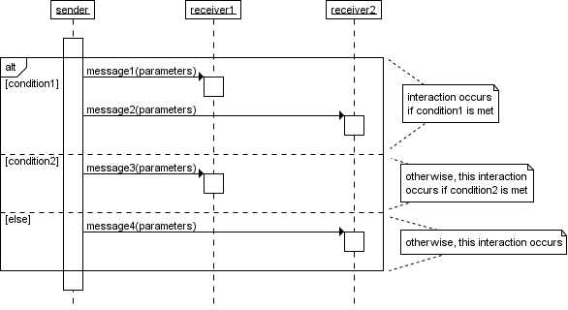
Alternative, optional interactions
Similarly can use an [alt] construct to show alternative flows
http://www.tracemodeler.com/articles/a_quick_introduction_to_uml_sequence_diagrams/

Slide 27
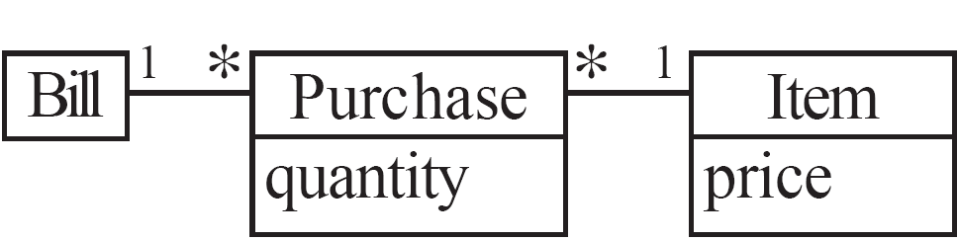
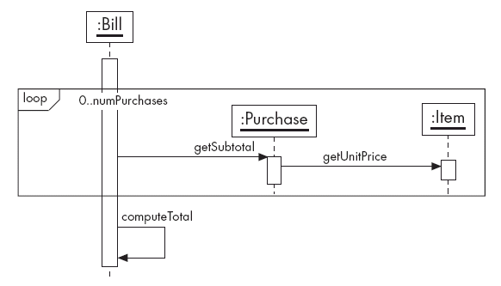

Iterative interactions
computeTotal
© Lethbridge/Laganière 2005

Slide 28
More on UML diagrams ….

Slide 29
Use Case Diagrams - Advanced Features

Slide 30
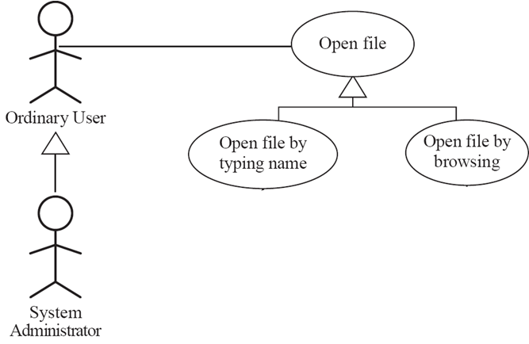
Use case and Actor specializations
Refines an abstract step of Open File
Refines an abstract step of Open File
Notes:
If we have a complex flow we can split to more use cases that are included in, OR extend, the main use case

Slide 31
Use case: Open file
ID:UC1
Actors:
Ordinary User
Related use cases:
Generalization of:
• Open file by typing name
• Open file by browsing
Pre conditions: The application is up and running
Basic Flow:
  The use case starts when the user chooses the “Open” command
  The file open dialog appears.
  The user specifies a file name
  The user confirms the selection
  The file open dialog disappears
Post conditions: The contents of the file are available to the user for further processing

Slide 32
Use case: Open file by typing name
ID:UC2
Actors:
Ordinary User
Related use cases: Specialization of: Open file
Pre conditions: The application is up and running
Basic Flow:
  The use case starts when the user chooses the “Open” command
  The file open dialog appears.
  The user specifies a file name
    The user selects the text field
    The user types the file name
  The user confirms the selection
  The file open dialog disappears
Post conditions: The contents of the file are available to the user for further processing
Alternative flow:
  A file not found exception is raised by the system
  The application indicates the file the user specified does not exist
  The user corrects the file name in the text field
Post conditions: The use case continues from step 4 of the main flow

Slide 33
Use case: Open file by browsing
ID:UC4
Actors:
Ordinary User
Related use cases: Specialization of: Open file
Pre conditions: The application is up and running
Basic Flow:
  The use case starts when the user chooses the “Open” command
  The file open dialog appears.
  The user specifies a file name
    While the desired file is not displayed in the files list of the file browser
      The user selects a directory from the list
      The application displays the contents of the directory in the files list
    The user selects the desired file
  The user confirms the selection
  The file open dialog disappears
Post conditions: The contents of the file are available to the user for further processing

Slide 34
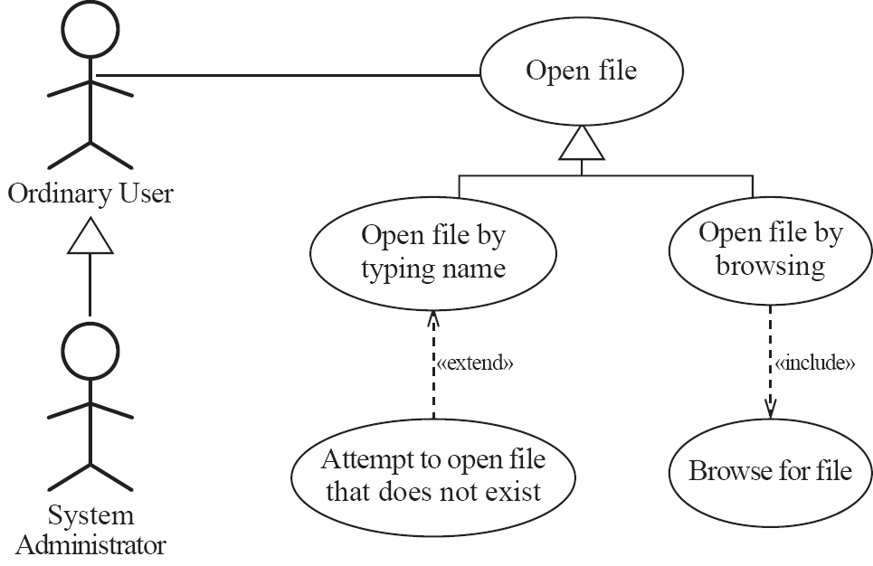
Refines an abstract step of Open File
Refines an abstract step of Open File
Describes a part of the normal flow that is complex OR used in >1 use cases and can stand as a separate use case
Describes a branching flow that is complex OR used in >1 use cases and can stand as a separate use case
Notes:
If we have a complex flow we can split to more use cases that are included in, OR extend, the main use case

Slide 35
Use case: Open file by typing name
ID:UC2
Actors:
Ordinary User
Related use cases:
Specialization of: Open file
Extended by: Attempt to open file that does not exist
Pre conditions: The application is up and running
Basic Flow:
  The use case starts when the user chooses the “Open” command
  The file open dialog appears.
  The user specifies a file name
    The user selects the text field
    The user types the file name
  The user confirms the selection
  The file open dialog disappears
Post conditions: The contents of the file are available to the user for further processing
Alternative flow:
Attempt to open file that does not exist

Slide 36
Use case: Attempt to open file that does not exist
ID:UC3
Actors:
Ordinary User
Related use cases:
Extension of: Open file by typing name
Pre conditions: The user executes UC2
Basic Flow:
  A file not found exception is raised
  The application indicates the file the user specified does not exist
  The user corrects the file name in the text field
Post conditions: The main flow of UC2 continues at step 4

Slide 37
Use case: Open file by browsing
ID:UC4
Actors:
Ordinary User
Related use cases:
Specialization of: Open file
Includes: Browse for file
Pre conditions: The application is up and running
Basic Flow:
  The use case starts when the user chooses the “Open” command
  The file open dialog appears.
  The user specifies a file name
    Browse for file
  The user confirms the selection
  The file open dialog disappears
Post conditions: The contents of the file are available to the user for further processing

Slide 38
Use case: Browse for file
ID:UC5
Actors:
Ordinary User
Related use cases:
Included by: Open file by browsing
Pre conditions: The application is up and running
Basic Flow:
  The use case starts at step 3 of UC4
  While the desired file is not displayed in the files list of the file browser
    The user selects a directory from the list
    The application displays the contents of the directory in the files list
  The user selects the desired file
Post conditions: UC 4 continues at step 4

Slide 39
State diagrams

Slide 40
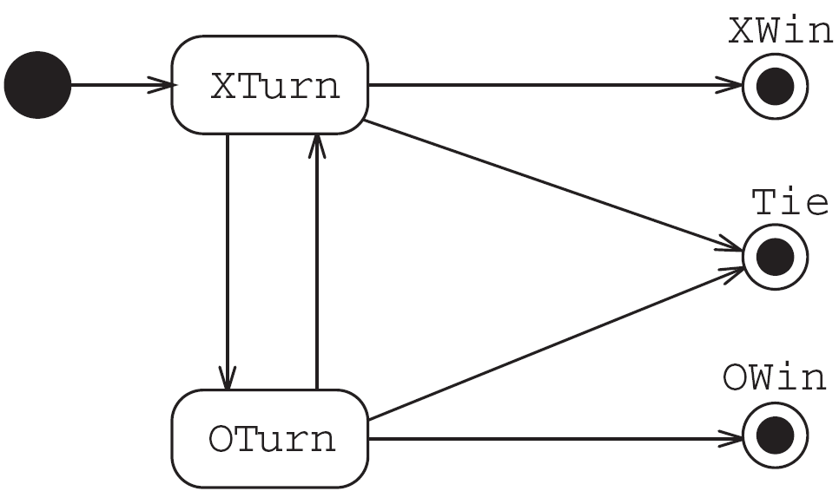
State diagrams
  Can be used to describe an automaton at the requirements level or at design/implementation level (how does a class works)
  tic-tac-toe game (also called noughts and crosses)
Requirements specification for the game
© Lethbridge/Laganière 2005

Slide 41
States
  At any given point in time, the system/object is in one state.
  A state is represented by a rounded rectangle containing the name of the state.
  Special states:
    A black circle represents the start state
    A circle with a ring around it represents an end state
© Lethbridge/Laganière 2005

Slide 42
Transitions, actions, activities
  A transition represents a change of state in response to an event.
    It is considered to occur instantaneously.
  The transition may be labeled :
    trigger is the cause of the transition, which could be a signal, an event, a change in some condition, or the passage of time.
    guard is a condition which must be true in order for the trigger to cause the transition.
    action is an action which will be invoked directly on the object that is described by the state machine as a result of the transition.
  [trigger] [guard] / [action]

Slide 43
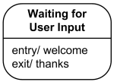
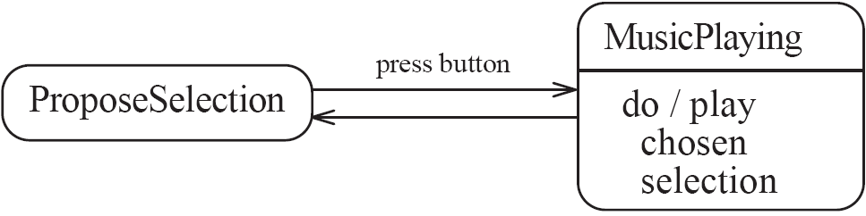
Transitions, actions, activities
A state may have an associated entry behavior. This behavior, if defined, is executed whenever the State is entered.
A state may also have an associated exit behavior, which, if defined, is executed whenever the state is exited.
A State may also have an associated doActivity behavior. This behavior commences execution when the state is entered (but only after the state entry behavior has completed) and executes until it completes or the state is exited.

Slide 44
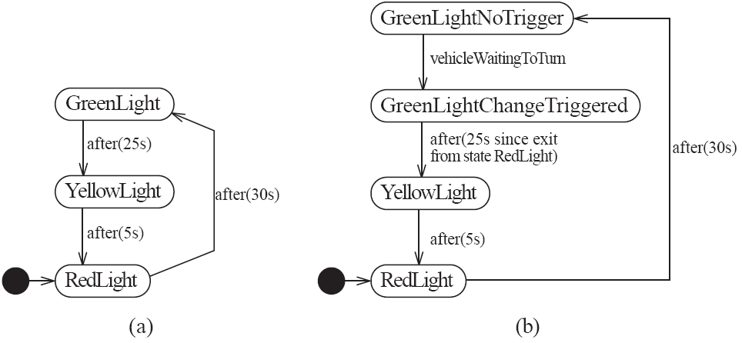
Time-outs and conditions
e.g. traffic light control logic
© Lethbridge/Laganière 2005

Slide 45
Activity diagrams

Slide 46
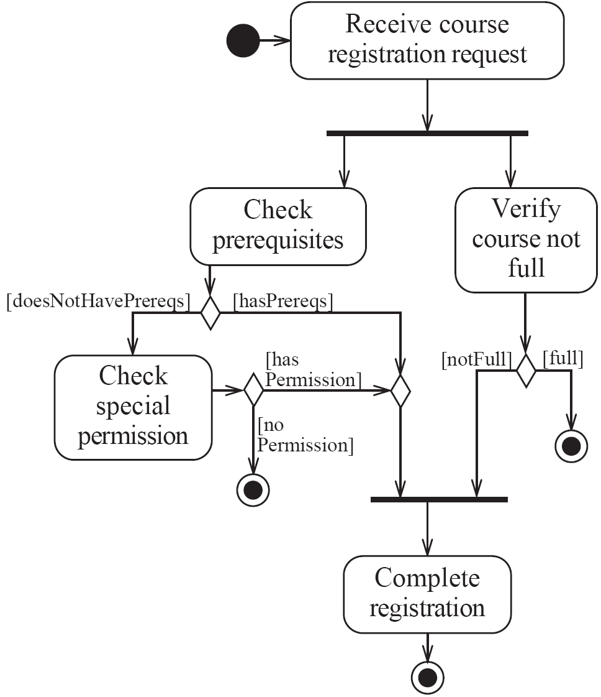
Activity Diagrams
  An activity diagram is typically used for process/algorithm modelling
  One of the strengths of activity diagrams is the representation of concurrent activities.
© Lethbridge/Laganière 2005

Slide 47
Representing concurrency
  Concurrency is shown using forks, joins and rendezvous.
    A fork has one incoming transition and multiple outgoing transitions.
      The execution splits into two concurrent threads.
    A join has multiple incoming transitions and one outgoing transition.
      The outgoing transition will be taken when all incoming transitions have occurred.
      The incoming transitions occur in separate threads.
      If one incoming transition occurs, a wait condition occurs at the join until the other transitions occur.
    A rendezvous has multiple incoming and multiple outgoing transitions.
      Once all the incoming transitions occur all the outgoing transitions may occur.
© Lethbridge/Laganière 2005

Slide 48
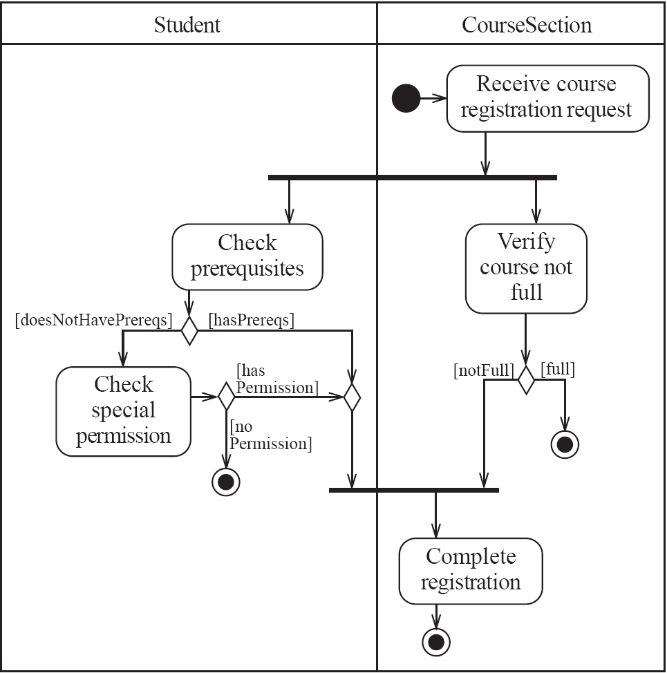
Swimlanes
Activity diagrams are most often associated with objects of several classes.
  The partition of activities among the existing classes can be explicitly shown using swimlanes.
© Lethbridge/Laganière 2005

