Slide 1
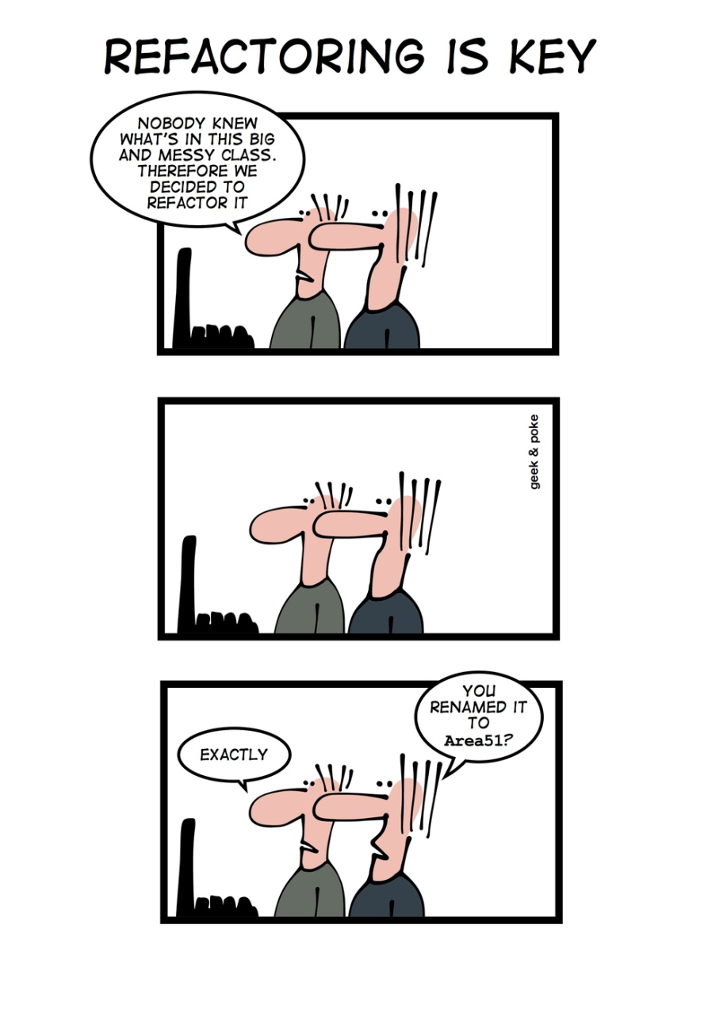
Redistribute Responsibilities www.cs.uoi.gr/~zarras/ Course URL
from OO Reengineering Patterns by Demeyer, Ducasse, Nierstrasz

Slide 2
The Reengineering Life-Cycle
(0) requirement
analysis
Requirements
(2) problem
detection
(3) problem
resolution
Designs
(1) model
capture
Code
(4) program transformation
OORPT —
© Stéphane Ducasse, Serge Demeyer, Oscar Nierstrasz

Slide 3
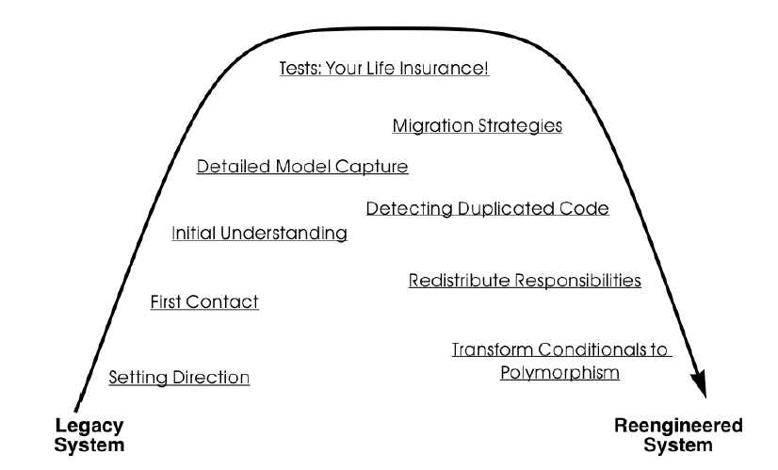
A Map of Reengineering Patterns
OORPT —
© Stéphane Ducasse, Serge Demeyer, Oscar Nierstrasz

Slide 4
Forces — Redistribute Responsibilities
Data containers (objects that just provide access to data, but no behavior) are a simple and convenient way to share information between many subsystems.
  Among others, data containers are the easiest way to provide access to database entities.
  However, data containers expose the data representation, hence are difficult to change when many application components depend on them.
  Consequently, a proliferation of data containers leads to fragile navigation code in the implementation of business logic.
OORPT —
© Stéphane Ducasse, Serge Demeyer, Oscar Nierstrasz

Slide 5
Forces — Redistribute Responsibilities
Many designers received a training in functional decomposition. But, functional decomposition tends to generate god classes.
  God classes are hard to extend, modify or subclass because such changes affect large numbers of other methods or instance variables.
OORPT —
© Stéphane Ducasse, Serge Demeyer, Oscar Nierstrasz

Slide 6
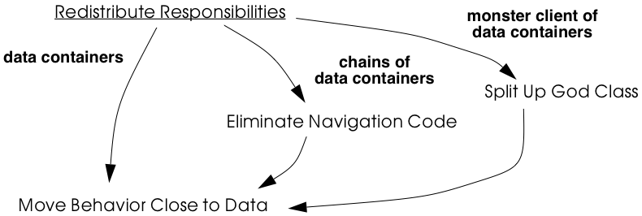
Redistribute Responsibilities

Slide 7
How do you transform a data container into a service provider?

Slide 8
Move Behavior Close to Data
Problem:
How do you transform a data container into a service provider?
Solution:
Move behavior defined by indirect clients to the class defining the data they manipulate
OORPT —
© Stéphane Ducasse, Serge Demeyer, Oscar Nierstrasz

Slide 9
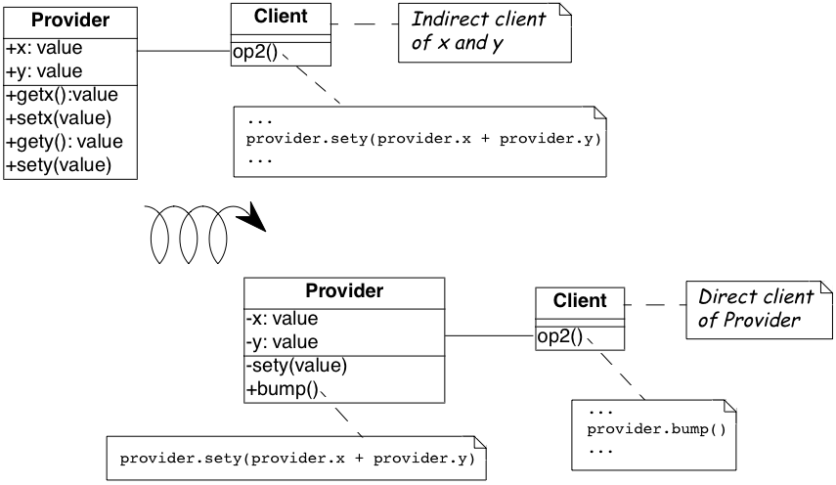
Move Behavior Close to Data

Slide 10
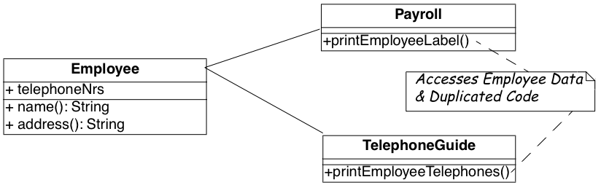
Move Behavior Close to Data
OORPT —
© Stéphane Ducasse, Serge Demeyer, Oscar Nierstrasz

Slide 11
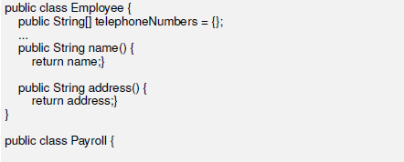
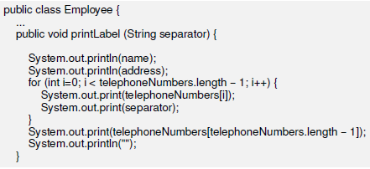
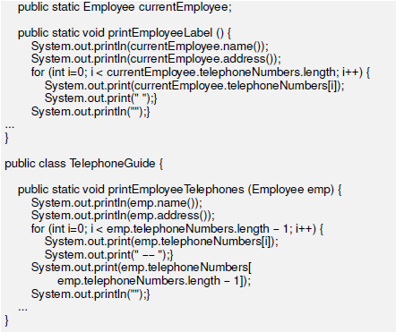
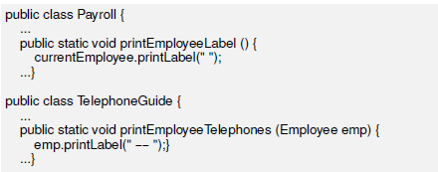
Move Behavior Close to Data
Before
After
OORPT —
© Stéphane Ducasse, Serge Demeyer, Oscar Nierstrasz

Slide 12
OORPT —
© Stéphane Ducasse, Serge Demeyer, Oscar Nierstrasz

Slide 13
Move Behavior Close to Data
OORPT —
© Stéphane Ducasse, Serge Demeyer, Oscar Nierstrasz
Notes:
Watch how it handles separator issue wrt the condition in the for loop – it keeps the second version of the algorithm

Slide 14
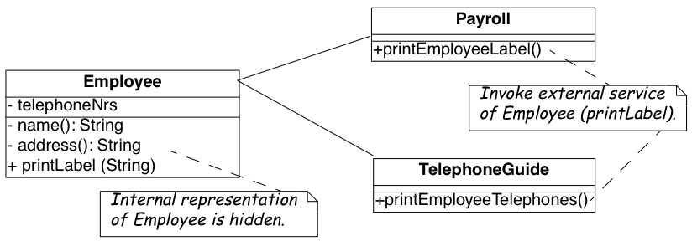
Move Behavior Close to Data
OORPT —
© Stéphane Ducasse, Serge Demeyer, Oscar Nierstrasz

Slide 15

Move Behavior Close to Data
Look for data containers, i.e., classes defining mostly public accessor methods and few behavior methods.
  i.e., the number of methods is approximately 2 times larger than the number of attributes.
Methods in client classes that invoke a sequence of accessor methods.
Duplicated client code that manipulates provider.
OORPT —
© Stéphane Ducasse, Serge Demeyer, Oscar Nierstrasz

Slide 16
Move Behavior Close to Data
Identify the client behavior that you want to move, i.e., the complete method or a part of a method that accesses provider data.
  If this this is a part of a method extract new method with intention revealing name.
Move the method in the provider class, if it does not already exist.
  Be sure to check that moving the code will not introduce any naming conflicts.
OORPT —
© Stéphane Ducasse, Serge Demeyer, Oscar Nierstrasz

Slide 17
Move Behavior Close to Data
Clean up the client code.
  Invoke new provider method with correct parameters.
  May need to deprecate moved method (Deprecate Obsolete Interfaces)
  It may be the case that the calling methods defined on the same object have to be also moved to the provider. In such a case repeat the steps for the methods.
OORPT —
© Stéphane Ducasse, Serge Demeyer, Oscar Nierstrasz

Slide 18
Move Behavior Close to Data
Repeat for multiple clients.
  In case many similar methods are introduced to the provider, consider:
    Factoring out the duplicated fragments as protected helper methods.
    Parameterization to unify similar code fragments.
OORPT —
© Stéphane Ducasse, Serge Demeyer, Oscar Nierstrasz

Slide 19
Move Behavior Close to Data
The legacy solution can be OK in the following cases:
  Visitor classes typically define behavior that acts on another class.
  Configuration classes (global settings, language dependent information..).
  Mapping classes between objects database representation.
OORPT —
© Stéphane Ducasse, Serge Demeyer, Oscar Nierstrasz
Notes:
Mapping can be done with frameworks

Slide 20

Move Behavior Close to Data
Data containers become service providers.
Clients are less sensitive to changes of the provider.
Code duplication in the system decreases.
The interface of the provider gets more complex.
Some classes like Stream or Set are really designed as data providers.
  ➔ Can consider defining a new provider class that wraps an instance of the data provider and holds the associated behavior.
OORPT —
© Stéphane Ducasse, Serge Demeyer, Oscar Nierstrasz

Slide 21
How do you reduce the coupling due to classes that navigate through the object graph?

Slide 22
Eliminate Navigation Code
Problem:
How do you reduce the coupling due to classes that navigate through the object graph?
Solution:
Iteratively move behavior close the data.
OORPT —
© Stéphane Ducasse, Serge Demeyer, Oscar Nierstrasz

Slide 23
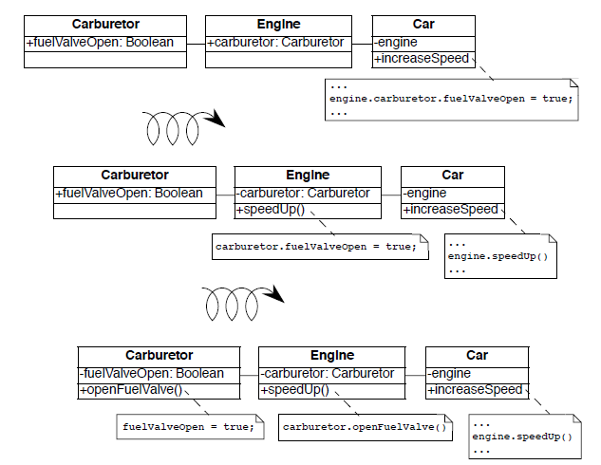
Eliminate Navigation Code
OORPT —
© Stéphane Ducasse, Serge Demeyer, Oscar Nierstrasz

Slide 24
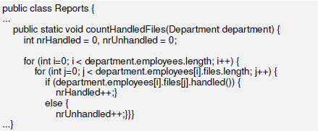
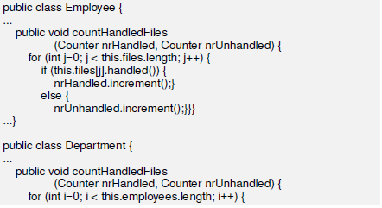
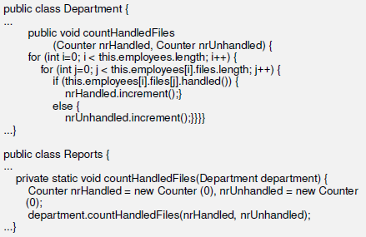
Eliminate Navigation Code
Before
After 2nd move
After 1st move
OORPT —
© Stéphane Ducasse, Serge Demeyer, Oscar Nierstrasz
Notes:
NOTE the countHandled files with the 2 parameters is not clean. Better have 2 different methods and turn the conditional if else to a simple if

Slide 25
Eliminate Navigation Code
OORPT —
© Stéphane Ducasse, Serge Demeyer, Oscar Nierstrasz
Notes:
NOTE the countHandled files with the 2 parameters is not clean. Better have 2 different methods and turn the conditional if else to a simple if

Slide 26
Eliminate Navigation Code
OORPT —
© Stéphane Ducasse, Serge Demeyer, Oscar Nierstrasz
Notes:
NOTE the countHandled files with the 2 parameters is not clean. Better have 2 different methods and turn the conditional if else to a simple if

Slide 27
Eliminate Navigation Code
OORPT —
© Stéphane Ducasse, Serge Demeyer, Oscar Nierstrasz
Notes:
NOTE the countHandled files with the 2 parameters is not clean. Better have 2 different methods and turn the conditional if else to a simple if

Slide 28
Eliminate Navigation Code
Look for indirect providers:
  Big aggregation hierarchies containing mostly data classes often play the role of indirect provider.
  Classes that contain a lot public attributes, accessor methods or methods returning as value attributes of the class.
OORPT —
© Stéphane Ducasse, Serge Demeyer, Oscar Nierstrasz

Slide 29
Eliminate Navigation Code
Look for indirect clients that contain a lot of navigation code.
Navigation code is of two kinds:
  A sequence of attribute accesses, e.g.,a.b.c.d where b is an attribute of a, c is an attribute of b and d an attribute of c.
  A sequence of accessor method calls.
Navigation code can be detected by simple pattern matching.
But should filter out sequences of calls converting one object to another one.
OORPT —
© Stéphane Ducasse, Serge Demeyer, Oscar Nierstrasz

Slide 30
Eliminate Navigation Code
The recipe for eliminating navigation code is to recursively Move Behavior Close to Data.
Identify the navigation code to move.
Apply Move Behavior Close to Data to remove one level of navigation.
  (At this point regression tests should run.)
Repeat, if necessary.
OORPT —
© Stéphane Ducasse, Serge Demeyer, Oscar Nierstrasz

Slide 31
Eliminate Navigation Code
The legacy solution can be OK in the following cases:
  Navigation code may be ok if objects should be graphically presented or mapped to a database.
  Brokers or object servers are special objects returning objects.
OORPT —
© Stéphane Ducasse, Serge Demeyer, Oscar Nierstrasz
Notes:
Mapping to db is no longer needed it is done by frame works… same for view construction logic

Slide 32
Eliminate Navigation Code
Chains of dependencies between classes are eliminated, so changes will impact fewer clients.
Functionality that was implicit in the system is now named and explicitly available to new clients.
The systematic application of Eliminate Navigation Code may lead to large interfaces.
OORPT —
© Stéphane Ducasse, Serge Demeyer, Oscar Nierstrasz

Slide 33
How to break a class that assumes too many responsibilities?

Slide 34
Split Up God Class
Problem:
How to break a class that assumes too many responsibilities?
Solution:
Incrementally redistribute the responsibilities of the god class either to its collaborating classes or to new classes that are pulled out the god class.
When there is nothing left of the god class but a façade/middle-man, remove or deprecate the facade.
OORPT —
© Stéphane Ducasse, Serge Demeyer, Oscar Nierstrasz

Slide 35
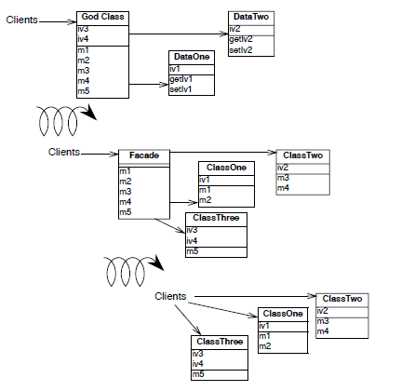
OORPT —
© Stéphane Ducasse, Serge Demeyer, Oscar Nierstrasz
Notes:
1. Identify cohesive subsets of instance variables of the god class, and
convert them to external data containers. Change the initialization
methods of the god class to refer to instances of the new data containers.
2. Identify all classes used as data containers by the god class (including
those created in step 1) and apply Move Behavior Close to Data
to promote the data containers into service providers. The original
methods of the god class will simply delegate behavior to the moved
methods.
3. After iteratively applying steps 1 and 2, there will be nothing left of
the god class except a facade with a big initialization method. Shift
the responsibility for initialization to a separate class, so only a pure
facade is left. Iteratively redirect clients to the objects for which the
former god class is now a facade, and either deprecate the facade
(see Deprecate Obsolete Interfaces [p. 215]), or simply remove it.

Slide 36
Split Up God Class
A single huge class treats many other classes as data structures.
A “root” class or other huge class has a name containing words like “System”, “Subsystem”, “Manager”, “Driver”, or “Controller”.
OORPT —
© Stéphane Ducasse, Serge Demeyer, Oscar Nierstrasz

Slide 37
Split Up God Class
(Divergent change) Changes to the system always result in changes to the same class.
Changes to the class are extremely difficult because you cannot identify which parts of the class they affect.
Reusing the class is nearly impossible because it covers too many design concerns.
OORPT —
© Stéphane Ducasse, Serge Demeyer, Oscar Nierstrasz

Slide 38
Split Up God Class
The class has an unrelated set of methods working on separated instance variables.
  The cohesiveness of the class is usually low.
The class requires long compile times, even for small modifications.
The class is difficult to test due to the many responsibilities it assumes.
The class uses a lot of memory.
OORPT —
© Stéphane Ducasse, Serge Demeyer, Oscar Nierstrasz
Notes:
• a single huge class treats many other classes as data structures.
• a “root” class or other huge class has a name containing words like
“System”, “Subsystem”, “Manager”, “Driver”, or “Controller”.
• changes to the system always result in changes to the same class.
• changes to the class are extremely difficult because you cannot identify
which parts of the class they affect.
• reusing the class is nearly impossible because it covers too many design
concerns.
• the class is a domain class holding the majority of attributes and
methods of a system or subsystem. (Note that the threshold is not
absolute because some UI frameworks produce big classes with lots
of methods, and some database interface classes may need a lot of
attributes).
• the class has an unrelated set of methods working on separated instance
variables. The cohesiveness of the class is usually low.
• the class requires long compile times, even for small modifications.
• the class is difficult to test due to the many responsibilities it assumes.
• the class uses a lot of memory.
• people tell you: “This is the heart of the system”.
• when you ask for the responsibility of a god class you get various,
long and unclear answers.
• god classes are the nightmare of maintainers, so ask what classes are
huge and difficult to maintain. Ask what is the class they would
not like to work on. (Variant: Ask people to choose which class they
want to work on. The one that everybody avoids may be a god class.)

Slide 39
Split Up God Class
People tell you: “This is the heart of the system”.
When you ask for the responsibility of a god class you get various, long and unclear answers.
God classes are the nightmare of maintainers, so ask what classes are huge and difficult to maintain. Ask what is the class they would not like to work on.
  (Variant: Ask people to choose which class they want to work on. The one that everybody avoids may be a god class.)
OORPT —
© Stéphane Ducasse, Serge Demeyer, Oscar Nierstrasz

Slide 40
Split Up God Class
Identify cohesive subsets of instance variables of the god class, and convert them to external data containers.
Identify all classes used as data containers by the god class (including those created in step 1) and apply Move Behavior Close to Data. The original methods of the god class will simply delegate behavior to the moved methods.
OORPT —
© Stéphane Ducasse, Serge Demeyer, Oscar Nierstrasz

Slide 41
Split Up God Class
After iteratively applying steps 1 and 2, there will be nothing left of the god class except a middle man (facade).
  Iteratively redirect clients to the objects for which the former god class is now a facade, and either deprecate the façade (see Deprecate Obsolete Interfaces), or simply remove it.
OORPT —
© Stéphane Ducasse, Serge Demeyer, Oscar Nierstrasz

Slide 42
Split Up God Class
Application control is no longer centralized.
The design evolves from a procedural design towards an object-oriented design.
Parts of the original god class are easier to understand and to maintain.
Overall compilation time may be reduced due to the simplification of system dependencies.
Splitting up a god class is a long, slow and tedious process.
Maintainers will no longer be able to go to a single god class to locate behavior to fix.
The number of classes will increase.
OORPT —
© Stéphane Ducasse, Serge Demeyer, Oscar Nierstrasz

Slide 43
Large Class

Slide 44
Large Class
Symptoms
Large number of instance variables
Large number of methods
Large number of lines
Causes
A little bit at a time. The author adds “one more capability” to a class, and eventually it grows too big.
Sometimes the problem is a lack of insight into the parts that make up the whole class.
In any case, the class represents too many responsibilities folded into one object.

Slide 45
Large Class
What to Do
In general, you’re trying to break up the class.
If the class has Long Methods, address that smell first.
To break up the class, three approaches are most common:
Extract Class, if you can identify a new object that has part of this class’s responsibilities
Extract Subclass, if you can divide responsibilities between the class and a new subclass
Extract Interface, if you can identify subsets of features that clients use.
Payoff
Improves communication, may expose duplication.

Slide 46
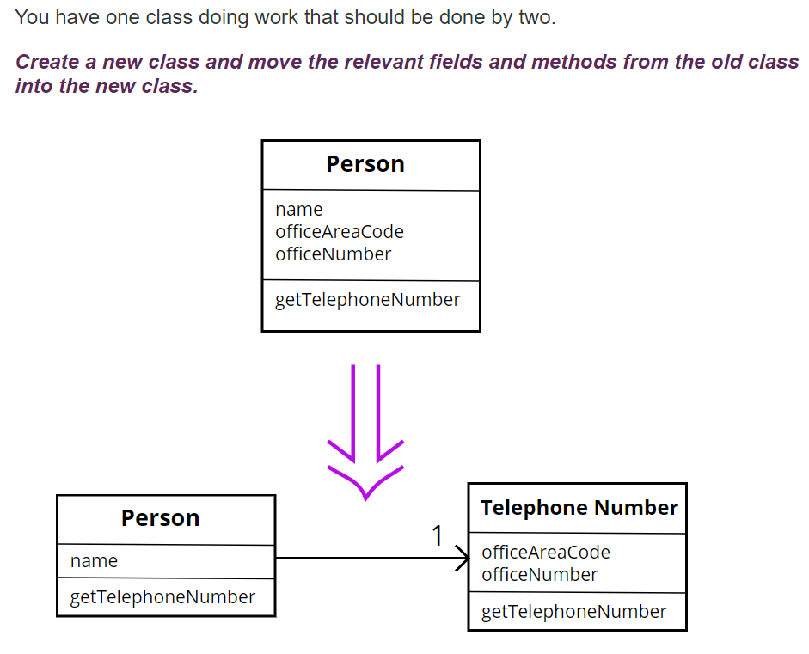
Extract Class

Slide 47
Extract Class
In practice, classes grow.
You add some operations here, a bit of data there. You add a responsibility to a class feeling that it's not worth a separate class, but as that responsibility grows and breeds, the class becomes too complicated.
Such a class is one with many methods and quite a lot of data. A class that is too big to understand easily.
You need to consider where it can be split, and you split it.
A good sign is that a subset of the data and a subset of the methods seem to go together. Other good signs are subsets of data that usually change together or are particularly dependent on each other.

Slide 48
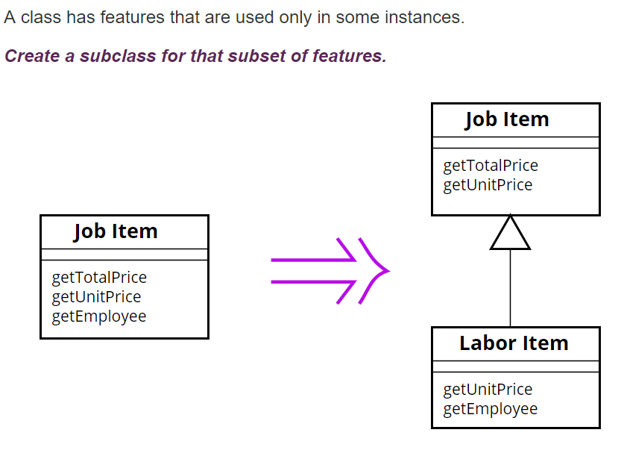
Extract Subclass

Slide 49
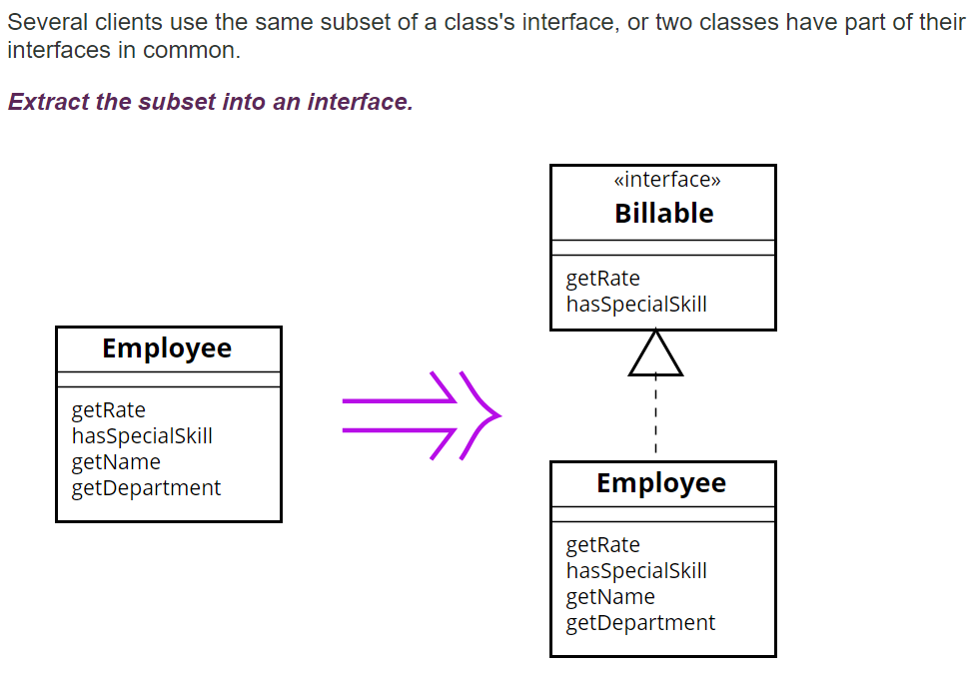
Extract Interface
Notes:
How does this reduce size?? (in the intro of large class we had loc, nom, noa)

Slide 50
Extract Interface
Classes use each other in several ways.
Use of a class often means ranging over the whole area of responsibilities of a class.
Another case is use of only a particular subset of a class's responsibilities by a group of clients.
For the second case it is often useful to define an interface for the subset of responsibilities.
That way it is easier to see how the responsibilities of a class divide wrt how they are used by other classes and the different roles played by the class

Slide 51
Visitor

Slide 52
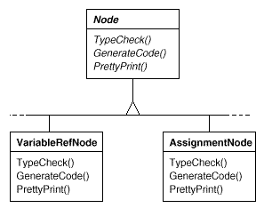

Visitor
The Abstract Syntax Tree (AST) of the program is a multi purpose data structure with many
unrelated operations
Notes:
Program:
For each node in nodes
node.typeCheck();
node.generateCode();
node.prettyPrint();

Slide 53
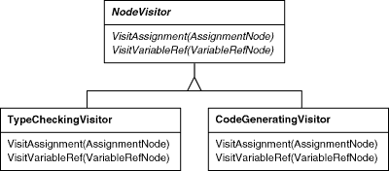
Visitor
Instead we can have a
class for each group
of related operations,
each for a different
concrete element
Group type checking
methods
Group code generation
methods

Slide 54
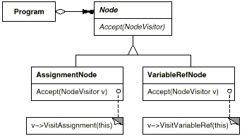
Visitor
We want to simulate the (original) polymorphic (visiting) method calls to the AST nodes that we would have if we havent used the pattern !!!
The AST of the program
The program has a list of Node objects … does not want to check the type
of each node so as to cast it and call the right operation on the visitor object
With the accept() operation it lets the node itself choose the right operation.
Notes:
Program:
For each node in nodes
node.accept(typeCheckingVisitor);
node.accept(codeGeneratingVisitor);
node.accept(prettyPrintingVisitor);

Slide 55
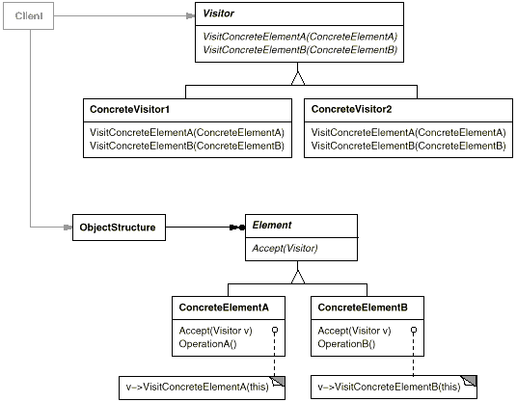
Visitor
Intent
Visitor lets you define a new operation without changing the classes of the elements on which it operates.
Applicability
Many distinct and unrelated operations need to be performed on objects in an object structure, and you want to avoid "polluting" their classes with these operations.
The classes defining the object structure rarely change, but you often want to define new operations over the structure

Slide 56
Visitor
Notes:
Iterate over a collection of elements and do some new work (eg transform the data to xml, draw all shapes wrt each shape coordinates, fidd shape with maximum area (so have to add area method to each concrete element, … )

Slide 57
Instead of having methods spread in the different element classes,
We group the methods that implement an operation by processing different element classes data into the same Visitor class
Visit1();
Visit2();
…
Operation1();
Operation2();
…
Visit1();
Visit2();
…
Visit1();
Visit2();
…
Notes:
An object structure is associated with a number of elements that may be of different concrete element classes
The idea is based on 2 key points
* Instead of having methods spread in the different element classes, you group the methods that implement an operation by processing different element classes data into the same class
** you don’t want the object structure OR the client to call directly the visit operations passing them the constituent element objects because the object structure would have to be coupled with all of the concrete element classes. Instead we let the elements themselves choose the right visit operation. How ? Via the accept() visit() double dispatch

Slide 58
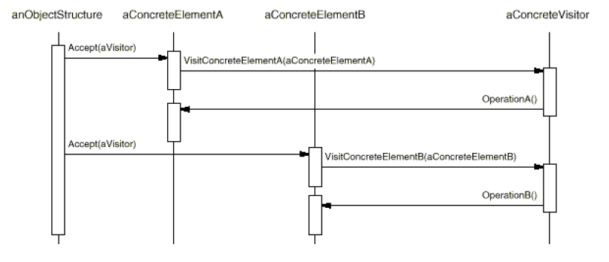
Visit1();
Visit2();
…
The object structure is not coupled with every possible concrete element class so it can not choose the right visit method!!
➔ we let the concrete element classes decide which visit operation to call via the accept methods that call the right visit methods
Notes:
An object structure is associated with a number of elements that may be of different concrete element classes
The idea is based on 2 key points
* Instead of having methods spread in the different element classes, you group the methods that implement an operation by processing different element classes data into the same class
** you don’t want the object structure OR the client to call directly the visit operations passing them the constituent element objects because the object structure would have to be coupled with all of the concrete element classes. Instead we let the elements themselves choose the right visit operation. How ? Via the accept() visit() double dispatch

Slide 59



Attribution-ShareAlike 2.5
You are free:
to copy, distribute, display, and perform the work
to make derivative works
to make commercial use of the work
Under the following conditions:
  Attribution. You must attribute the work in the manner specified by the author or licensor.
  Share Alike. If you alter, transform, or build upon this work, you may distribute the resulting work only under a license identical to this one.
For any reuse or distribution, you must make clear to others the license terms of this work.
Any of these conditions can be waived if you get permission from the copyright holder.
Your fair use and other rights are in no way affected by the above.

