Slide 1
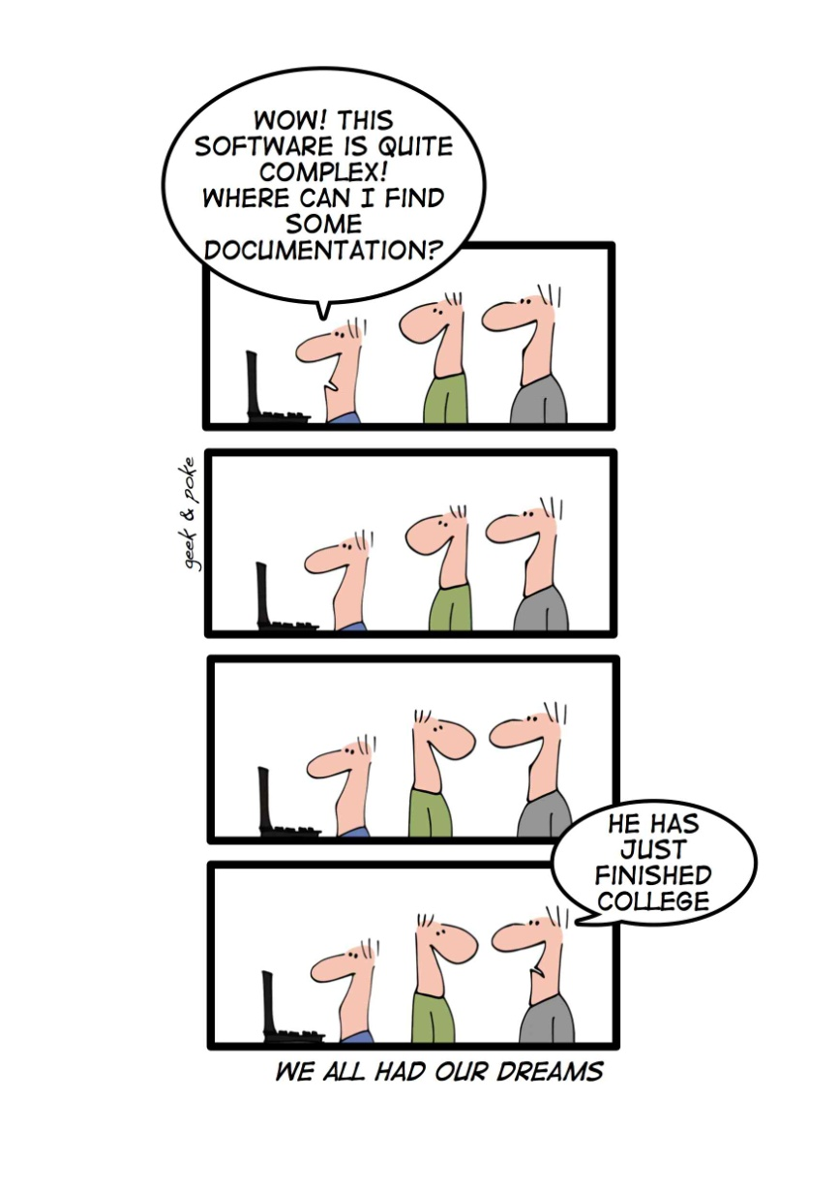
Reverse Engineering www.cs.uoi.gr/~zarras/software-data-evol.html
Reused slides material from OO Reengineering Patterns by Demeyer, Ducasse, Nierstrasz

Slide 2
The Reengineering Life-Cycle
(0) requirement
analysis
Requirements
(2) problem
detection
(3) problem
resolution
Designs
(1) model
capture
Code
(4) program transformation
OORPT — Introduction
© Stéphane Ducasse, Serge Demeyer, Oscar Nierstrasz

Slide 3
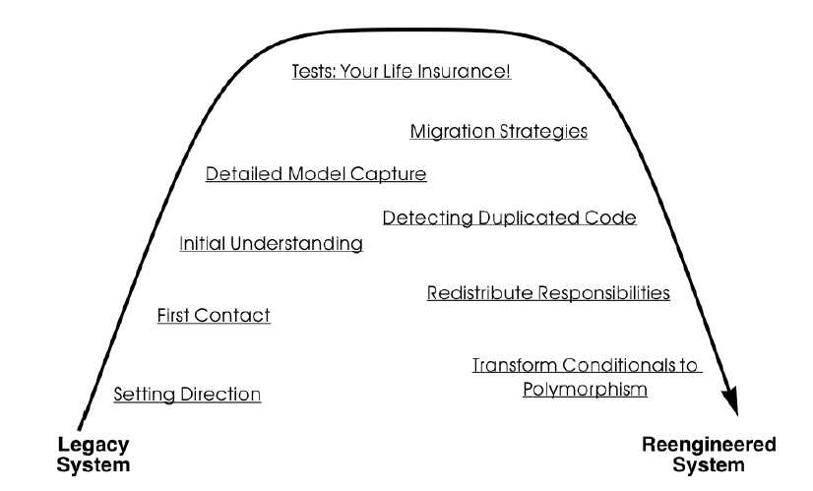
A Map of Reengineering Patterns
OORPT — Introduction
© Stéphane Ducasse, Serge Demeyer, Oscar Nierstrasz

Slide 4
Setting Direction

Slide 5
Forces — Setting Direction
Conflicting interests
  (technical, ergonomic, economic, political)
Communication can be complicated between stakeholders
  Presence/absence original developers
Legacy architecture may pull towards a specific direction
Which problems to tackle?
  Interesting vs important problems?
Wrap, refactor or rewrite?
How to limit the degree to which we reengineer?
OORPT — Reverse Engineering
© Stéphane Ducasse, Serge Demeyer, Oscar Nierstrasz

Slide 6
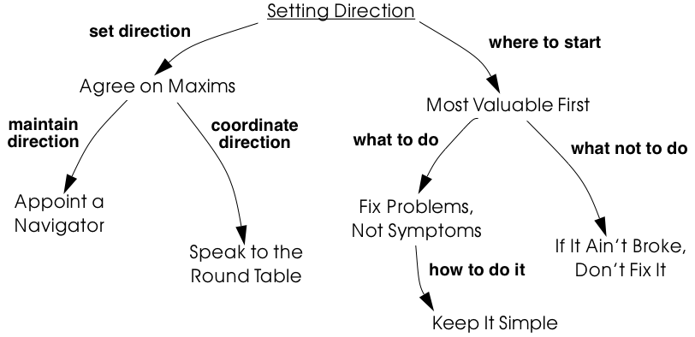
Setting Direction

Slide 7
How do you establish a common sense of purpose in a team?

Slide 8
Agree on Maxims
Problem:
How do you establish a common sense of purpose in a team?
Solution:
Establish the key priorities for the project and identify guiding principles (maxims) that will help the team to stay on track.
OORPT — Reverse Engineering
© Stéphane Ducasse, Serge Demeyer, Oscar Nierstrasz

Slide 9
How do you maintain architectural vision during the course of complex project?

Slide 10
Appoint a Navigator
Problem:
How do you maintain architectural vision during the course of complex project?
Solution:
Appoint a specific person whose responsibility in role of navigator is to ensure that the architectural vision is maintained.
OORPT — Reverse Engineering
© Stéphane Ducasse, Serge Demeyer, Oscar Nierstrasz

Slide 11
How do you keep the team synchronized?

Slide 12
Speak to the Round Table
Problem:
How do you keep your team synchronized?
Solution:
Hold brief, regular round table meetings.
OORPT — Reverse Engineering
© Stéphane Ducasse, Serge Demeyer, Oscar Nierstrasz

Slide 13

Speak to the Round Table
Round table meetings should be held at least once a week, but perhaps as often as daily.
Minutes of a meeting are important to maintain a log of progress, but keeping minutes can be an unpleasant task.
To keep it simple, record only decisions taken and actions to be performed by a certain deadline.
Beck and Fowler recommend “Stand Up Meetings” (meetings without chairs) as a way to keep round table meetings short
OORPT — Reverse Engineering
© Stéphane Ducasse, Serge Demeyer, Oscar Nierstrasz

Slide 14
Which problems should you focus on first?

Slide 15
Most Valuable First
Problem:
Which problems should you focus on first?
Solution:
Work on aspects that are most valuable to your customer
OORPT — Reverse Engineering
© Stéphane Ducasse, Serge Demeyer, Oscar Nierstrasz

Slide 16
Most Valuable First
Maximize commitment, early results; build confidence
Which stakeholder do you listen to?
How do you tell what is valuable?
Understand the business model.
Identify measurable goals
Identify the primary goal (protect an existing asset or add new features).
Check evolution history; most valuable is often a change magnet.
Play the planning game with the customer.
Plan for small frequent iterations.
Most valuable may be a rat’s nest; determine whether you will wrap, refactor, rewrite.
OORPT — Reverse Engineering
© Stéphane Ducasse, Serge Demeyer, Oscar Nierstrasz

Slide 17
How can you possibly tackle all the problems?

Slide 18
Fix Problems not Symptoms
Problem:
How can you possibly tackle all the reported problems?
Solution:
Address the source of a problem, rather than particular requests of your stakeholders.
OORPT — Reverse Engineering
© Stéphane Ducasse, Serge Demeyer, Oscar Nierstrasz

Slide 19
Which parts of a legacy system should you reengineer and which should you leave as they are?

Slide 20
If It Ain’t Broke, Don’t Fix It
Problem:
Which parts of a legacy system should you reengineer and which should you leave as they are?
Solution:
Only fix the parts that are “broken” — those that can no longer be adapted to planned changes; those that contain large numbers of defects.
OORPT — Reverse Engineering
© Stéphane Ducasse, Serge Demeyer, Oscar Nierstrasz

Slide 21
How much flexibility should you try to build into the new system?

Slide 22
Keep It Simple!
Problem:
How much flexibility should you try to build into the new system?
Solution:
Prefer an adequate, but simple solution to a potentially more general, but complex solution.
OORPT — Reverse Engineering
© Stéphane Ducasse, Serge Demeyer, Oscar Nierstrasz

Slide 23



Attribution-ShareAlike 2.5
You are free:
to copy, distribute, display, and perform the work
to make derivative works
to make commercial use of the work
Under the following conditions:
  Attribution. You must attribute the work in the manner specified by the author or licensor.
  Share Alike. If you alter, transform, or build upon this work, you may distribute the resulting work only under a license identical to this one.
For any reuse or distribution, you must make clear to others the license terms of this work.
Any of these conditions can be waived if you get permission from the copyright holder.
Your fair use and other rights are in no way affected by the above.

