Slide 1
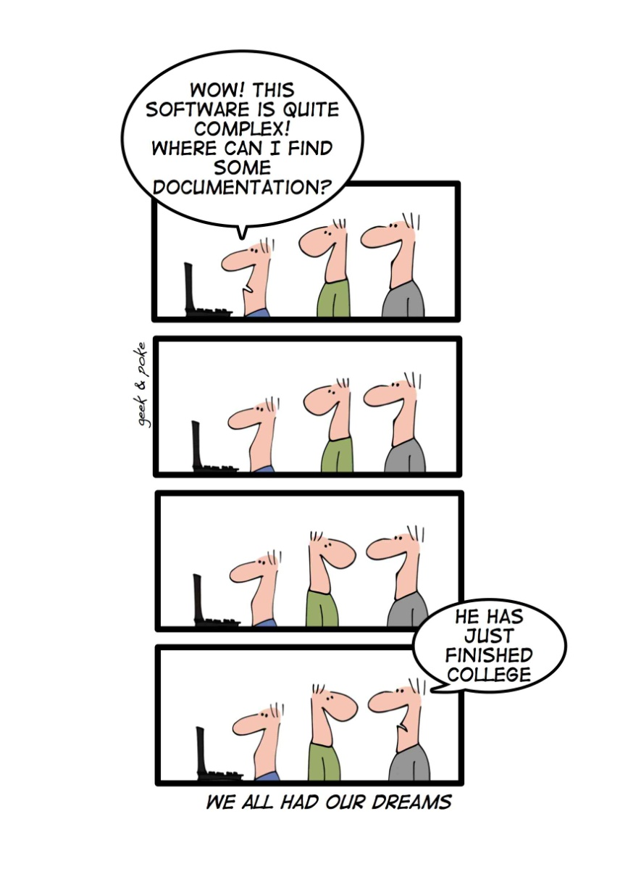
Reverse Engineering www.cs.uoi.gr/~zarras/software-data-evol.html
Reused slides material from OO Reengineering Patterns by Demeyer, Ducasse, Nierstrasz
Notes:
Basically from initial understanding we have a class diagram for the classes and a class diagram for the persistent data.
Now we aim at adding details to the class diagrams (important methods, constructors, template/hook methods, creational patterns)
Also we aim at the construction of behavioral diagrams (what happens at runtime)

Slide 2
The Reengineering Life-Cycle
(0) requirement
analysis
Requirements
(2) problem
detection
(3) problem
resolution
Designs
(1) model
capture
Code
(4) program transformation
OORPT — Introduction
© Stéphane Ducasse, Serge Demeyer, Oscar Nierstrasz

Slide 3
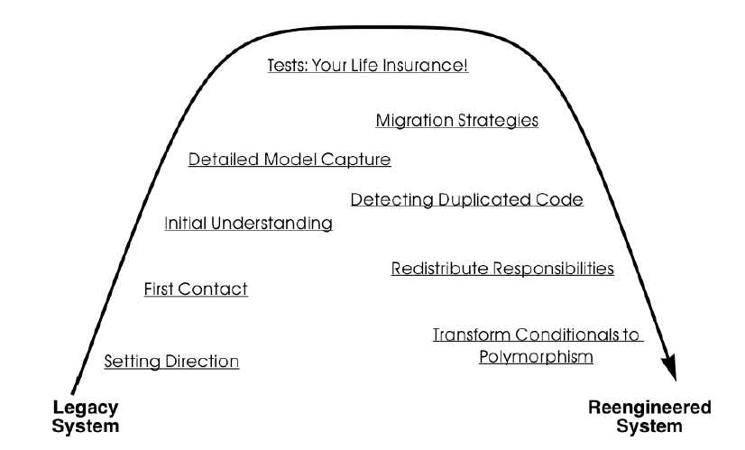
A Map of Reengineering Patterns
OORPT — Introduction
© Stéphane Ducasse, Serge Demeyer, Oscar Nierstrasz

Slide 4
Detailed Model Capture

Slide 5
Forces — Detailed Model Capture
Details matter.
  Pay attention to the details!
Design remains implicit.
  Expose contracts.
  Expose the design of cryptic code.
  Record design rationale when you discover it!
Code only exposes static structure.
  Study dynamic behavior to extract detailed design.
Design evolves.
  Design documents will most often be out of date
  Expose/explore evolution because important issues are reflected in changes to the code!
OORPT — Reverse Engineering
© Stéphane Ducasse, Serge Demeyer, Oscar Nierstrasz

Slide 6
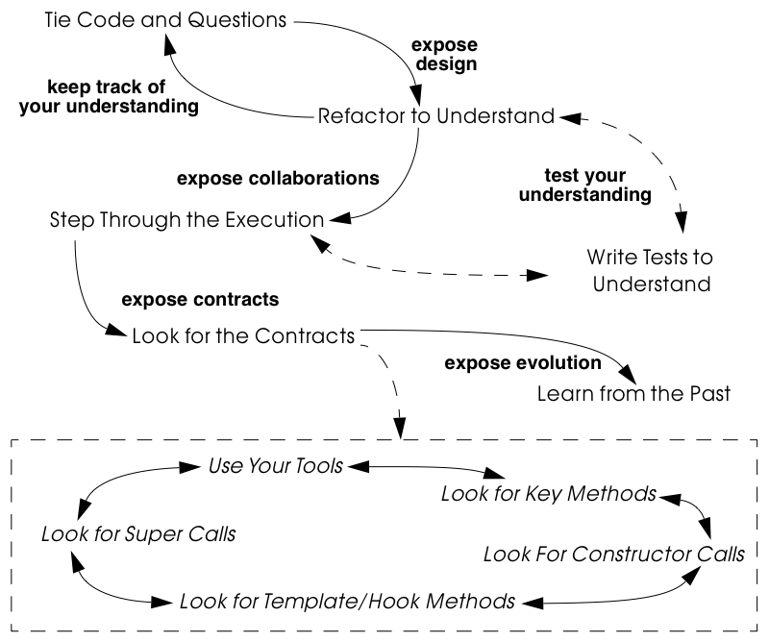
Detailed Model Capture

Slide 7
How do you keep track of your understanding?

Slide 8
Tie Code and Questions
Problem:
How do you keep track of your understanding?
Solution:
Annotate the code
OORPT — Reverse Engineering
© Stéphane Ducasse, Serge Demeyer, Oscar Nierstrasz

Slide 9

Tie Code and Questions
Comment-based Annotations.
  This approach uses the commenting conventions of the programming language and as such is better suited for a text-oriented environment.
  A few conventions are needed to distinguish the normal comments from the annotations.
/* #to: John #by: SD #on: 3/12/99
***** Screws up when we have nested IFs. */
  Basic text search tools part of your program environment can then be used to search and modify annotations.
OORPT — Reverse Engineering
© Stéphane Ducasse, Serge Demeyer, Oscar Nierstrasz

Slide 10
Tie Code and Questions
Method-based annotations.
  The idea is to declare a global method accepting a few strings as an argument and having an empty method body.
  Each time you want to annotate a particular piece of code, you invoke that method passing your annotations as a parameter.
    this.annotateCode(
    "#to: John #by: SD #on: 3/12/99",
    "Screws up when we have nested IFs.");
  This approach exploits the possibility to query which method invokes a given method, a feature provided by many of today’s programming environments.
OORPT — Reverse Engineering
© Stéphane Ducasse, Serge Demeyer, Oscar Nierstrasz

Slide 11
Tie Code and Questions
Record your annotations as close as possible to the code to which they refer.
Annotations may be questions, hypotheses, “to do” lists, or simply observations about the code that you wish to record for future reference.
When you discover the answer to any one of your questions, immediately update the annotation for the benefit of future readers, or simply delete the question if it is no longer relevant.
OORPT — Reverse Engineering
© Stéphane Ducasse, Serge Demeyer, Oscar Nierstrasz

Slide 12

Tie Code and Questions
Natural Synchronization (code, annotations).
Improves Team Communication.
Minimize Context Description.
Passive in nature.
Process incompatibility.
Finding the right granularity.
Quality of the annotations.
Motivating the programmers to add/remove annotations.
OORPT — Reverse Engineering
© Stéphane Ducasse, Serge Demeyer, Oscar Nierstrasz

Slide 13
How do you decipher cryptic code?
Notes:
What do we know about refactoring?
Stickers, what kind of refactoring techniques would be useful?

Slide 14
Refactor to Understand
Problem:
How do you decipher cryptic code?
Solution:
Refactor the code to improve understanding.
OORPT — Reverse Engineering
© Stéphane Ducasse, Serge Demeyer, Oscar Nierstrasz
Notes:
Feathers has also some techniques for this (notes sketch, listings markup)

Slide 15
Refactor to Understand
Rename attributes to convey roles.
  To find out about their roles, look at all the attribute accesses (including invocations of accessors methods).
  Afterwards, rename the attribute and its accessors according to its role, update all references and re-compile the system.
Rename methods to reveal intent.
  To retrieve the intent of a method that does not have an intention revealing name, investigate all invocations and attribute uses, and deduce the method’s responsibility.
  Afterwards, rename the method according to its intent, update all invocations and re-compile the system.
OORPT — Reverse Engineering
© Stéphane Ducasse, Serge Demeyer, Oscar Nierstrasz

Slide 16
Refactor to Understand
Rename classes to reveal purpose.
  To capture the purpose of class having an unclear name, investigate clients of the class by examining who is invoking its operations or who is creating instances of it.
  Afterwards, rename the class according to its purpose, update all references and re-compile the system.
Remove duplicated code
  If you identify duplicated code, try to refactor it into a single location.
  As such, you will identify slight differences that you probably would not have noticed before refactoring and that are likely to reveal some subtle design issues.
  https://sourcemaking.com/refactoring/smells/duplicate-code
OORPT — Reverse Engineering
© Stéphane Ducasse, Serge Demeyer, Oscar Nierstrasz

Slide 17
Refactor to Understand
Replace condition branches by methods.
  If you encounter conditions with large branches, extract the leaves as new (private) methods. To name these methods, study the condition until you understand it well enough to choose an intention revealing name
Refactor method bodies to a consistent level of abstraction.
  Long method bodies with comments separating blocks of code indicate that the method body should be simplified/shortened.
  Refactor such code by extracting new (private) methods for each meaningful block of code; name the method after the intent recorded in the comment.
OORPT — Reverse Engineering
© Stéphane Ducasse, Serge Demeyer, Oscar Nierstrasz

Slide 18
Refactor to Understand
Expose the design of cryptic code.
Risk of introducing errors.
OORPT — Reverse Engineering
© Stéphane Ducasse, Serge Demeyer, Oscar Nierstrasz

Slide 19
How do you determine which contracts a class supports, i.e., how it collaborates with other classes?
Notes:
By contracts we mean
Usage contracts
Creation contracts
Extension contracts

Slide 20
Look for the Contracts
Problem:
How do you determine which contracts a class supports?
That is, how do you know what a class expects from its client classes in order to function as intended.
Solution:
Look for common programming features, constructs, idioms that expose the way clients make use of the class interface.
OORPT — Reverse Engineering
© Stéphane Ducasse, Serge Demeyer, Oscar Nierstrasz
Notes:
This is basically to add behavior to the class diagrams of the speculate about design and the analyze persistent data … and find who is calling who …

Slide 21
Look for the Contracts
Look for “key methods”
  Key methods are likely to bear intention revealing names.
  Methods taking parameters with types corresponding to key classes in the system are likely to be important.
    Parameters represent temporary associations between objects.
    When the same parameter types often recur in method signatures, they are likely to represent important associations.
OORPT — Reverse Engineering
© Stéphane Ducasse, Serge Demeyer, Oscar Nierstrasz

Slide 22
Look for the Contracts
Look for constructor calls
  Invocations of constructor methods may reveal a part-whole associations.
    When a client stores the result of a constructor method in an attribute then this client will probably serve as the whole.
    On the other hand, when a client passes itself as an argument to a constructor method it is likely to act as a – possibly shared - part.
OORPT — Reverse Engineering
© Stéphane Ducasse, Serge Demeyer, Oscar Nierstrasz
Notes:
As a matter of fact the parameter objects are parts of an aggregate (i.e. aggregation relation)

Slide 23
Look for the Contracts
Look for constructor calls
  Invocations of a constructor method may also expose a Factory Method or even an Abstract Factory.
  If they do, then you know that you will be able extend the system by subclassing the class under study.
OORPT — Reverse Engineering
© Stéphane Ducasse, Serge Demeyer, Oscar Nierstrasz

Slide 24
Look for the Contracts
Look for template methods calling hook/abstract methods.
  To understand how to extend a class, look for (protected) methods that are overridden by subclasses, and identify the public methods that call them.
  The public, calling method is almost certainly a Template Method.
OORPT — Reverse Engineering
© Stéphane Ducasse, Serge Demeyer, Oscar Nierstrasz

Slide 25
Look for the Contracts
Look for super calls.
  To understand what assumptions a class makes about its subclasses, look for super calls (like in GUI frameworks for instance).
  Super calls may be used by subclasses to extend or adapt an inherited method in an ad hoc way.
OORPT — Reverse Engineering
© Stéphane Ducasse, Serge Demeyer, Oscar Nierstrasz

Slide 26
Look for the Contracts
Reliable. You can trust the source code more than the documentation.
Noise. Browsing the source code is like mining—once in a while you will find a gem but you will have to dig through a lot of dirt first.
OORPT — Reverse Engineering
© Stéphane Ducasse, Serge Demeyer, Oscar Nierstrasz

Slide 27
How do you discover which objects are instantiated at runtime and how they collaborate?
Notes:
2 ways debug or test

Slide 28
Step Through the Execution
Problem:
How do you discover which objects are instantiated at run-time and how they collaborate?
Solution:
Execute scenarios of known use cases and step through the code with a debugger
OORPT — Reverse Engineering
© Stéphane Ducasse, Serge Demeyer, Oscar Nierstrasz

Slide 29
Step Through the Execution
Tests can also be used as scenario generators.
It is too time-consuming to step through every single statement of a running system.
  The assumption here is that you focus on some specific aspects of the system that are important or difficult to understand.
Set breakpoints to interrupt execution when the system enters the code you are interested in.
Change the internal state of the objects to see how alternative execution paths are triggered.
OORPT — Reverse Engineering
© Stéphane Ducasse, Serge Demeyer, Oscar Nierstrasz
Notes:
White box testing instead of debugging
What do we know about this ??

Slide 30
Step Through the Execution
Realistic View.
Handles complexity when code size is too big.
Scenario-based.
Restricted Applicability.
OORPT — Reverse Engineering
© Stéphane Ducasse, Serge Demeyer, Oscar Nierstrasz

Slide 31
How do you discover how the system design evolved over time?
How can you learn which parts of the system are stable and which parts aren’t?

Slide 32
Learn from the Past
Problem:
How do you discover how the system designed evolved over time?
How can you learn which parts of the system are stable and which parts aren’t?
Solution:
Use the metrics or configuration management tool to find entities where functionality has been removed, because such entities are a sign of a consolidating design.
Also, look for entities which change often as these may point you to an unstable part of the design.
OORPT — Reverse Engineering
© Stéphane Ducasse, Serge Demeyer, Oscar Nierstrasz

Slide 33
Learn from the Past
Understand which parts of the system have been heavily refactored, which parts have become stable, and which parts are hot spots of activity.
  Unstable design - Repeated growth and refactoring in the same portion of the system.
    It may indicate opportunities to redesign.
  Mature and stable design - Some growth and refactoring, followed by a period of stability.
OORPT — Reverse Engineering
© Stéphane Ducasse, Serge Demeyer, Oscar Nierstrasz

Slide 34
Learn from the Past
Concentrates on important design artifacts that change often.
Provides an unbiased view of the system evolution.
Requires considerable experience and tool support.
Could be imprecise and is sensitive to simple or complex changes that involve renamings.
OORPT — Reverse Engineering
© Stéphane Ducasse, Serge Demeyer, Oscar Nierstrasz
Notes:
If you don’t bind adds and rms you loose track of what happened

Slide 35
Factory Method

Slide 36
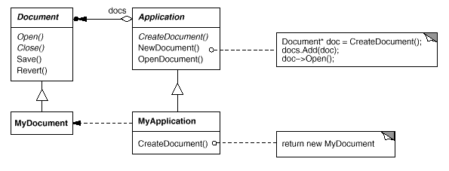
Factory Method
Notes:
We cant anticipate the class of object we use but we can represent this class with an abstract class/interface

Slide 37
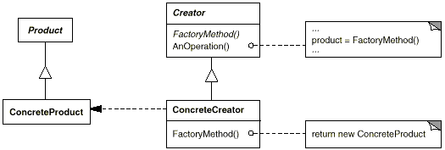
Factory Method
Intent
Factory Method lets a class defer instantiation to subclasses.
Applicability
Use the Factory Method pattern when
a class can't anticipate the class of objects it must create.
a class wants its subclasses to specify the objects it creates.
Structure
Notes:
We cant anticipate the class of object we use but we can represent this class with an abstract class/interface

Slide 38
Abstract Factory

Slide 39
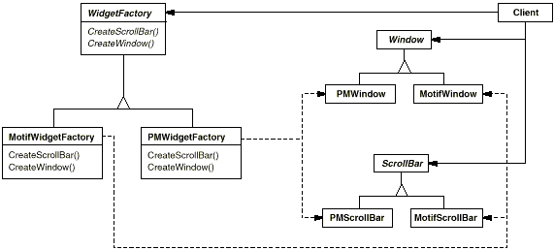
Abstract Factory
Notes:
In general by family we mean a set of objects that belong to different classes which should be used together
2 Apis for open office and microsoft office
Spreadsheet
Presentation
Document
Are the 3 abstract classes

Slide 40
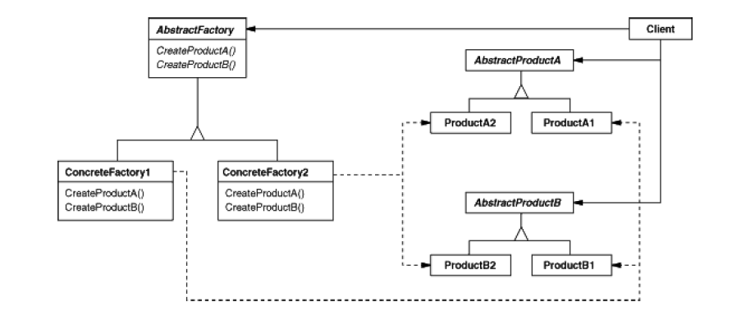
Abstract Factory
Intent
Provide an interface for creating families of related objects
Applicability
A system should be configured with one of multiple families of products.
A family of related product objects is designed to be used together, and you need to enforce this constraint.
Structure
Notes:
In general by family we mean a set of objects that belong to different classes which should be used together
2 Apis for open office and microsoft office
Spreadsheet
Presentation
Document
Are the 3 abstract classes

Slide 41
Template Method

Slide 42
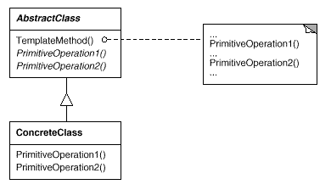
Template Method
Intent
Define the skeleton of an algorithm in an operation, deferring some steps to subclasses.
Applicability
The Template Method pattern should be used
to implement the invariant parts of an algorithm
when common behavior should be factored to avoid code duplication.
to control subclasses extensions - you can define a template method that calls "hook" operations
Structure

Slide 43



Attribution-ShareAlike 2.5
You are free:
to copy, distribute, display, and perform the work
to make derivative works
to make commercial use of the work
Under the following conditions:
  Attribution. You must attribute the work in the manner specified by the author or licensor.
  Share Alike. If you alter, transform, or build upon this work, you may distribute the resulting work only under a license identical to this one.
For any reuse or distribution, you must make clear to others the license terms of this work.
Any of these conditions can be waived if you get permission from the copyright holder.
Your fair use and other rights are in no way affected by the above.

