Slide 1
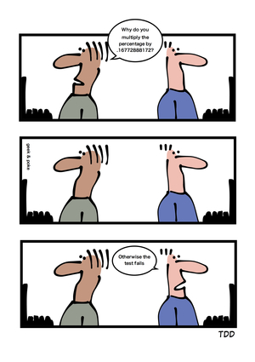
Tests: Your Life Insurance www.cs.uoi.gr/~zarras/ Course URL
from OO Reengineering Patterns by Demeyer, Ducasse, Nierstrasz

Slide 2
The Reengineering Life-Cycle
(0) requirement
analysis
Requirements
(2) problem
detection
(3) problem
resolution
Designs
(1) model
capture
Code
(4) program transformation
OORPT —
© Stéphane Ducasse, Serge Demeyer, Oscar Nierstrasz

Slide 3
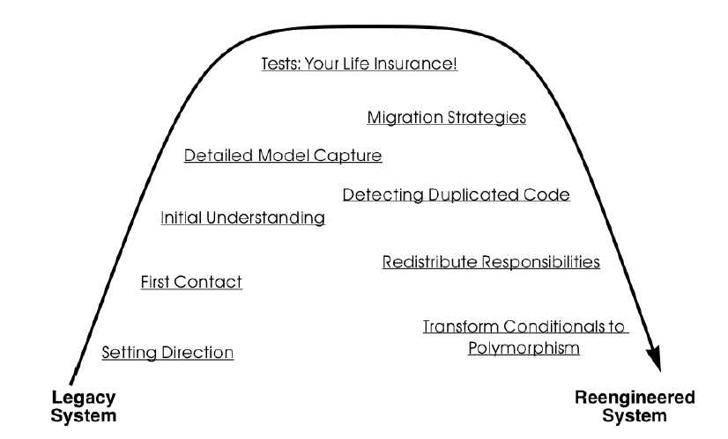
A Map of Reengineering Patterns
OORPT —
© Stéphane Ducasse, Serge Demeyer, Oscar Nierstrasz

Slide 4
Forces — Testing
Reengineering Forces
  Changing parts of the system can introduce new bugs.
  Legacy often do not have tests in place.
System Development Forces
  Not every aspect of a system can be tested.
  Certain aspects like concurrency and user interfaces are difficult to test.
  Under time pressure, writing tests is always the task that is eliminated first.
OORPT —
© Stéphane Ducasse, Serge Demeyer, Oscar Nierstrasz
Notes:
There is a good reason for having testing before starting to change
There are many reasons for which these tests are not there

Slide 5
Forces — Testing
Human Forces (customers)
  Customers ultimately do not pay for tests but for new features in the system.
  An unstable or buggy system is not acceptable for customers.
Human Forces (developers)
  Programmers believe they do not need tests, since they write good code.
  Programmers are not motivated by long term goals since they may leave the project in a month from now.
  Programmers are more interested in tools and processes that can reduce the time they are losing in identifying problems.
  Fixing bugs is not fun.
  Writing tests is not considered to be a noble task.
OORPT —
© Stéphane Ducasse, Serge Demeyer, Oscar Nierstrasz

Slide 6
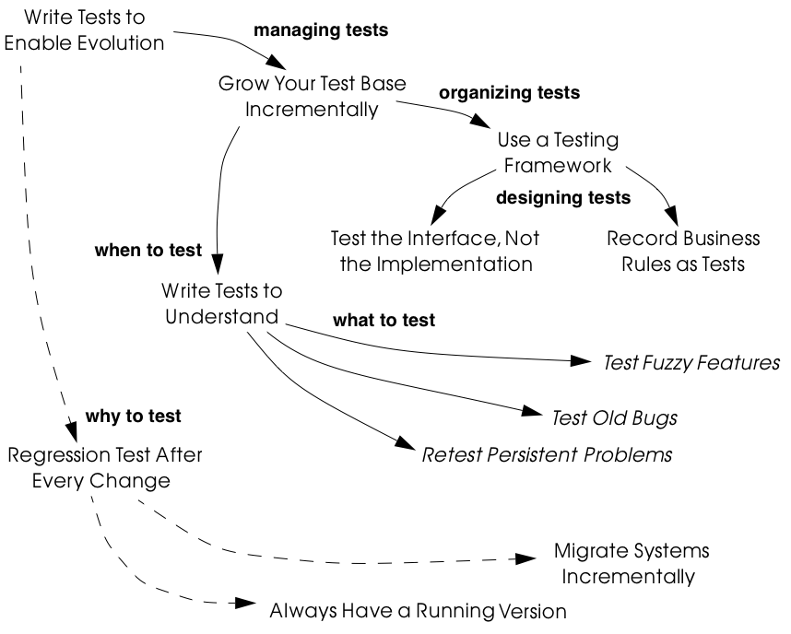
Tests: Your Life Insurance
OORPT —
© Stéphane Ducasse, Serge Demeyer, Oscar Nierstrasz
Notes:
Balance between effort and risk of breaking things

Slide 7
How do you minimize the risks of change?
Notes:
Problem statement is not very good here

Slide 8
Write Tests to Enable Evolution
Problem:
How do you minimize the risks of change?
Solution:
Introduce automated, repeatable, stored tests
OORPT —
© Stéphane Ducasse, Serge Demeyer, Oscar Nierstrasz

Slide 9

Write Tests to Enable Evolution
Well-designed tests exhibit the following properties:
  Automation. Tests should run without human intervention.
    Only fully automated tests offer an efficient way to check after every change to the system whether it still works as it did before. By minimizing the effort needed to run tests, developers will hesitate less to use them.
  Persistence. Tests must be stored to be automatable.
    Each test documents its test data, the actions to perform, and the expected results.
  Efficiency and failure localization. Τwo key features for testing; these are satisfied by unit testing.
    Unit testing. Tests should be associated to individual software components so that they identify clearly which part of the system they test.
OORPT —
© Stéphane Ducasse, Serge Demeyer, Oscar Nierstrasz

Slide 10
Write Tests to Enable Evolution
Well-designed tests exhibit the following properties:
  Repeatability. Confidence in the system is increased if tests can be repeated after any change is implemented.
    Whenever new functionality is added, new tests can be added to the pool of existing tests, thereby increasing the confidence in the system.
  Independence. Dependent tests typically result in avalanche effects: when one test breaks, many others break as well.
    It is important that the number of failures represent quantitatively the size of the detected faults.
    This minimizes fault localization effort.
OORPT —
© Stéphane Ducasse, Serge Demeyer, Oscar Nierstrasz

Slide 11

Write Tests to Enable Evolution
Tests are necessary for enabling future system evolution.
Tests increase confidence in the system, facilitate changes.
Tests document how artifacts of a system are to be used.
Simple unit testing frameworks exist.
Tests require time and development effort.
It is impossible to test all the aspects of a legacy system.
Inadequate tests will give you false confidence.
Plethora of testing approaches exists; chose a simple one.
OORPT —
© Stéphane Ducasse, Serge Demeyer, Oscar Nierstrasz

Slide 12
When should you introduce tests? When can you stop?

Slide 13
Grow Your Test Base Incrementally
Problem:
When should you introduce tests? When can you stop?
Solution:
Introduce tests incrementally for parts of the system you are working on.
OORPT —
© Stéphane Ducasse, Serge Demeyer, Oscar Nierstrasz
Notes:
The problem statement is not exact … How/When do you write tests

Slide 14
Grow Your Test Base Incrementally
Assess priorities and initially develop tests only for the most critical components.
  As you reengineer the system, introduce tests for the new features, parts of the legacy that may be affected, and any bugs you identify along the way.
Focus on business values. Start to write tests for the parts of your system that have the most important artifacts.
  Try to Record Business Rules as Tests.
Use existing tests derived from the history of bug fixes or problems
  Apply Test Old Bugs as a starting point.
OORPT —
© Stéphane Ducasse, Serge Demeyer, Oscar Nierstrasz
Notes:
Test Old Bugs…
e.g. a schema change may affect the same software modules that query the DB. So looking for past issues can reveal these modules

Slide 15
Grow Your Test Base Incrementally
Test the obscure parts of the system.
  If you have documentation and some original developers of the system at hand, apply Test Fuzzy Features.
If there is not much time start to test big abstractions (Feathers: pinch points) and then refine tests if time allows
  Apply Test the Interface, Not the Implementation.
Keep a snapshot of the old system handy so you can later introduce tests that should run against both the original system and its new incarnation.
OORPT —
© Stéphane Ducasse, Serge Demeyer, Oscar Nierstrasz
Notes:
2022 project,
Obscure parts --
In the project gui can be a big abstraction
Have to run an original snapshot to store the contents of the jtables somewhere
See example on how to change code for that

Slide 16
Grow Your Test Base Incrementally
You save time by developing the tests that you need.
You build up a base of the most critical tests.
You build confidence as you go along.
You may guess wrong which aspects are critical.
Tests can give you false confidence.
Setting-up the proper context for the tests may require considerable time and effort.
OORPT —
© Stéphane Ducasse, Serge Demeyer, Oscar Nierstrasz

Slide 17
How do you encourage systematic testing?

Slide 18
Use a Testing Framework
Problem:
How do you encourage systematic testing?
Solution:
Use a framework to structure your tests
OORPT —
© Stéphane Ducasse, Serge Demeyer, Oscar Nierstrasz

Slide 19
Use a Testing Framework
Basic principles of testing frameworks
  The user must provide test cases that set up test data, exercise them, and make assertions about the results.
  The testing framework wraps test cases as tests.
  The testing framework clearly distinguishes between assertion failures and unexpected errors.
    The framework should provide only minimal feedback if tests succeed.
    Assertion failures should indicate precisely which test failed.
    Errors should result in more detailed feedback (such as a full stack trace).
  The framework should allow tests to be composed as test suites.
OORPT —
© Stéphane Ducasse, Serge Demeyer, Oscar Nierstrasz

Slide 20
Use a Testing Framework
A testing framework simplifies the formulation of tests and encourages programmers to write tests and use them.
Testing requires commitment, discipline and support. You must convince your team of the need and benefits.
OORPT —
© Stéphane Ducasse, Serge Demeyer, Oscar Nierstrasz

Slide 21
How do you protect your investment in tests?

Slide 22
Test the Interface, Not the Implementation
Problem:
How do you protect your investment in tests?
Solution:
Apply black-box testing
OORPT —
© Stéphane Ducasse, Serge Demeyer, Oscar Nierstrasz

Slide 23
Test the Interface, Not the Implementation
Test boundary values (i.e., minimum and maximum values for method parameters). The most common errors occur here.
Test equivalent classes of input to reduce test space.
Test scenarios, not paths.
Use a top-down strategy to develop black-box tests if there are many fine-grained components that you do not initially have time to develop tests for.
Use a bottom-up strategy if you are changing functionality in a very focused part of the legacy system.
OORPT —
© Stéphane Ducasse, Serge Demeyer, Oscar Nierstrasz

Slide 24
Test the Interface, Not the Implementation
Tests that exercise public interfaces are more reusable.
Black-box tests can be used to exercise multiple implementations of the same interface.
Black-box tests will not exercise all possible paths.
If the interface changes have to adapt the tests.
OORPT —
© Stéphane Ducasse, Serge Demeyer, Oscar Nierstrasz

Slide 25
How do you keep business rules, and implementation in sync, while changing?
Notes:
The problem statement is not exact
How do you check if they are in sync ?

Slide 26
Record Business Rules as Tests
Problem:
How do you keep the actual business rules, the documentation and the system implementation in sync, while all three are changing?
A Solution:
Write executable tests that record the business rules as test cases.
When tests break, you know that things are out of sync.
➔ A business rule defines or constrains some aspect of business.
OORPT —
© Stéphane Ducasse, Serge Demeyer, Oscar Nierstrasz

Slide 27
Record Business Rules as Tests
Recording business rules as tests enables evolution.
The rules become explicit, reducing dependency on human memory.
When the business deals with a large number of cases, it may be impractical to test them all.
Recording business rules can be difficult for system whose original developers and users have all left.
OORPT —
© Stéphane Ducasse, Serge Demeyer, Oscar Nierstrasz

Slide 28
Other test patterns …
Write Tests to Understand
  Formalize your reverse-engineering hypotheses as tests and exercise the code.
  AZ → Characterization tests
Retest Persistent Problems
  Always test persistent problem areas, even if you are making no changes to this part of the system.
Test Fuzzy Features
  Identify and write tests for ambiguous, not well specified/documented parts of the system.
Test Old Bugs
  To select test cases you can examine old problems reports, especially since the last stable release.
OORPT —
© Stéphane Ducasse, Serge Demeyer, Oscar Nierstrasz

Slide 29



Attribution-ShareAlike 2.5
You are free:
to copy, distribute, display, and perform the work
to make derivative works
to make commercial use of the work
Under the following conditions:
  Attribution. You must attribute the work in the manner specified by the author or licensor.
  Share Alike. If you alter, transform, or build upon this work, you may distribute the resulting work only under a license identical to this one.
For any reuse or distribution, you must make clear to others the license terms of this work.
Any of these conditions can be waived if you get permission from the copyright holder.
Your fair use and other rights are in no way affected by the above.

