Slide 1
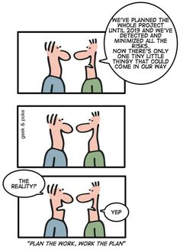
Migration Strategies www.cs.uoi.gr/~zarras/ Course URL
from OO Reengineering Patterns by Demeyer, Ducasse, Nierstrasz
Notes:
Discuss relation to the project….

Slide 2
The Reengineering Life-Cycle
(0) requirement
analysis
Requirements
(2) problem
detection
(3) problem
resolution
Designs
(1) model
capture
Code
(4) program transformation
OORPT —
© Stéphane Ducasse, Serge Demeyer, Oscar Nierstrasz

Slide 3
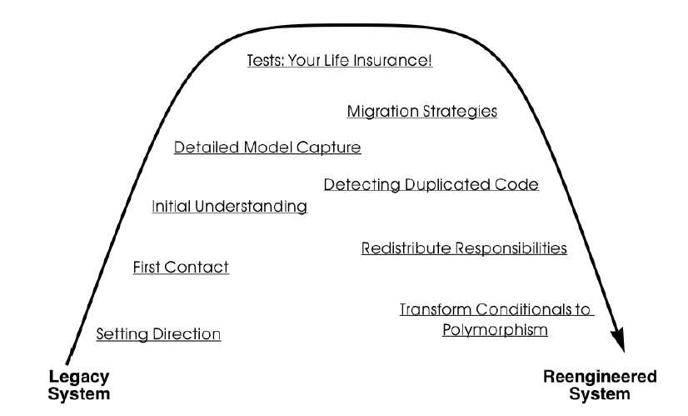
A Map of Reengineering Patterns
OORPT —
© Stéphane Ducasse, Serge Demeyer, Oscar Nierstrasz

Slide 4
Forces — Migration
Big-bang migration often fails.
Users hate change.
You need constant feedback to stay on track, though it may be difficult and costly to achieve.
Users just want to get their work done, not to mess with incomplete solutions.
The legacy data must be available during the transition.
OORPT —
© Stéphane Ducasse, Serge Demeyer, Oscar Nierstrasz

Slide 5
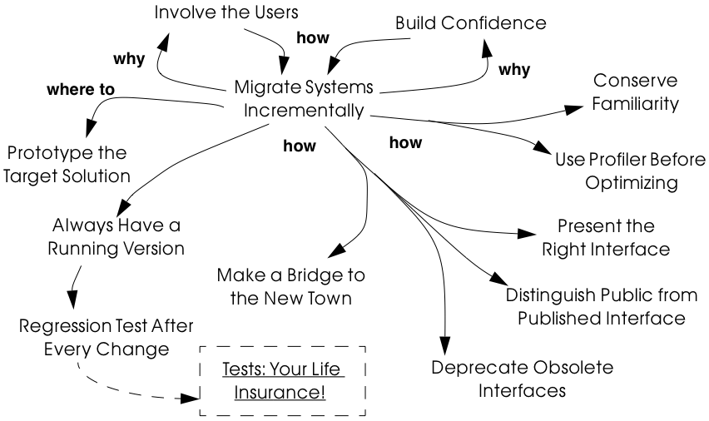
Migration
OORPT —
© Stéphane Ducasse, Serge Demeyer, Oscar Nierstrasz
Notes:
You want to make users accept change and overcome scepticism
To this end you migrate incrementally.
To migrate incrementally you follow the rest of the patterns

Slide 6
How to get users to accept change?
Notes:
Don’t plan on your own!

Slide 7
Involve the Users
Problem:
How to get users to accept change?
Solution:
Get them involved by giving them what they want
OORPT —
© Stéphane Ducasse, Serge Demeyer, Oscar Nierstrasz
Notes:
Migrate incrementally

Slide 8

Involve the Users
Create an environment that will encourage contact between users and developers.
  Physical location is important.
Get the users to tell you where their priorities lie.
  Start with Most Valuable First.
Break the priorities down into small steps that can be delivered in regular increments
Establish simple procedure for delivering intermediate results on a regular basis and obtaining feedback (based on following patterns ….).
Account for supporting changes due to regular feedback.
OORPT —
© Stéphane Ducasse, Serge Demeyer, Oscar Nierstrasz
Notes:
XP (release planning) – scrum project/sprint backlog…

Slide 9
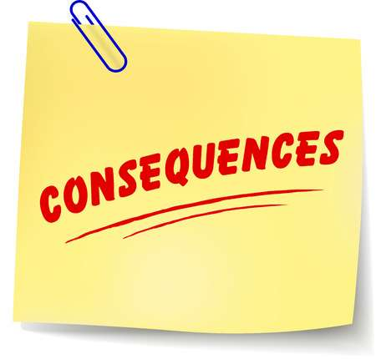
Involve the Users
Results are continuously validated and updated.
The users put extra effort into giving useful feedback.
The need for a special training session late in the project is eliminated.
It takes time to frequently synchronize with the users.
Involving the users may raise expectations.
Developers may feel that supporting users is distracting.
OORPT —
© Stéphane Ducasse, Serge Demeyer, Oscar Nierstrasz

Slide 10
How do you overcome skepticism that the project can be a success?
Notes:
At the beginning …. These people were there
During the project they are still there…

Slide 11
Build Confidence
Problem:
How do you overcome skepticism?
Solution:
Demonstrate results in short, regular intervals
OORPT —
© Stéphane Ducasse, Serge Demeyer, Oscar Nierstrasz
Notes:
Choreos experience… demo and review in M3
Again the answer is migrate incrementally ++ demo some results

Slide 12
Build Confidence
Create a positive atmosphere by demonstrating some positive results as early as you can, and continue to do so on a regular basis.
Plan regular, big demos, esp. to convince management.
OORPT —
© Stéphane Ducasse, Serge Demeyer, Oscar Nierstrasz

Slide 13
Build Confidence
Both users and developers can see real progress.
Good results early in the project, may raise expectations
Users may resent extra work to use the new system.
OORPT —
© Stéphane Ducasse, Serge Demeyer, Oscar Nierstrasz

Slide 14
When/How should you plan to deploy the new system?
Notes:
How do you migrate incrementally ?

Slide 15
Migrate Systems Incrementally
Problem:
When/how should you plan to deploy the new system?
Solution:
Deploy a first update of the legacy system as soon as possible, and migrate incrementally to the target system.
OORPT —
© Stéphane Ducasse, Serge Demeyer, Oscar Nierstrasz

Slide 16
Migrate Systems Incrementally
Decompose the legacy system into parts.
Chose one part at a time (Most Valuable First).
Put suitable tests in place.
Wrap, reengineer, or replace the part.
Deploy the updated part and obtain feedback.
Iterate.
OORPT —
© Stéphane Ducasse, Serge Demeyer, Oscar Nierstrasz

Slide 17
Migrate Systems Incrementally
You Involve the Users and Build Confidence early.
You see immediately when things break.
Users learn the new system as it’s being built.
You will have to work harder to keep the system running, synchronize with users and support them, while you are changing it.
It may be difficult to migrate to a new architecture (use Prototype the Target Solution in this case)
OORPT —
© Stéphane Ducasse, Serge Demeyer, Oscar Nierstrasz
Notes:
In general in all these patts you get feedback the users learn the system and feel better BUT you and them need to work more to sync develop demos use incomplete systems support the users when using the system

Slide 18
How do you know if your ideas for the new target system will work?

Slide 19
Prototype the Target Solution
Problem:
How do you know if your ideas for the new target system will work?
Solution:
Develop a prototype of the new concept and evaluate it with respect to the new, emerging requirements.
OORPT —
© Stéphane Ducasse, Serge Demeyer, Oscar Nierstrasz
Notes:
Build it twice as royce says in the waterfall model

Slide 20
Prototype the Target Solution
Identify the biggest technical risks for your reengineering project (decide what to assess or demo).
  Typically they concern things like:
    Choice of a new system architecture.
    Adequate quality gains — with new technology or platform
    Migration of legacy data to new system
Decide whether to implement:
  An exploratory (i.e., throwaway) prototype that will service purely to evaluate the feasibility of a technical option.
  An evolutionary prototype that will eventually evolve into the new target system.
OORPT —
© Stéphane Ducasse, Serge Demeyer, Oscar Nierstrasz
Notes:
Eg. Last year I had a proto for migrating datakeeper to a more oo version … didn’t do all the work just moved a few methods from diff classes and broke the keeper in pieces wrt lists of kepts objects….

Slide 21
Prototype the Target Solution
A prototype can be built quickly.
You can hack parts of the legacy system in the prototype.
You can learn quickly if you are sound.
Users may not be highly motivated to spend time on evaluating a throwaway prototype.
It can take too much time to make an evolutionary prototype.
You may be tempted to continue to develop the throwaway prototype.
OORPT —
© Stéphane Ducasse, Serge Demeyer, Oscar Nierstrasz

Slide 22
How do you convince your customer that you are on the right path?

Slide 23
Always Have a Running Version
Problem:
How do you convince your customer that you are on the right path? What facilities do you need to migrate incrementally
Solution:
Integrate changes on a daily basis using a configuration management system
OORPT —
© Stéphane Ducasse, Serge Demeyer, Oscar Nierstrasz
Notes:
One way is to demo but it may not be easy to do this. Have to have a running version to demo

Slide 24
Always Have a Running Version
Have a configuration management system in place.
Plan iterations to be as short as possible to allow changes to be integrated into a running system.
If necessary, re-architect the system (break dependencies) to enable short build times.
OORPT —
© Stéphane Ducasse, Serge Demeyer, Oscar Nierstrasz

Slide 25
Always Have a Running Version
You Always Have a Running Version to Build Confidence.
You can quickly validate your changes.
You must continuously integrate changes.
Large systems may have very long build times.
Radical architecture level modification may be hard to break into meaningful updates
OORPT —
© Stéphane Ducasse, Serge Demeyer, Oscar Nierstrasz

Slide 26
How can you be sure that the last change you made won’t break the system?

Slide 27
Regression Test After Every Change
Problem:
How can you be sure that the last change you made won’t break the system?
Solution:
Run the tests at each “stable” point
OORPT —
© Stéphane Ducasse, Serge Demeyer, Oscar Nierstrasz

Slide 28
Regression Test After Every Change
You must relentlessly write tests!
  Take time to convince your team of the joy of testing.
  Write new tests whenever new (untested) bugs are discovered.
If testing takes too long, categorize tests.
  But run all the tests at least once a day
Consider writing tests up front (TDD)
OORPT —
© Stéphane Ducasse, Serge Demeyer, Oscar Nierstrasz

Slide 29
Regression Test After Every Change
It allows to Always Have a Running Version.
It allows to Build Confidence as you proceed.
You must relentlessly write the tests.
OORPT —
© Stéphane Ducasse, Serge Demeyer, Oscar Nierstrasz

Slide 30
How do you incrementally migrate data from a legacy system to its replacement while the two systems are running?

Slide 31
Make a Bridge to the New Town
Problem:
How do you incrementally migrate data from a legacy system to its replacement while the two systems are running in tandem?
Solution:
Make a (data) bridge that will incrementally transfer data from the legacy to the replacement and redirect r/w requests accordingly.
OORPT —
© Stéphane Ducasse, Serge Demeyer, Oscar Nierstrasz

Slide 32
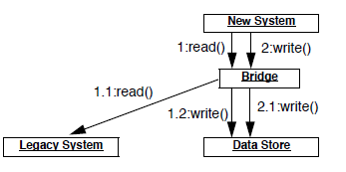
Make a Bridge to the New Town
Identify legacy and replacement components that deal with the same logical data entities.
The “data bridge” redirects read requests from the new component to the legacy, if the data have not been migrated.
  The data read are converted and written in the new data store.
OORPT —
© Stéphane Ducasse, Serge Demeyer, Oscar Nierstrasz

Slide 33
Make a Bridge to the New Town
OORPT —
© Stéphane Ducasse, Serge Demeyer, Oscar Nierstrasz

Slide 34
Make a Bridge to the New Town
Redirect write requests from the legacy to the new component, so that the new data stay up-to-date.
When all the data have been transferred, remove the bridge and the legacy component.
OORPT —
© Stéphane Ducasse, Serge Demeyer, Oscar Nierstrasz

Slide 35
Make a Bridge to the New Town
You can start using the new system without migrating all the legacy data.
A data bridge can be tricky to implement.
The data bridge will add a performance overhead.
OORPT —
© Stéphane Ducasse, Serge Demeyer, Oscar Nierstrasz

Slide 36
How do you prevent the legacy design from polluting the new system, when there is a need to access legacy services?
Notes:
You are working on the API and the internal improvements of a particular subsystem that depends on another that is not yet treated. How do you ….

Slide 37
Present the Right Interface
Problem:
How do you prevent the legacy design from polluting the new system, when there is a need to access legacy services?
Solution:
Wrap old services as new abstractions
OORPT —
© Stéphane Ducasse, Serge Demeyer, Oscar Nierstrasz
Notes:
Draw a target architecture with a set of components B, C that are not ready yet and a component A under development that need to use B, C. B, C are supposed to be derived by breaking a legacy D component. How can we reuse D while implementing A ?
Draw legacy architecture with A_old and D_old, Draw the target architecture with A_new, B_new, C_new (use big boxes and internal structure to represent)
Define interfaces for all new components, build adaptors implementations for B_new and C_new

Slide 38
Present the Right Interface
Identify the new abstractions you want.
Wrap/Adapt the legacy services to emulate the new interface
OORPT —
© Stéphane Ducasse, Serge Demeyer, Oscar Nierstrasz
Notes:
Draw a target architecture with a set of components B, C that are not ready yet and a component A under development that need to use B, C. B, C are supposed to be derived by breaking a legacy D component. How can we reuse D while implementing A ?
Draw legacy architecture with A_old and D_old, Draw the target architecture with A_new, B_new, C_new (use big boxes and internal structure to represent)
Define interfaces for all new components, build adaptors implementations for B_new and C_new

Slide 39
Present the Right Interface
Enable reuse of legacy functionality in the new system
You reduce the risk that the legacy design will adversely influence the new target.
The new interface may not be stable, so developers may be reluctant to use it.
OORPT —
© Stéphane Ducasse, Serge Demeyer, Oscar Nierstrasz

Slide 40
How do you deal with the migration of legacy interfaces to new possibly unstable interfaces?
Notes:
You have the new api for subsystem A but of might change a bit…. how do you deal with the clients of the new interface ?

Slide 41
Public vs. Published Interface
Problem:
How do you deal with the migration from legacy interfaces to new target interfaces while the new interfaces are still not stable ?
Solution:
Distinguish between public interfaces of components that are available to the rest of the system, and unstable “published” interfaces of components that are available within a subsystem, but are not yet ready for prime time.
OORPT —
© Stéphane Ducasse, Serge Demeyer, Oscar Nierstrasz
Notes:
The issue is to allow the clients to assess the risk of using something new whose interface is not stable

Slide 42
Public vs. Published Interface
Since “published” interfaces are not supported by any programming language, you may have to use naming conventions, or abuse other features to achieve the desired effect.
  Consider decorating the names of unstable components or interfaces to indicate their “published” status.
OORPT —
© Stéphane Ducasse, Serge Demeyer, Oscar Nierstrasz

Slide 43
Public vs. Published Interface
Clients of published interfaces are aware that they are likely to change.
Identifying an interface as “published” is purely a matter of convention and discipline.
Clients can be put in a bind for the interface they should use.
OORPT —
© Stéphane Ducasse, Serge Demeyer, Oscar Nierstrasz

Slide 44
How to modify an interface without invalidating all clients?
Notes:
How will you modify the unstable interface ??

Slide 45
Deprecate Obsolete Interfaces
Problem:
How to modify an interface without invalidating all clients?
Solution:
Flag the old interface as «deprecated»
OORPT —
© Stéphane Ducasse, Serge Demeyer, Oscar Nierstrasz

Slide 46
Deprecate Obsolete Interfaces
Implement the new interface, but “deprecate” the old one.
The deprecation mechanism/technique should inform clients that the interface has changed, and that a newer interface is recommended instead.
Evaluate to what extent the deprecated interface continues to be used, and whether it can be permanently retired.
  Consider removing it in a future release.
OORPT —
© Stéphane Ducasse, Serge Demeyer, Oscar Nierstrasz

Slide 47
Deprecate Obsolete Interfaces
Java supports deprecation as a language feature.
Other approaches are:
  Simply inform users in the documentation which interfaces are deprecated.
  Replace deprecated components by equivalent ones that generate run-time warnings or output warnings to a log file.
  Rename the deprecated interface or component ???
OORPT —
© Stéphane Ducasse, Serge Demeyer, Oscar Nierstrasz
Notes:
Use decorators for the deprecation ??

Slide 48
Deprecate Obsolete Interfaces
Clients do not have to immediately adapt to changes.
There is time to change your mind.
Clients are free to ignore deprecation.
It may be hard to track down the clients.
It can be hard to decide when to really retire.
OORPT —
© Stéphane Ducasse, Serge Demeyer, Oscar Nierstrasz

Slide 49
When should you rewrite inefficient code?

Slide 50
Use Profiler Before Optimizing
Problem:
When should you rewrite inefficient code?
Solution:
Only when you have benchmarks that prove it is worthwhile
OORPT —
© Stéphane Ducasse, Serge Demeyer, Oscar Nierstrasz

Slide 51
Use Profiler Before Optimizing
Whenever you are tempted to optimize a “clearly inefficient” part of the system, first use a profiler to determine whether it is actually a bottleneck.
Don’t optimize anything unless your profiler tells you it will make a difference.
If you decide to go ahead, prepare benchmarks that will demonstrate the gains.
OORPT —
© Stéphane Ducasse, Serge Demeyer, Oscar Nierstrasz

Slide 52
Use Profiler Before Optimizing
You do not waste time optimizing something that will not make a difference to overall performance.
Naive algorithms will survive longer in the system.
OORPT —
© Stéphane Ducasse, Serge Demeyer, Oscar Nierstrasz

Slide 53
Adapter

Slide 54
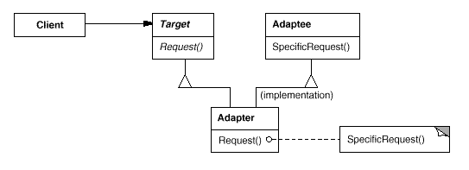
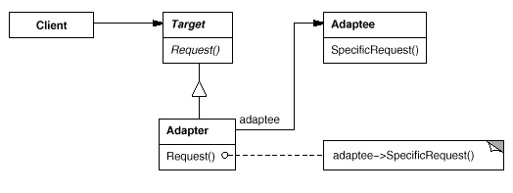
Adapter
Intent
Convert the interface of a class into another interface clients expect. Adapter lets classes work together that couldn't otherwise because of incompatible interfaces.
Applicability
you want to use an existing class, and its interface does not match the one you need
Structure

Slide 55
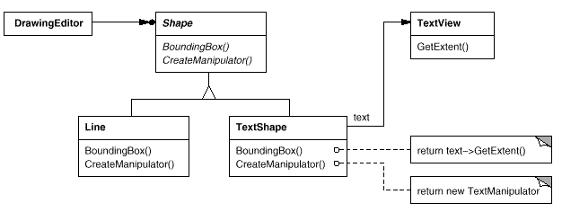
Adapter
Reusing
external API element

Slide 56
Adapter

Slide 57
Adapter

Slide 58



Attribution-ShareAlike 2.5
You are free:
to copy, distribute, display, and perform the work
to make derivative works
to make commercial use of the work
Under the following conditions:
  Attribution. You must attribute the work in the manner specified by the author or licensor.
  Share Alike. If you alter, transform, or build upon this work, you may distribute the resulting work only under a license identical to this one.
For any reuse or distribution, you must make clear to others the license terms of this work.
Any of these conditions can be waived if you get permission from the copyright holder.
Your fair use and other rights are in no way affected by the above.

