Slide 1
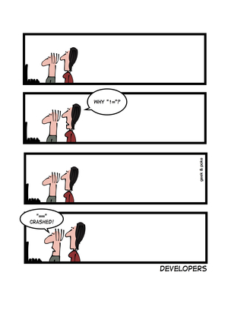
Transform Conditionals www.cs.uoi.gr/~zarras/ Course URL
from OO Reengineering Patterns by Demeyer, Ducasse, Nierstrasz

Slide 2
The Reengineering Life-Cycle
(0) requirement
analysis
Requirements
(2) problem
detection
(3) problem
resolution
Designs
(1) model
capture
Code
(4) program transformation
OORPT —
© Stéphane Ducasse, Serge Demeyer, Oscar Nierstrasz

Slide 3
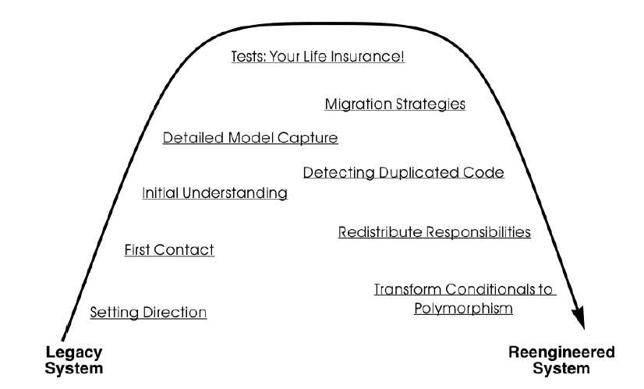
A Map of Reengineering Patterns
OORPT —
© Stéphane Ducasse, Serge Demeyer, Oscar Nierstrasz

Slide 4
Forces
As requirements change over time, classes in a software system will have to be adapted to handle new, special cases.
The quickest way to adapt a working piece of software to handle a new requirement, is often to add a conditional test for the special case at some point in the code.
  Over time, a simple design tends to get cluttered with many conditional tests for special cases.
  Editing several classes and fixing case statements to introduce a new behavior is error prone.
Case statements group all the variants into a single place instead of spreading the different cases across different classes.
  However, they lead to design that is less flexible if the case statement appears in more than one place.
OORPT —
© Stéphane Ducasse, Serge Demeyer, Oscar Nierstrasz

Slide 5
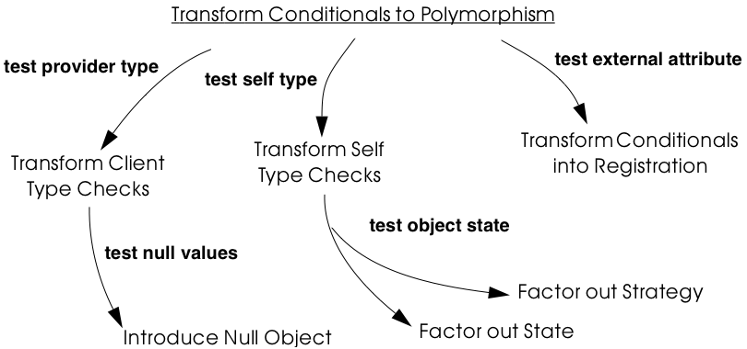
Transform Conditionals to Polymorphism
OORPT —
© Stéphane Ducasse, Serge Demeyer, Oscar Nierstrasz

Slide 6
A class is hard to modify or extend because it bundles multiple behaviors in complex conditional statements that test some attribute representing the current “type” of the object.
The TYPE VALUE does not change after the creation of the object

Slide 7
Transform Self Type Checks
Problem:
A class is hard to modify or extend because it bundles multiple possible behaviors in complex conditional statements that test some attribute representing the current “type” of the object.
Solution:
Identify the methods with complex conditional branches.
In each case, replace the conditional code with a call to a new hook method. Identify or introduce subclasses corresponding to the cases of the conditional. In each of these subclasses, implement the hook method with the code corresponding to that case in the original case statement.
OORPT —
© Stéphane Ducasse, Serge Demeyer, Oscar Nierstrasz

Slide 8
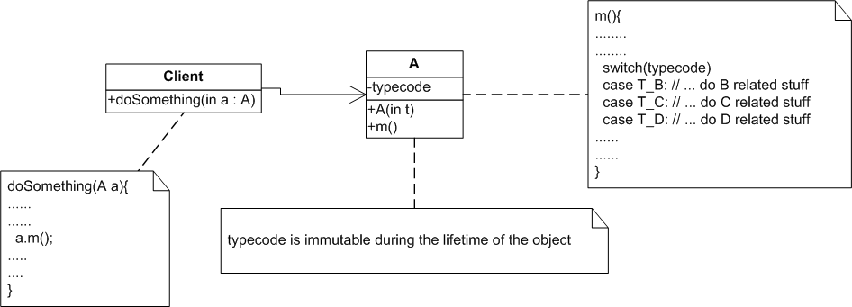
Transform Self Type Checks
OORPT —
© Stéphane Ducasse, Serge Demeyer, Oscar Nierstrasz

Slide 9
Transform Self Type Checks
Make hook method
OORPT —
© Stéphane Ducasse, Serge Demeyer, Oscar Nierstrasz

Slide 10
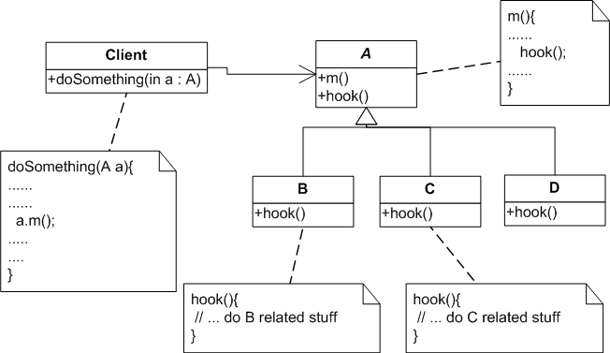
Transform Self Type Checks
OORPT —
© Stéphane Ducasse, Serge Demeyer, Oscar Nierstrasz

Slide 11
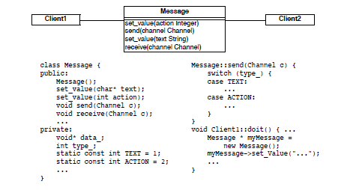
Transform Self Type Checks
OORPT —
© Stéphane Ducasse, Serge Demeyer, Oscar Nierstrasz

Slide 12
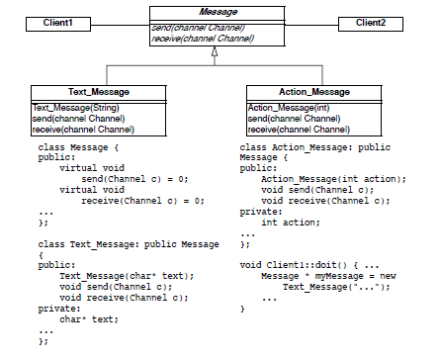
Transform Self Type Checks
OORPT —

Slide 13

Transform Self Type Checks
Look for long methods with complex decision structures on some immutable attribute of the object that models type information.
  In particular look for attributes that are set in the constructor and never changed.
Attributes that are used to model type information (typecodes) typically take on values from some enumerated type, or from some finite set of constant values.
Especially look for classes where multiple methods switch on the same attribute.
  This is another common sign that the attribute is being used to simulate a type.
OORPT —
© Stéphane Ducasse, Serge Demeyer, Oscar Nierstrasz

Slide 14
Transform Self Type Checks
Identify the class to transform and the different conceptual classes that it implements.
Introduce a new subclass for each type that is simulated.
  Modify object creation points to instantiate the new subclasses rather than the original class.
  Run the tests.
Identify all methods of the original class that implement varying behavior by means of conditional statements.
  If the conditionals are surrounded by other statements, extract them to separate, protected hook methods.
  When each conditional occupies a method of its own, run the tests.
OORPT —
© Stéphane Ducasse, Serge Demeyer, Oscar Nierstrasz
Notes:
1. Identify the class to transform and the different conceptual classes
that it implements. An enumeration type or set of constants will
probably document this well.
2. Introduce a new subclass for each behavior that is implemented (see
Figure 10.2). Modify clients to instantiate the new subclasses rather
than the original class. Run the tests.
3. Identify all methods of the original class that implement varying behavior
by means of conditional statements. If the conditionals are
surrounded by other statements, move them to separate, protected
hook methods. When each conditional occupies a method of its own,
run the tests.
4. Iteratively move the cases of the conditionals down to the corresponding
subclasses, periodically running the tests.
5. The methods that contain conditional code should now all be empty.
Replace these by abstract methods and run the tests.
6. Alternatively, if there are suitable default behaviors, implement
these at the root of the new hierarchy.
7. If the logic required to decide which subclass to instantiate is nontrivial,
consider encapsulating this logic as a factory method of the
new hierarchy root. Update clients to use the new factory method
and run the tests.

Slide 15
Transform Self Type Checks
Iteratively move the cases of the conditionals down to the corresponding subclasses, periodically running the tests.
The original methods that contained conditional code should now all be empty.
  Replace these by abstract methods
  Alternatively, if there are suitable default behaviors, implement these at the root of the new hierarchy.
  run the tests.
If the logic required to decide which subclass to instantiate is nontrivial, consider encapsulating this logic as a factory of the new hierarchy root.
Update clients to use the new factory and run the tests.
OORPT —
© Stéphane Ducasse, Serge Demeyer, Oscar Nierstrasz

Slide 16

Transform Self Type Checks
New types of objects are easy to add and to understand.
No need to change different methods to add new types of objects.
All behaviors represented with a common interface.
Behaviors are dispersed into multiple classes.
Typecode variable(s) not always obvious.
Clients should be changed to apply the pattern.
OORPT —
© Stéphane Ducasse, Serge Demeyer, Oscar Nierstrasz

Slide 17
How do you reduce the coupling between clients and providers, where the clients explicitly check the type of providers and compose providers code?

Slide 18
Transform Client Type Checks
Problem:
How do you reduce the coupling between clients and providers of services, where the clients explicitly check the type of providers and have the responsibility to compose providers code?
Solution:
Introduce a new method to the provider hierarchy. Implement the new method in each subclass of the provider hierarchy by moving the corresponding case of the clients conditional to that class.
Replace the entire conditional in the client by a simple call to the new method.
OORPT —
© Stéphane Ducasse, Serge Demeyer, Oscar Nierstrasz

Slide 19
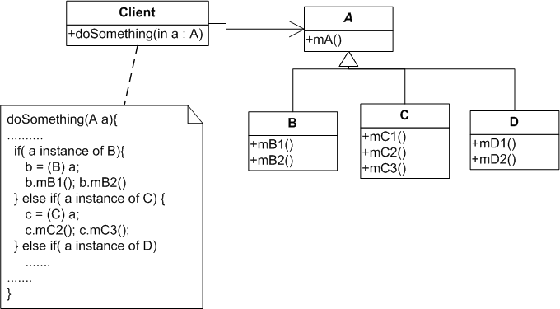
Transform Client Type Checks

Slide 20
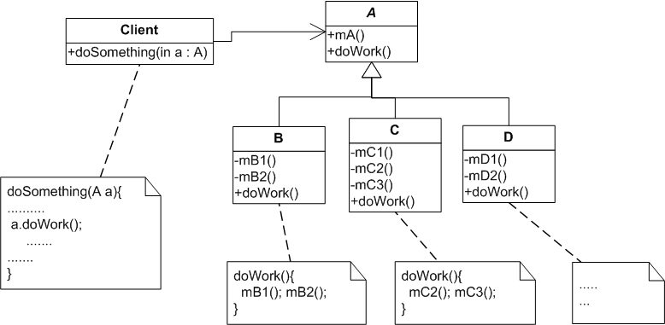
Transform Client Type Checks

Slide 21
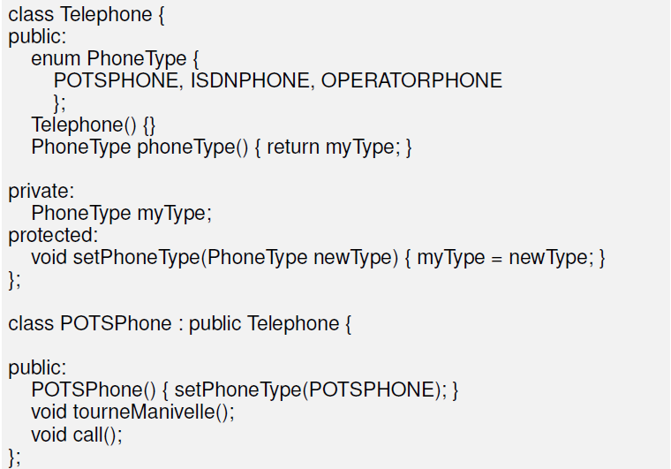
Transform Client Type Checks
OORPT —
© Stéphane Ducasse, Serge Demeyer, Oscar Nierstrasz

Slide 22
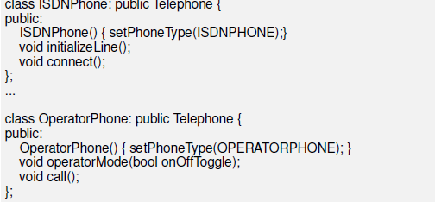
Transform Client Type Checks
OORPT —
© Stéphane Ducasse, Serge Demeyer, Oscar Nierstrasz

Slide 23
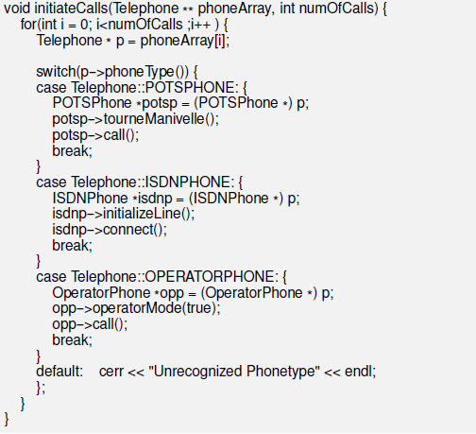
OORPT —
© Stéphane Ducasse, Serge Demeyer, Oscar Nierstrasz

Slide 24
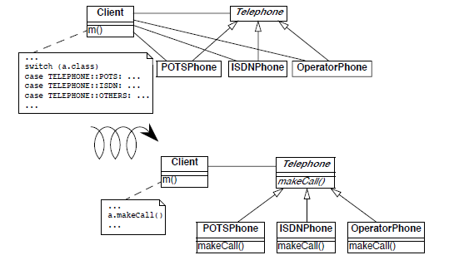
Transform Client Type Checks
OORPT —
© Stéphane Ducasse, Serge Demeyer, Oscar Nierstrasz
Notes:
As an example, CASE STATEMENTS over a type
WHEN IS THIS NOT A PROBLEM ?
the set of types to choose from NEVER CHANGE
the case statement only occurs IN ONE PLACE
with a perl script we extracted C++ switch statements
in the source code of the case studies, we found 2 RECURRING situations and some others
first case (LEFT) switches on an INTERNAL ATTRIBUTE, typically encoding some type information used to interpret another field (i.e., the void data pointer)
PROBLEM: when the set of types extends, we must extend many methods
second case (RIGHT) switches on an external type attribute provided by an ARGUMENT IN A SUBROUTINE
PROBLEM: strong coupling between subroutine and argument; updating many locations

Slide 25
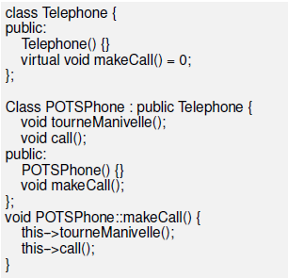
Transform Client Type Checks
OORPT —
© Stéphane Ducasse, Serge Demeyer, Oscar Nierstrasz
Notes:
As an example, CASE STATEMENTS over a type
WHEN IS THIS NOT A PROBLEM ?
the set of types to choose from NEVER CHANGE
the case statement only occurs IN ONE PLACE
with a perl script we extracted C++ switch statements
in the source code of the case studies, we found 2 RECURRING situations and some others
first case (LEFT) switches on an INTERNAL ATTRIBUTE, typically encoding some type information used to interpret another field (i.e., the void data pointer)
PROBLEM: when the set of types extends, we must extend many methods
second case (RIGHT) switches on an external type attribute provided by an ARGUMENT IN A SUBROUTINE
PROBLEM: strong coupling between subroutine and argument; updating many locations

Slide 26
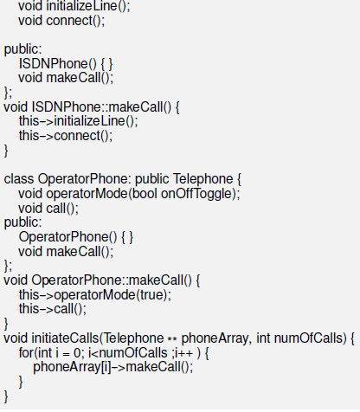
OORPT —
© Stéphane Ducasse, Serge Demeyer, Oscar Nierstrasz
Notes:
As an example, CASE STATEMENTS over a type
WHEN IS THIS NOT A PROBLEM ?
the set of types to choose from NEVER CHANGE
the case statement only occurs IN ONE PLACE
with a perl script we extracted C++ switch statements
in the source code of the case studies, we found 2 RECURRING situations and some others
first case (LEFT) switches on an INTERNAL ATTRIBUTE, typically encoding some type information used to interpret another field (i.e., the void data pointer)
PROBLEM: when the set of types extends, we must extend many methods
second case (RIGHT) switches on an external type attribute provided by an ARGUMENT IN A SUBROUTINE
PROBLEM: strong coupling between subroutine and argument; updating many locations

Slide 27
Transform Client Type Checks
Identify the clients performing explicit type checks on an object that belongs to a provider hierarchy.
Add a new, empty method to the root of the provider hierarchy representing the action performed in the conditional code
Iteratively move a case of the conditional to some provider class.
  After each move, the regression tests should run.
Replace the entire conditional by a single call to the new method.
Consider making the method abstract in the provider’s root.
Alternatively implement suitable default behavior.
OORPT —
© Stéphane Ducasse, Serge Demeyer, Oscar Nierstrasz

Slide 28
Transform Client Type Checks
It may well be that multiple clients are performing exactly the same test and taking the same/similar actions.
  In this case, the duplicated code can be replaced by a single method call after one of the clients has been transformed.
If the case statement does not cover all the concrete subclasses of the provider hierarchy, create a new abstract common superclass of the concerned classes.
OORPT —
© Stéphane Ducasse, Serge Demeyer, Oscar Nierstrasz

Slide 29
Transform Client Type Checks
The legacy solution can be OK in the following cases:
  A factory object may need to test a type variable in order to know which class to instantiate.
  If the provider hierarchy is frozen (e.g., because the source code is not available), then it will not be possible to transfer behavior to the provider classes.
    In this case, can use wrapper classes.
    AZ or try to apply the Bridge pattern
OORPT —
© Stéphane Ducasse, Serge Demeyer, Oscar Nierstrasz

Slide 30
Transform Client Type Checks
  The provider offers a polymorphic interface that can be used by clients.
  Adding new types of provider objects does not impact the clients.
  Clients are no longer responsible of combining provider logic.
Sometimes could be convenient to have the code handling different cases in a single location.
OORPT —
© Stéphane Ducasse, Serge Demeyer, Oscar Nierstrasz

Slide 31
The behavior of the objects of a class depends on the value of some attribute/parameter, which may change during the lifetime of the object.
How do you make the class more simple and extensible ??

Slide 32
Factor Out Strategy
Problem:
  The behavior of the objects of a class depends on the value of some attribute/parameter, which may change during the lifetime of the object.
  How do you make the class more simple and extensible ??
Solution:
Apply the Strategy pattern, i.e., encapsulate the strategy dependent behavior into separate objects with polymorphic interfaces and delegate calls to these objects
OORPT —
© Stéphane Ducasse, Serge Demeyer, Oscar Nierstrasz

Slide 33
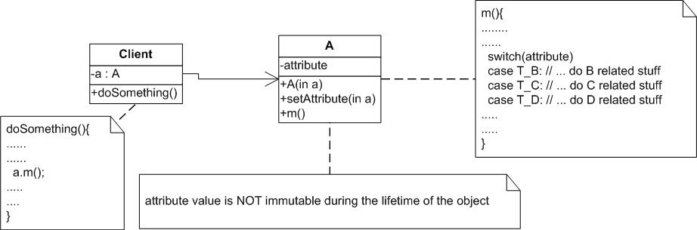
Factor Out Strategy
OORPT —
© Stéphane Ducasse, Serge Demeyer, Oscar Nierstrasz

Slide 34
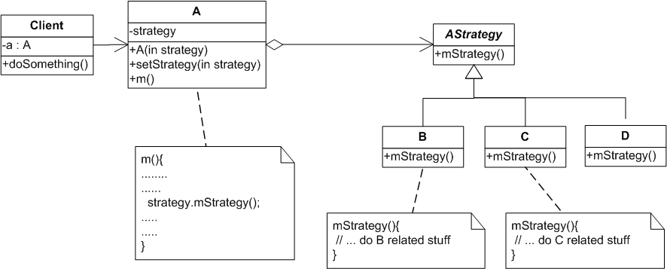
Factor Out Strategy
Create hierarchy of different strategies.
AStrategy is the common interface
OORPT —
© Stéphane Ducasse, Serge Demeyer, Oscar Nierstrasz

Slide 35
Factor Out Strategy
Create a new abstract class/interface, AStrategy, representing the different the strategies.
Create a new subclass of AStrategy for each different conditional branch of the original (Context) class.
Define methods in each of the strategy classes by copying the corresponding conditional branch code.
Add a new instance variable in the original (Context) class to refer to the current strategy.
Initialize the newly created instance to refer to a default strategy instance.
  AZ – add a method in the original class that allows to configure the strategy.
Change the methods of the original class by delegating calls to the instance variable.
OORPT —
© Stéphane Ducasse, Serge Demeyer, Oscar Nierstrasz
Notes:
Steps
1. Identify the interface of the strategy class.
2. Create a new abstract class, Strategy, representing the interface of
the strategies.
3. Create a new class subclass of Strategy for each identified algorithms.
4. Define methods of the interface identified in Step 1 in each of the
strategy classes by copying the corresponding code of the test to the
method.
5. Add a new instance variable in the Context class to refer to the current
strategy.
6. You may have to have a reference from the Strategy to the Context
class to provide access to the information maintained by the Context
(See difficulties).
7. Initialize the newly created instance to refer to a default strategy instance.
8. Change the methods of the Context class containing the tests by eli

Slide 36
Factor Out Strategy
  Behavior extension with new strategies is easy.
  Change strategy at run-time is easy.
  Class explosion risk
  Object explosion risk
  Yet another indirection.
OORPT —
© Stéphane Ducasse, Serge Demeyer, Oscar Nierstrasz

Slide 37
How do you make a class whose behavior depends on a complex evaluation of its current state more simple/extensible?

Slide 38
Factor Out State
Problem:
How do you make a complex class whose behavior depends on a complex evaluation of its current state more simple/extensible?
Solution:
Apply the State pattern, i.e., encapsulate the state-dependent behavior into separate objects, delegate calls to these objects and keep the state of the object consistent by referring to the right instance of these state objects.
OORPT —
© Stéphane Ducasse, Serge Demeyer, Oscar Nierstrasz

Slide 39
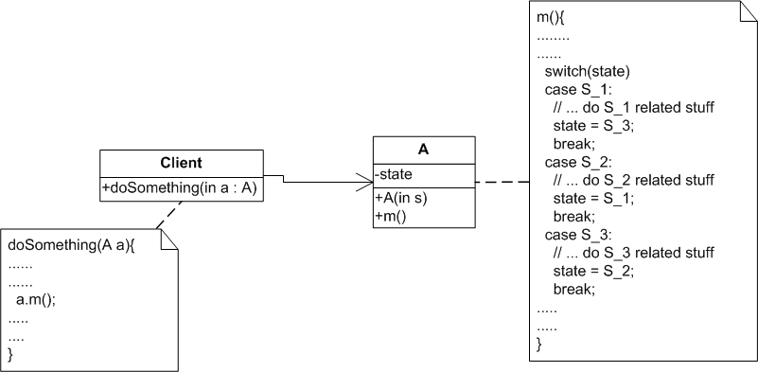
Factor Out State
Here state may be a value or a set of
values of the object’s attributes

Slide 40
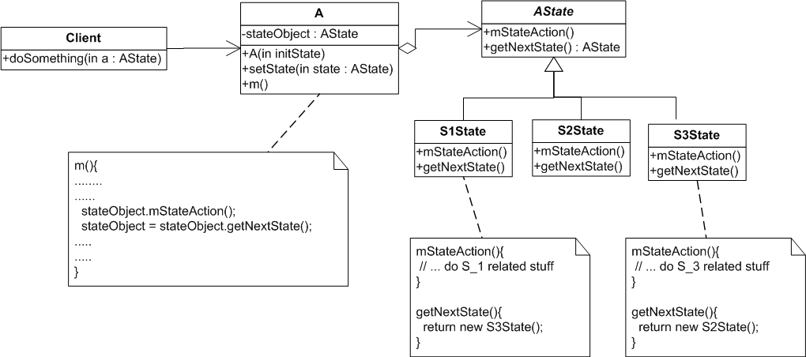
Factor Out State

Slide 41
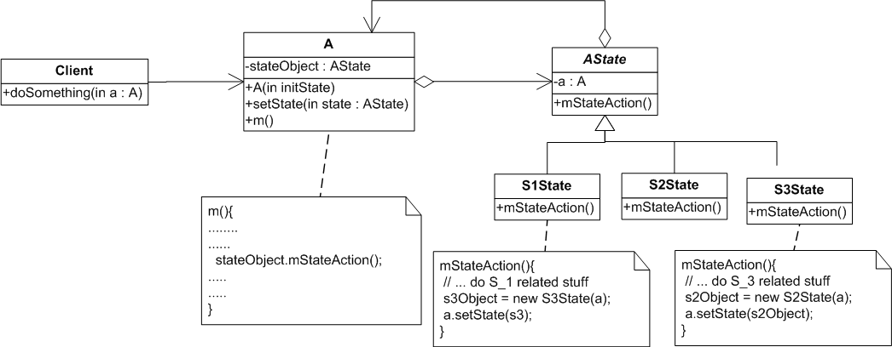
Factor Out State

Slide 42
Factor Out State
Create a new abstract class, State, representing the interface of the states.
Create a new subclass of State for each state.
Define methods in each of the state classes by copying the corresponding code of the conditional to the new methods.
  Do not forget to change the state object in the original class to refer to the right instance of State class.
  The State methods may have the responsibility to change the state object so that it always refers to the next state instance.
OORPT —
© Stéphane Ducasse, Serge Demeyer, Oscar Nierstrasz

Slide 43
Factor Out State
Add a new State object as a field in the original class.
You may have to have a reference from State objects to the original class to enable the state transitions between different State objects.
Initialize the newly created instance to refer to a default State object.
Change the methods of the original class containing the tests to delegate the call to the instance variable.
  Note that after each step, the regression tests should still run.
OORPT —
© Stéphane Ducasse, Serge Demeyer, Oscar Nierstrasz

Slide 44
Factor Out State
The legacy solution can be OK in the following cases:
  When the states are clearly identified and it is known that they will not be changed, the legacy solution has the advantage of grouping all the state behavior by functionality instead of spreading it over different subclasses.
  In certain domains, such as parsers, table-driven behavior, encoded as conditionals over state, are well-understood, and factoring out the state objects may just make the code harder to understand, and hence to maintain.
OORPT —
© Stéphane Ducasse, Serge Demeyer, Oscar Nierstrasz

Slide 45
Factor Out State
Complex conditional logic is simplified.
The systematic application of this pattern may lead to an explosion in the number of classes.
Should not be applied when there are too many possible states, or the number of states is not fixed.
OORPT —
© Stéphane Ducasse, Serge Demeyer, Oscar Nierstrasz

Slide 46
How can you avoid repeated tests for null values?

Slide 47
Introduce NullObject
Problem:
  How can you avoid repeated tests for null values?
Solution:
Apply the Null Object pattern, i.e., encapsulate the null behavior as a separate provider class so that the client class does not have to perform a null test.
OORPT —
© Stéphane Ducasse, Serge Demeyer, Oscar Nierstrasz

Slide 48

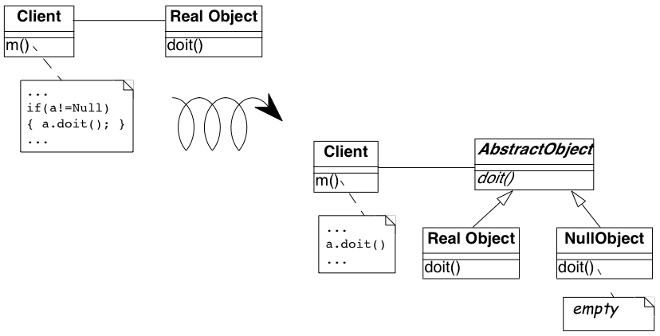
Null Object Pattern
RealObject getTheObject() {
….
if (…)
return new RealObject();
else
return null;
}
a = provider.getTheObject();
Notes:
cluter = ακαταστασια

Slide 49

Null Object Pattern
AbstractObject getTheObject() {
….
if (…)
return new RealObject();
else
return new NullObject();
}
a = provider.getTheObject();
Notes:
cluter = ακαταστασια

Slide 50
Introduce NullObject
Create a new abstract superclass of the RealObject class.
Create a new subclass of the abstract superclass with a name starting with No or Null.
Define default methods into the Null Object class.
Make the variable that was checked to hold at least an instance of the Null Object class.
Remove the conditional tests from the client.
OORPT —
© Stéphane Ducasse, Serge Demeyer, Oscar Nierstrasz

Slide 51
Introduce NullObject
  Clients do not need to test for null values.
  Provider hierarchy gets more complex.
  Have to agree on the null object behavior
OORPT —
© Stéphane Ducasse, Serge Demeyer, Oscar Nierstrasz

Slide 52
Clients have to choose between objects/tools providing services; how do you reduce the coupling between these objects and clients so that addition/removal of such objects does not change client code?

Slide 53
Transform Conditional into Registration
Problem:
  Clients have to choose between objects providing services;
  how do you reduce the coupling between these objects and clients so that addition/removal of such objects does not change client code?
Solution:
Introduce a registration mechanism. Objects register/unregister, while clients query them via the registration repository
OORPT —
© Stéphane Ducasse, Serge Demeyer, Oscar Nierstrasz
Notes:
Problem
How can you reduce the coupling between tools providing services and
clients so that the addition or removal of tools does not lead to changing
the code of the clients?
This problem is difficult because:
• Having one single place to look for all the kinds of tools makes it
easy to understand the system and easy to add new tools.
• However, every time you remove a tool, you have to remove one case
in some conditional statement, else certain parts (tool clients) would
still reflect the presence of the removed tools, leading to fragile systems.
Then every time you add a new tool, you have to add a new
conditional in all the tool clients.
Yet, solving this problem is feasible because:
• Long conditionals make it easy to identify the different type of tools
used.
Solution
Introduce a registration mechanism to which each tool is responsible for registering
itself, and transform the tool clients to query the registration repository
instead of performing conditionals.

Slide 54
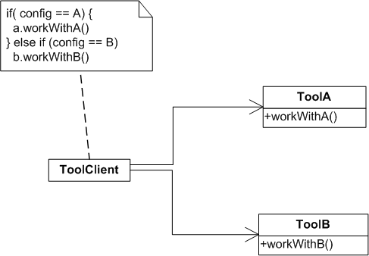
Transform Conditional into Registration

Slide 55
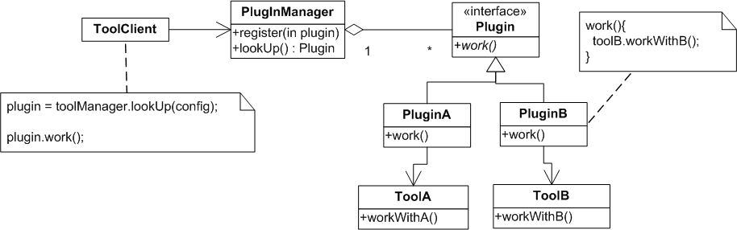
Transform Conditional into Registration

Slide 56
Transform Conditional into Registration
Define a class describing plug-in objects, i.e., an object encapsulating the information necessary for using a tool.
Introduce a plug-in manager.
For each case of the conditional, define a plug-in object associated with the given tool.
Transform the entire conditional expression into a query to the manager object.
OORPT —
© Stéphane Ducasse, Serge Demeyer, Oscar Nierstrasz

Slide 57
Transform Conditional into Registration
  New tools can be added without impacting clients
  Interaction between tools and clients is unified
  Reduce coupling and support modular design
  Additional classes (Plugin abstraction, PluginManager)
OORPT —
© Stéphane Ducasse, Serge Demeyer, Oscar Nierstrasz

Slide 58



Attribution-ShareAlike 2.5
You are free:
to copy, distribute, display, and perform the work
to make derivative works
to make commercial use of the work
Under the following conditions:
  Attribution. You must attribute the work in the manner specified by the author or licensor.
  Share Alike. If you alter, transform, or build upon this work, you may distribute the resulting work only under a license identical to this one.
For any reuse or distribution, you must make clear to others the license terms of this work.
Any of these conditions can be waived if you get permission from the copyright holder.
Your fair use and other rights are in no way affected by the above.

