Slide 1
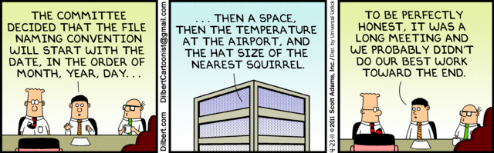
Meaningful Names www.cs.uoi.gr/~zarras/soft-devII.htm
from Clean Code by R. C. Martin, a.k.a “Uncle Bob”

Slide 2
Use Intention Revealing Names
int d; // elapsed time in days

Slide 3
Use Intention Revealing Names
int d; // elapsed time in days
If a name requires a comment, then the name does not reveal its intent.

Slide 4
Use Intention Revealing Names
int d; // elapsed time in days
The name d reveals nothing. It does not evoke a sense of elapsed time, nor of days.
We should choose a name that specifies
what is being measured
and the unit of that measurement:
int elapsedTimeInDays;
int daysSinceCreation;
int daysSinceModification;
int fileAgeInDays;
Notes:
which of the 4 options is better ?
last three give also reason we measure

Slide 5
Use Intention Revealing Names
The name of a variable, function, or class, should answer all the big questions.
It should tell you
why it exists,
what it does,
and how it is used.

Slide 6
Use Intention Revealing Names
What is the purpose of this code?
public List<int[]> getThem() {
List<int[]> list1 = new ArrayList<int[]>();
for (int[] x : theList)
if (x[0] == 4)
list1.add(x);
return list1;
}

Slide 7
Use Intention Revealing Names
What is the purpose of this code?
public List<int[]> getThem() {
List<int[]> list1 = new ArrayList<int[]>();
for (int[] x : theList)
if (x[0] == 4)
list1.add(x);
return list1;
}
Why is it hard to tell what this code is doing?
The code implicitly requires that we know the answers to questions such as:
What kinds of things are in theList?
What is the significance of the zero-th subscript of an item in theList?
What is the significance of the value 4?
How would we use the list being returned?

Slide 8
Use Intention Revealing Names
Say that we’re working in a mine sweeper game. We find that the board is a list of
cells called theList.
Each cell on the board is represented by a simple array.
We further find that the zero-th subscript is the location of a status value
and that a status value of 4 means “flagged.”
Just by giving these concepts names we can improve the code considerably:
public List<int[]> getFlaggedCells() {
List<int[]> flaggedCells = new ArrayList<int[]>();
for (int[] cell : gameBoard)
if (cell[STATUS_VALUE] == FLAGGED)
flaggedCells.add(cell);
return flaggedCells;
}
Notes:
σημαδεμένα κελιά
constants to express that 0th position is the cell status and 4 is the flagged value

Slide 9
Use Intention Revealing Names
Once again compare
for (int j=0; j<34; j++) {
s += (t[j]*4)/5;
}

Slide 10
Use Intention Revealing Names
Once again compare
for (int j=0; j<34; j++) {
s += (t[j]*4)/5;
}
to
int realDaysPerIdealDay = 4;
const int WORK_DAYS_PER_WEEK = 5;
int sum = 0;
for (int j=0; j < NUMBER_OF_TASKS; j++) {
int realTaskDays = taskEstimate[j] * realDaysPerIdealDay;
int realTaskWeeks = (realTaskDays / WORK_DAYS_PER_WEEK);
sum += realTaskWeeks;
}

Slide 11
Avoid Disinformation
What is accountList ??
if(accountList == null){
throw new BankException();
}

Slide 12
Avoid Disinformation
What is accountList ??
Account searchForAccount(Account accountList[]){
…......
if(accountList == null){
throw new BankException();
}
…………
}
The word list means something specific to programmers.
If the container holding the accounts is not actually a List, it may lead to false conclusions.
So accountGroup or bunchOfAccounts or just plain accounts would be better.
Notes:
Why is this bad??
Imagine calling list methods on the variable and getting compile errors back, searching what is going on, list documentation and so on…

Slide 13
Avoid Disinformation
What does this code do ??
int a = l;
if (O == l)
a = O1;
else
l = 01;

Slide 14
Avoid Disinformation
What does this code do ??
int a = l;
if (O == l)
a = O1;
else
l = 01;
A truly awful example of disinformative names would be the use of lower-case L or uppercase O as variable names, especially in combination.
Such things do exist !!!.
In one case the author of the code suggested using a different font so that the differences are more clear !!!!

Slide 15
Make Meaningful Distinctions
what is the purpose of the parameters ???
public static void copyChars(char a1[], char a2[]) {
………
}
Notes:
ουσιαστική διακριση μεταξυ των εννοιων
Πρέπει να αναδεικνύουν τις διαφορές μεταξυ των εννοιων
λογικα src, dest αλλά ποιο είναι ποιο? τα ονόματα δεν βοηθάνε να καταλάβουμε τη διαφορά

Slide 16
Make Meaningful Distinctions
what is the purpose of the parameters ???
public static void copyChars(char a1[], char a2[]) {
for (int i = 0; i < a1.length; i++) {
a2[i] = a1[i];
}
}
Number-series naming (a1, a2, .. aN) is the opposite of intentional naming. Such
names are not disinformative—they are non-informative; they provide no clue to the author’s intention.
This function reads much better when source and destination are used for the parameter names.
Notes:
ουσιαστική διακριση μεταξυ των εννοιων

Slide 17
Make Meaningful Distinctions
what is the purpose of the classes ???
class Product {…}
class ProductInfo {…}
class ProductData {…}

Slide 18
Make Meaningful Distinctions
what is the purpose of the classes ???
class Product {…}
class ProductInfo {…}
class ProductData {…}
Noise words are another meaningless distinction.
We have made the names different without making them mean anything different !!!!
→ Distinguish names in such a way that the reader knows what the differences offer.

Slide 19
Use Pronounceable Names
Try to read this !!
class DtaRcrd102 {
private Date genymdhms;
private Date modymdhms;
private final String pszqint = "102";
/* ... */
};

Slide 20
Use Pronounceable Names
Compare these two ….
class DtaRcrd102 {
private Date genymdhms;
private Date modymdhms;
private final String pszqint = "102";
/* ... */
};
class Customer {
private Date generationTimestamp;
private Date modificationTimestamp;;
private final String recordId = "102";
/* ... */
};
If you can’t pronounce it, you can’t discuss it !!!!
This matters because programming is a social activity !!!!
Notes:
when you want to tell someone to change something, correct something, there is a bug in something ….

Slide 21
Use Searchable Names
Imagine that you search for a variable, named e in a file that contains the following code
Exception e;
Date timestampGeneration;
Date timestampModification;

Slide 22
Use Searchable Names
Imagine that you search for a variable, named e in a file that contains the following code
Exception errorInFileOpening;
Date generationTimestamp;
Date modificationTimestamp;
you would get > 10 matches …
the name e is a poor choice for any variable for which a programmer might need to search.
It is the most common letter in the English language and likely to show up in every passage of text in every program.

Slide 23
Avoid Encodings
What do these variable names mean ???
bBusy
chInitial
dLightYears
iSize
fpPrice
dbPi
piFoo

Slide 24
Avoid Encodings
What do these variable names mean ???
boolean bBusy;
char chInitial;
double dLightYears;
int iSize;
float fpPrice;
double dbPi;
int *piFoo;
In the old years we often used encodings like these; In Hungarian Notation, a variable name starts with a group of lower-case letters which are mnemonics for the type of that variable.
Today there is a trend toward smaller classes and shorter functions so that people can usually see the point of declaration of each variable they’re using.
So encodings are unnessesary burden; plus encoded names are seldom pronounceable.

Slide 25
Avoid Encodings
Suppose we use encodings, what is the type of this variable ??
if(stringPhone == null)
throw new NullPointerException();

Slide 26
Avoid Encodings
Suppose we use encodings, what is the type of this variable ??
PhoneNumber stringPhone;
// name not changed when type changed!
.......
if(stringPhone == null)
throw new NullPointerException();
encoded names are easy to mis-type !!!!

Slide 27
Avoid Encodings
Yet another kind of encoding …
public class Part {
private String m_dsc; // The textual description
void setName(String name) {
m_dsc = name;
}
}

Slide 28
Avoid Encodings
Yet another kind of old-times encoding …
public class Part {
private String m_dsc; // The textual description
void setName(String name) {
m_dsc = name;
}
}
You also don’t need to prefix member variables with m_ anymore.
Your classes and functions should be small enough that you don’t need them.
And you should be using an editing environment that highlights or colorizes members to make them distinct.
Notes:
προθέματα για ξεχωρίζουμε μεταβλητές από πεδία κλάσης

Slide 29
Avoid Encodings
Yet another kind of encoding …
public class Part {
private String m_dsc; // The textual description
void setName(String name) {
m_dsc = name;
}
}
much better…
public class Part {
String description;
void setDescription(String description) {
this.description = description;
}
}
Besides, people quickly learn to ignore the prefix (or suffix) to see the meaningful part of the name.
The more we read the code, the less we see the prefixes.

Slide 30
Avoid Mental Mapping
Readers shouldn’t have to mentally translate your names into other names they already know.
This problem generally arises from a choice to use neither problem domain terms nor solution domain terms.
This is a problem with single-letter variable names.
Certainly a loop counter may be named i or j or k (though never l!) if its scope is very small and no other names can conflict with it.
However, in most other contexts a single-letter name is a poor choice; it’s just a place holder that the reader must mentally map to the actual concept.

Slide 31
Class Names
Classes are concepts of the problem domain.
Hence, Classes and objects should have noun or noun phrase names like:
Customer, WikiPage, Account, and AddressParser
A class name should not be a verb.

Slide 32
Method Names
Methods are actions performed by the objects. Hence, methods should have verb or verb phrase names like:
postPayment, deletePage, save
Accessors, mutators, and predicates should be named for their value and prefixed with get, set, and is.
string name = employee.getName();
customer.setName("mike");
if (paycheck.isPosted()) { …. }

Slide 33
Method Names
When constructors are overloaded, sometimes it is useful to use static factory methods with names that describe the arguments.
Complex lowPoint = new Complex(23.0);
Complex highPoint = new Complex(12.5, 23.0);

Slide 34
Method Names
When constructors are overloaded, sometimes it is useful to use static factory methods with names that describe the arguments.
Complex lowPoint = Complex.createFromRealNumber(23.0);
vs.
Complex lowPoint = new Complex(23.0);
Complex highPoint = new Complex.createFromRealAndImaginary(12.5, 23.0);
vs.
Complex highPoint = new Complex(12.5, 23.0);
How can we enforce the use of the factory methods, instead of the overloaded constructors to the programmers that use our class ??

Slide 35
Method Names
When constructors are overloaded, sometimes it is useful to use static factory methods with names that describe the arguments.
Complex lowPoint = Complex.createFromRealNumber(23.0);
vs.
Complex lowPoint = new Complex(23.0);
Complex highPoint = new Complex.createFromRealAndImaginary(12.5, 23.0);
vs.
Complex highPoint = new Complex(12.5, 23.0);
How can we enforce the use of the factory methods, instead of the overloaded constructors to the programmers that use our class ??
We can just make the constructors private !

Slide 36
Don’t be Cute
What is the purpose of these methods ?
interface CuteThread {
whack();
hitTheRoad();
letItRoll();
}
Notes:
έξυπνα ή χιουμοριστικά ονόματα …

Slide 37
Don’t be Cute
What is the purpose of these methods ?
interface CuteThread {
whack();
hitTheRoad();
letItRoll();
}
If you use clever or humorous names, they will be memorable only to people who share your sense of humor, and only as long as these people remember the joke.
interface ClearThread {
kill();
run();
execute();
}
still there is a problem here … can you spot it ???

Slide 38
Don’t be Cute
interface ClearThread {
kill();
run();
execute();
}
still there is a problem here … can you spot it ???
there is no clear distinction between run and execute

Slide 39
Pick One Name per Concept
Pick one word for one abstract concept and stick with it.
For instance, it’s confusing to have:
fetch(), retrieve(), and get() as equivalent methods of different classes
Likewise, it’s confusing to have a Controller and a Manager and a Driver in the same code base.
it makes people wonder what is the difference between these terms….

Slide 40

Smells and related refactorings
https://refactoring.com/catalog/

Slide 41
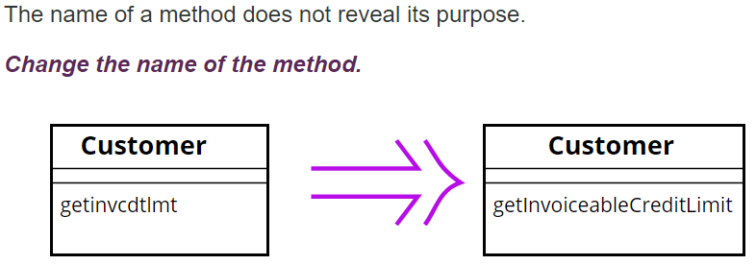
Rename Method
Before changing the name, check if the method overrides (or is overridden) a super class method (by subclasses methods). In that case all the names must change.
Changing the name implies changing the callers of the method.
What we do if this is not possible ??
We can keep the previous version of the method and make it call the new one to avoid duplication; mark the old version of the method as deprecated

Slide 42
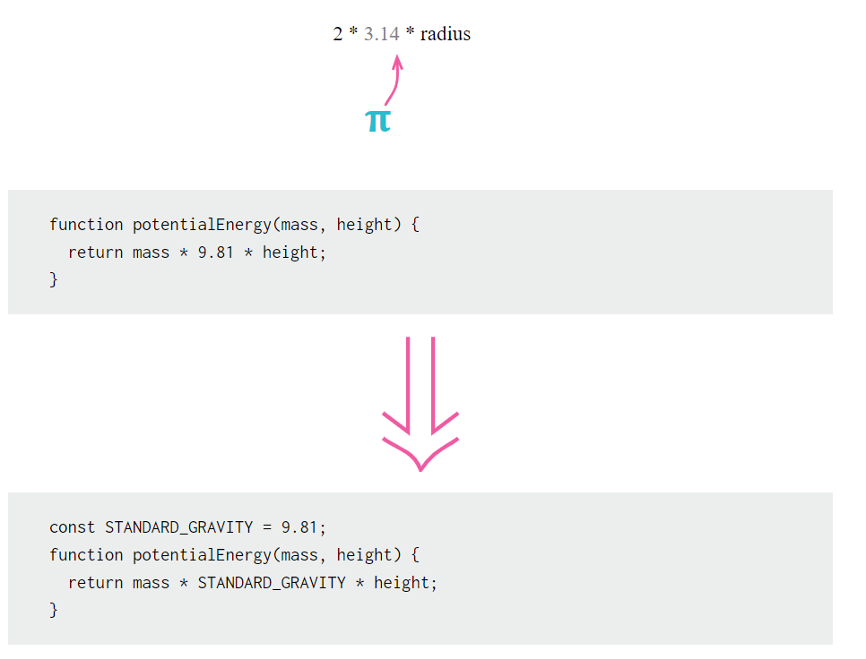
Replace Magic Number with Symbolic Constant
You have a literal number with a particular meaning.
Create a constant, name it after the meaning, and replace the number with it.

