Slide 1
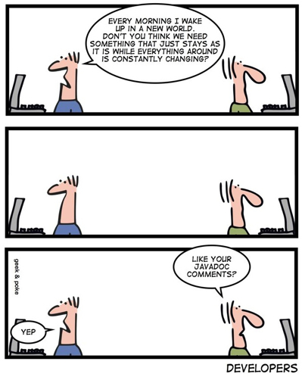
Clean Comments www.cs.uoi.gr/~zarras/soft-devII.htm
from Clean Code by R. C. Martin, a.k.a “Uncle Bob”

Slide 2
Comments - A necessary evil !!
The proper use of comments is to compensate for our failure to express ourselves in code !!!
We must have them because we cannot always figure out how to express ourselves without them, but their use is not a cause for celebration….
Notes:
αποζημίωση

Slide 3
Comments don’t make up for bad code !!
One of the more common motivations for writing comments is bad code.
We write a module and we know it is confusing and disorganized. We know it’s a mess. So we say to ourselves, “Ooh, I’d better comment that!”
Rather than spend your time writing the comments that explain the mess you’ve made, spend it cleaning that mess.

Slide 4
Explain yourself in code !!
// Check to see if the employee is eligible for full benefits
if ((employee.flags & HOURLY_FLAG) && (employee.age > 65))
……
A comment over a complex expression ….
Can we do better than this ??

Slide 5
Explain yourself in code !!
// Check to see if the employee is eligible for full benefits
if ((employee.flags & HOURLY_FLAG) && (employee.age > 65))
……
A comment over a complex expression ….
Can we do better that this ??
It takes only a few seconds of thought to explain most of our intent in code.
In many cases it’s simply a matter of creating a function that says the same thing as the comment you want to write.
if (employee.isEligibleForFullBenefits())

Slide 6
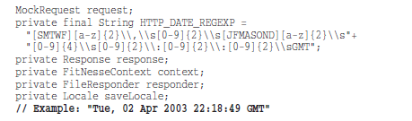
Comments lie !!
Do you see anything strange ??

Slide 7
Comments lie !!
Comments lie !! Not always, and not intentionally, but too often.
The older a comment is, and the farther away it is from the code it describes, the more likely it is to be just plain wrong.
The reason is simple. Programmers can’t realistically maintain them. Code changes and evolves. Chunks of it move from here to there. Those chunks bifurcate and reproduce and come together again to form chimeras. Unfortunately the comments don’t always follow them—can’t always follow them.

Slide 8
Good Comments !!

Slide 9
Legal Comments
// Copyright (C) 2003,2004,2005 by Object Mentor, Inc.
// All rights reserved.
// Released under the terms of the GNU
// General Public License version.
Copyright and authorship statements are necessary and reasonable things to put into a comment at the start of each source file.
BUT, comments like this should not be contracts or legal tomes.
For example, where possible, refer to a standard license or other external document rather than putting all the terms and conditions into the comment.

Slide 10
Informative Comments
It is sometimes useful to provide basic information that is not present in the implementation with a comment.
For example, this comment that explains the return value of an abstract method; the method does not have an implementation so we cannot figure out the intent of the returned value:
// Returns an instance of the Responder being tested.
protected abstract Responder responderInstance();
Could we avoid it ??

Slide 11
Informative Comments
It is sometimes useful to provide basic information that is not present in the implementation with a comment.
For example, this comment that explains the return value of an abstract method; the method does not have an implementation so there is no way to figure out the intent of the returned value:
// Returns an instance of the Responder being tested.
protected abstract Responder responderInstance();
Could we avoid it ??
The method is not implemented but a better name would do
protected abstract Responder getResponderBeingTested();

Slide 12
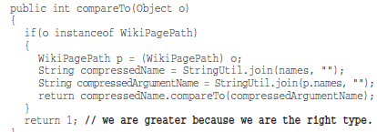
Explain design decisions
Sometimes a comment goes beyond just useful information about the implementation and provides the intent behind a decision.
In the following case, we see an interesting decision documented by a comment. When comparing any object that does not belong to the hosting class (WikiPagePath), with a WikiPagePath object, the latter is considered greater.
without the comment we could wonder why, with the comment its clearer that this was just a decision taken by the author
Notes:
αξιωματικές υποθέσεις
πέρα από την υλοποίηση, εξηγούν το σκεπτικό μιας σχεδιαστικής απόφασης που παρθηκε

Slide 13
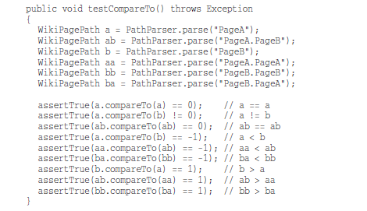
Clarification of arguments, ret values
Sometimes it is just helpful to clarify the meaning of some obscure argument or return value into something that’s readable.
Useful but hard to verify that comments are correct.
Are they ??
Notes:
explain assertTrue; takes the result of an expression; verifies if true and prints something out; it is used for testing

Slide 14
Warnings
Sometimes it is useful to warn other programmers about certain consequences.
// Don't run unless you
// have some time to kill.
public void _testWithReallyBigFile(){
writeLinesToFile(10000000);
response.setBody(testFile);
response.readyToSend(this);
String responseString = output.toString();
assertSubString("Content-Length: 1000000000", responseString);
assertTrue(bytesSent > 1000000000);
}

Slide 15
TODO
It is sometimes reasonable to leave “To do” notes in the form of //TODO comments.
In the following case, the TODO comment explains why the function has a degenerate implementation and what that function’s future should be.
//TODO-MdM these are not needed
// We expect this to go away when we do the checkout model
protected VersionInfo makeVersion() throws Exception {
return null;
}
TODOs are jobs that the programmer thinks should be done, but for some reason can’t do at the moment.
It might be a reminder to delete a deprecated feature or a plea for someone else to look at a problem.
It might be a request for someone else to think of a better name or a reminder to make a change.

Slide 16
Amplification
A comment may be used to amplify the importance of something that may otherwise seem inconsequential.
String listItemContent = match.group(3).trim();
// the trim is real important. It removes the starting
// spaces that could cause the item to be recognized
// as another list.
new ListItemWidget(this, listItemContent, this.level + 1);
return buildList(text.substring(match.end()));

Slide 17
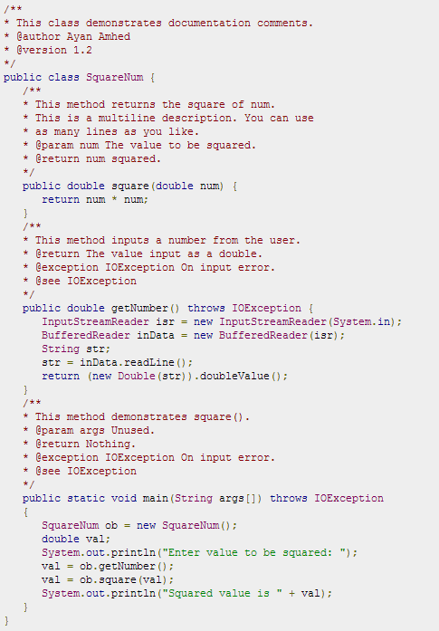
Javadocs
There is nothing quite so helpful and satisfying as a well-described public API. The javadocs for the standard Java library are a case in point.
It would be difficult, at best, to write Java programs without them.
If we are writing a public API, then we should certainly write good javadocs for it.
But keep that Javadocs can be just as misleading, nonlocal, and dishonest as any other kind of comment.

Slide 18
Bad Comments !!

Slide 19
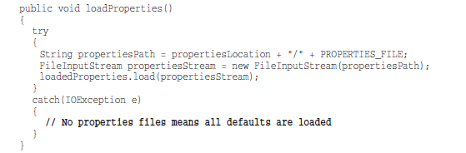
Mumbling
What does that comment in the catch block mean?
Clearly it meant something to the author, but the meaning does not come through all that well.
Notes:
μουρμουρητό

Slide 20
Mumbling
ΜΑΥΒΕ, if we get an IOException, it means that there was no properties file; and in that case all the defaults are loaded.
But are they loaded in a different place ? Where ? Who is responsible for that ?
Notes:
μουρμουρητό

Slide 21
Mumbling
Or — and this is the scary possibility —the author trying to tell himself to come back here later and write the code that would load the defaults?
Notes:
μουρμουρητό

Slide 22
Mumbling
Our only recourse is to examine the code in other parts of the system to find out what’s going on.
Any comment that forces you to look in another module for the meaning of that comment has failed to communicate to you and is not worth the bits it consumes !!
Notes:
μουρμουρητό

Slide 23
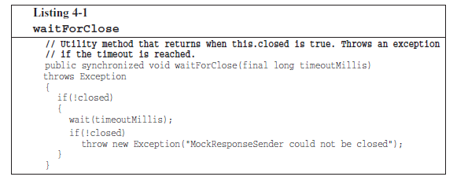
Redundant Comments
What purpose does this comment serve?
Notes:
μουρμουρητό

Slide 24
Redundant Comments
It’s certainly not more informative than the code.
It is not easier to read than the code.
Indeed, it is less precise than the code and entices the reader to accept that lack of precision in lieu of true understanding.
Probably it takes longer to read than the code itself !!!
Notes:
μουρμουρητό

Slide 25
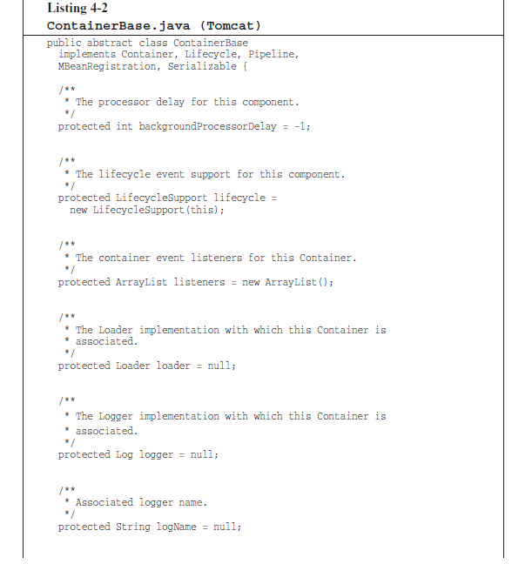
Redundant Comments
More useless and redundant javadoc comments in a class taken from Tomcat.
These comments serve only to clutter and obscure the code.
Remember → vertical density !!
Notes:
μουρμουρητό

Slide 26
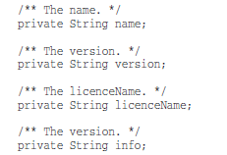
Redundant Comments
more redundant/noise comments !!
But there is something even more scary here !!
can you spot it ??
Notes:
μουρμουρητό

Slide 27
Redundant Comments
more redundant/noise comments !!
But there is something even more scary here !!
can you spot it ??
there is a copy paste error in the last comment !!
Notes:
μουρμουρητό

Slide 28
Misleading Comments
Sometimes, with all the best intentions, a programmer makes a statement in his comments that isn’t precise enough to be accurate.
Do you see how the above comment is misleading?
Notes:
μουρμουρητό

Slide 29
Misleading Comments
Sometimes, with all the best intentions, a programmer makes a statement in his comments that isn’t precise enough to be accurate.
Do you see how the above comment is misleading?
The method does not return when closed is true ; it returns if closed is true, else it waits for a time out and if closed is still false it throws an exception.
Notes:
μουρμουρητό

Slide 30
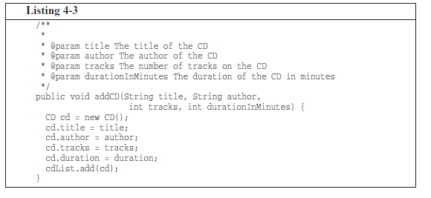
Mandated Comments
How about these comments ??
These comments are there because of a rule followed by the development team that requires each function to have a javadoc comment
Notes:
μουρμουρητό

Slide 31
Mandated Comments
How about these comments ??
These comments are there because of a rule followed by the development team that requires each function to have a javadoc comment
It is just plain silly to have a rule that says that every function must have a javadoc, or every variable must have a comment !!
Notes:
μουρμουρητό

Slide 32
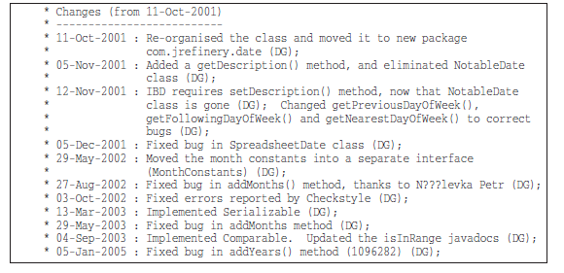
Log Comments
How about these comments ??
Notes:
μουρμουρητό

Slide 33
Log Comments
How about these comments ??
Long ago there was a good reason to create and maintain these log entries at the start of every module. We didn’t have source code control systems that did it for us.
Nowadays, however, these long comments are just more clutter to obfuscate the module. They should be completely removed.
Notes:
μουρμουρητό

Slide 34
Position Markers
Sometimes programmers like to mark a particular position in a source file.
// Actions //////////////////////////////////
There are rare times when it makes sense to gather certain functions together beneath a banner like this. But in general they are clutter that should be eliminated.
So use them very sparingly, and only when the benefit is significant.
Notes:
μουρμουρητό

Slide 35
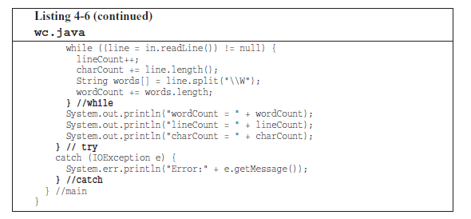
Closing Brace Comments
Closing brace comments make sense for long functions with deeply nested structures.
Notes:
μουρμουρητό

Slide 36
Closing Brace Comments
Closing brace comments make sense for long functions with deeply nested structures.
BUT, we don’t like long functions !!
So if you find yourself wanting to mark your closing braces, try to shorten your functions instead !!
Notes:
μουρμουρητό

Slide 37
Attributions
/* Added by Rick */
Source code control systems are very good at remembering who added what, when.
There is no need to pollute the code with little bylines.
You might think that such comments would be useful in order to help others know who to talk to about the code. But the reality is that they tend to stay around for years and years, getting less and less accurate and relevant.
Notes:
μουρμουρητό

Slide 38

Commented out code
Few practices are as odious as commenting-out code. Don’t do this !!
Others who see that commented-out code won’t have the courage to delete it. They’ll think it is there for a reason and is too important to delete.
Notes:
μουρμουρητό

Slide 39
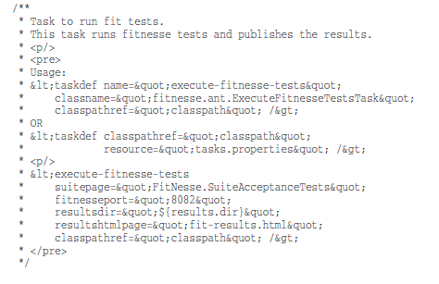
HTML in Comments
What does this comment say ?
Notes:
μουρμουρητό

Slide 40
HTML in Comments
HTML in source code makes the comments hard to read.
If comments are going to be extracted by some tool (like Javadoc) to appear in a Web page, then it should be the responsibility of that tool, and not the programmer, to adorn the comments with appropriate HTML.
Notes:
μουρμουρητό

Slide 41
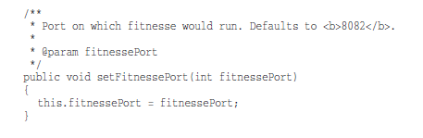
Non local information
How about this comment ??
Notes:
μουρμουρητό

Slide 42
Non local information
Aside from the fact that it is horribly redundant, it also offers information about the default port !!
And yet the function has absolutely no control over what that default is. The comment is not describing the function, but some other, far distant part of the system.
Of course there is no guarantee that this comment will be changed when the code containing the default port is changed !!!
Notes:
μουρμουρητό

Slide 43
Javadocs in non public code
As useful as javadocs are for public APIs, they are anathema to code that is not intended for public consumption.
Generating javadoc pages for the classes and functions inside a system is not generally useful.

Slide 44
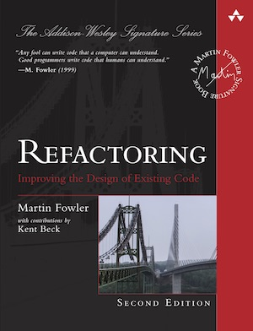
Smells and related refactorings
https://refactoring.com/catalog/

Slide 45
Comments
Symptoms
Scan the text for “//” or “/*” (comment markers).
Causes
Usually, for the best of reasons. The author realizes that something isn’t as clear as it could be, and adds a comment.
Some comments are particularly helpful:
Legal comments, informative, Javadoc public API, TODO, amplification, warnings. Etc….

Slide 46
Comments
What to Do
When a comment explains a block of code, you can often use Extract Method to
pull the block out into a separate method.
The comment will often suggest a name for the new method.

Slide 47
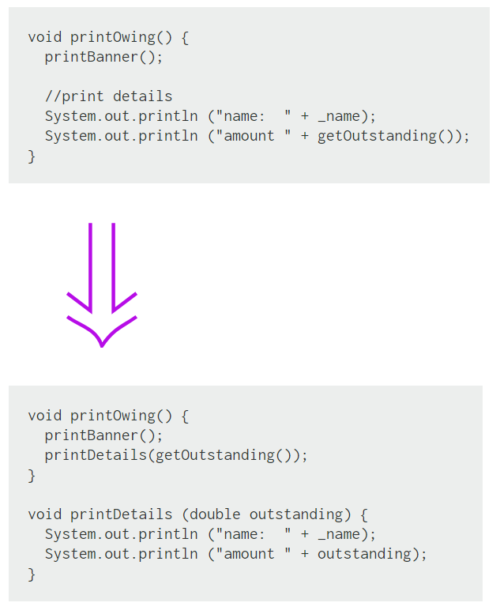
Extract Method
If you have a code fragment that can be grouped together.
Turn the fragment into a method whose name explains the purpose of the method.

Slide 48
Extract Method
Extract Method is one of the most common refactorings
If you have a code fragment that can be grouped together.
Turn the fragment into a method whose name explains the purpose of the method.
Short, well-named methods increase the chances that other methods can reuse them.
It allows the higher-level methods to read more like a story.
Overriding also is easier when the methods are fine grained.
Small methods really work only when you have good names, so you need to pay attention to naming.

Slide 49
Comments
What to Do
When a comment explains what a method does (better than the method’s name!),
use Rename Method using the comment as the basis of the new name.

Slide 50
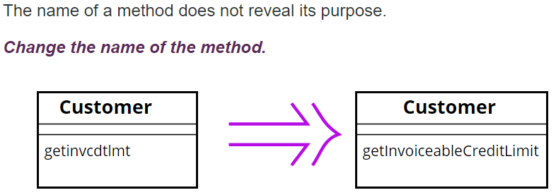
Rename Method
Before changing the name, check if the method overrides (or is overridden) a super class method (by subclasses methods). In that case all the names must change.
Changing the name implies changing the callers of the method.
What we do if this is not possible ??
We can keep the previous version of the method and make it call the new one to avoid duplication; mark the old version of the method as deprecated

Slide 51
Comments
What to Do
When a comment explains preconditions, consider using Introduce Assertion to
replace the comment with code.

Slide 52
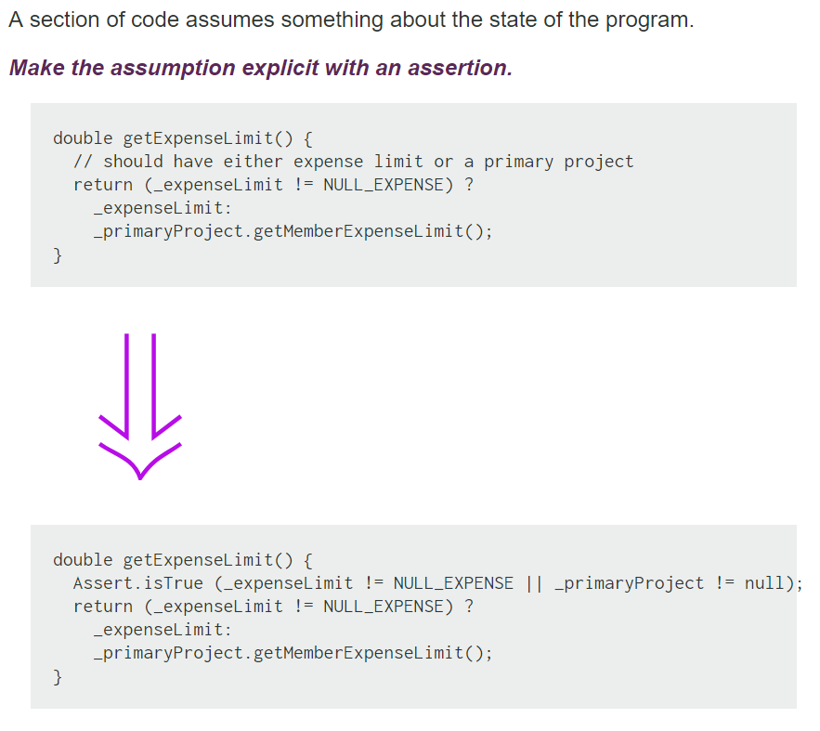
Introduce Assertion
public void setup() {
Connection conn = getConnection();
// conn should be != null to the
// rest of the code to work…
…….
}
// In Java there is a specific programming construct!!
// Don’t confuse it with Junit
// To enable them java –ea
public void setup() {
Connection conn = getConnection();
assert conn != null : "Connection is null";
}
Notes:
assert _expenseLimit != NULL_EXPENSE || …;
Have to run with VM arguments -ea

Slide 53
Introduce Assertion
Often sections of code work only if certain conditions are true. Such assumptions often are not stated but can only be decoded by looking through an algorithm.
Sometimes the assumptions are stated with a comment.
A better technique is to make the assumption explicit by writing an assertion.
Assertions act as communication and debugging aids. In communication they help the reader understand the assumptions the code is making. In debugging, assertions can help catch bugs closer to their origin.

