Slide 1
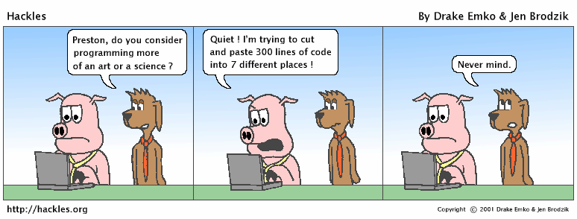
Clean Functions www.cs.uoi.gr/~zarras/soft-devII.htm
from Clean Code by R. C. Martin, a.k.a “Uncle Bob”

Slide 2
Function size and responsibilities

Slide 3
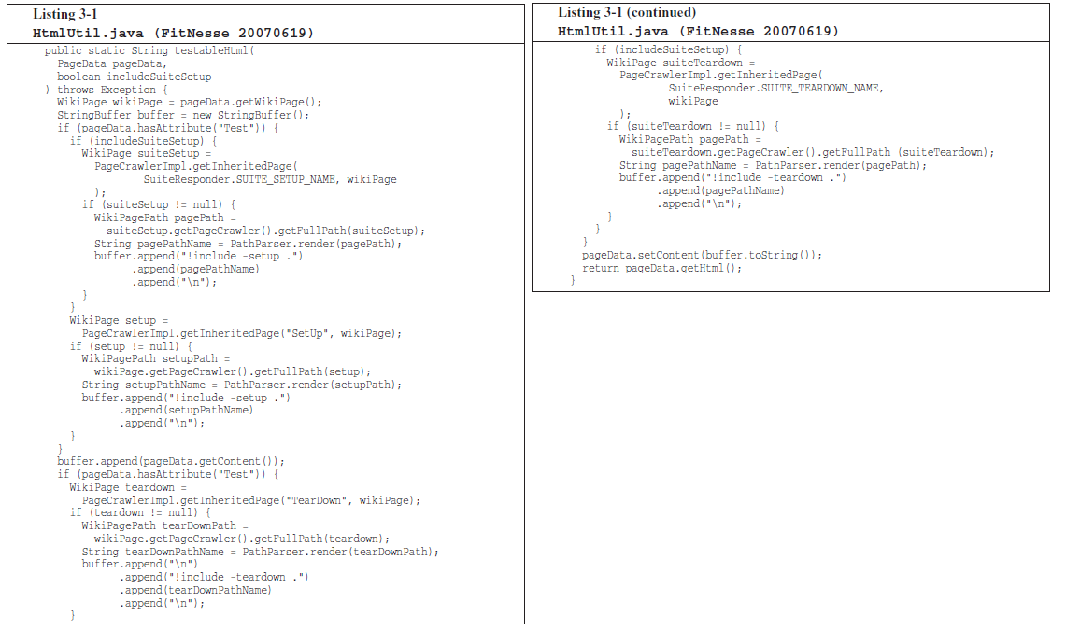
Can You Figure Out What it Does ?
Notes:
Briefly describe fitnesse
χρησιμοποιείς μια markup γλώσσα για να περιγράψεις τα δεδομένα μιας σελίδας.
wiki για developers… μεταξύ άλλων φτιάχνουμε σελίδες για tests …
ακολούθως το fitness φτιάχνει html
μπορούμε να φτιάξουμε τεστ σελίδες … που έχουν In/out, σύνδεση με λειτουργία ενός προγράμματος που θέλουμε να τεστάρουμε κουμπί
create test pages that can be used to run tests on code
a test page contains a table with input data and expected output

Slide 4
Can You Figure Out What it Does ?
Probably not !!
Not only is it long, but it’s got duplicated
code, lots of odd strings, and many strange data types and APIs.
Notes:
ελέγχει αν το page data περιέχει δεδομένα για τη δημιουργία μιας τεστ σελίδας
αν ναι τότε πάει και προσθέτει στο page data setup λειτουργίες που πρέπει να εκτελεστούν πρίν
επίσης προσθέτει στο page data teardown λειτουργίες που πρέπει να εκτελεστούν μετά την εκτέλεση του τεστ
τέλος δημιουργεί το html
(links σε λειτουργίες που πρέπει να εκτελεστούν πρίν/μετά)
a test page comprises setup (specify init actions like init resources for the test) and teardown pages (specify end actions like release resources used for tests)
a test page may be part of a test suite
in this case we may have setup suite and teardown suite pages for the page – i.e., references to pages for tests to be executed before or after the test specified in the current test page
THIS function checks if page data is for a test page and in this case includes the setup and teardown data to the page data
then it creates html for the pagedata

Slide 5
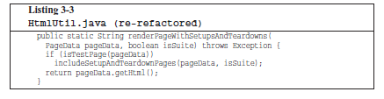
Small !!
the first rule is that functions should be small !!!
Notes:
after some refactoring we get this method; better starting point to understand the code of fitnesse; details hidden in includeSteupTeardownPages
its better because it is small!!

Slide 6
Small !!
What does small mean ???
hundreds of lines ??
tens of lines ??
less ??

Slide 7
Small !!
In the eighties they used to say that a function should be no bigger than a screen-full.
At that time VT100 screens were 24 lines by 80 columns, and the editors used 4 lines for administrative purposes.
Nowadays with a cranked-down font and a nice big monitor, you can fit 150 characters on a line and a 100 lines or more on a screen.
Lines should not be 150 characters long. Functions should not be 100 lines long.
Functions should hardly ever be 20 lines long !!!!
Notes:
μεγάλες και σύγχρονες οθόνες

Slide 8

Small !!
… we can make large programs with two, or three, or four lines functions ….
e.g. Kent Beck’s Sparkle graphical application…
practically ➔ it is quite reasonable to make algorithms of 2, 3, 4 steps,
consisting of more detailed algorithms of 2, 3, 4 steps,
etc.

Slide 9
Small !!
What does it take to make so small functions ???
Blocks within if block statements, else block statements, while block statements, and so on should be one line long.
Probably that line should be a function call.
Not only does this keep the enclosing function small, but it also adds documentary value because the function called within the block can have a nicely descriptive name.

Slide 10
Small !!
What does it take to make so small functions ???
Functions should not be large enough to hold nested blocks.
Therefore, the indent level of a function should not be greater than one or two.
This, of course, makes the functions easier to read and understand.
Notes:
1-2 φωλιασμένα μπλοκ εντολών

Slide 11

Do One Thing !!
The following advice has appeared in one form or another for 30 years or more.
FUNCTIONS SHOULD DO ONE THING.
THEY SHOULD DO IT WELL.
THEY SHOULD DO IT ONLY.

Slide 12
Do One Thing !!
The following advice has appeared in one form or another for 30 years or more.
FUNCTIONS SHOULD DO ONE THING.
THEY SHOULD DO IT WELL.
THEY SHOULD DO IT ONLY.
Great but the problem is that it is hard to know what one thing is !!!

Slide 13
Do One Thing !!
Does this code do one thing?

Slide 14
Do One Thing !!
Does this code do one thing?
It’s easy to make the case that it’s doing three things:
1. Check whether pageData refer to a test page.
2. If so, includes setup and teardown data to pageData.
3. Renders pageData in HTML.

Slide 15
Do One Thing !!
1. Check whether pageData refer to a test page.
2. If so, includes setup and teardown parts to pageData.
3. Renders pageData in HTML.
These three steps are at the same level of abstraction (detail) one level below the stated name of the function; they explain how to construct a page that comprises setup and teardown parts.
Notes:
a function should consist of a sequence of steps that explain what it does, without going into details on how each step is realized (if the step is complex)

Slide 16
Do One Thing !!
To describe what the function does we need only a simple TO paragraph (1,2 simple sentences)….
TO RenderPageWithSetupsAndTeardowns, we check to see whether the pageData refers to a test page and if so, we include the setup and teardown parts. We conclude by extracting the HTML code that contains the pageData.
Notes:
a function should consist of a sequence of steps that explain what it does, without going into details on how each step is realized (if the step is complex)

Slide 17
Do One Thing !!
To explain what this function does we would need many nested TO paragraphs
almost every nested block of commands is by itself a TO paragraph explaining how to realize a step of the higher level block
This indicates that it does more than one thing
Notes:
Κάθε εμφωλευμένο μπλοκ εντολών εξηγεί το πώς υλοποιείται ένα βήμα του αμέσως προηγούμενου επιπέδου εμφώλευσης

Slide 18
Step down rule
We want the code to read like a top-down narrative.
We want every function to be followed by the functions that it calls, so that we can read the program, descending one level of abstraction (detail) at a time.
To say this differently, we want to be able to read the program as though it were a set of TO paragraphs, each of which is describing the current level of abstraction and referencing subsequent TO paragraphs at the next level down.
Notes:
third rule …
after each function we put the functions it calls

Slide 19
Switch Statements & if/else chains
class Bird{
// …
private int type;
private static final int EUROPEAN = 0;
private static final int AFRICAN = 1;
private static final int NORVEGIAN_BLUE = 2;
public double getSpeed(){
switch(type) {
case EUROPEAN: return getBaseSpeed();
case AFRICAN: return getBaseSpeed() – getLoadFactor()*numberOfCoconuts;
case NORVEGIAN_BLUE: return (isNailed) ? 0 : getBaseSpeed();
}
}
// ….
}
It’s hard to make a small switch statement.
By their nature, switch statements always do N things.
Notes:
a primary reason that makes functions long is switch statements and nested if statements

Slide 20
Switch Statements & if/else chains
class Bird{
// …
private int type;
private static final int EUROPEAN = 0;
private static final int AFRICAN = 1;
private static final int NORVEGIAN_BLUE = 2;
public double getSpeed(){
switch(type) {
case EUROPEAN: return getBaseSpeed();
case AFRICAN: return getBaseSpeed() – getLoadFactor()*numberOfCoconuts;
case NORVEGIAN_BLUE: return (isNailed) ? 0 : getBaseSpeed();
}
}
// ….
}
The worst thing is that they never appear once !!
Why is that ???
Notes:
a primary reason that makes functions long is switch statements and nested if statements

Slide 21
Switch Statements & if/else chains
class Bird{
// …
private int type;
private static final int EUROPEAN = 0;
private static final int AFRICAN = 1;
private static final int NORVEGIAN_BLUE = 2;
public double getSpeed(){
switch(type) {
case EUROPEAN: return getBaseSpeed();
case AFRICAN: return getBaseSpeed() – getLoadFactor()*numberOfCoconuts;
case NORVEGIAN_BLUE: return (isNailed) ? 0 : getBaseSpeed();
}
}
// ….
}
The worst thing is that they never appear once !!
Most likely there are:
more Bird methods like this one,
several places where Bird objects are created… in these places the code has a similar structure that chooses what kind of Bird object to create !!!

Slide 22
Switch Statements & if/else chains
// somewhere else …
Bird newBird;
if(birdSelectionFromGui.equals(”European”)){
newBird = new Bird(0, “”);
} else
if(birdSelectionFromGui.equals(”African”, “”)){
newBird = new Bird(1, “”);
} else
if(birdSelectionFromGui.equals(”Norvegian”, “”)){
newBird = new Bird(2, “”);
}
// somewhere else …
Bird birdFromFile;
if(birdSelectionFromFile.equals(”European”)){
birdFromFile = new Bird(0, fileName);
} else
if(birdSelectionFromFile.equals(”African”)){
birdFromFile = new Bird(1, fileName);
} else
if(birdSelectionFromFile.equals(”Norvegian”)){
birdFromFile = new Bird(2, fileName);
}
The worst thing is that they never appear once !!
Most likely there are:
more Bird methods like this one,
several places where Bird objects are created… in these places the code has a similar structure that chooses what kind of Bird object to create !!!

Slide 23
Switch Statements & if/else chains
class Bird{
// …
private int type;
private static final int EUROPEAN = 0;
private static final int AFRICAN = 1;
private static final int NORVEGIAN_BLUE = 0;
public double getSpeed(){
switch(type) {
case EUROPEAN: return getBaseSpeed();
case AFRICAN: return getBaseSpeed() – getLoadFactor()*numberOfCoconuts;
case NORVEGIAN_BLUE: return (isNailed) ? 0 : getBaseSpeed();
}
}
// ….
}
Unfortunately we can’t always avoid switch statements.
Here we can, but how ??
Notes:
another way is to use chain of responsibility !!

Slide 24
Switch Statements & if/else chains
class Bird{
// …
private int type;
private static final int EUROPEAN = 0;
private static final int AFRICAN = 1;
private static final int NORVEGIAN_BLUE = 0;
public double getSpeed(){
switch(type) {
case EUROPEAN: return getBaseSpeed();
case AFRICAN: return getBaseSpeed() – getLoadFactor()*numberOfCoconuts;
case NORVEGIAN_BLUE: return (isNailed) ? 0 : getBaseSpeed();
}
}
// ….
}
In many cases we can replace switch statements with polymorphism !!!

Slide 25
Switch Statements & if/else chains
abstract class Bird{
public abstract double getSpeed();
// ….
}
class European extends Bird {
public double getSpeed(){return getBaseSpeed();}
}
class African extends Bird {
public double getSpeed(){
return getBaseSpeed() – getLoadFactor()*_numberOfCoconuts;
}
}
……
In many cases we can replace switch statements with polymorphism !!!
Did we solve the problem ??

Slide 26
Switch Statements & if/else chains
abstract class Bird{
public abstract double getSpeed();
// ….
}
class European extends Bird {
public double getSpeed(){return getBaseSpeed();}
}
class African extends Bird {
public double getSpeed(){
return getBaseSpeed() – getLoadFactor()*_numberOfCoconuts;
}
}
……
Did we solve the problem ??
We did for class Bird,
but, how about the rest of the places where Bird objects are created… in these places the code has a switch structure that chooses which subclass of Bird objects to create !!!

Slide 27
Switch Statements & if/else chains
// somewhere else …
Bird birdFromFile;
if(birdSelectionFromFile.equals(”European”)){
birdFromFile = new European(fileName);
} else
if(birdSelectionFromFile.equals(”African”)){
birdFromFile = new African(fileName);
} else
if(birdSelectionFromFile.equals(”Norvegian”)){
birdFromFile = new Norvegian(fileName);
}
// somewhere else …
Bird newBird;
if(birdSelectionFromGui.equals(”European”)){
newBird = new European(“”);
} else
if(birdSelectionFromGui.equals(”African”)){
newBird = new African(“”);
} else
if(birdSelectionFromGui.equals(”Norvegian”)){
newBird = new Norvegian(“”);
}
But, how about the rest of the places where Bird objects are created… in these places the code has a switch structure that chooses which subclass of Bird objects to create !!!
What can we do to fix this ???

Slide 28
Switch Statements & if/else chains
// somewhere else …
Bird newBird;
if(birdSelectionFromGui.equals(”European”)){
newBird = new European(“”);
} else
if(birdSelectionFromGui.equals(”African”)){
newBird = new African(“”);
} else
if(birdSelectionFromGui.equals(”Norvegian”)){
newBird = new Norvegian(“”);
}
// somewhere else …
Bird birdFromFile;
if(birdSelectionFromFile.equals(”European”)){
birdFromFile = new European(fileName);
} else
if(birdSelectionFromFile.equals(”African”)){
birdFromFile = new African(fileName);
} else
if(birdSelectionFromFile.equals(”Norvegian”)){
birdFromFile = new Norvegian(fileName);
}
What can we do to fix this ???
The best we can do is to keep the object creation logic buried in one place, and reuse it in all the different places that need to create (a subclass of) Bird objects
This place is often called a Factory class

Slide 29
Switch Statements & if/else chains
class BirdFactory{
private final int EUROPEAN = 0;
private final int AFRICAN = 1;
private final int NORVEGIAN_BLUE = 0;
public Bird createBird(String type, String fileName){
if(type.equals(”European”))
return new European(fileName);
if(type.equals(”African”))
return new African(fileName);
if(type.equals(”Norvegian”))
return new Norvegian(fileName);
}
// ….
}
This place is often called a factory class
What is the benefit of that ??

Slide 30
Switch Statements & if/else chains
class BirdFactory{
private static final int EUROPEAN = 0;
private static final int AFRICAN = 1;
private static final int NORVEGIAN_BLUE = 0;
public static Bird createBird(String type, String fileName){
if(type.equals(”European”))
return new European(fileName);
if(type.equals(”African”))
return new African(fileName);
if(type.equals(”Norvegian”))
return new Norvegian(fileName);
}
// ….
}
This place is often called a factory class
What is the benefit of that ??
Additions/removals/changes in one place

Slide 31
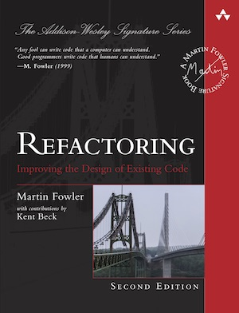
Smells and related refactorings
https://refactoring.com/catalog/

Slide 32
Long Method
Symptoms
Large number of lines in the method. (immediately suspicious of any method with more than five to ten lines.)
Causes
A method has started down a path, and rather than break the flow or identify the helper objects, the author adds “one more thing.”
Code is often easier to write than it is to read, so there’s a temptation to write blocks that are too big.

Slide 33
Long Method
What to Do
Use Extract Method to break up the method into smaller pieces. Look for comments or white space that delineate “interesting” blocks.

Slide 34
Long Method
What to Do
You may find other related refactorings (those that clean up straight-line code, conditionals, and variable usage) helpful before you even begin splitting up the method.

Slide 35
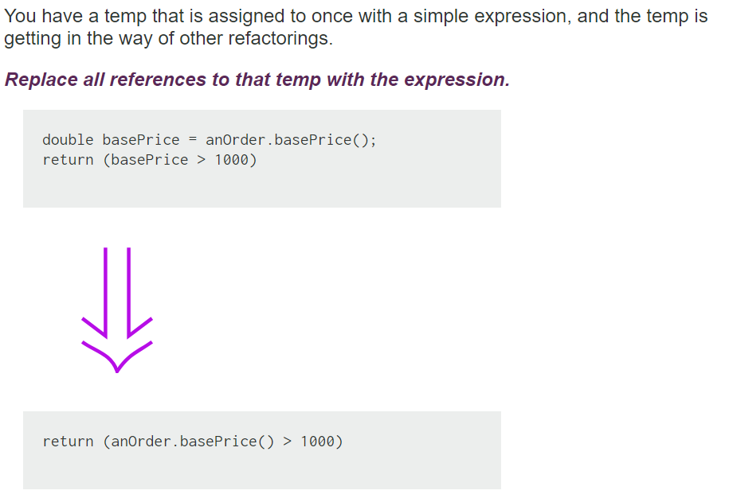
Inline Temp
Notes:
Say about separate query from modifier importance

Slide 36
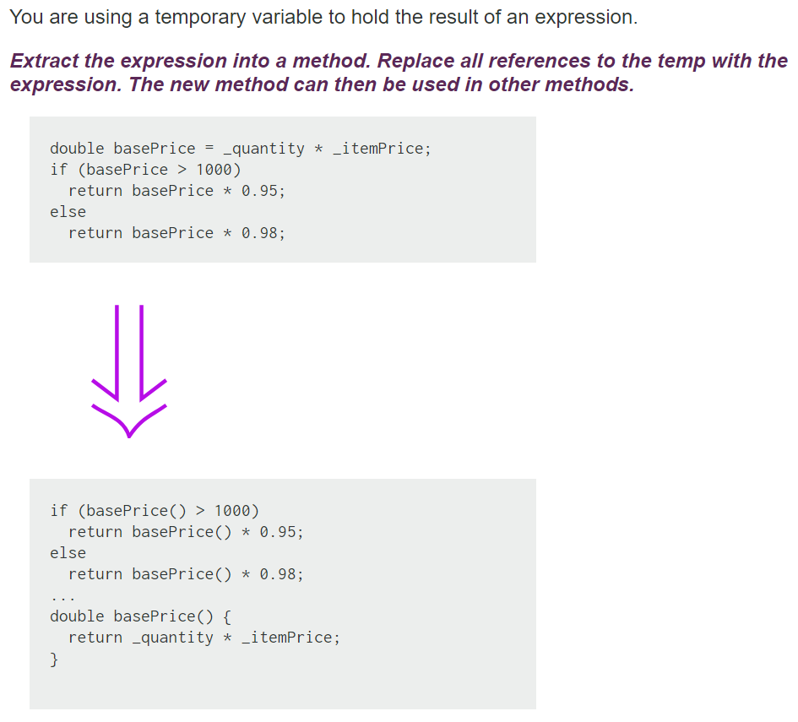
Replace Temp with Query

Slide 37
Replace Temp with Query
Replace Temp with Query often is a vital step before Extract Method.
Local variables make it difficult to extract, so replace as many variables as you can with queries.
The straightforward cases of this refactoring are those in which temps are assigned only to once. Other cases are trickier (e.g. see Split Temporaty Variable) but possible.

Slide 38
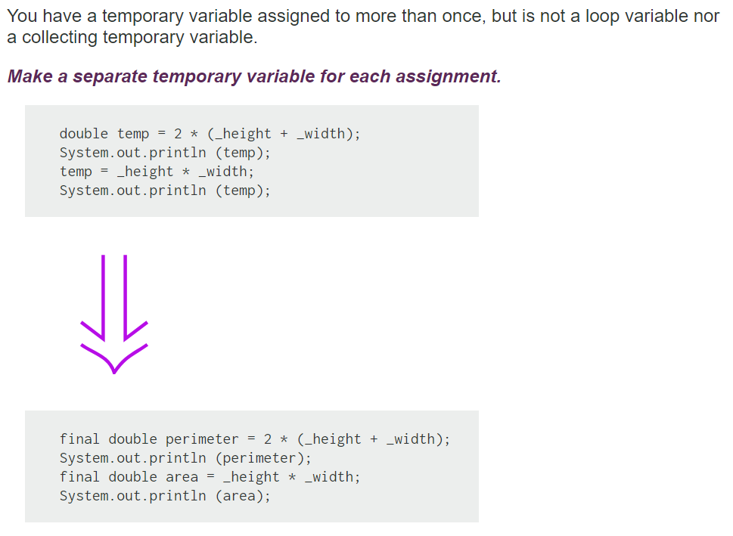
Split Temporary Variable

Slide 39
Split Temporary Variable
Temporary variables are made for various uses.
Some of these uses naturally lead to the temp's being assigned to several times. Loop variables change for each run around a loop (such as the i in for (int i=0; i<10; i++). Collecting temporary variables collect together some value that is built up during the method.
Many other temporaries are used to hold the result of a bit of code for easy reference later.
These kinds of variables should be set only once. That they are set more than once is a sign that they have more than one responsibility within the method.
Any variable with more than one responsibility should be replaced with a temp for each responsibility. Using a temp for two different things is very confusing for the reader.

Slide 40
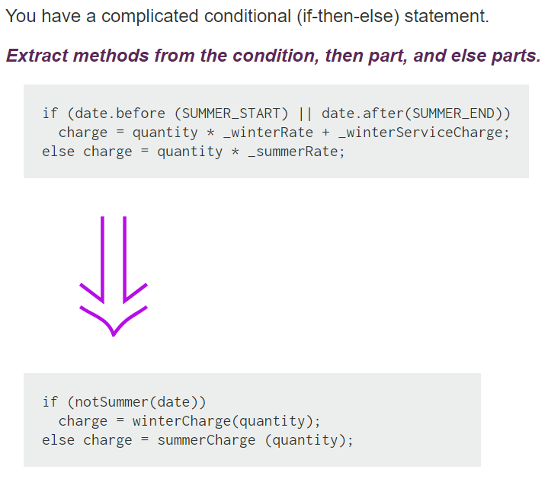
Decompose Conditional

Slide 41
Decompose Conditional
One of the most common areas of complexity in a program lies in complex conditional logic. As you write code to test conditions and to do various things depending on various conditions, you quickly end up with a pretty long method. Length of a method is in itself a factor that makes it harder to read, but conditions increase the difficulty.
As with any large block of code, you can make your intention clearer by decomposing it and replacing chunks of code with a method call named after the intention of that block of code.
With conditions you can receive further benefit by doing this for the conditional part and each of the alternatives.
This way you highlight the condition and make it clearly what you are branching on. You also highlight the reason for the branching.

Slide 42
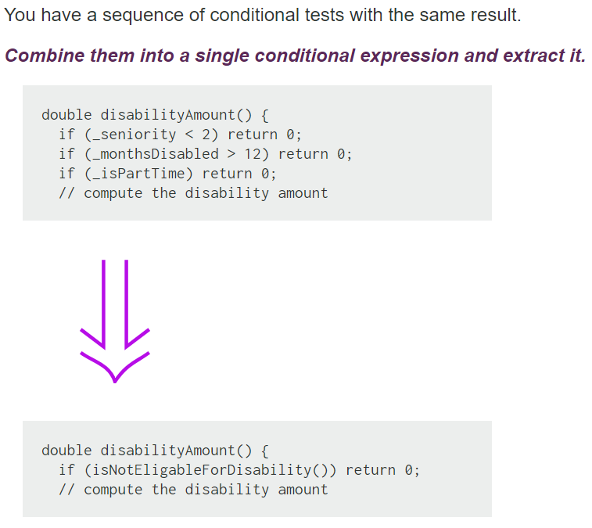
Consolidate Conditional

Slide 43
Consolidate Conditional
Sometimes you see a series of conditional checks in which each check is different yet the resulting action is the same. When you see this, you should use ands and ors to consolidate them into a single conditional check with a single result.
Consolidating the conditional code is important for two reasons.
First, it makes the check clearer by showing that you are really making a single check. The sequence has the same effect, but it communicates carrying out a sequence of separate checks that just happen to be done together.
The second reason for this refactoring is that it often sets you up for EXTRACT METHOD and DECOMPOSE CONDITIONAL.
The reasons in favor of consolidating conditionals also point to reasons for not doing it. If you think the checks are really independent and shouldn't be thought of as a single check, don't do the refactoring.
**** Check that any of the conditionals has side effects. If there are side effects, you won't be able to do this refactoring
Notes:
Side effects issue…
The code that executes if true may return meaning that only one condition is evaluated – and – the respective side effects take place. In the refactored case you evaluate all the conditions

Slide 44
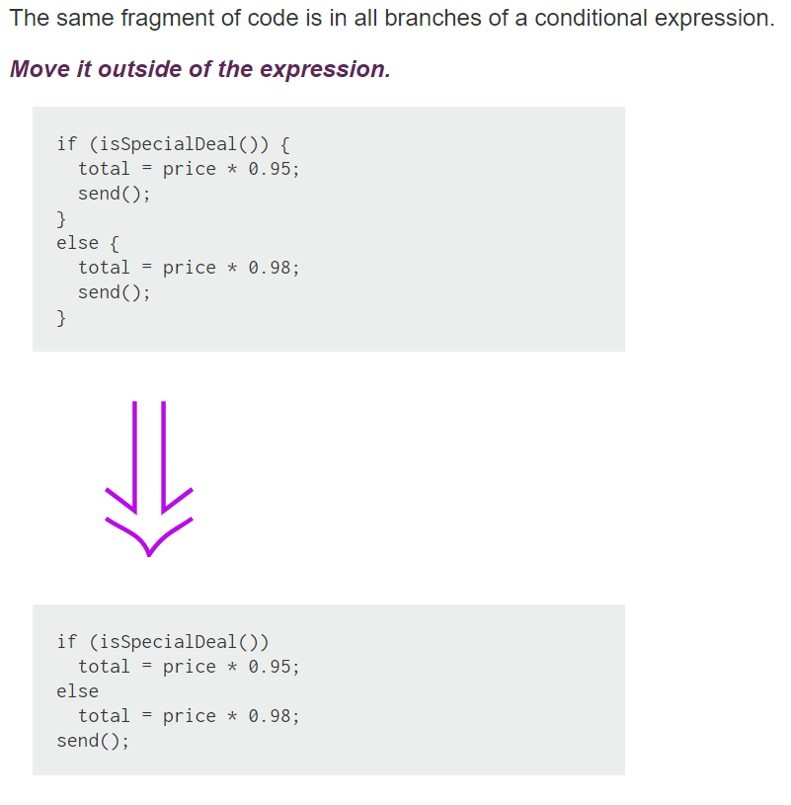
Consolidate Duplicate Conditional Fragments

Slide 45
Consolidate Duplicate Conditional Fragments
Sometimes you find common code executed in all legs of a conditional. In that case you should move the code to outside the conditional. This makes clearer what varies and what stays the same. Simplifies DECOMPOSE CONDITIONAL too.
If the common code is at the beginning, move it to before the conditional.
If the common code is at the end, move it to after the conditional.
If the common code is in the middle, look to see whether the code before or after it changes anything. Depending on this, you can move the common code forward or backward to the ends.
If there is more than a single statement, you should extract that code into a method.

Slide 46
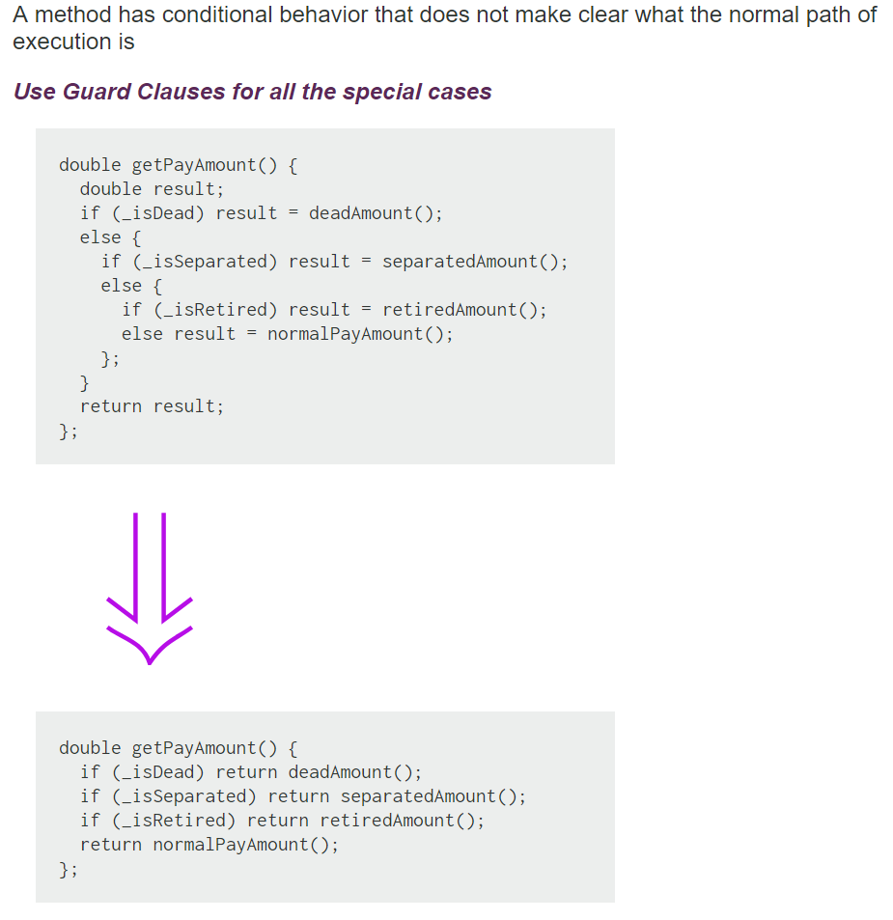
Replace Nested Conditional with Guard

Slide 47
Replace Nested Conditional with Guard
We find that conditional expressions come in two forms.
--- The first form is a check whether either course is part of the normal behavior.
--- The second form is a situation in which one branch from the conditional indicates normal behavior and the other indicates an unusual condition.
These kinds of conditionals have different intentions, and these intentions should come through in the code.
--- If both are part of normal behavior, use a condition with an if and an else leg.
--- If the condition is an unusual condition, check the condition and return if the condition is true. This is called guard clause.
The key point about Replace Nested Conditional with Guard Clauses is one of emphasis. If you
are using an if-then-else construct you are giving equal weight to the if leg and the else leg. This communicates to the reader that the legs are equally likely and important. Instead the guard clause says, "This is rare, and if it happens, do something and get out."

Slide 48
Function parameters

Slide 49

Function Arguments
What is the ideal # of arguments for a clean function ?

Slide 50
Function Arguments
What is the ideal # of arguments for a clean function ?
zero !! Niladic functions are the best
one (monadic functions), or two arguments (dyadic functions), are also OK
Avoid functions with 3, or more than 3 arguments !!!
Why many arguments are not good ??

Slide 51
Function Arguments
Arguments require a lot of brain cycles !!
Each time you use the function, have to remember the arguments, their intent, their order, etc.
Arguments are even harder from a testing point of view.
Imagine the difficulty of writing all the test cases to ensure that various combinations of arguments work properly.
With more than two arguments, testing every combination of appropriate values can become very painful
Notes:
take examples from the BVA testing method !!!
in simple testing methods we need 4 * N + 1 test cases
in more advanced we need 6*N +1
in even more advanced we need 5^N, 7^N test cases

Slide 52
Common Monadic Forms
There are two very common reasons to pass a single argument.
You may be asking a question about that argument, as in:
boolean fileExists(“MyFile”)
Or you may be operating on that argument, transforming it into something else and returning it. For example,:
InputStream openFile(“MyFile”)
transforms a file name String into an InputStream return value.
Another very useful form for a single argument function, is an event/command. In this form there is an input argument but no output argument.
The function uses the argument to alter the state of the program, for example:
void parseStream(InputStream stream)

Slide 53

Flag Arguments
Flag arguments are terrible practice !!!
Why is that ??

Slide 54
Flag Arguments
Flag arguments are terrible practice !!!
Why is that ??
Passing a boolean loudly proclaims that this function does more than one thing.
It does one thing if the flag is true and another if the flag is false
How can we avoid them ???

Slide 55
Flag Arguments
Flag arguments are terrible practice !!!
Why is that ??
Passing a boolean loudly proclaims that this function does more than one thing.
It does one thing if the flag is true and another if the flag is false
How can we avoid them ???
Easy, we can make 2 functions without flag, instead of one with a flag

Slide 56
Argument Objects
When a function seems to need more than two or three arguments, it is likely that some of those arguments ought to be wrapped into a class of their own.
Consider, for example:
Circle makeCircle(double x, double y, double radius);

Slide 57
Argument Objects
When a function seems to need more than two or three arguments, it is likely that some of those arguments ought to be wrapped into a class of their own.
Consider, for example:
Circle makeCircle(double x, double y, double radius);
can become:
Circle makeCircle(Point center, double radius);

Slide 58
Separate Commands from Queries
public int parseFile(String fileName);
……..
what is the meaning of this ?
Unclear what is returned by the function

Slide 59
Separate Commands from Queries
public void parseFile(String fileName);
public int getNumberOfDataEntries();
……..
Much better if we separate command from query

Slide 60
Smells and related refactorings
https://refactoring.com/catalog/

Slide 61
Long Parameter List
Symptoms
Count the number of parameters to a method.
(Even three or four might be too many.)
Causes
An author often tries to minimize coupling between objects. Instead of the called object being aware of relationships between objects, you let the caller locate everything; then the method concentrates on what it is being asked to do with the pieces.
Or, the author generalizes the routine to deal with multiple variations: there’s a general algorithm and a lot of “control” parameters.

Slide 62
Long Parameter List
What to Do
For control/flag parameters Replace Parameter with Explicit Methods

Slide 63
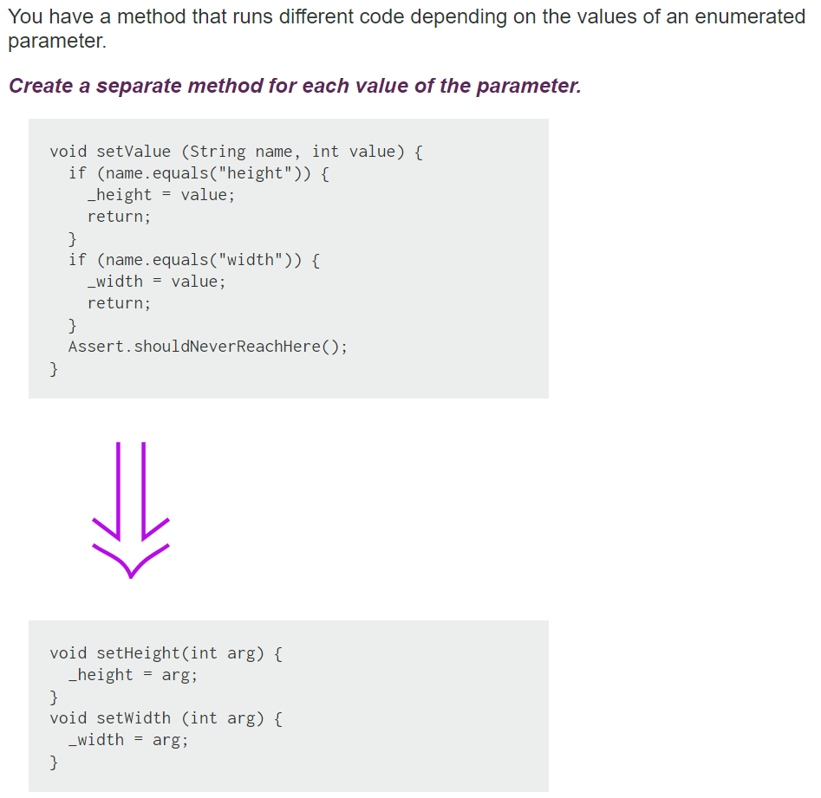
Replace Parameter with Explicit Methods

Slide 64
Replace Parameter with Explicit Methods
The usual case for this refactoring is that you have discrete values of a parameter, test for those values in a conditional, and do different things.
Remember, methods should do one thing that can be expressed in a simple TO statement.
Otherwise, the caller has to decide what it wants to do, set the parameter, and generally do more work than needed.

Slide 65
Long Parameter List
What to Do
If the parameter value can be obtained from an object or method that the called method already knows, Replace Parameter with Method.

Slide 66
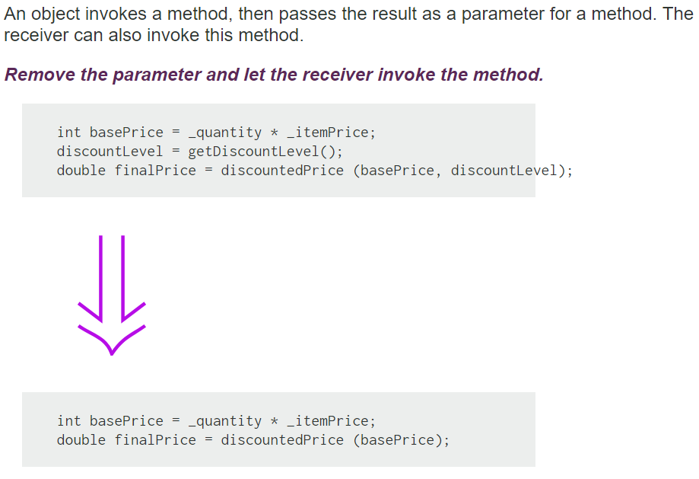
Replace Parameter with Method
Notes:
In different places you may initialize discount level differently before calling discountPrice()
This is a tradeoff to apply the refactoring because it may complicate the code, or it may not be possible, or you may endup with duplicate code (different methods that call a third method :-)
This can be a good question + a nice pattern for plop!!!

Slide 67
Replace Parameter with Method
If a method can get a value that is passed in as parameter by another means, it should. Long parameter lists are difficult to understand, and we should reduce them as much as possible.
One way of reducing parameter lists is to look to see whether the receiving method can make the same calculation.

Slide 68
Long Parameter List
What to Do
If the parameters come from a single object, try Preserve Whole Object.

Slide 69
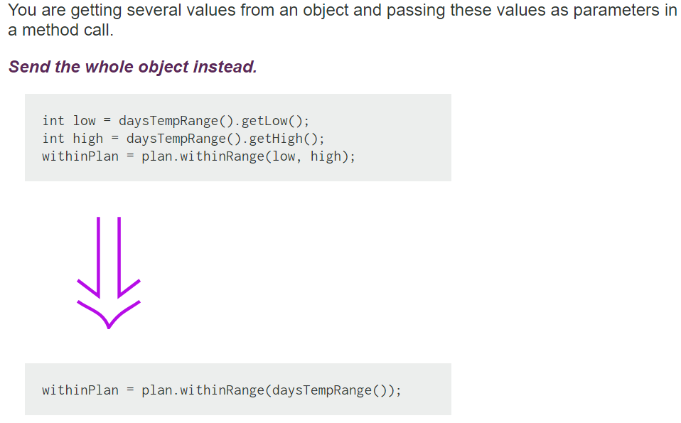
Preserve Object
Notes:
theme how can we combine this refactoring with another to get rid of the coupling issue ?

Slide 70
Preserve Object
Preserve Whole Object often makes the code more readable.
Long parameter lists can be hard to work with because both caller and callee have to remember which values were there.
There is a down side. When you pass in values, the called object has a dependency on the values, but there isn't any dependency to the object from which the values were extracted.
Passing in the required object causes a dependency between the required object and the called object. If this is going to mess up your dependency structure, don't use Preserve Whole Object.
Notes:
theme how can we combine this refactoring with another to get rid of the coupling issue ?

Slide 71
Long Parameter List
What to Do
If the data is not from one logical object, you still might group them via Introduce Parameter Object.

Slide 72
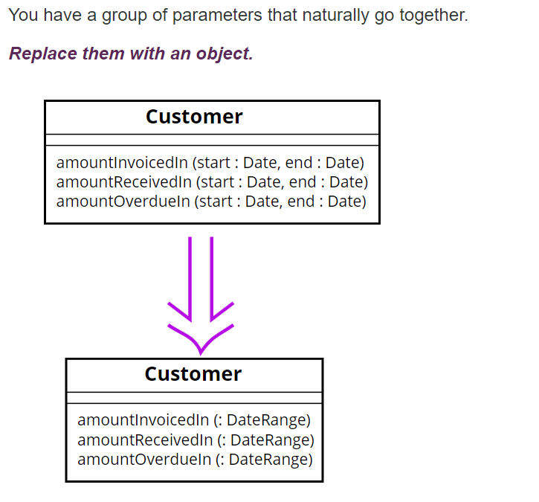
Introduce Parameter Object

Slide 73
Introduce Parameter Object
Often you see a particular group of parameters that tend to be passed together. Several methods may use this group, either on one class or in several classes.
Such a group of classes is a data clump and can be replaced with an object that carries all of this data. It is worthwhile to turn these parameters into objects just to group the data together.
This refactoring is useful because it reduces the size of the parameter lists, and long parameter lists are hard to understand.
You get a deeper benefit, however, because once you have clumped together the parameters, you soon see behavior that you can also move into the new class.
Often the bodies of the methods have common manipulations of the parameter values. By moving this behavior into the new object, you can remove a lot of duplicated code.

Slide 74
Error handling

Slide 75

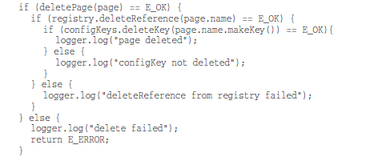
What is wrong with error handling ?
Notes:
Μια υποκατηγορία συναρτήσεων που εκτελούν μια εντολή και απαντουν σε μια ερώτηση είναι αυτές που επιστρέφουν ένα error code, αυτές απαντούν στο ερώτημα αν πήγαν όλα καλά...
κατ’επέκταση του προηγουμένου γενικά είναι προτιμότερο να χρησιμοποιούμε εξαιρέσεις από error codes
στο παράδειγμα …

Slide 76
Prefer Exceptions to Error Codes
Returning error codes from command functions is a subtle violation of command query separation.
The practical problem is that it code that calls the function gets complicated, mixing error handling with normal execution.
Notes:
Μια υποκατηγορία συναρτήσεων που εκτελούν μια εντολή και απαντουν σε μια ερώτηση είναι αυτές που επιστρέφουν ένα error code, αυτές απαντούν στο ερώτημα αν πήγαν όλα καλά...
κατ’επέκταση του προηγουμένου γενικά είναι προτιμότερο να χρησιμοποιούμε εξαιρέσεις από error codes
στο παράδειγμα …

Slide 77
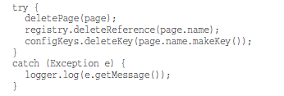
Prefer Exceptions to Error Codes
Here, each method throws an exception, instead of returned error codes.
Then the error processing code can be separated from the normal code using try/catch
The code is much simplified !!

Slide 78
Prefer Exceptions to Error Codes
try/catch blocks are also considered ugly and hard to read…
it forces the reader to understand 2 things, how is the normal work done and how exceptions are handled !!
Can we do better ???

Slide 79
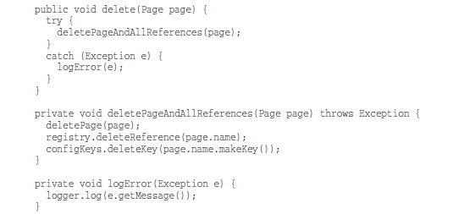
Prefer Exceptions to Error Codes
The above, provides a better separation between normal and error handling code that makes the code easier to understand and modify.

Slide 80
Provide Context with Exceptions
Each exception that you throw should provide enough context to determine the source and location of an error.
In Java, you can get a stack trace from any exception; however, a stack trace can’t tell you the intent of the operation that failed.
Create informative error messages and pass them along with your exceptions.
Mention the operation that failed and the type of failure. If you are logging in your application, pass along enough information to be able to log the error in your catch.
Notes:
οδηγία – παροχή χρήσιμης πληροφορίας

Slide 81
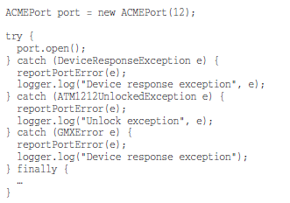
Define Meaningful Exceptions wrt Caller’s Needs
How about this code ??
Notes:
οδηγία - το νόημα των exceptions πρέπει να είναι ξεκάθαρο για αυτόν που τα διαχειρίζεται

Slide 82
Define Meaningful Exceptions wrt Caller’s Needs
How about this code ??
A lot of exceptions for just one method call with weird names that don’t make much sense for the caller of port.open();
The third party API that is used here provides a poor set of exception classes that obscure the readability of the code…
Notes:
cluter = ακαταστασια

Slide 83
Define Meaningful Exceptions wrt Caller’s Needs
when we define exception classes in an application, our most important concern should be to be meaningful for the code that catches and handles them.
Notes:
cluter = ακαταστασια

Slide 84
Define Meaningful Exceptions wrt Caller’s Needs
How can we deal with poor exceptions that come from an external API ??
Notes:
cluter = ακαταστασια

Slide 85
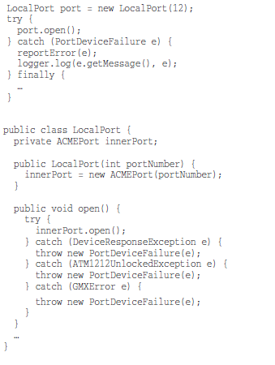
Define Meaningful Exceptions
How can we deal with poor exceptions that come from an external API ??
We can improve our code considerably by wrapping (adapting) the API that we are calling and making sure that it returns a meaningful exception type
LocalPort class is just a simple wrapper that catches and transforms exceptions thrown by the ACMEPort class into a simpler more meaningful for the caller exception
Notes:
cluter = ακαταστασια

Slide 86
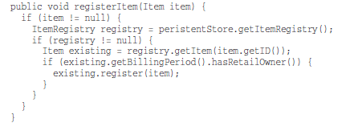
Don’t Return Null
How about this code ??

Slide 87
Don’t Return Null
How about this code ??
When we return null, we are essentially creating work for ourselves and foisting problems upon our callers.
All it takes is one missing null check to send an application spinning out of control.
Notes:
cluter = ακαταστασια

Slide 88
Don’t Return Null
If you are tempted to return null from a method, consider
throwing an exception
or returning a SPECIAL CASE object instead.
If you are calling a null-returning method from a third-party API, consider wrapping that method with a method that either throws an exception or returns a special case object.
Notes:
cluter = ακαταστασια

Slide 89
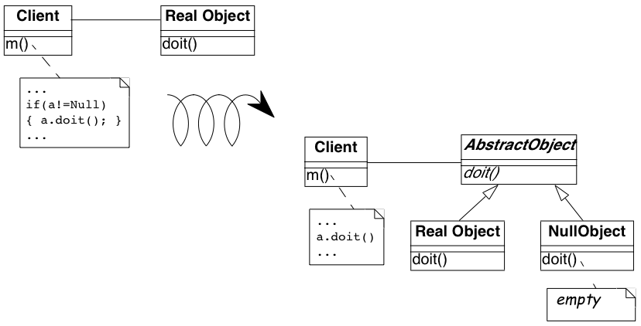
Null Object Pattern
RealObject getTheObject() {
….
if (…)
return new RealObject();
else
return null;
}
Provider
a = provider.getTheObject();
Notes:
cluter = ακαταστασια

Slide 90
Null Object Pattern
AbstractObject getTheObject() {
….
if (…)
return new RealObject();
else
return new NullObject();
}
Provider
a = provider.getTheObject();
Notes:
cluter = ακαταστασια

Slide 91

Don’t Return Null
Right now, getEmployees() can return null, but does it have to?

Slide 92


Don’t Return Null
If we change getEmployees() so that it returns an empty list, we can clean up the code. Java has a special method for making immutable empty lists… Collections.emptyList()
Or just return new ArrayList<Employee>();
Notes:
cluter = ακαταστασια

Slide 93
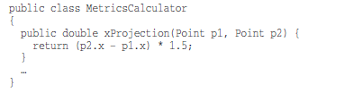
Don’t Pass Null
What happens when someone passes null as an argument?
Notes:
cluter = ακαταστασια

Slide 94
Don’t Pass Null
What happens when someone passes null as an argument?
we will get a NullPointerException
Notes:
cluter = ακαταστασια

Slide 95
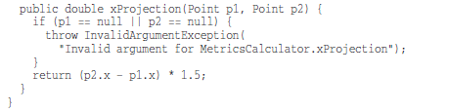
Don’t Pass Null
Could the developer of the class do something better ?
He could check the arguments and throw a more informative exception…
Notes:
cluter = ακαταστασια

Slide 96
Don’t Pass Null
Is this better?
It might be a little better than a null pointer exception, but remember, we have to define a handler for InvalidArgumentException.
Notes:
cluter = ακαταστασια

Slide 97
Don’t Pass Null
Passing null can only create problems…The caller should check what happens in this case. The called must perform null checks. Everybody’s code becomes more complex.
Because this is the case, the rational approach is to avoid passing null by default.
Notes:
cluter = ακαταστασια

