Slide 1
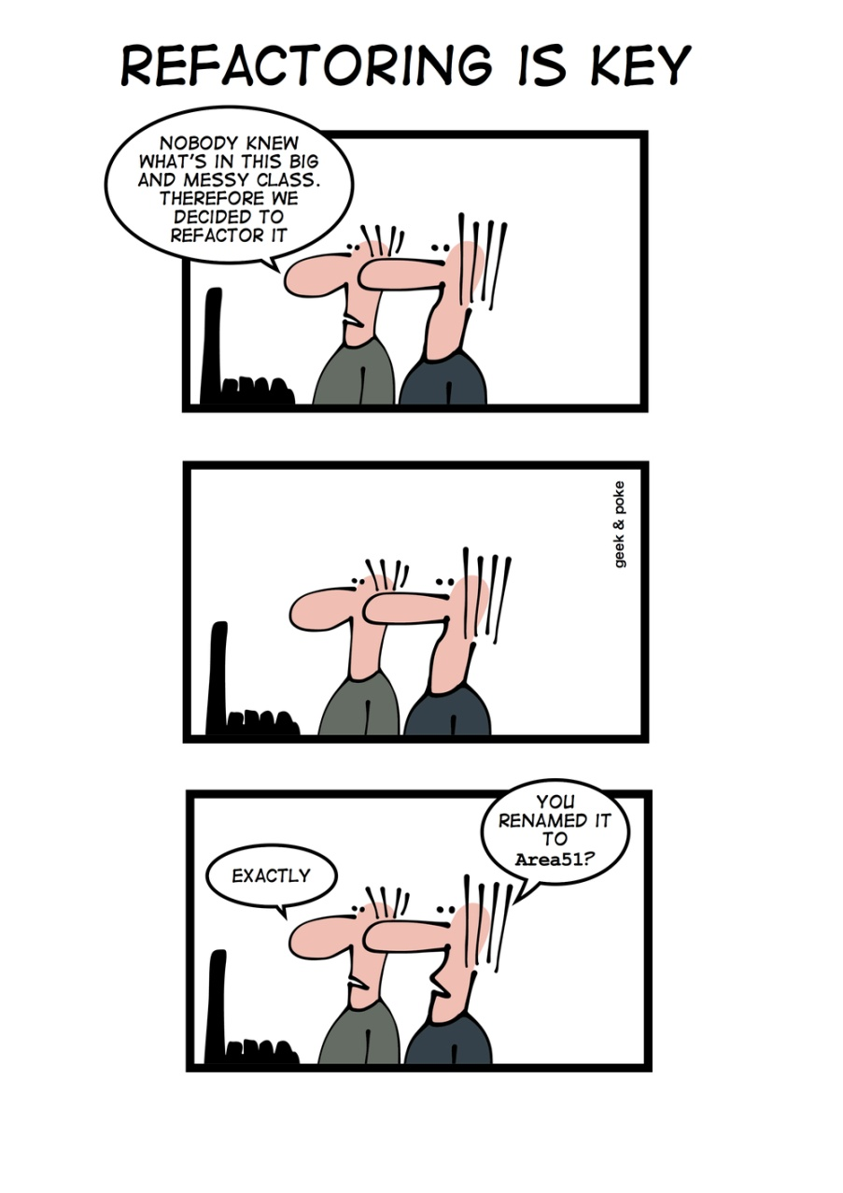
Common Smells www.cs.uoi.gr/~zarras/soft-devII.htm
Sources: M. Fowler Refactorings Catalog
W. Wake Refactoring Workbook

Slide 2
Comments

Slide 3
Comments
Symptoms
Scan the text for “//” or “/*” (comment markers).
Causes
Usually, for the best of reasons. The author realizes that something isn’t as clear as it could be, and adds a comment.
Some comments are particularly helpful:
Legal comments, informative, Javadoc public API, TODO, amplification, warnings. Etc….

Slide 4
Comments
What to Do
When a comment explains a block of code, you can often use Extract Method to
pull the block out into a separate method.
The comment will often suggest a name for the new method.

Slide 5
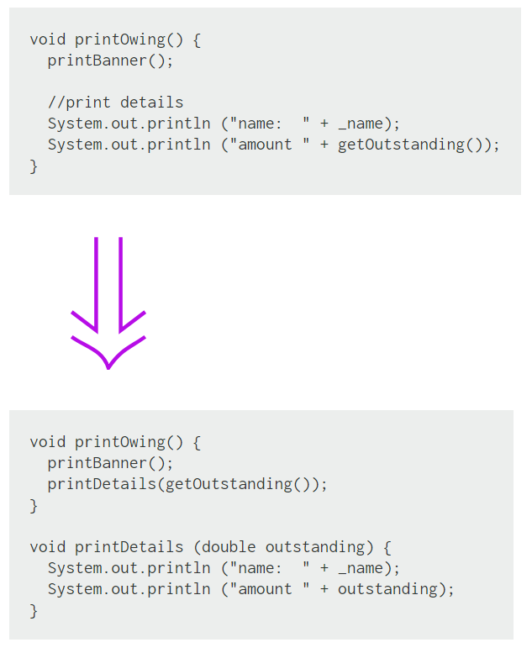
Extract Method
If you have a code fragment that can be grouped together.
Turn the fragment into a method whose name explains the purpose of the method.

Slide 6
Extract Method
Extract Method is one of the most common refactorings
If you have a code fragment that can be grouped together.
Turn the fragment into a method whose name explains the purpose of the method.
Short, well-named methods increase the chances that other methods can reuse them.
It allows the higher-level methods to read more like a story.
Overriding also is easier when the methods are fine grained.
Small methods really work only when you have good names, so you need to pay attention to naming.

Slide 7
Comments
What to Do
When a comment explains what a method does (better than the method’s name!),
use Rename Method using the comment as the basis of the new name.

Slide 8
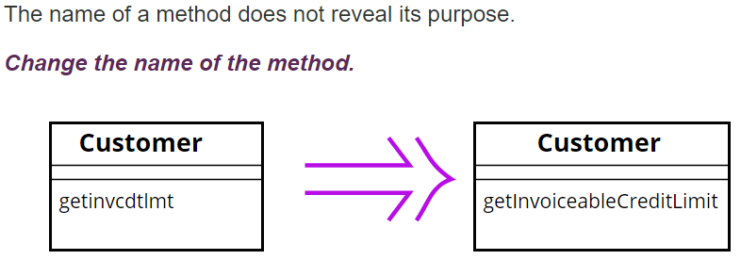
Rename Method
Before changing the name, check if the method overrides (or is overridden) a super class method (by subclasses methods). In that case all the names must change.
Changing the name implies changing the callers of the method.
What we do if this is not possible ??
We can keep the previous version of the method and make it call the new one to avoid duplication; mark the old version of the method as deprecated

Slide 9
Comments
What to Do
When a comment explains preconditions, consider using Introduce Assertion to
replace the comment with code.

Slide 10
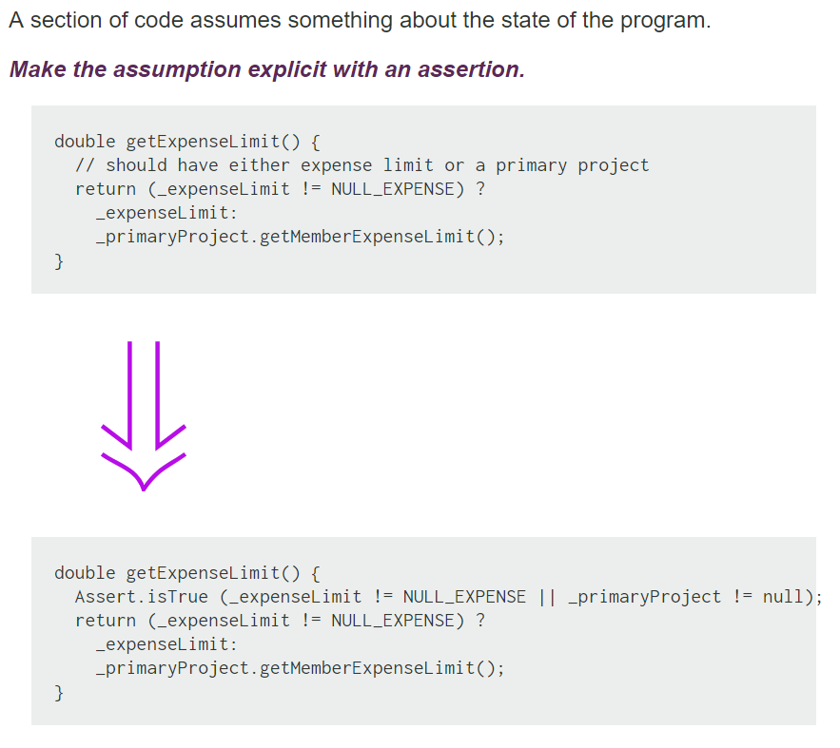
Introduce Assertion
public void setup() {
Connection conn = getConnection();
// conn should be != null to the
// rest of the code to work…
…….
}
// In Java there is a specific programming construct!!
// Don’t confuse it with Junit
// To enable them java –ea
public void setup() {
Connection conn = getConnection();
assert conn != null : "Connection is null";
}
Notes:
assert _expenseLimit != NULL_EXPENSE || …;
Have to run with VM arguments -ea

Slide 11
Introduce Assertion
Often sections of code work only if certain conditions are true. Such assumptions often are not stated but can only be decoded by looking through an algorithm.
Sometimes the assumptions are stated with a comment.
A better technique is to make the assumption explicit by writing an assertion.
Assertions act as communication and debugging aids. In communication they help the reader understand the assumptions the code is making. In debugging, assertions can help catch bugs closer to their origin.

Slide 12
Long Method

Slide 13
Long Method
Symptoms
Large number of lines in the method. (immediately suspicious of any method with more than five to ten lines.)
Causes
A method has started down a path, and rather than break the flow or identify the helper objects, the author adds “one more thing.”
Code is often easier to write than it is to read, so there’s a temptation to write blocks that are too big.

Slide 14
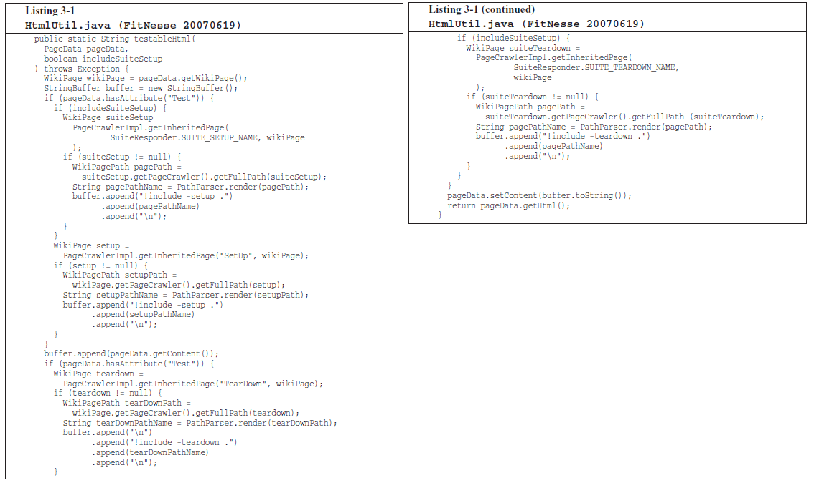
Long Method
Can You Figure Out What it Does ?
Notes:
Briefly describe fitnesse
χρησιμοποιείς μια markup γλώσσα για να περιγράψεις τα δεδομένα μιας σελίδας.
wiki για developers… μεταξύ άλλων φτιάχνουμε σελίδες για tests …
ακολούθως το fitness φτιάχνει html
μπορούμε να φτιάξουμε τεστ σελίδες … που έχουν In/out, σύνδεση με λειτουργία ενός προγράμματος που θέλουμε να τεστάρουμε κουμπί
create test pages that can be used to run tests on code
a test page contains a table with input data and expected output

Slide 15
Long Method
Probably not !!
Not only is it long, but it’s got duplicated
code, lots of odd strings, and many strange data types and APIs.
Notes:
ελέγχει αν το page data περιέχει δεδομένα για τη δημιουργία μιας τεστ σελίδας
αν ναι τότε πάει και προσθέτει στο page data setup λειτουργίες που πρέπει να εκτελεστούν πρίν
επίσης προσθέτει στο page data teardown λειτουργίες που πρέπει να εκτελεστούν μετά την εκτέλεση του τεστ
τέλος δημιουργεί το html
(links σε λειτουργίες που πρέπει να εκτελεστούν πρίν/μετά)
a test page comprises setup (specify init actions like init resources for the test) and teardown pages (specify end actions like release resources used for tests)
a test page may be part of a test suite
in this case we may have setup suite and teardown suite pages for the page – i.e., references to pages for tests to be executed before or after the test specified in the current test page
THIS function checks if page data is for a test page and in this case includes the setup and teardown data to the page data
then it creates html for the pagedata

Slide 16
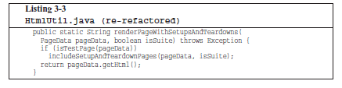
Methods should be small !!
the first rule is that functions should be small !!!
Notes:
after some refactoring we get this method; better starting point to understand the code of fitnesse; details hidden in includeSteupTeardownPages
its better because it is small!!

Slide 17
Methods should be small !!
What does small mean ???
hundreds of lines ??
tens of lines ??
less ??

Slide 18
Methods should be small !!
In the eighties they used to say that a function should be no bigger than a screen-full.
At that time VT100 screens were 24 lines by 80 columns, and the editors used 4 lines for administrative purposes.
Nowadays with a cranked-down font and a nice big monitor, you can fit 150 characters on a line and a 100 lines or more on a screen.
Lines should not be 150 characters long. Functions should not be 100 lines long.
Functions should hardly ever be 20 lines long !!!!
Notes:
μεγάλες και σύγχρονες οθόνες

Slide 19
Methods should be small !!
What does it take to make so small functions ???
Blocks within if statements, else block statements, while block statements, and so on should be one line long.
Probably that line should be a function call.
Not only does this keep the enclosing function small, but it also adds documentary value because the function called within the block can have a nicely descriptive name.

Slide 20
Methods should be small !!
What does it take to make so small functions ???
Functions should not be large enough to hold nested blocks.
Therefore, the indent level of a function should not be greater than one or two.
This, of course, makes the functions easier to read and understand.
Notes:
1-2 φωλιασμένα μπλοκ εντολών

Slide 21
Long Method
What to Do
Use Extract Method to break up the method into smaller pieces. Look for comments or white space that delineate “interesting” blocks.

Slide 22
Long Method
What to Do
You may find other related refactorings (those that clean up straight-line code, conditionals, and variable usage) helpful before you even begin splitting up the method.

Slide 23
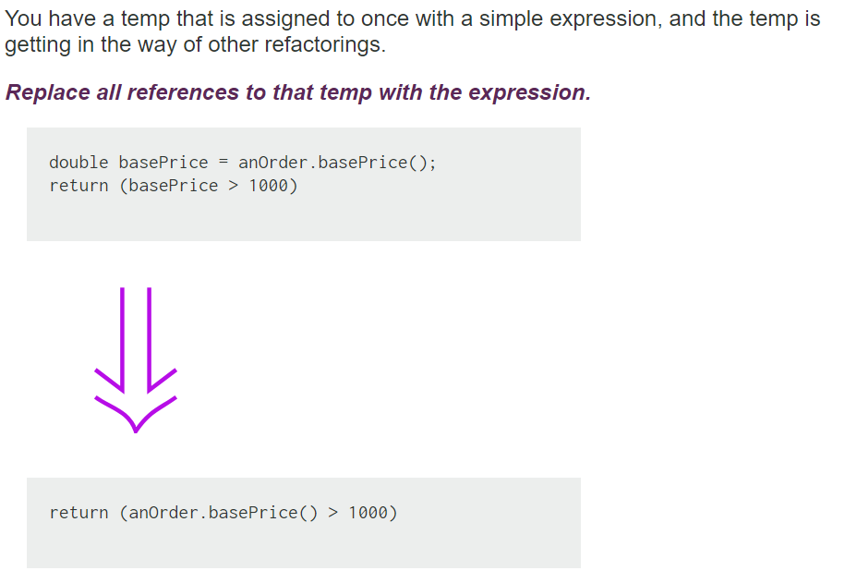
Inline Temp
Notes:
Say about separate query from modifier importance

Slide 24
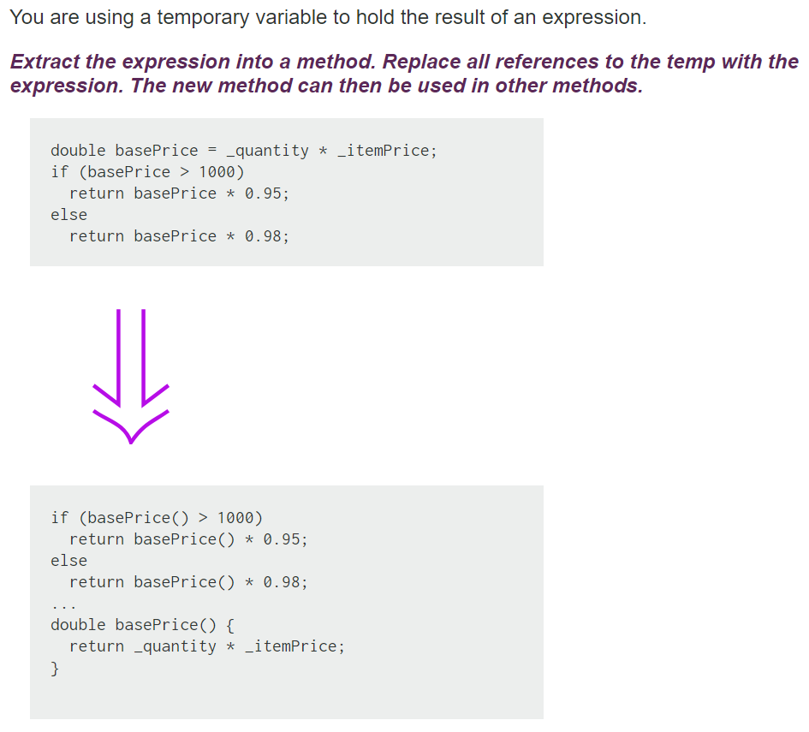
Replace Temp with Query

Slide 25
Replace Temp with Query
Replace Temp with Query often is a vital step before Extract Method.
Local variables make it difficult to extract, so replace as many variables as you can with queries.
The straightforward cases of this refactoring are those in which temps are assigned only to once. Other cases are trickier (e.g. see Split Temporaty Variable) but possible.

Slide 26
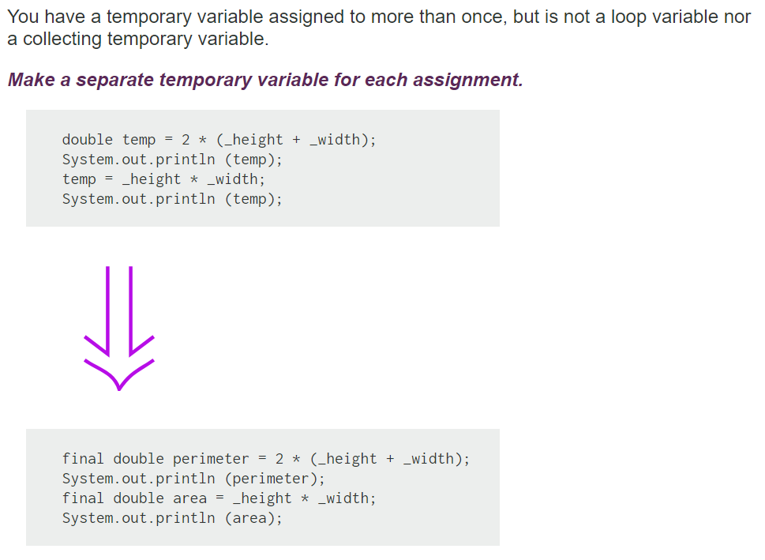
Split Temporary Variable

Slide 27
Split Temporary Variable
Temporary variables are made for various uses.
Some of these uses naturally lead to the temp's being assigned to several times. Loop variables change for each run around a loop (such as the i in for (int i=0; i<10; i++). Collecting temporary variables collect together some value that is built up during the method.
Many other temporaries are used to hold the result of a bit of code for easy reference later.
These kinds of variables should be set only once. That they are set more than once is a sign that they have more than one responsibility within the method.
Any variable with more than one responsibility should be replaced with a temp for each responsibility. Using a temp for two different things is very confusing for the reader.

Slide 28
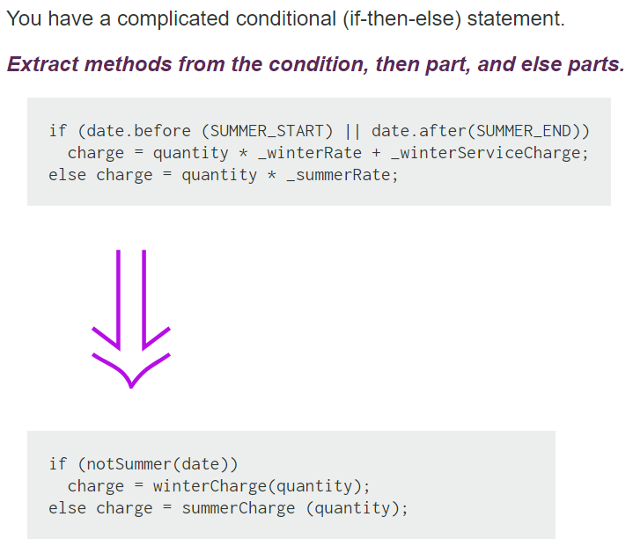
Decompose Conditional

Slide 29
Decompose Conditional
One of the most common areas of complexity in a program lies in complex conditional logic. As you write code to test conditions and to do various things depending on various conditions, you quickly end up with a pretty long method. Length of a method is in itself a factor that makes it harder to read, but conditions increase the difficulty.
As with any large block of code, you can make your intention clearer by decomposing it and replacing chunks of code with a method call named after the intention of that block of code.
With conditions you can receive further benefit by doing this for the conditional part and each of the alternatives.
This way you highlight the condition and make it clearly what you are branching on. You also highlight the reason for the branching.

Slide 30
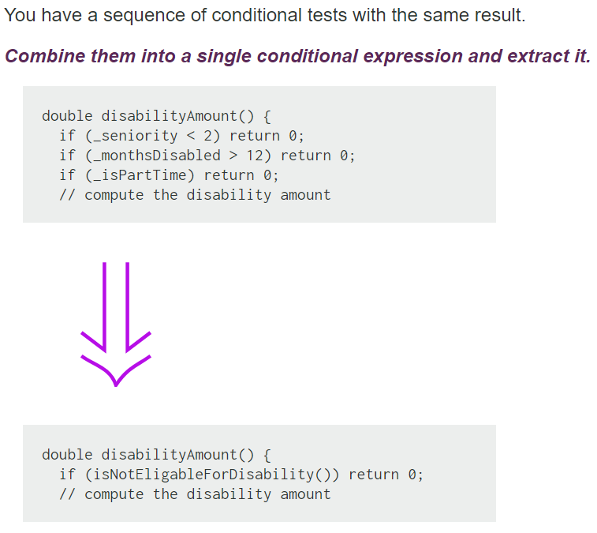
Consolidate Conditional

Slide 31
Consolidate Conditional
Sometimes you see a series of conditional checks in which each check is different yet the resulting action is the same. When you see this, you should use ands and ors to consolidate them into a single conditional check with a single result.
Consolidating the conditional code is important for two reasons.
First, it makes the check clearer by showing that you are really making a single check. The sequence has the same effect, but it communicates carrying out a sequence of separate checks that just happen to be done together.
The second reason for this refactoring is that it often sets you up for EXTRACT METHOD and DECOMPOSE CONDITIONAL.
The reasons in favor of consolidating conditionals also point to reasons for not doing it. If you think the checks are really independent and shouldn't be thought of as a single check, don't do the refactoring.
**** Check that any of the conditionals has side effects. If there are side effects, you won't be able to do this refactoring
Notes:
Side effects issue…
The code that executes if true may return meaning that only one condition is evaluated – and – the respective side effects take place. In the refactored case you evaluate all the conditions

Slide 32
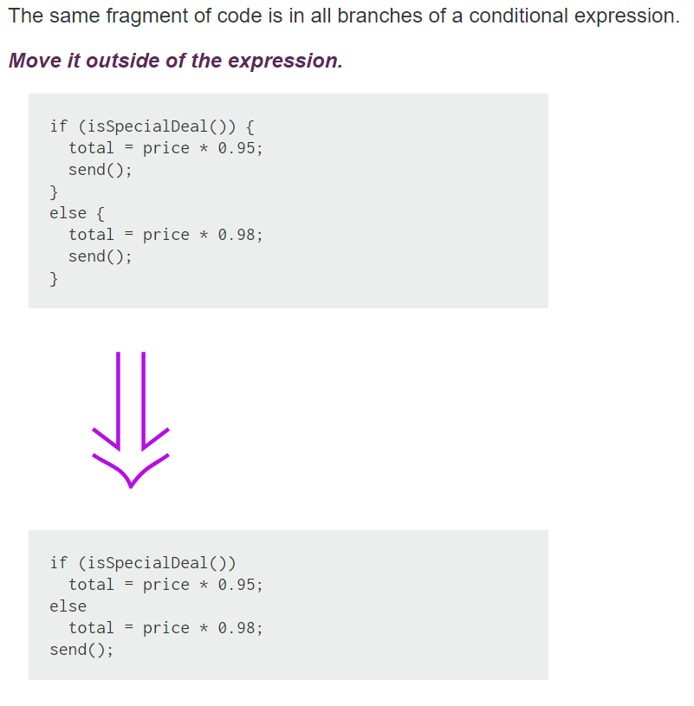
Consolidate Duplicate Conditional Fragments

Slide 33
Consolidate Duplicate Conditional Fragments
Sometimes you find common code executed in all legs of a conditional. In that case you should move the code to outside the conditional. This makes clearer what varies and what stays the same. Simplifies DECOMPOSE CONDITIONAL too.
If the common code is at the beginning, move it to before the conditional.
If the common code is at the end, move it to after the conditional.
If the common code is in the middle, look to see whether the code before or after it changes anything. Depending on this, you can move the common code forward or backward to the ends.
If there is more than a single statement, you should extract that code into a method.

Slide 34
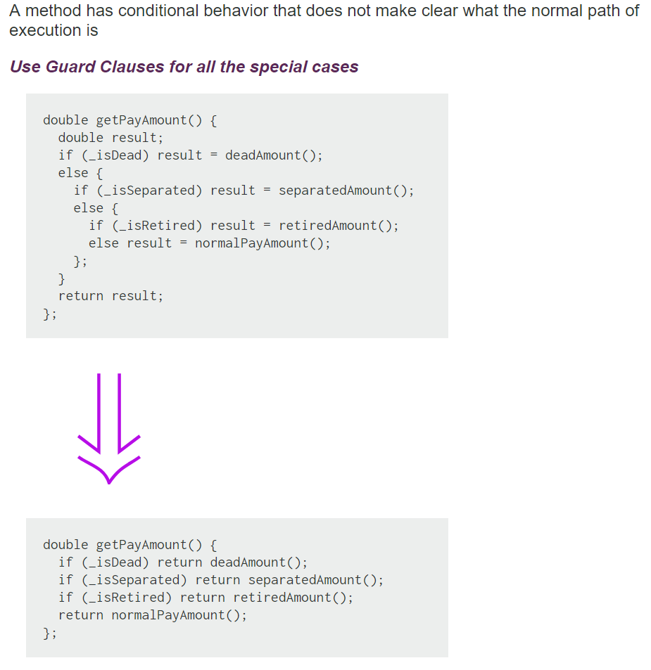
Replace Nested Conditional with Guard

Slide 35
Replace Nested Conditional with Guard
We find that conditional expressions come in two forms.
--- The first form is a check whether either course is part of the normal behavior.
--- The second form is a situation in which one branch from the conditional indicates normal behavior and the other indicates an unusual condition.
These kinds of conditionals have different intentions, and these intentions should come through in the code.
--- If both are part of normal behavior, use a condition with an if and an else leg.
--- If the condition is an unusual condition, check the condition and return if the condition is true. This is called guard clause.
The key point about Replace Nested Conditional with Guard Clauses is one of emphasis. If you
are using an if-then-else construct you are giving equal weight to the if leg and the else leg. This communicates to the reader that the legs are equally likely and important. Instead the guard clause says, "This is rare, and if it happens, do something and get out."

Slide 36
Large Class

Slide 37
Large Class
Symptoms
Large number of instance variables
Large number of methods
Large number of lines
Very general name
Causes
A little bit at a time. The author adds “one more capability” to a class, and eventually it grows too big.
Sometimes the problem is a lack of insight into the parts that make up the whole class.
In any case, the class represents too many responsibilities folded into one object.

Slide 38
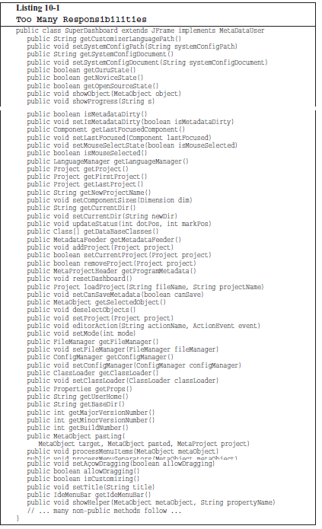
Large Class
With functions we measured size by counting physical lines.
Listing 10-1 outlines a class, SuperDashboard, that exposes about 70 public methods.
Most developers would agree that it’s a bit too super in size.
Some developers might refer to SuperDashboard as a “God class”

Slide 39
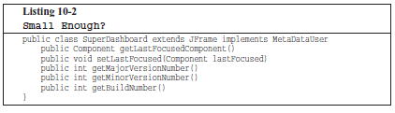
Large Class
But what if SuperDashboard contained only 5 methods ?
Five methods isn’t too much, is it?

Slide 40
Large Class
With classes we use a different measure. We count responsibilities.
In this case the class is NOT small, despite its small number of methods, SuperDashboard has too many responsibilities.
The name of a class should describe what responsibilities it fulfills.
In fact, naming is probably the first way of helping determine class size. If we cannot derive a concise name for a class, then it’s likely too large. The more ambiguous the class name, the more likely it has too many responsibilities.
For example, class names including weasel words like Processor or Manager or Super often hint at unfortunate aggregation of responsibilities.

Slide 41
Classes should be small!!
Is there any well known principle that promotes small classes ???

Slide 42
The Single Responsibility Principle
This principle gives us both a definition of responsibility, and a guideline for class size.
Classes should have one responsibility—one reason to change !!

Slide 43
The Single Responsibility Principle
The seemingly small SuperDashboard class has two reasons to change.
First, it tracks version information that would seemingly need to be updated every time the software gets shipped.
Second, it manages Java Swing components (it is a derivative of JFrame, the Swing representation of a top-level GUI window).

Slide 44
Large Class
What to Do
In general, you’re trying to break up the class.
*** If the class has Long Methods, address that smell first.
Extract Class, if you can identify a new object that has part of this class’s responsibilities
Notes:
Draw figures … to discuss issues and refactorings ….
Explain that the resolution of long methods (exam???) is important before extract class to have something to move to the extracted class
In fact there is this paper that puts order in smell resolution that may be interesting

Slide 45
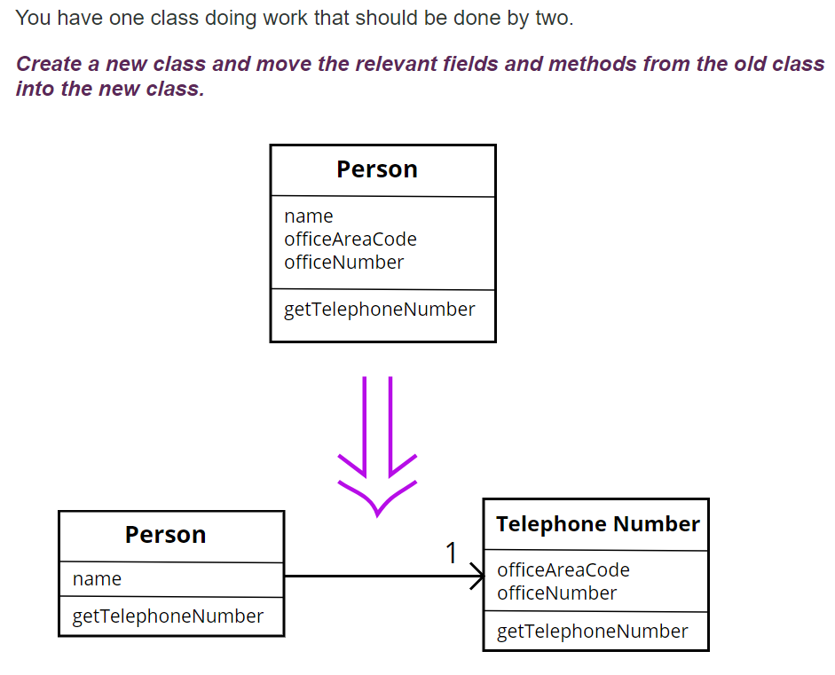
Extract Class

Slide 46
Extract Class
In practice, classes grow.
You add some operations here, a bit of data there. You add a responsibility to a class feeling that it's not worth a separate class, but as that responsibility grows and breeds, the class becomes too complicated.
Such a class is one with many methods and quite a lot of data. A class that is too big to understand easily.
You need to consider where it can be split, and you split it.
A good sign is that a subset of the data and a subset of the methods seem to go together. Other good signs are subsets of data that usually change together or are particularly dependent on each other.

Slide 47
Large Class
What to Do
Extract Subclass, if you can divide responsibilities between the class and a new subclass

Slide 48
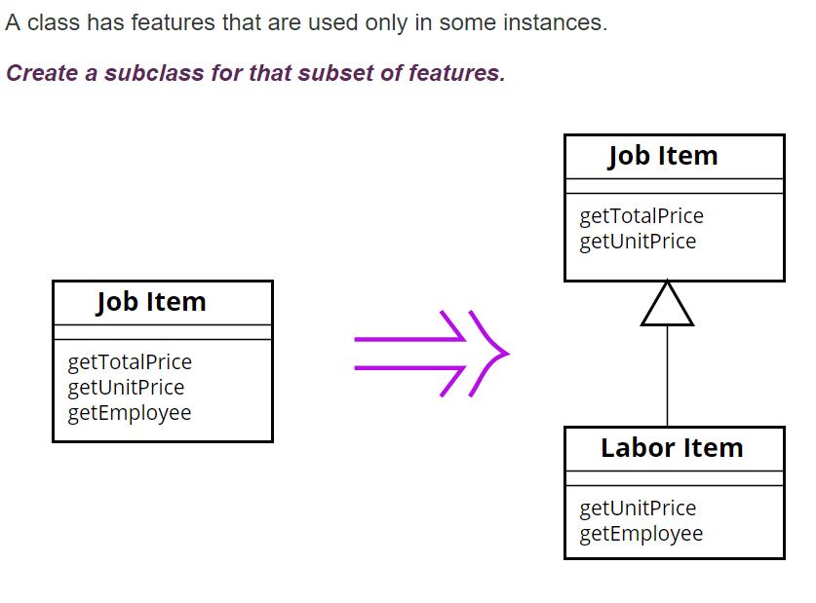
Extract Subclass

Slide 49
Large Class
What to Do
Extract Interface,
you can identify subsets of features that clients use and make separate interfaces for the clients
When ??
If you have no time to extract class or
If it is very complex to extract class
If it does not make sense to extract class because it is cohesive

Slide 50
Extract Interface
Classes use each other in several ways.
Use of a class often means ranging over the whole area of responsibilities of a class.
Another case is use of only a particular subset of a class's responsibilities by a group of clients.
For the second case it is often useful to define an interface for the subset of responsibilities.
That way it is easier to see how the responsibilities of a class divide wrt how they are used by other classes and the different roles played by the class
Notes:
Here can draw a combination of extract interface and progressive extract class to refactor a complicate legacy god class

Slide 51
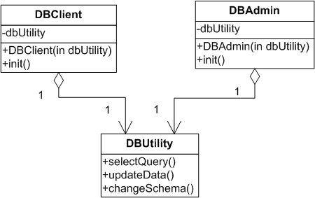
Extract Interface
DBUtility is large
Changes to any method may affect both DBAdmin and DBUser
Both should be re-tested, re-compiled, etc…
But this is waste of time and effort shouldn’t because DBUser only uses selectData() while DBAdmin only uses updateData() and changeSchema()
Notes:
How does this reduce size?? (in the intro of large class we had loc, nom, noa)

Slide 52
Extract Interface
There is no time to extract class ….
DBUtility is more or less cohesive
Notes:
How does this reduce size?? (in the intro of large class we had loc, nom, noa)

Slide 53
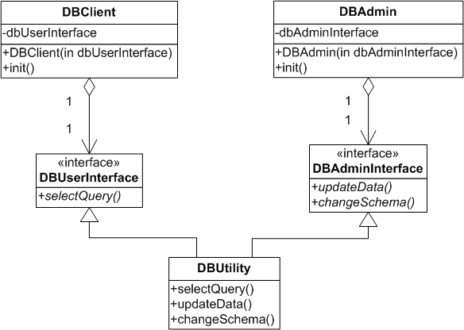
Extract Interface
DBClient and DBAdmin are now isolated from changes to methods they do not use as they use different interfaces implemented by the same class
Notes:
in DIP we had many classes that played the same role. We used an iface to represent this role – this allow to easily change the role players classes
we may also have one class that can play many roles for different clients. In this case it is useful to use ifaces for the different roles. It isolates client classes that don’t relate with a role from role changes

Slide 54
Extract Interface
The Interface Segregation Principle (ISP) says that our classes should not depend upon methods that they don’t use !!
The idea then is to extract different interfaces that match the needs of the client classes…
Notes:
in DIP we had many classes that played the same role. We used an iface to represent this role – this allow to easily change the role players classes
we may also have one class that can play many roles for different clients. In this case it is useful to use ifaces for the different roles. It isolates client classes that don’t relate with a role from role changes

Slide 55
Long Parameter List

Slide 56
Long Parameter List
Symptoms
Count the number of parameters to a method.
(Even three or four might be too many.)
Causes
An author often tries to minimize coupling between objects. Instead of the called object being aware of relationships between objects, you let the caller locate everything; then the method concentrates on what it is being asked to do with the pieces.
Or, the author generalizes the routine to deal with multiple variations: there’s a general algorithm and a lot of “control” parameters.

Slide 57
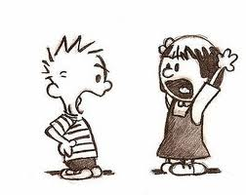
Long Parameter List
What is the ideal # of arguments for a clean function ?

Slide 58
Long Parameter List
What is the ideal # of arguments for a clean function ?
zero !! Niladic functions are the best
one (monadic functions), or two arguments (dyadic functions), are also OK
Avoid functions with 3, or more than 3 arguments !!!
Why many arguments are not good ??

Slide 59
Long Parameter List
Arguments require a lot of brain cycles !!
Each time you use the function, have to remember the arguments, their intent, their order, etc.
Arguments are even harder from a testing point of view.
Imagine the difficulty of writing all the test cases to ensure that various combinations of arguments work properly.
With more than two arguments, testing every combination of appropriate values can become very painful
Notes:
take examples from the BVA testing method !!!
in simple testing methods we need 4 * N + 1 test cases
in more advanced we need 6*N +1
in even more advanced we need 5^N, 7^N test cases

Slide 60
Common Monadic Forms
There are two very common reasons to pass a single argument.
You may be asking a question about that argument, as in:
boolean fileExists(“MyFile”)
Or you may be operating on that argument, transforming it into something else and returning it. For example,:
InputStream openFile(“MyFile”)
transforms a file name String into an InputStream return value.
Another very useful form for a single argument function, is an event/command. In this form there is an input argument but no output argument.
The function uses the argument to alter the state of the program, for example:
void parseStream(InputStream stream)

Slide 61
Long Parameter List
What to Do
For control/flag parameters Replace Parameter with Explicit Methods

Slide 62
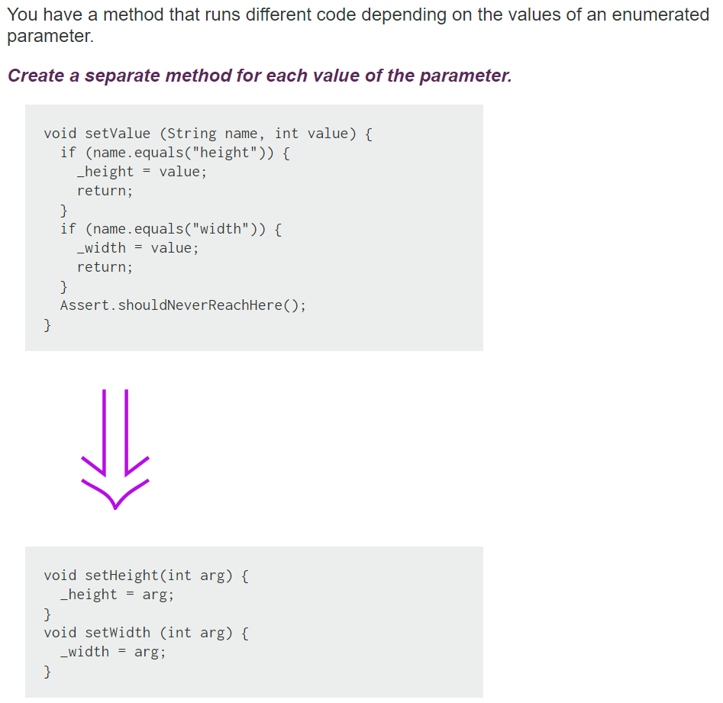
Replace Parameter with Explicit Methods

Slide 63
Replace Parameter with Explicit Methods
The usual case for this refactoring is that you have discrete values of a parameter, test for those values in a conditional, and do different things.
Remember, methods should do one thing that can be expressed in a simple TO statement.
Otherwise, the caller has to decide what it wants to do, set the parameter, and generally do more work than needed.

Slide 64
Long Parameter List
What to Do
If the parameter value can be obtained from an object or method that the called method already knows, Replace Parameter with Method.

Slide 65
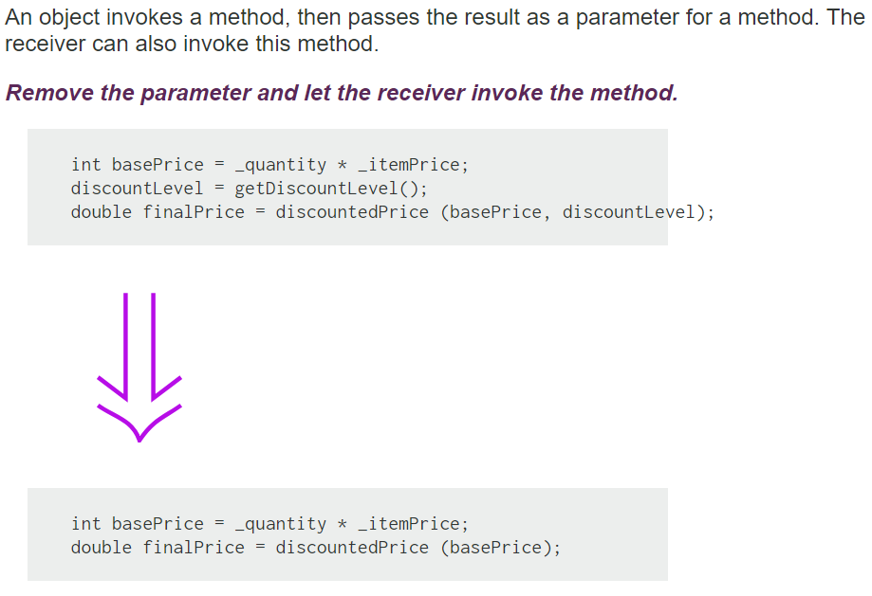
Replace Parameter with Method
Notes:
In different places you may initialize discount level differently before calling discountPrice()
This is a tradeoff to apply the refactoring because it may complicate the code, or it may not be possible, or you may endup with duplicate code (different methods that call a third method :-)
This can be a good question + a nice pattern for plop!!!

Slide 66
Replace Parameter with Method
If a method can get a value that is passed in as parameter by another means, it should. Long parameter lists are difficult to understand, and we should reduce them as much as possible.
One way of reducing parameter lists is to look to see whether the receiving method can make the same calculation.

Slide 67
Long Parameter List
What to Do
If the parameters come from a single object, try Preserve Whole Object.

Slide 68
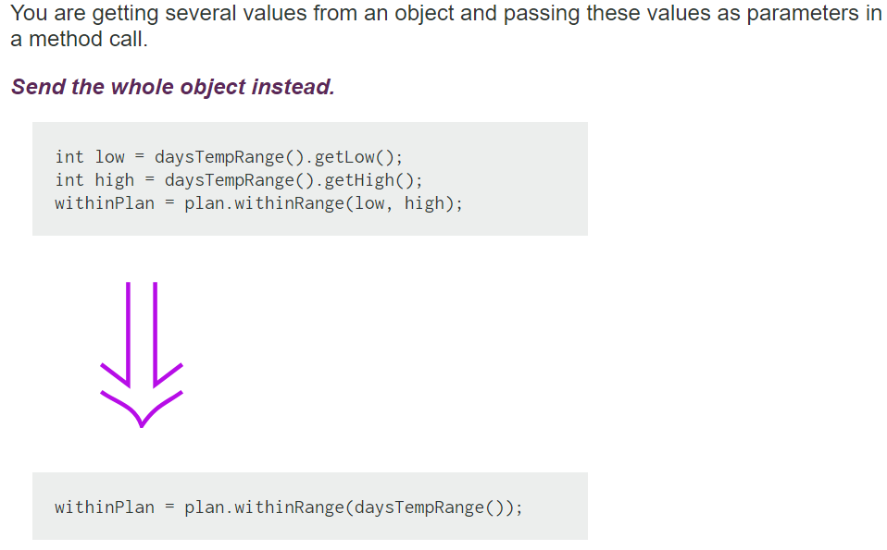
Preserve Object
Notes:
theme how can we combine this refactoring with another to get rid of the coupling issue ?

Slide 69
Preserve Object
Preserve Whole Object often makes the code more readable.
Long parameter lists can be hard to work with because both caller and callee have to remember which values were there.
There is a down side. When you pass in values, the called object has a dependency on the values, but there isn't any dependency to the object from which the values were extracted.
Passing in the required object causes a dependency between the required object and the called object. If this is going to mess up your dependency structure, don't use Preserve Whole Object.
Notes:
theme how can we combine this refactoring with another to get rid of the coupling issue ?

Slide 70
Long Parameter List
What to Do
If the data is not from one logical object, you still might group them via Introduce Parameter Object.

Slide 71
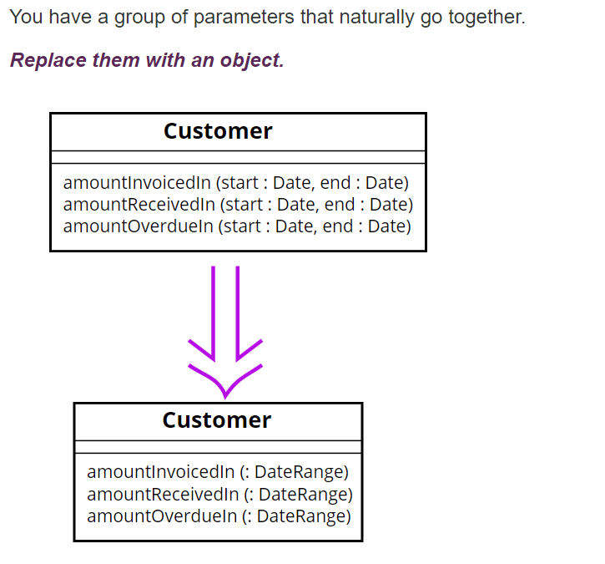
Introduce Parameter Object

Slide 72
Introduce Parameter Object
Often you see a particular group of parameters that tend to be passed together. Several methods may use this group, either on one class or in several classes.
Such a group of classes is a data clump and can be replaced with an object that carries all of this data. It is worthwhile to turn these parameters into objects just to group the data together.
This refactoring is useful because it reduces the size of the parameter lists, and long parameter lists are hard to understand.
You get a deeper benefit, however, because once you have clumped together the parameters, you soon see behavior that you can also move into the new class.
Often the bodies of the methods have common manipulations of the parameter values. By moving this behavior into the new object, you can remove a lot of duplicated code.

