Slide 1
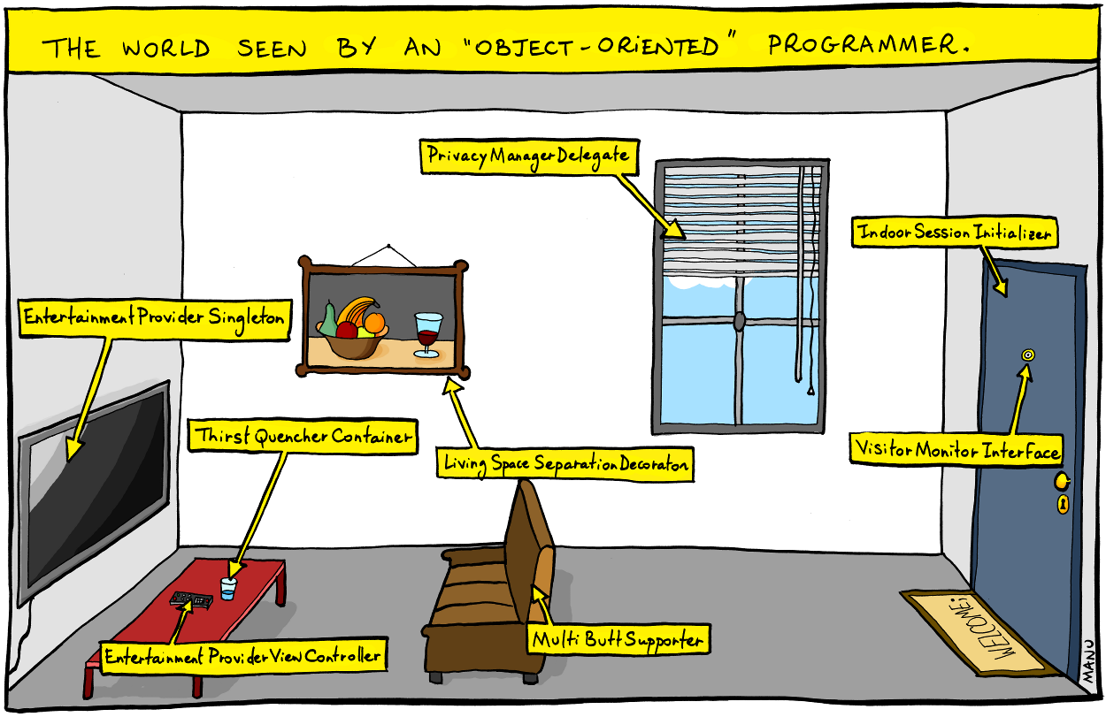
Clean Classes www.cs.uoi.gr/~zarras/soft-devII.htm
from Clean Code by R. C. Martin, a.k.a “Uncle Bob”

Slide 2
Class Organization
Following the standard Java convention, a class should begin with a list of attributes.
Public static constants, if any, should come first. Then private static attributes, followed by private instance attributes.
Public functions/methods should follow the list of attributes. We like to put the private utilities called by a public function right after the public function itself. This follows the stepdown rule and helps the program read like a newspaper article.

Slide 3
Encapsulation
We like to keep our attributes and utility functions/methods private, but we’re not fanatic about it.
Sometimes we need to make an attribute or utility function/methods protected.
There is seldom a good reason to have a public attribute !!!

Slide 4
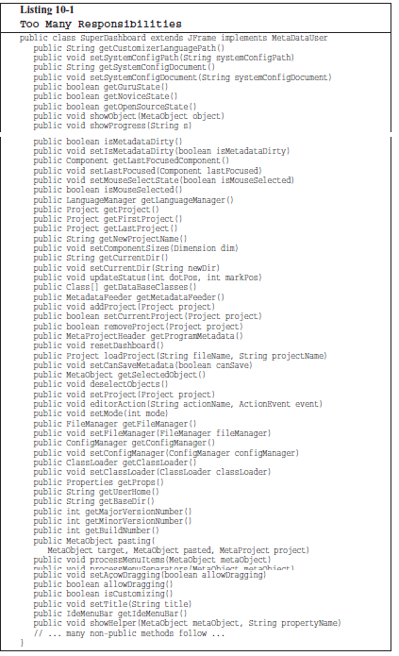
Classes should be small!!
With functions we measured size by counting physical lines.
Listing 10-1 outlines a class, SuperDashboard, that exposes about 70 public methods.
Most developers would agree that it’s a bit too super in size.
Some developers might refer to SuperDashboard as a “God class”

Slide 5
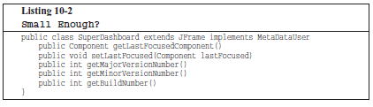
Classes should be small!!
But what if SuperDashboard contained only 5 methods ?
Five methods isn’t too much, is it?

Slide 6
Classes should be small!!
With classes we use a different measure. We count responsibilities.
In this case the class is NOT small, despite its small number of methods, SuperDashboard has too many responsibilities.
The name of a class should describe what responsibilities it fulfills.
In fact, naming is probably the first way of helping determine class size. If we cannot derive a concise name for a class, then it’s likely too large. The more ambiguous the class name, the more likely it has too many responsibilities.
For example, class names including weasel words like Processor or Manager or Super often hint at unfortunate aggregation of responsibilities.

Slide 7
Classes should be small!!
We should also be able to write a brief description of the class in about 25 words, without using the words “if,” “and,” “or,” or “but.”
How would we describe the SuperDashboard?
“The SuperDashboard provides access to the GUI component that last held the focus, and it also allows us to track the version and build numbers.”
The first “and” is a hint that SuperDashboard has too many responsibilities.

Slide 8
Classes should be small!!
Is there any well known principle that promotes small classes ???

Slide 9
The Single Responsibility Principle
This principle gives us both a definition of responsibility, and a guideline for class size.
Classes should have one responsibility—one reason to change !!

Slide 10
The Single Responsibility Principle
The seemingly small SuperDashboard class has two reasons to change.
First, it tracks version information that would seemingly need to be updated every time the software gets shipped.
Second, it manages Java Swing components (it is a derivative of JFrame, the Swing representation of a top-level GUI window).

Slide 11

Smells and related refactorings
https://refactoring.com/catalog/

Slide 12
Large Class
Symptoms
Large number of instance variables
Large number of methods
Large number of lines
Very general name
Causes
A little bit at a time. The author adds “one more capability” to a class, and eventually it grows too big.
Sometimes the problem is a lack of insight into the parts that make up the whole class.
In any case, the class represents too many responsibilities folded into one object.

Slide 13
Large Class
What to Do
In general, you’re trying to break up the class.
*** If the class has Long Methods, address that smell first.
Extract Class, if you can identify a new object that has part of this class’s responsibilities
Notes:
Explain that the resolution of long methods is important before extract class to have something to move to the extracted class
In fact there is this paper that puts order in smell resolution that may be interesting

Slide 14
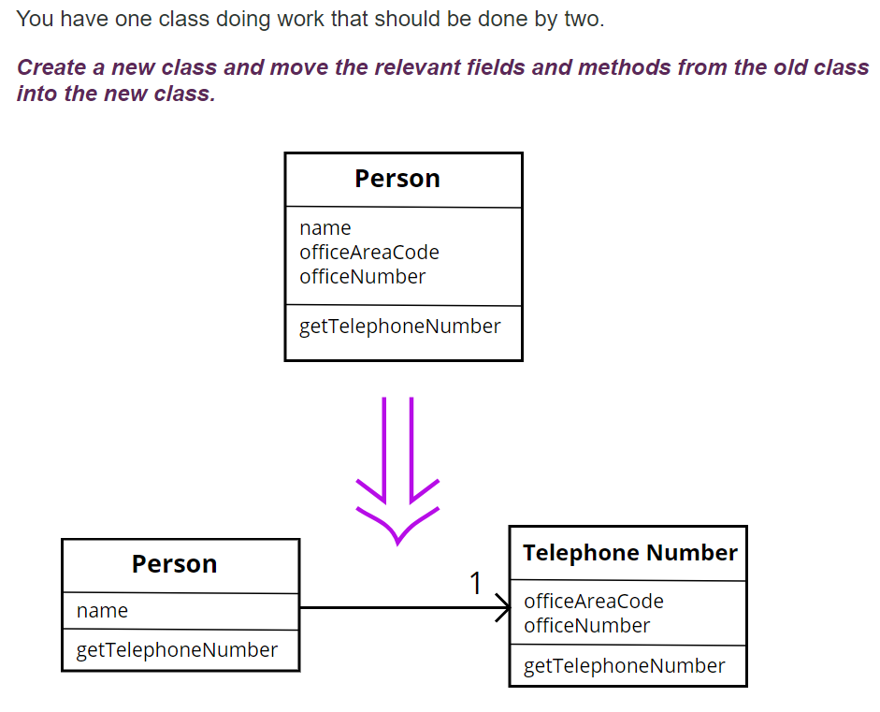
Extract Class

Slide 15
Extract Class
In practice, classes grow.
You add some operations here, a bit of data there. You add a responsibility to a class feeling that it's not worth a separate class, but as that responsibility grows and breeds, the class becomes too complicated.
Such a class is one with many methods and quite a lot of data. A class that is too big to understand easily.
You need to consider where it can be split, and you split it.
A good sign is that a subset of the data and a subset of the methods seem to go together. Other good signs are subsets of data that usually change together or are particularly dependent on each other.

Slide 16
Large Class
What to Do
In general, you’re trying to break up the class.
If the class has Long Methods, address that smell first.
Extract Subclass, if you can divide responsibilities between the class and a new subclass

Slide 17
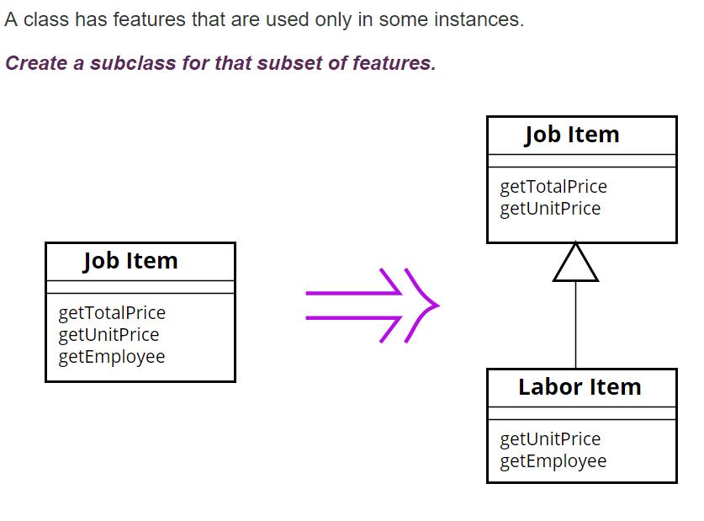
Extract Subclass

Slide 18
Large Class
What to Do
Extract Interface,
you can identify subsets of features that clients use
you have no time to extract class or
it is very complex to extract class or
It does not make sense to extract class because it is cohesive

Slide 19
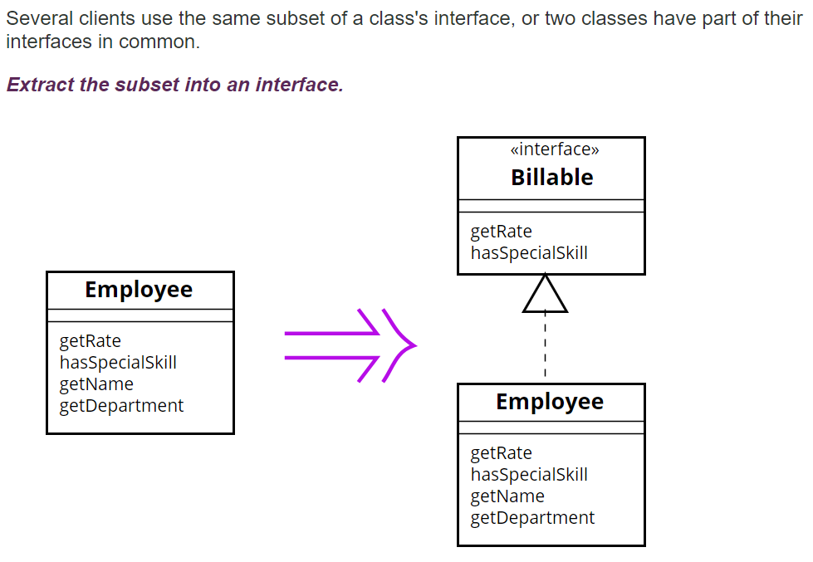
Extract Interface
Notes:
How does this reduce size?? (in the intro of large class we had loc, nom, noa)

Slide 20
Extract Interface
Classes use each other in several ways.
Use of a class often means ranging over the whole area of responsibilities of a class.
Another case is use of only a particular subset of a class's responsibilities by a group of clients.
For the second case it is often useful to define an interface for the subset of responsibilities.
That way it is easier to see how the responsibilities of a class divide wrt how they are used by other classes and the different roles played by the class
Notes:
Here can draw a combination of extract interface and progressive extract class to refactor a complicate legacy god class

Slide 21
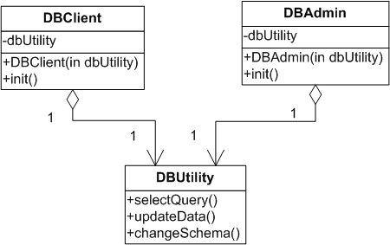
Extract Interface
Changes to any method affect both DBAdmin and DBUser
Both should be re-tested, re-compiled, etc…
But it shouldn’t because DBUser only uses selectData() while DBAdmin only uses updateData() and changeSchema()
Notes:
in DIP we had many classes that played the same role. We used an iface to represent this role – this allow to easily change the role players classes
we may also have one class that can play many roles for different clients. In this case it is useful to use ifaces for the different roles. It isolates client classes that don’t relate with a role from role changes

Slide 22
Extract Interface
Maybe we should separate selectQuery and updateData, changeSchema to different classes ????
What if we DON’T have time to split DBUtility ?
Or what if it DOES NOT MAKE SENSE to split it because it is generally cohesive, providing a single responsibility (ACCESS TO Database) ?
How can we organize better for change?
Notes:
in DIP we had many classes that played the same role. We used an iface to represent this role – this allow to easily change the role players classes
we may also have one class that can play many roles for different clients. In this case it is useful to use ifaces for the different roles. It isolates client classes that don’t relate with a role from role changes

Slide 23
Extract Interface
The Interface Segregation Principle (ISP) says that our classes should not depend upon methods that they don’t use !!
The idea then is to extract different interfaces that match the needs of the client classes…
Notes:
in DIP we had many classes that played the same role. We used an iface to represent this role – this allow to easily change the role players classes
we may also have one class that can play many roles for different clients. In this case it is useful to use ifaces for the different roles. It isolates client classes that don’t relate with a role from role changes

Slide 24
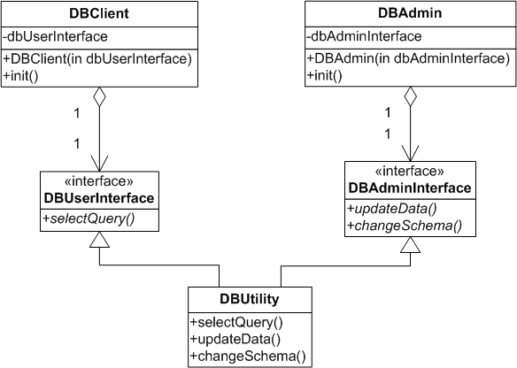
Extract Interface
DBClient and DBAdmin are now isolated from changes to methods they do not use as they use different interfaces implemented by the same class
Notes:
in DIP we had many classes that played the same role. We used an iface to represent this role – this allow to easily change the role players classes
we may also have one class that can play many roles for different clients. In this case it is useful to use ifaces for the different roles. It isolates client classes that don’t relate with a role from role changes

