Slide 1
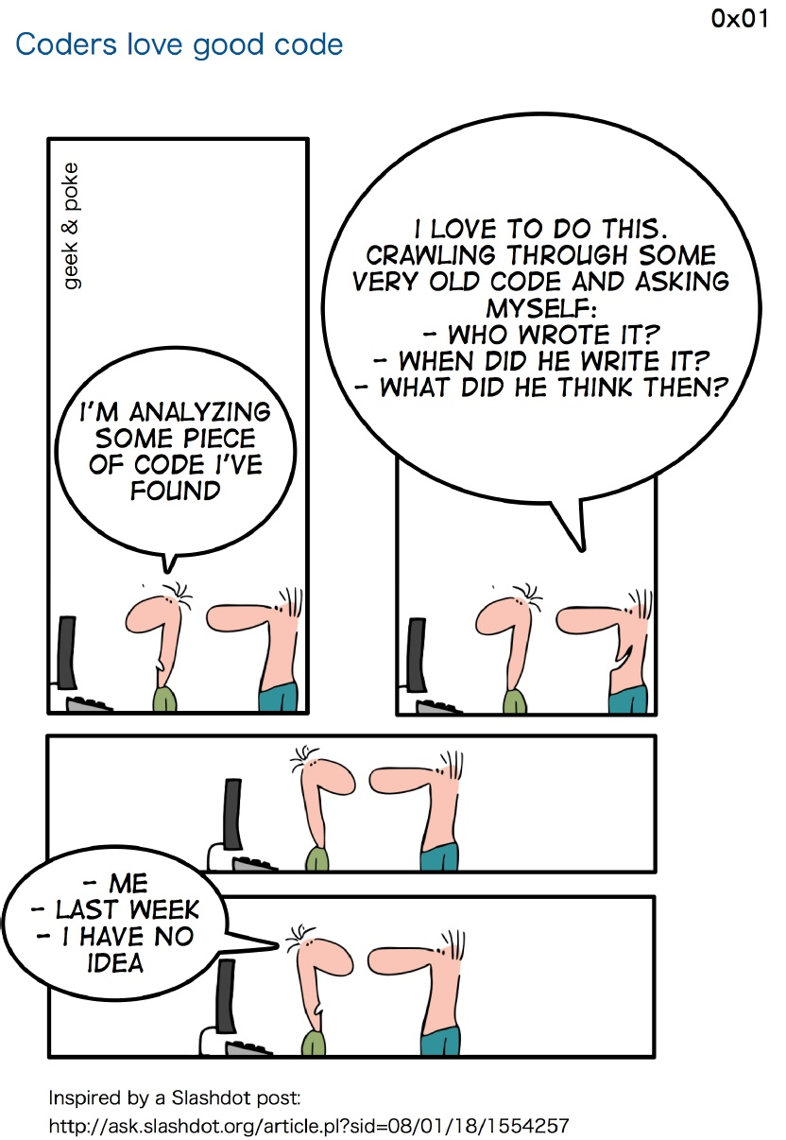
Responsibility www.cs.uoi.gr/~zarras/soft-devII.htm
Sources: M. Fowler Refactorings Catalog
W. Wake Refactoring Workbook

Slide 2
Feature Envy

Slide 3
Feature Envy
Symptoms
You see a method in a class that seems to be focused on manipulating the data of another class rather than itself. (You may notice this because of duplication—several clients do the same manipulation.)
Causes
This is very common among clients of current and former data classes, but you can see it for any class and its clients.
What to Do
Move Method to put the actions on the correct class. (You may have to Extract
Method first to isolate the misplaced part.)

Slide 4
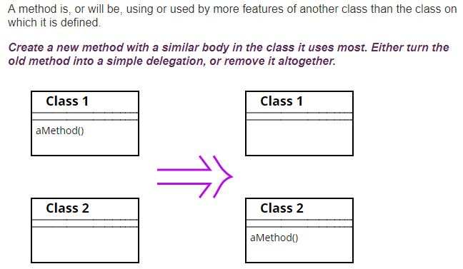
Move Method
Check the sub- and superclasses of the source class for other declarations of the method.
If there are any other declarations, you may not be able to make the move, unless the polymorphism can also be expressed on the target.

Slide 5
Divergent Change

Slide 6
Divergent Change
Symptoms
You find yourself changing the same class for different reasons.
Causes
The class picked up more responsibilities as it evolved, with no one noticing that two different types of decisions were involved.
What to Do
Extract Class to pull out separate classes for the separate responsibilities.
If several classes are sharing the same type of decisions, you may be able to consolidate those new classes (e.g., by Extract Superclass or Extract Subclass).
Notes:
Draw here the case where you extract more than one

Slide 7
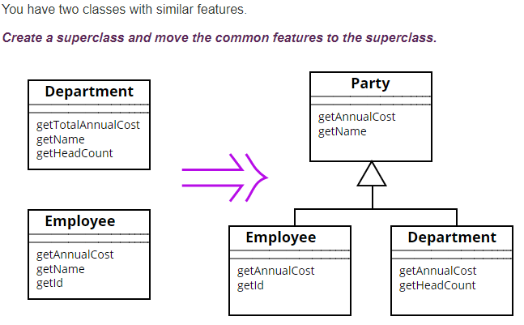
Extract Super Class

Slide 8
Extract Super Class
Another form of duplicate code is two classes that do similar things in the same way or similar things in similar ways.
Objects provide a built-in mechanism to simplify this situation with inheritance. However, often we don't notice the commonalities until we have created some classes, in which case we need to create the inheritance structure later.
It's usually easier to move the common fields first.
If you have subclass methods that have different signatures but the same purpose, use Rename Method to get them to the same name and then use Pull Up Method.
If you have methods with the same signature but different bodies, declare the common signature as an abstract method on the superclass.

Slide 9
Shotgun Surgery

Slide 10
Shotgun Surgery
Symptoms
You want to make a “simple” change, but you have to touch several classes.
Causes
One responsibility has been split among several classes. There may be a missing class that would understand the whole responsibility.
What to Do
Identify the class that should own the group of changes. It may be an existing class, or you may need to Extract Class to create a new one.
Use Move Field and Move Method to put the functionality onto the chosen class.
Notes:
In the example you can consider moving all methods to one class and then solve duplicate code

