Slide 1
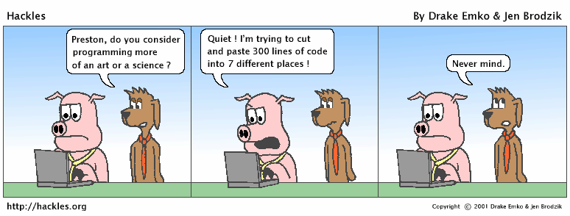
Clean Functions www.cs.uoi.gr/~zarras/soft-devII.htm
from Clean Code by R. C. Martin, a.k.a “Uncle Bob”

Slide 2
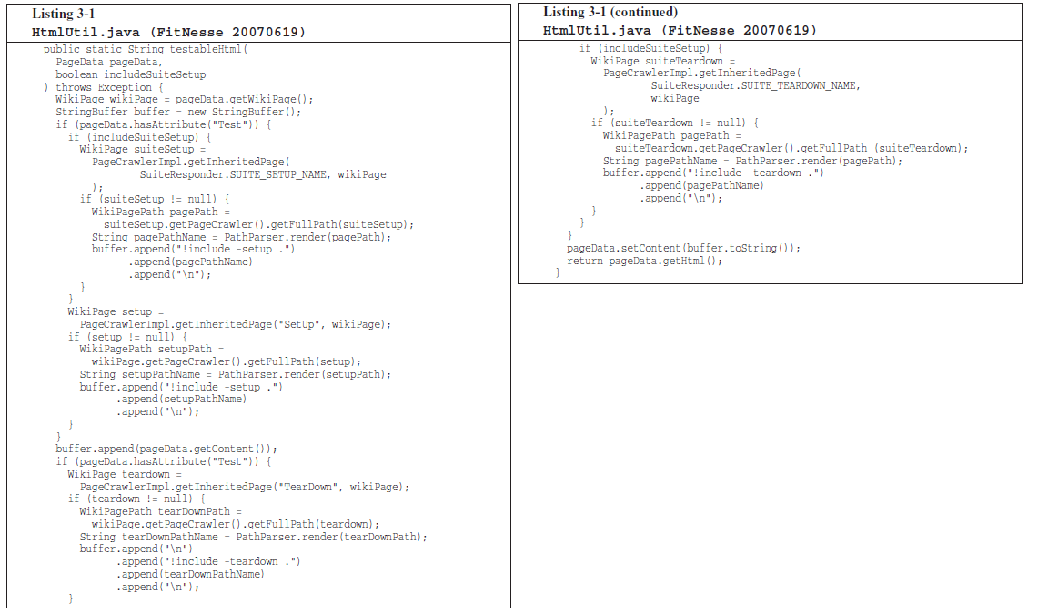
Can You Figure Out What it Does ?
Notes:
Briefly describe fitnesse
χρησιμοποιείς μια markup γλώσσα για να περιγράψεις τα δεδομένα μιας σελίδας.
wiki για developers… μεταξύ άλλων φτιάχνουμε σελίδες για tests …
ακολούθως το fitness φτιάχνει html
μπορούμε να φτιάξουμε τεστ σελίδες … που έχουν In/out, σύνδεση με λειτουργία ενός προγράμματος που θέλουμε να τεστάρουμε κουμπί
create test pages that can be used to run tests on code
a test page contains a table with input data and expected output

Slide 3
Can You Figure Out What it Does ?
Probably not !!
Not only is it long, but it’s got duplicated
code, lots of odd strings, and many strange data types and APIs.
Notes:
ελέγχει αν το page data περιέχει δεδομένα για τη δημιουργία μιας τεστ σελίδας
αν ναι τότε πάει και προσθέτει στο page data setup λειτουργίες που πρέπει να εκτελεστούν πρίν
επίσης προσθέτει στο page data teardown λειτουργίες που πρέπει να εκτελεστούν μετά την εκτέλεση του τεστ
τέλος δημιουργεί το html
(links σε λειτουργίες που πρέπει να εκτελεστούν πρίν/μετά)
a test page comprises setup (specify init actions like init resources for the test) and teardown pages (specify end actions like release resources used for tests)
a test page may be part of a test suite
in this case we may have setup suite and teardown suite pages for the page – i.e., references to pages for tests to be executed before or after the test specified in the current test page
THIS function checks if page data is for a test page and in this case includes the setup and teardown data to the page data
then it creates html for the pagedata

Slide 4
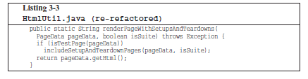
Small !!
the first rule is that functions should be small !!!
Notes:
after some refactoring we get this method; better starting point to understand the code of fitnesse; details hidden in includeSteupTeardownPages
its better because it is small!!

Slide 5
Small !!
What does small mean ???
hundreds of lines ??
tens of lines ??
less ??

Slide 6
Small !!
In the eighties they used to say that a function should be no bigger than a screen-full.
At that time VT100 screens were 24 lines by 80 columns, and the editors used 4 lines for administrative purposes.
Nowadays with a cranked-down font and a nice big monitor, you can fit 150 characters on a line and a 100 lines or more on a screen.
Lines should not be 150 characters long. Functions should not be 100 lines long.
Functions should hardly ever be 20 lines long !!!!
Notes:
μεγάλες και σύγχρονες οθόνες

Slide 7

Small !!
… we can make large programs with two, or three, or four lines functions ….
e.g. Kent Beck’s Sparkle graphical application…
practically ➔ it is quite reasonable to make algorithms of 2, 3, 4 steps,
consisting of more detailed algorithms of 2, 3, 4 steps,
etc.

Slide 8
Small !!
What does it take to make so small functions ???
Blocks within if statements, else block statements, while block statements, and so on should be one line long.
How can this be possible ??

Slide 9
Small !!
What does it take to make so small functions ???
Blocks within if statements, else block statements, while block statements, and so on should be one line long.
Probably that line should be a function call.
Not only does this keep the enclosing function small, but it also adds documentary value because the function called within the block can have a nicely descriptive name.

Slide 10
Small !!
What does it take to make so small functions ???
Functions should not be large enough to hold nested blocks.
Therefore, the indent level of a function should not be greater than one or two.
This, of course, makes the functions easier to read and understand.
Notes:
1-2 φωλιασμένα μπλοκ εντολών

Slide 11

Do One Thing !!
The following advice has appeared in one form or another for 30 years or more.
FUNCTIONS SHOULD DO ONE THING.
THEY SHOULD DO IT WELL.
THEY SHOULD DO IT ONLY.

Slide 12
Do One Thing !!
The following advice has appeared in one form or another for 30 years or more.
FUNCTIONS SHOULD DO ONE THING.
THEY SHOULD DO IT WELL.
THEY SHOULD DO IT ONLY.
Great but the problem is that it is hard to know what one thing is !!!

Slide 13
Do One Thing !!
Does this code do one thing?

Slide 14
Do One Thing !!
Does this code do one thing?
It’s easy to make the case that it’s doing three things:
1. Check whether pageData refer to a test page.
2. If so, includes setup and teardown data to pageData.
3. Renders pageData in HTML.

Slide 15
Do One Thing !!
1. Check whether pageData refer to a test page.
2. If so, includes setup and teardown parts to pageData.
3. Renders pageData in HTML.
These three steps are at the same level of abstraction (detail) one level below the stated name of the function; they explain how to construct a page that comprises setup and teardown parts.
Notes:
a function should consist of a sequence of steps that explain what it does, without going into details on how each step is realized (if the step is complex)

Slide 16
Do One Thing !!
To describe what the function does we need only a simple TO paragraph (1,2 simple sentences)….
TO RenderPageWithSetupsAndTeardowns, we check to see whether the pageData refers to a test page and if so, we include the setup and teardown parts. We conclude by extracting the HTML code that contains the pageData.
Notes:
a function should consist of a sequence of steps that explain what it does, without going into details on how each step is realized (if the step is complex)

Slide 17
Do One Thing !!
To explain what this function does we would need many nested TO paragraphs
almost every nested block of commands is by itself a TO paragraph explaining how to realize a step of the higher level block
This indicates that it does more than one thing
Notes:
Κάθε εμφωλευμένο μπλοκ εντολών εξηγεί το πώς υλοποιείται ένα βήμα του αμέσως προηγούμενου επιπέδου εμφώλευσης

Slide 18
Step down rule
We want the code to read like a top-down narrative.
We want every function to be followed by the functions that it calls, so that we can read the program, descending one level of abstraction (detail) at a time.
To say this differently, we want to be able to read the program as though it were a set of TO paragraphs, each of which is describing the current level of abstraction and referencing subsequent TO paragraphs at the next level down.
Notes:
third rule …
after each function we put the functions it calls

Slide 19
Switch Statements & if/else chains
class Bird{
// …
private int type;
private static final int EUROPEAN = 0;
private static final int AFRICAN = 1;
private static final int NORVEGIAN_BLUE = 2;
public double getSpeed(){
switch(type) {
case EUROPEAN: return getBaseSpeed();
case AFRICAN: return getBaseSpeed() – getLoadFactor()*numberOfCoconuts;
case NORVEGIAN_BLUE: return (isNailed) ? 0 : getBaseSpeed();
}
}
// ….
}
It’s hard to make a small switch statement.
By their nature, switch statements always do N things.
Notes:
a primary reason that makes functions long is switch statements and nested if statements

Slide 20
Switch Statements & if/else chains
class Bird{
// …
private int type;
private static final int EUROPEAN = 0;
private static final int AFRICAN = 1;
private static final int NORVEGIAN_BLUE = 2;
public double getSpeed(){
switch(type) {
case EUROPEAN: return getBaseSpeed();
case AFRICAN: return getBaseSpeed() – getLoadFactor()*numberOfCoconuts;
case NORVEGIAN_BLUE: return (isNailed) ? 0 : getBaseSpeed();
}
}
// ….
}
The worst thing is that they never appear once !!
Why is that ???
Notes:
a primary reason that makes functions long is switch statements and nested if statements

Slide 21
Switch Statements & if/else chains
class Bird{
// …
private int type;
private static final int EUROPEAN = 0;
private static final int AFRICAN = 1;
private static final int NORVEGIAN_BLUE = 2;
public double getSpeed(){
switch(type) {
case EUROPEAN: return getBaseSpeed();
case AFRICAN: return getBaseSpeed() – getLoadFactor()*numberOfCoconuts;
case NORVEGIAN_BLUE: return (isNailed) ? 0 : getBaseSpeed();
}
}
// ….
}
The worst thing is that they never appear once !!
Most likely there are:
more Bird methods like this one,
several places where Bird objects are created… in these places the code has a similar structure that chooses what kind of Bird object to create !!!

Slide 22
Switch Statements & if/else chains
// somewhere else …
Bird newBird;
if(birdSelectionFromGui.equals(”European”)){
newBird = new Bird(0, “”);
} else
if(birdSelectionFromGui.equals(”African”, “”)){
newBird = new Bird(1, “”);
} else
if(birdSelectionFromGui.equals(”Norvegian”, “”)){
newBird = new Bird(2, “”);
}
// somewhere else …
Bird birdFromFile;
if(birdSelectionFromFile.equals(”European”)){
birdFromFile = new Bird(0, fileName);
} else
if(birdSelectionFromFile.equals(”African”)){
birdFromFile = new Bird(1, fileName);
} else
if(birdSelectionFromFile.equals(”Norvegian”)){
birdFromFile = new Bird(2, fileName);
}
The worst thing is that they never appear once !!
Most likely there are:
more Bird methods like this one,
several places where Bird objects are created… in these places the code has a similar structure that chooses what kind of Bird object to create !!!

Slide 23
Switch Statements & if/else chains
class Bird{
// …
private int type;
private static final int EUROPEAN = 0;
private static final int AFRICAN = 1;
private static final int NORVEGIAN_BLUE = 0;
public double getSpeed(){
switch(type) {
case EUROPEAN: return getBaseSpeed();
case AFRICAN: return getBaseSpeed() – getLoadFactor()*numberOfCoconuts;
case NORVEGIAN_BLUE: return (isNailed) ? 0 : getBaseSpeed();
}
}
// ….
}
Unfortunately we can’t always avoid switch statements.
Here we can, but how ??
Notes:
another way is to use chain of responsibility !!

Slide 24
Switch Statements & if/else chains
class Bird{
// …
private int type;
private static final int EUROPEAN = 0;
private static final int AFRICAN = 1;
private static final int NORVEGIAN_BLUE = 0;
public double getSpeed(){
switch(type) {
case EUROPEAN: return getBaseSpeed();
case AFRICAN: return getBaseSpeed() – getLoadFactor()*numberOfCoconuts;
case NORVEGIAN_BLUE: return (isNailed) ? 0 : getBaseSpeed();
}
}
// ….
}
In many cases we can replace switch statements with polymorphism !!!

Slide 25
Switch Statements & if/else chains
abstract class Bird{
public abstract double getSpeed();
// ….
}
class European extends Bird {
public double getSpeed(){return getBaseSpeed();}
}
class African extends Bird {
public double getSpeed(){
return getBaseSpeed() – getLoadFactor()*_numberOfCoconuts;
}
}
……
In many cases we can replace switch statements with polymorphism !!!
Did we solve the problem ??

Slide 26
Switch Statements & if/else chains
abstract class Bird{
public abstract double getSpeed();
// ….
}
class European extends Bird {
public double getSpeed(){return getBaseSpeed();}
}
class African extends Bird {
public double getSpeed(){
return getBaseSpeed() – getLoadFactor()*_numberOfCoconuts;
}
}
……
Did we solve the problem ??
We did for class Bird,
but, how about the rest of the places where Bird objects are created… in these places the code has a switch structure that chooses which subclass of Bird objects to create !!!

Slide 27
Switch Statements & if/else chains
// somewhere else …
Bird birdFromFile;
if(birdSelectionFromFile.equals(”European”)){
birdFromFile = new European(fileName);
} else
if(birdSelectionFromFile.equals(”African”)){
birdFromFile = new African(fileName);
} else
if(birdSelectionFromFile.equals(”Norvegian”)){
birdFromFile = new Norvegian(fileName);
}
// somewhere else …
Bird newBird;
if(birdSelectionFromGui.equals(”European”)){
newBird = new European(“”);
} else
if(birdSelectionFromGui.equals(”African”)){
newBird = new African(“”);
} else
if(birdSelectionFromGui.equals(”Norvegian”)){
newBird = new Norvegian(“”);
}
But, how about the rest of the places where Bird objects are created… in these places the code has a switch structure that chooses which subclass of Bird objects to create !!!
What can we do to fix this ???

Slide 28
Switch Statements & if/else chains
// somewhere else …
Bird newBird;
if(birdSelectionFromGui.equals(”European”)){
newBird = new European(“”);
} else
if(birdSelectionFromGui.equals(”African”)){
newBird = new African(“”);
} else
if(birdSelectionFromGui.equals(”Norvegian”)){
newBird = new Norvegian(“”);
}
// somewhere else …
Bird birdFromFile;
if(birdSelectionFromFile.equals(”European”)){
birdFromFile = new European(fileName);
} else
if(birdSelectionFromFile.equals(”African”)){
birdFromFile = new African(fileName);
} else
if(birdSelectionFromFile.equals(”Norvegian”)){
birdFromFile = new Norvegian(fileName);
}
What can we do to fix this ???
The best we can do is to keep the object creation logic buried in one place, and reuse it in all the different places that need to create (a subclass of) Bird objects
This place is often called a Factory class

Slide 29
Switch Statements & if/else chains
class BirdFactory{
private final int EUROPEAN = 0;
private final int AFRICAN = 1;
private final int NORVEGIAN_BLUE = 0;
public Bird createBird(String type, String fileName){
if(type.equals(”European”))
return new European(fileName);
if(type.equals(”African”))
return new African(fileName);
if(type.equals(”Norvegian”))
return new Norvegian(fileName);
}
// ….
}
This place is often called a factory class
What is the benefit of that ??

Slide 30
Switch Statements & if/else chains
class BirdFactory{
private static final int EUROPEAN = 0;
private static final int AFRICAN = 1;
private static final int NORVEGIAN_BLUE = 0;
public static Bird createBird(String type, String fileName){
if(type.equals(”European”))
return new European(fileName);
if(type.equals(”African”))
return new African(fileName);
if(type.equals(”Norvegian”))
return new Norvegian(fileName);
}
// ….
}
This place is often called a factory class
What is the benefit of that ??
Additions/removals/changes in one place

Slide 31

Function Arguments
What is the ideal # of arguments for a clean function ?

Slide 32
Function Arguments
What is the ideal # of arguments for a clean function ?
zero !! Niladic functions are the best
one (monadic functions), or two arguments (dyadic functions), are also OK
Avoid functions with 3, or more than 3 arguments !!!
Why many arguments are not good ??

Slide 33
Function Arguments
Arguments require a lot of brain cycles !!
Each time you use the function, have to remember the arguments, their intent, their order, etc.
Arguments are even harder from a testing point of view.
Imagine the difficulty of writing all the test cases to ensure that various combinations of arguments work properly.
With more than two arguments, testing every combination of appropriate values can become very painful
Notes:
take examples from the BVA testing method !!!
in simple testing methods we need 4 * N + 1 test cases
in more advanced we need 6*N +1
in even more advanced we need 5^N, 7^N test cases

Slide 34
Common Monadic Forms
There are two very common reasons to pass a single argument.
You may be asking a question about that argument, as in:
boolean fileExists(“MyFile”)
Or you may be operating on that argument, transforming it into something else and returning it. For example,:
InputStream openFile(“MyFile”)
transforms a file name String into an InputStream return value.
Another very useful form for a single argument function, is an event/command. In this form there is an input argument but no output argument.
The function uses the argument to alter the state of the program, for example:
void parseStream(InputStream stream)

Slide 35

Flag Arguments
Flag arguments are terrible practice !!!
Why is that ??

Slide 36
Flag Arguments
Flag arguments are terrible practice !!!
Why is that ??
Passing a boolean loudly proclaims that this function does more than one thing.
It does one thing if the flag is true and another if the flag is false
How can we avoid them ???

Slide 37
Flag Arguments
Flag arguments are terrible practice !!!
Why is that ??
Passing a boolean loudly proclaims that this function does more than one thing.
It does one thing if the flag is true and another if the flag is false
How can we avoid them ???
Easy, we can make 2 functions without flag, instead of one with a flag

Slide 38
Argument Objects
When a function seems to need more than two or three arguments, it is likely that some of those arguments ought to be wrapped into a class of their own.
Consider, for example:
Circle makeCircle(double x, double y, double radius);

Slide 39
Argument Objects
When a function seems to need more than two or three arguments, it is likely that some of those arguments ought to be wrapped into a class of their own.
Consider, for example:
Circle makeCircle(double x, double y, double radius);
can become:
Circle makeCircle(Point center, double radius);

Slide 40
Separate Commands from Queries
public int parseFile(String fileName);
……..
what is the meaning of this ?
Unclear what is returned by the function

Slide 41
Separate Commands from Queries
public void parseFile(String fileName);
public int getNumberOfDataEntries();
……..
Much better if we separate command from query

Slide 42

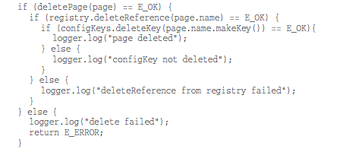
What is wrong with error handling ?
Notes:
Μια υποκατηγορία συναρτήσεων που εκτελούν μια εντολή και απαντουν σε μια ερώτηση είναι αυτές που επιστρέφουν ένα error code, αυτές απαντούν στο ερώτημα αν πήγαν όλα καλά...
κατ’επέκταση του προηγουμένου γενικά είναι προτιμότερο να χρησιμοποιούμε εξαιρέσεις από error codes
στο παράδειγμα …

Slide 43
Prefer Exceptions to Error Codes
Returning error codes from command functions is a subtle violation of command query separation.
The practical problem is that it code that calls the function gets complicated, mixing error handling with normal execution.
Notes:
Μια υποκατηγορία συναρτήσεων που εκτελούν μια εντολή και απαντουν σε μια ερώτηση είναι αυτές που επιστρέφουν ένα error code, αυτές απαντούν στο ερώτημα αν πήγαν όλα καλά...
κατ’επέκταση του προηγουμένου γενικά είναι προτιμότερο να χρησιμοποιούμε εξαιρέσεις από error codes
στο παράδειγμα …

Slide 44
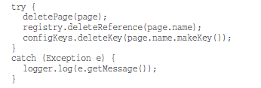
Prefer Exceptions to Error Codes
Here, each method throws an exception, instead of returned error codes.
Then the error processing code can be separated from the normal code using try/catch
The code is much simplified !!

Slide 45
Prefer Exceptions to Error Codes
try/catch blocks are also considered ugly and hard to read…
it forces the reader to understand 2 things, how is the normal work done and how exceptions are handled !!
Can we do better ???

Slide 46
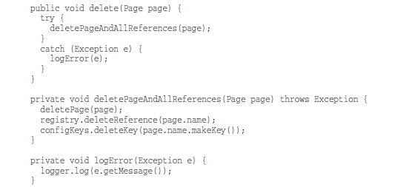
Prefer Exceptions to Error Codes
The above, provides a better separation between normal and error handling code that makes the code easier to understand and modify.

Slide 47
Provide Context with Exceptions
Each exception that you throw should provide enough context to determine the source and location of an error.
In Java, you can get a stack trace from any exception; however, a stack trace can’t tell you the intent of the operation that failed.
Create informative error messages and pass them along with your exceptions.
Mention the operation that failed and the type of failure. If you are logging in your application, pass along enough information to be able to log the error in your catch.
Notes:
οδηγία – παροχή χρήσιμης πληροφορίας

Slide 48
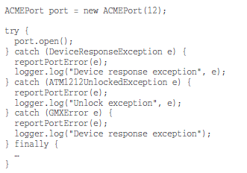
Define Meaningful Exceptions wrt Caller’s Needs
How about this code ??
Notes:
οδηγία - το νόημα των exceptions πρέπει να είναι ξεκάθαρο για αυτόν που τα διαχειρίζεται

Slide 49
Define Meaningful Exceptions wrt Caller’s Needs
How about this code ??
A lot of exceptions for just one method call with weird names that don’t make much sense for the caller of port.open();
The third party API that is used here provides a poor set of exception classes that obscure the readability of the code…
Notes:
cluter = ακαταστασια

Slide 50
Define Meaningful Exceptions wrt Caller’s Needs
when we define exception classes in an application, our most important concern should be to be meaningful for the code that catches and handles them.
Notes:
cluter = ακαταστασια

Slide 51
Define Meaningful Exceptions wrt Caller’s Needs
How can we deal with poor exceptions that come from an external API ??
Notes:
cluter = ακαταστασια

Slide 52
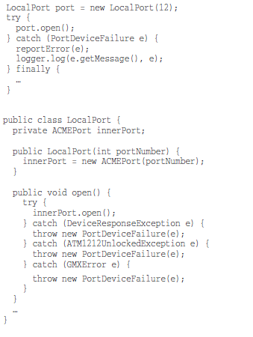
Define Meaningful Exceptions
How can we deal with poor exceptions that come from an external API ??
We can improve our code considerably by wrapping (adapting) the API that we are calling and making sure that it returns a meaningful exception type
LocalPort class is just a simple wrapper that catches and transforms exceptions thrown by the ACMEPort class into a simpler more meaningful for the caller exception
Notes:
cluter = ακαταστασια

Slide 53
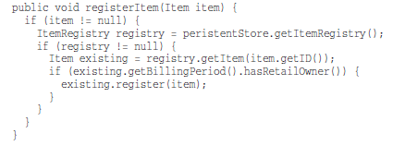
Don’t Return Null
How about this code ??

Slide 54
Don’t Return Null
How about this code ??
When we return null, we are essentially creating work for ourselves and foisting problems upon our callers.
All it takes is one missing null check to send an application spinning out of control.
Notes:
cluter = ακαταστασια

Slide 55
Don’t Return Null
If you are tempted to return null from a method, consider
throwing an exception
or returning a SPECIAL CASE object instead.
If you are calling a null-returning method from a third-party API, consider wrapping that method with a method that either throws an exception or returns a special case object.
Notes:
cluter = ακαταστασια

Slide 56
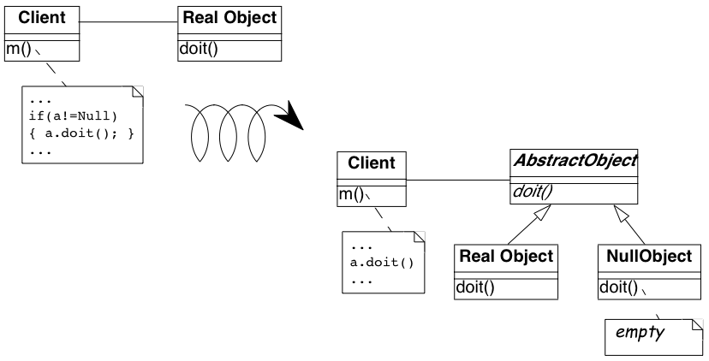
Null Object Pattern
RealObject getTheObject() {
….
if (…)
return new RealObject();
else
return null;
}
Provider
a = provider.getTheObject();
Notes:
cluter = ακαταστασια

Slide 57
Null Object Pattern
AbstractObject getTheObject() {
….
if (…)
return new RealObject();
else
return new NullObject();
}
Provider
a = provider.getTheObject();
Notes:
cluter = ακαταστασια

Slide 58

Don’t Return Null
Right now, getEmployees() can return null, but does it have to?

Slide 59


Don’t Return Null
If we change getEmployees() so that it returns an empty list, we can clean up the code. Java has a special method for making immutable empty lists… Collections.emptyList()
Or just return new ArrayList<Employee>();
Notes:
cluter = ακαταστασια

Slide 60
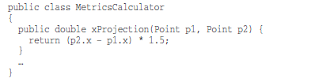
Don’t Pass Null
What happens when someone passes null as an argument?
Notes:
cluter = ακαταστασια

Slide 61
Don’t Pass Null
What happens when someone passes null as an argument?
we will get a NullPointerException
Notes:
cluter = ακαταστασια

Slide 62
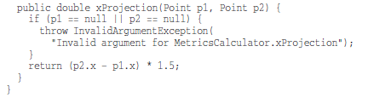
Don’t Pass Null
Could the developer of the class do something better ?
He could check the arguments and throw a more informative exception…
Notes:
cluter = ακαταστασια

Slide 63
Don’t Pass Null
Is this better?
It might be a little better than a null pointer exception, but remember, we have to define a handler for InvalidArgumentException.
Notes:
cluter = ακαταστασια

Slide 64
Don’t Pass Null
Passing null can only create problems…The caller should check what happens in this case. The called must perform null checks. Everybody’s code becomes more complex.
Because this is the case, the rational approach is to avoid passing null by default.
Notes:
cluter = ακαταστασια

Slide 65

How do you write functions like this ?
Writing software is like any other kind of writing. When we write a paper or an article, the first draft might be clumsy and disorganized, so we restructure it and refine it until it reads the way we want it to read.
When we write functions, they come out long and complicated. They have lots of indenting and nested loops. They have long argument lists. The names are arbitrary, and there is duplicated code.
Then, we refactor to meet the rules !!

