Slide 1
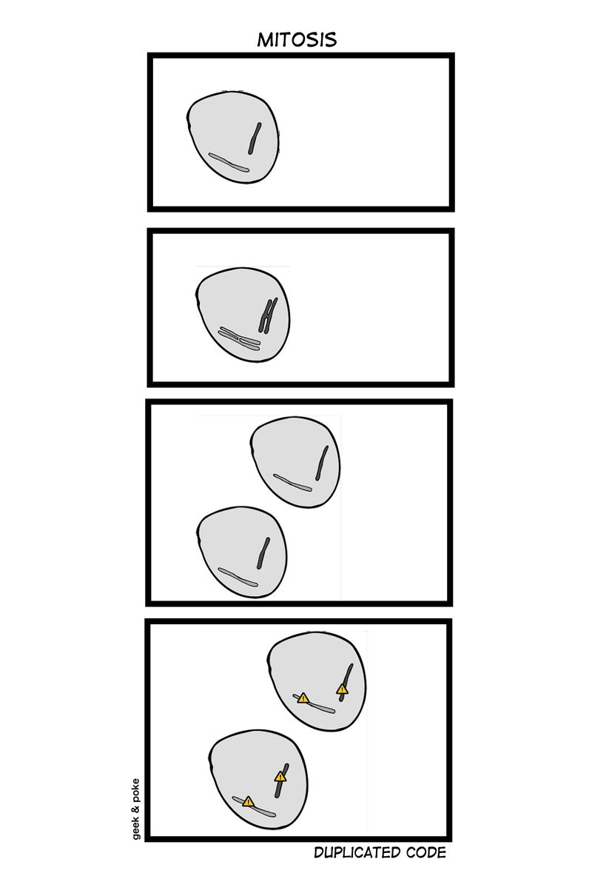
Duplication www.cs.uoi.gr/~zarras/soft-devII.htm
Sources: M. Fowler Refactorings Catalog
W. Wake Refactoring Workbook
Notes:
Draw figures to analyze the stuff

Slide 2
Duplication

Slide 3
Duplication
Symptoms
The easy version: Two fragments of code look nearly identical.
The hard version: Two fragments of code have nearly identical effects (at any conceptual level).
Causes
Some duplication occurs because programmers were working independently in different parts of the system, and they didn’t realize that they were creating almost identical code.
A worse case (but perhaps the most common) occurs when the programmers intentionally duplicate code. They find some code that is “almost” right, so they copy-and-paste it into the new spot with some slight alterations.

Slide 4
Duplication
What to Do
If the duplication occurs because a special number, string, or other value recurs, use Replace Magic Number with Symbolic Constant.

Slide 5
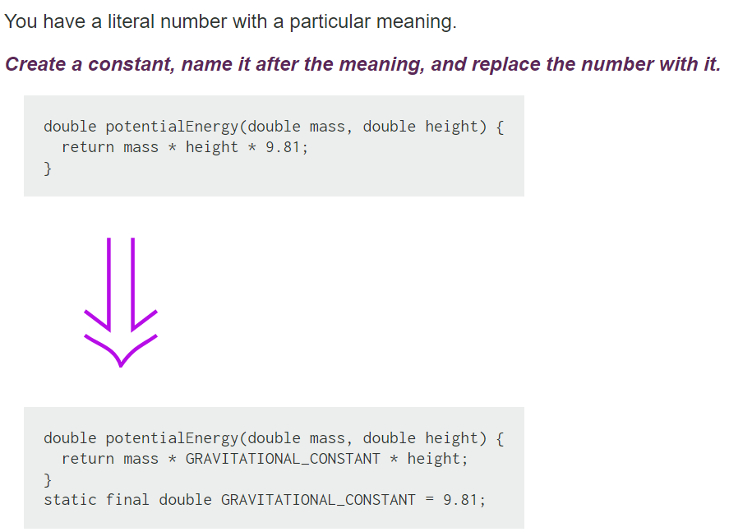
Replace Magic Number with Symbolic Constant

Slide 6
Duplication
What to Do
If the duplication is within a method or in two different methods in the same class: use Extract Method and Parameterize Method to pull the common/different part out into separate methods.

Slide 7
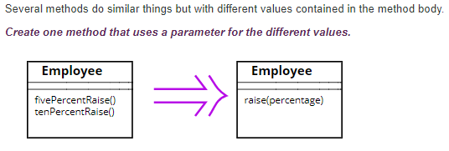
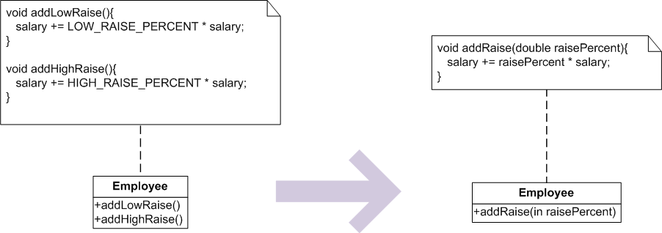
Parameterize Method

Slide 8
Duplication
What to Do
If the duplication is within two sibling classes: use Extract Method and Parameterize Method to create a single routine, then Pull Up Field and/or Pull Up Method to bring the common parts together.

Slide 9
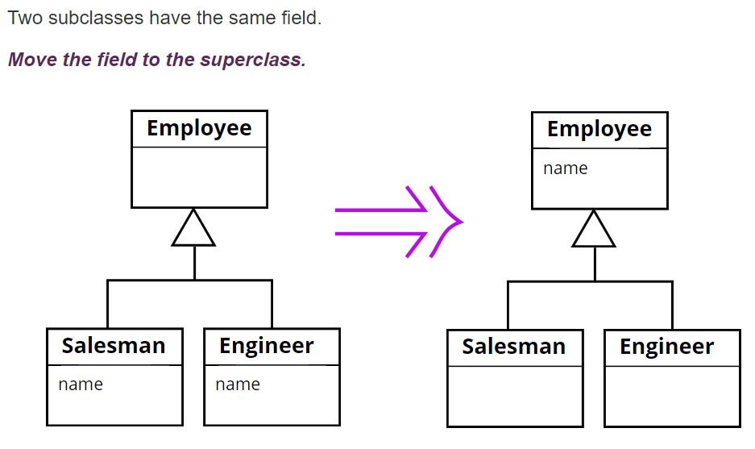
Pull Up Field

Slide 10
Pull Up Field
If subclasses are developed independently, or combined through refactoring, you often find that they duplicate features.
*** In particular, certain fields can be duplicates. Such fields sometimes have similar names but not always. The only way to determine what is going on is to look at the fields and see how they are used by other methods. If they are being used in a similar way, you can generalize them.
Doing this reduces duplication in two ways. It removes the duplicate data declaration and allows you to move from the subclasses to the superclass methods or parts of them that use the field.
If the fields are private, you will need to protect the superclass field so that the subclasses can refer to it.

Slide 11
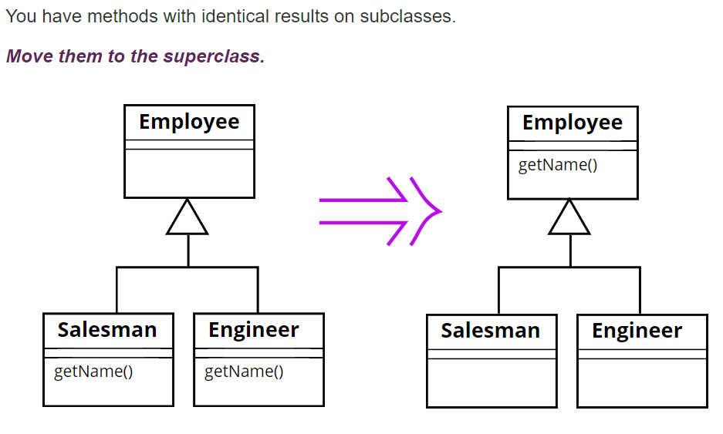
Pull Up Method

Slide 12
Pull Up Method
Eliminating duplicate behavior is important. Whenever there is duplication, you face the risk that an alteration to one will not be made to the other.
The easiest case of using Pull Up Method occurs when the methods have the same body, implying there's been a copy and paste. You may need to change a method's signature to get this to work.
Of course it's not always as obvious as that. Often Pull Up Method comes after other steps. You see two methods in different classes that can be parameterized in such a way that they end up as essentially the same method. In that case the smallest step is to parameterize each method separately and then generalize them.

Slide 13
Duplication
What to Do
*** The most awkward element of Pull Up Method is that the body of the methods may refer to features that are on the subclass but not on the superclass. If the feature is a method, you can either generalize the other method or create an abstract method in the superclass.
Then you may be able to use Form Template Method to create a common algorithm in the parent, and unique steps in the children.

Slide 14
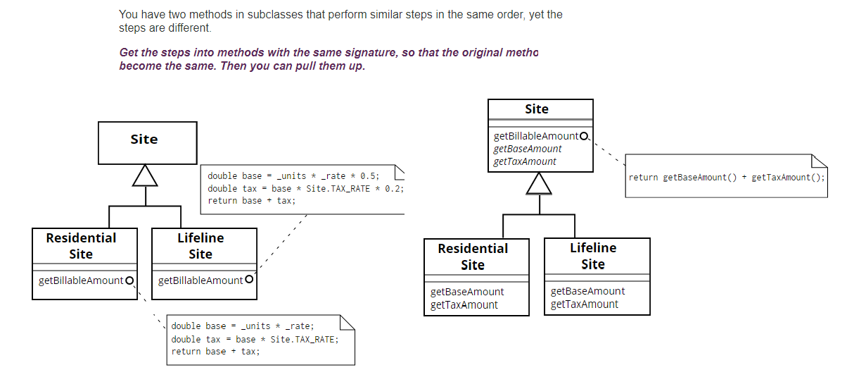
Form Template Method

Slide 15
Form Template Method
Inheritance is a powerful tool for eliminating duplicate behavior. Whenever we see two similar methods in subclasses, we want to bring them together in a superclass.
A common case is two methods that seem to carry out broadly similar steps in the same sequence, but the steps are not the same. In this case we can move the sequence to the superclass and allow polymorphism to play its role in ensuring the different steps do their things differently. This kind of method is called a template method

Slide 16
Duplication
What to Do
If the duplication is in two unrelated classes:
either extract the common part into a new class via Extract Class, or
Check if the common code really belongs on only one class or the other.
In any of these cases, you may find that the two places aren’t literally identical but have the same effect. Then you may do a Substitute Algorithm so that only one copy is involved.
Payoff
Reduces duplication, lowers size. Can lead to better abstractions and more flexible code.

Slide 17
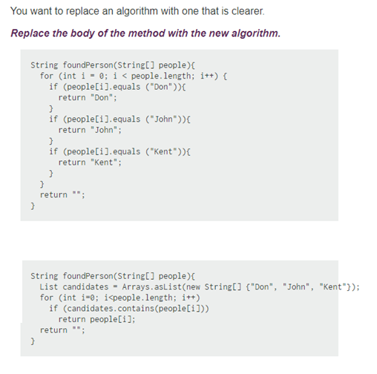
Substitute Algorithm

