Slide 1
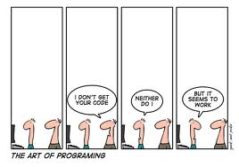
Software Development II www.cs.uoi.gr/~zarras/soft-devII.htm
from Clean Code by R. C. Martin, a.k.a “Uncle Bob”
Notes:
σκοπός να μάθουμε να αναπτύσσουμε γράφουμε καθαρό κώδικα – βασική προϋπόθεση για να έχουμε λογισμικό καλής ποιότητας, δηλαδή, …
γενικά είναι κάτι που είναι δύσκολο, γιατί δουλεύουμε υπο πίεση, αλλά πρέπει να μάθουμε μα το κάνουμε γιατί σε πραγματικές συνθήκες εργασίας είναι πολύ σημαντικό !

Slide 2
What are the general objectives of the course?
Identify issues of poor software design/implementation.
Improve the quality of software that suffers from issues of poor software design/implementation by applying good practices, refactoring, patterns.

Slide 3
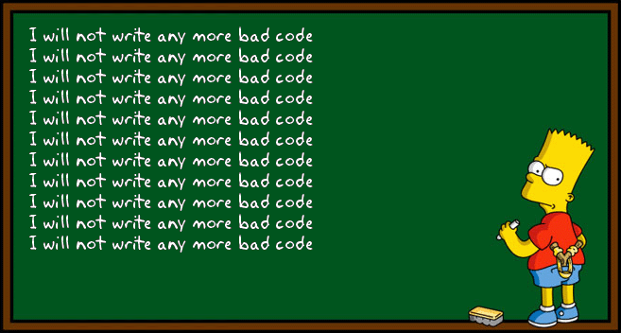
What will we study ?
Clean Code Rules
Meaningful Names
Comments
Formatting
Functions/Methods
Error Handling
Classes

Slide 4

What will we study ?
Code Smells
Long Method
God Class
Long Param List
Primitive Obsession
Data Container
Duplication
Feature Envy
Shotgun Surgery
Message Chains
Middle Man
……..
Refactoring Techniques
Composing Methods
Simplifying Conditionals
Moving Features
Generalization
Simplifying Method Calls

Slide 5
Readings
Αντικειμενοστρεφής Σχεδίαση, Α. Χατζηγεωργίου
Ανάπτυξη Προγραμμάτων σε Java, B. Liskov, J Guttag
Clean Code - A Handbook of Agile Software Craftsmanship, R. C. Martin
Refactoring - Improving the Design of Existing Code, M.Fowler

Slide 6
Project, Final Exam & Grades
We will develop a project in Java in groups of up to 2 person.
Part1: Review and analyze the problems of an existing software
Part II: Refactoring and extension of the software
We will have a final examination at the end of the semester
Final Grade
if (exam >= 5 and project >=5) then
grade = 0.7 * exam + 0.3 * project
else
grade = min(exam, project)

Slide 7
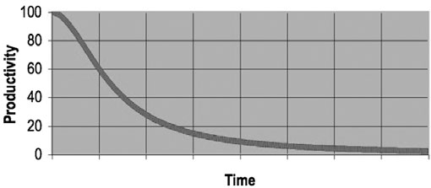
Bad Code
The total cost of owning a mess:
Over the span of a year or two, teams that were moving very fast at the beginning of a project can find themselves moving at a snail’s pace.
As the mess builds, the productivity of the team continues to decrease, asymptotically
approaching zero.
Notes:
εδώ βλέπουμε ακριβώς γιατί είναι σημαντικό
το διάγραμμα δείχνει το πώς μεταβάλλεται η παραγωγικότητα μιας ομάδας που αναπτύσσει ένα κακοφτιαγμένο λογισμικό

Slide 8
Bad Code
What would you do If you were the manager of such project ??

Slide 9
Bad Code
A managerial solution:
As productivity decreases, management does the only thing they can; they add more staff to the project in hope of increasing productivity.
Would that work ??

Slide 10
Bad Code
A managerial solution:
As productivity decreases, management does the only thing they can; they add more staff to the project in hopes of increasing productivity.
But that new staff is not versed in the design of the system.
They, and everyone else on the team, are under horrific pressure to increase productivity.
So they all make more and more messes (!!!!!), driving the productivity ever further toward zero.

Slide 11
Bad Code
What would you do if you were a developer in such a project ??

Slide 12
Bad Code
A technical solution:
Eventually the team rebels. They demand a redesign. Management eventually bend to the demands of the developers and authorize the grand redesign in the sky.
A new tiger team is selected. Everyone else must continue to maintain the current system.
Would that work ??
Notes:
ένα σύνηθες σενάριο είναι οι developers να ζητήσουν από τους διαχειριστές την συνολική ανακατασκευή του λογισμικού.
συνήθως οι διαχειριστές το δέχονται κατόπιν πίεσης και με βάση την ελάχιστη παραγωγικότητα
οπότε οργανώνουν μια ομάδα με στόχο την ανακατσκευή

Slide 13
Bad Code
A technical solution:
Now the two teams are in a race.
The tiger team must build a new system that does everything that the old system does.
Not only that, they have to keep up with the changes that are continuously being made to the old system !!!!
And by the time it’s done, the tiger team members are demanding that the new system be redesigned because it’s such a mess !!!!

Slide 14
Bad Code
The moral:
Spending time keeping your code clean is not just cost effective; it’s a matter of professional survival !!!!
Notes:
το να κρατάμε τον κώδικά μας καθαρό είναι ο μόνος τρόπος να αποφύγουμε τέτοιες καταστάσεις …

Slide 15
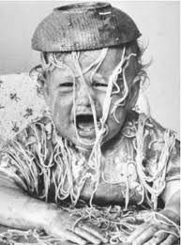
Bad Code
Why does good code turn into bad code ???
Notes:
γιατί ο κώδικας που φτιάχνουμε είναι κακός ?
όλοι ξέρουμε ότι αυτό μπορεί να έχει πολύ δυσάρεστες συνέπειες …

Slide 16
Bad Code
Why does good code turn into bad code ???
All developers with more than a few years experience know that previous messes slow them down.
And yet all developers feel the pressure to make messes in order to meet deadlines !!!
In practice, …. the mess will slow you down instantly, and will force you to miss the deadline. The only way to make the deadline—the only way to go fast—is to keep the code as clean as possible at all times.

Slide 17
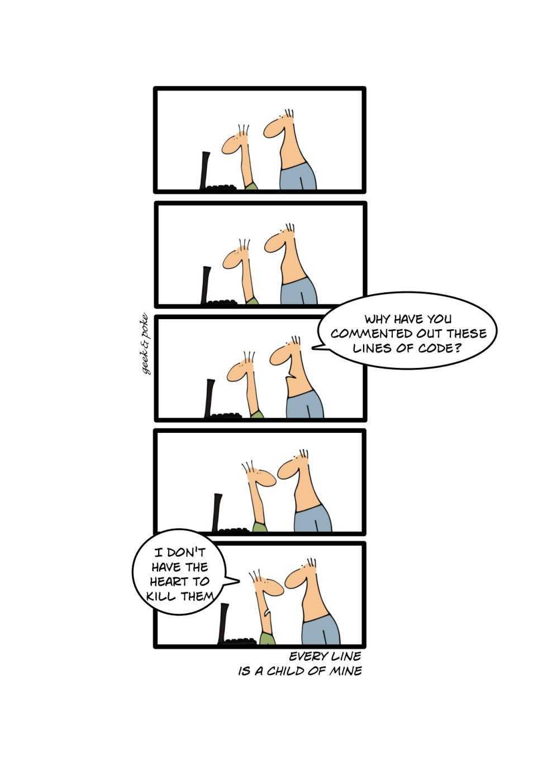
Clean Code
What is clean code ???

Slide 18
Clean Code
What is clean code ???
Probably as many definitions as programmers !!!
But, still the baseline is the same,
code is clean if its can be easily understood, tested and maintained….

Slide 19
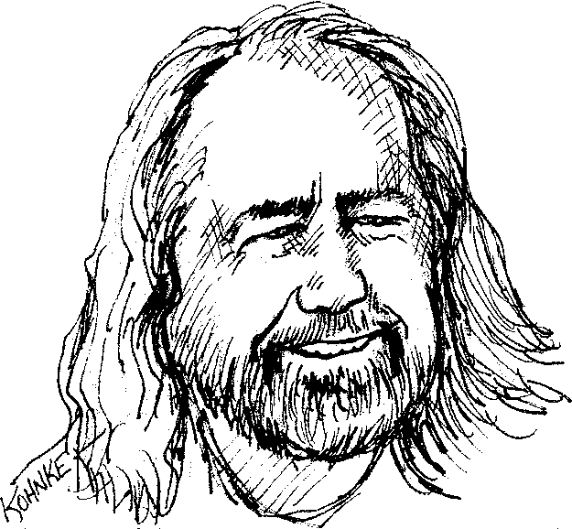
Clean Code
Grady Booch, author of Object Oriented Analysis and Design with Applications
Clean code is simple and direct. Clean code reads like well-written prose….
Notes:
απλός και άμεσος
(booch, rumbaugh, jacobson)

Slide 20
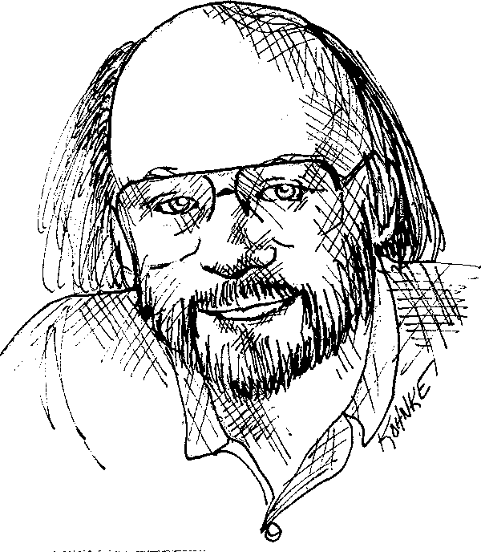
Clean Code
Bjarne Stroustrup, inventor of C++ and author of The C++ Programming Language
…elegant and efficient.
The logic should be straightforward to make it hard for bugs to hide,
the dependencies minimal to ease maintenance, error handling complete according to an articulated strategy, and performance close to optimal so as not to tempt people to make the code messy with unprincipled optimizations.
Clean code does one thing well.
Notes:
αποδοτικός και κομψός

Slide 21
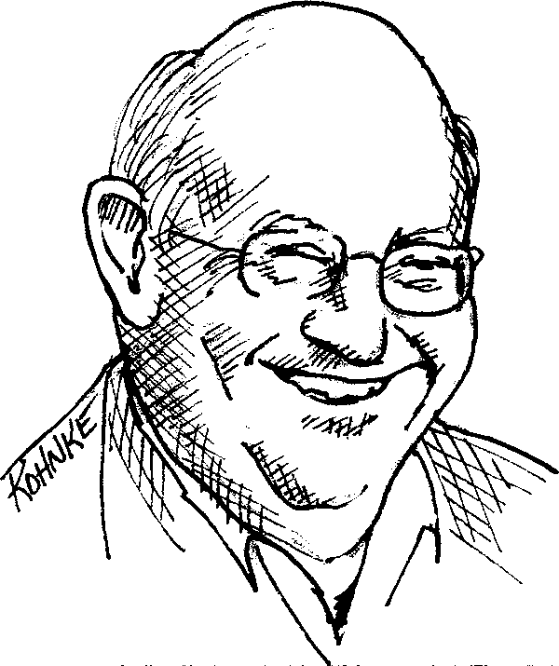
Clean Code
Dave Thomas, godfather of the
Eclipse strategy
Clean code can be read, and enhanced by a developer other than its original author.
It has unit and acceptance tests.
It has meaningful names.
It provides one way rather than many ways for doing one thing.
It has minimal dependencies, which are explicitly defined, and provides a clear and minimal API.….

Slide 22
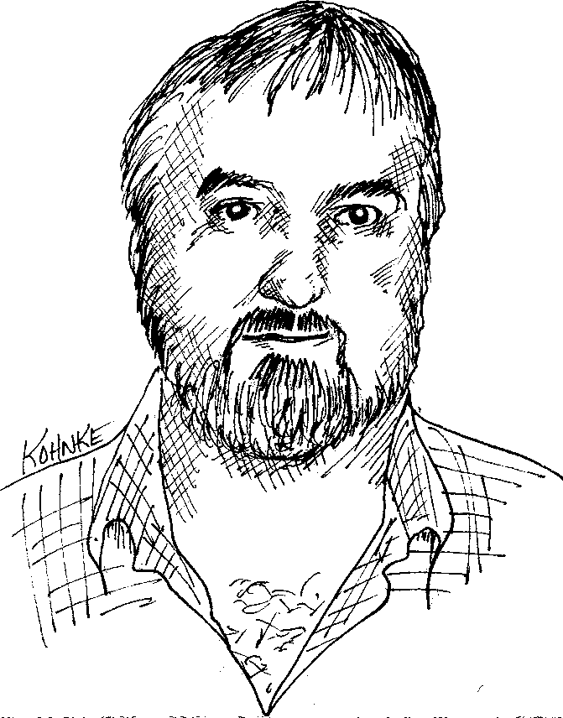
Clean Code
Michael Feathers, author of Working Effectively with Legacy Code
….. Clean code always looks like it was written by someone who cares….

Slide 23
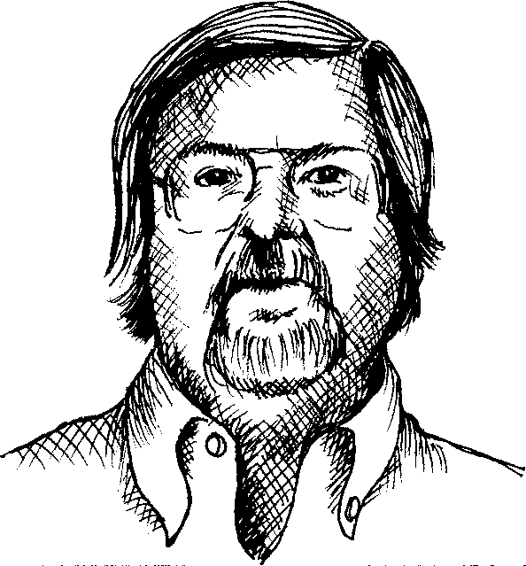
Clean Code
Ron Jeffries, author of Extreme Programming Installed and Extreme Programming Adventures in C#
Simple code:
• Runs all the tests;
• Contains no duplication;
• Expresses all the design ideas that are in the system;
• Minimizes the number of entities such as classes, methods, functions, and the like.

Slide 24
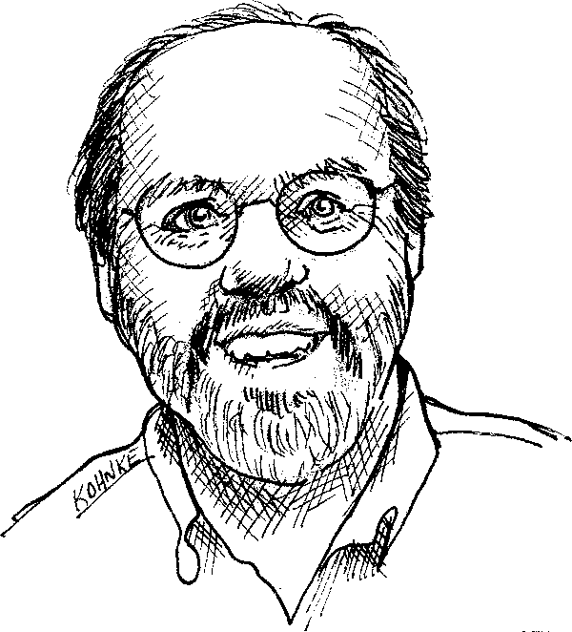
Clean Code
Ward Cunningham, motive force behind Design Patterns. The godfather of all those who care about code.
You know you are working on clean code when each
routine you read turns out to be pretty much what
you expected….

Slide 25
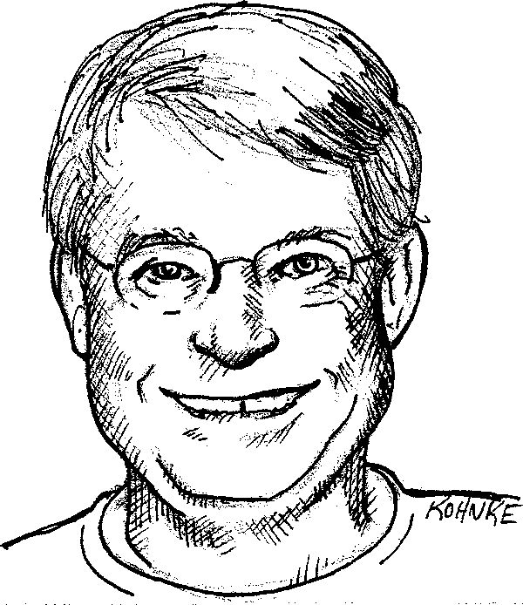
Clean Code
R. C. Martin, a.k.a. “Uncle Bob”
The next time you write a line of code, remember you are an author, writing for readers who will judge your effort.
It’s not enough to write the code well. The code has to be kept clean over time. We’ve all seen code rot and degrade as time passes.
The Boy Scouts have a simple rule that we can apply to our profession.
Leave the campground cleaner than you found it.

