Slide 1
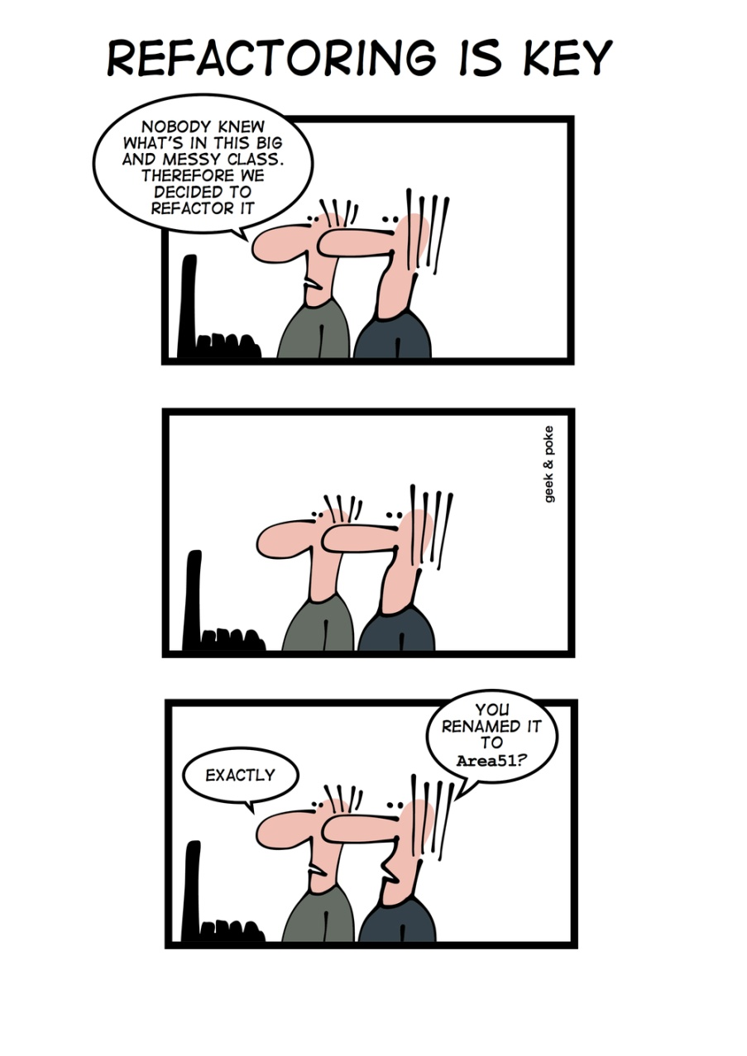
Data www.cs.uoi.gr/~zarras/soft-devII.htm
Sources: M. Fowler Refactorings Catalog
W. Wake Refactoring Workbook

Slide 2
Primitive Obsession

Slide 3
Primitive Obsession
Symptoms
Look for:
in general, the problem is if we use variables/fields of primitive type instead of objects
uses of the primitive or near-primitive types (int, float, String, etc.)
constants and enumerations representing small integers
string constants representing field names
Causes (what kind of primitives can we have??)
Missing class: Since almost all data must be in a primitive somewhere, it’s easy to
start with a primitive, and miss an opportunity to introduce a new object.
Simulated field accessors: Sometimes, a primitive is used as an index, to provide access to pseudo-fields in an array. Strings are occasionally used this way with HashTables or Maps.
Type codes: instead of having different sub-classes of objects we have a class field whose values distinguish different kinds of objects. That belong to the class
Notes:
Typecode is a class attribute that we use to distinguish different subsets of the class objects

Slide 4
Primitive Obsession
What to Do
For missing classes:
Replace Data Value with Object to make data values “first-class.”

Slide 5
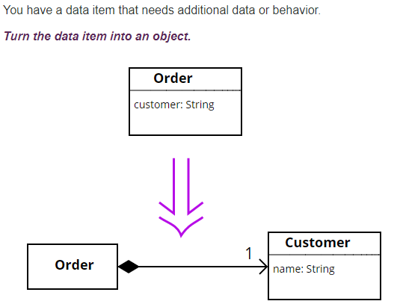
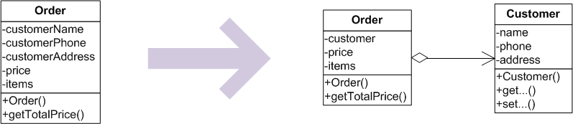
Replace Data Value with Object
Notes:
Give example with various custore related fields

Slide 6
Primitive Obsession
What to Do
For simulated field accessors:
If the primitives are indexes used to treat certain array elements as pseudo fields, Replace Array with Object.

Slide 7
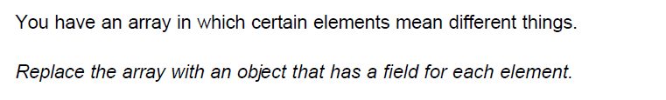
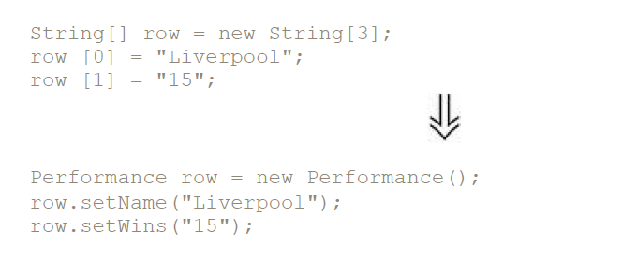
Replace Array with Object
The primitives here are the array and the indexes

Slide 8
Primitive Obsession
What to Do
For type codes:.
If no behavior is conditional on the type code, then it is more like an enumeration, so Replace Type Code with Class.

Slide 9
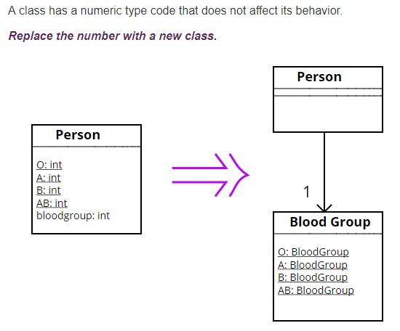
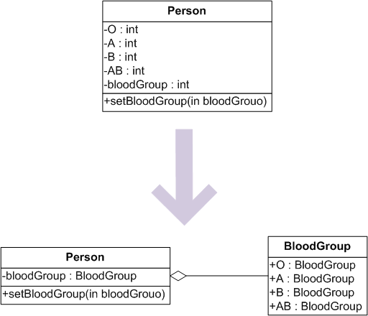
Replace Type Code with Class
Notes:
No matter the typecode the behavior is the same

Slide 10
Primitive Obsession
What to Do
For simulated types: an integer type code stands in for a class.
If the behavior of the object depends on the typecode and the typecode value is immutable during the lifetime of the object, and the class is not subclassed already, Replace Type Code with Subclass.

Slide 11
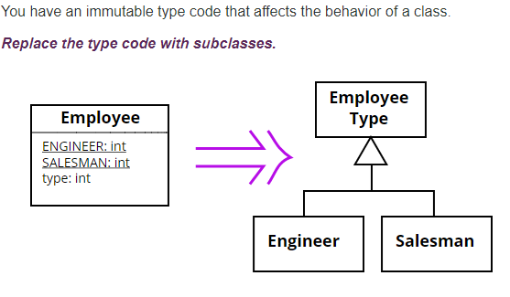
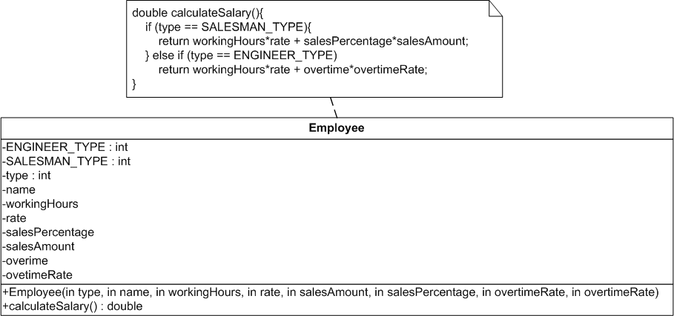
Replace Type Code with Subclass
Notes:
The behavior varies depending on the typecode
The typecode is immutable after the object creation
Make the varying parts abstract and put the concrete variations into subclasses

Slide 12
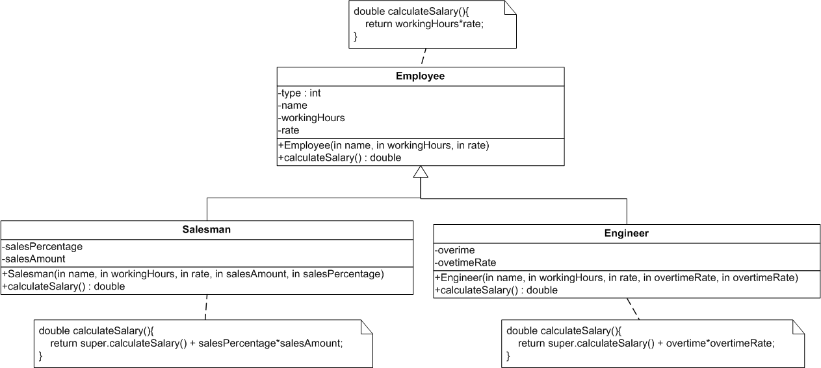
Replace Type Code with Subclass
Notes:
The behavior varies depending on the typecode
The typecode is immutable after the object creation
Make the varying parts abstract and put the concrete variations into subclasses

Slide 13
Primitive Obsession
What to Do
For simulated types: an integer type code stands in for a class.
If the behavior of the object depends on the typecode and the type code changes during the lifetime of the object (or the class is subclassed already), Replace Type Code with Strategy.
Notes:
If the typecode value changes and the behavior of the class objects changes accordingly you need to be able to change the behavior of the class objects dynamically

Slide 14
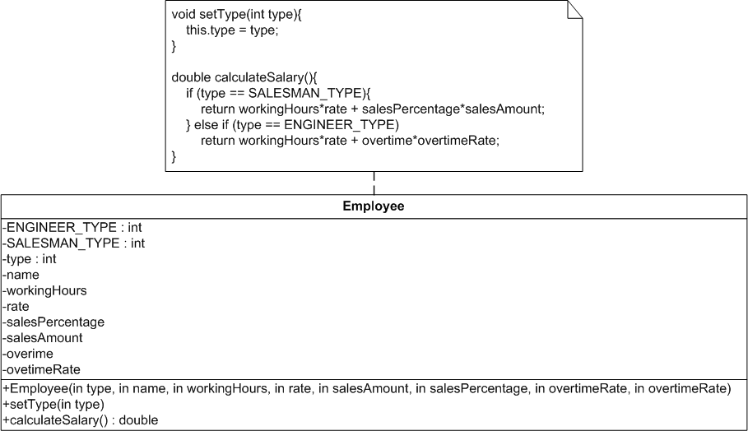
Replace Type Code with Strategy
Apply the Strategy pattern, i.e., encapsulate the typecode dependent behavior into separate objects with polymorphic interfaces and delegate calls to these objects
Notes:
The behavior varies depending on the typecode
The typecode can change after the object creation
The typecode is changed from the clients of the object -> Strategy
The typecode is changed from the object itself depending on its current state -> State
Create an new Hierarchy and move the varying parts there
Base class has abstract defs of the varying parts
Subclasses have the concrete variations
Original class delegates calls to the varying parts to the encapsulated object

Slide 15
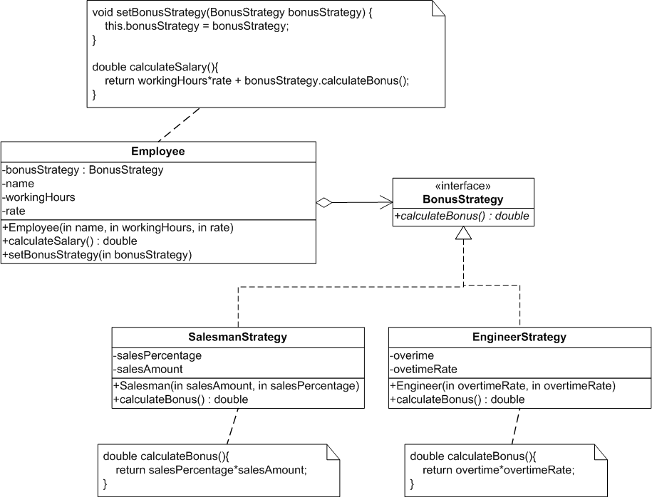
Replace Type Code with Strategy
Apply the Strategy pattern, i.e., encapsulate the typecode dependent behavior into separate objects with polymorphic interfaces and delegate calls to these objects
Notes:
The behavior varies depending on the typecode
The typecode can change after the object creation
The typecode is changed from the clients of the object -> Strategy
The typecode is changed from the object itself depending on its current state -> State
Create an new Hierarchy and move the varying parts there
Base class has abstract defs of the varying parts
Subclasses have the concrete variations
Original class delegates calls to the varying parts to the encapsulated object

Slide 16
Data Class/Container

Slide 17
Data Class/Container
Symptoms
The class consists only of public data members, or of simple getting and setting methods.
Causes
It’s common for classes to begin like this: you realize that some data is part of an independent object, so you extract it out. But objects are about the commonality of behavior, and these objects aren’t developed enough to have much behavior yet.

Slide 18
Data Class/Container
What to Do
Encapsulate Field to block direct access to the fields (allowing access only through getters and setters).

Slide 19
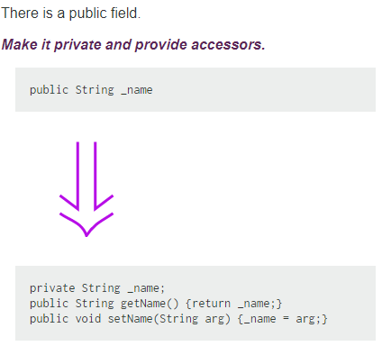
Encapsulate Field

Slide 20
Data Class/Container
What to Do
Encapsulate Collection to remove direct access to any collection-type fields.

Slide 21
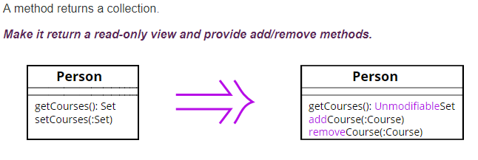
Encapsulate Collection

Slide 22
Data Class/Container
What to Do
Look at each client of the object. Almost invariably, you’ll find clients accessing the fields and manipulating the results, when the class could do it for them.
(This is often a source of duplication, as many callers will tend to do the same things with the data.)
On the client, use Extract Method to pull out the class-related code, then Move Method to put it over on the class.

Slide 23
Data Class/Container
What to Do
After doing this a while, you may find that you have several similar methods on the class. Use Rename Method, Extract Method, Add Parameter, Remove Parameter, etc. to harmonize signatures and remove duplication.

Slide 24
Data Clump

Slide 25
Data Clump
Symptoms
The same two or three items frequently appear together in classes and parameter lists.
You also get a whiff of this when people declare some fields, then methods that work with those fields, then more fields and more methods, etc. (That is, there are groups of fields and methods together within the class.)
You may see groups of field/parameter names that start or end with similar substrings.
Causes
The values are typically part of some other entity, but no one has yet had the insight to realize that there’s a missing class. Or sometimes, people know the object is missing, but think it’s too small or unimportant to stand alone.
Notes:
Clump = συστάδα

Slide 26
Data Clump
What to Do
If the values are fields in a class, use Extract Class to pull them into a new class.
If the values are together in method calls, Introduce Parameter Object to extract the new object.

