Slide 1
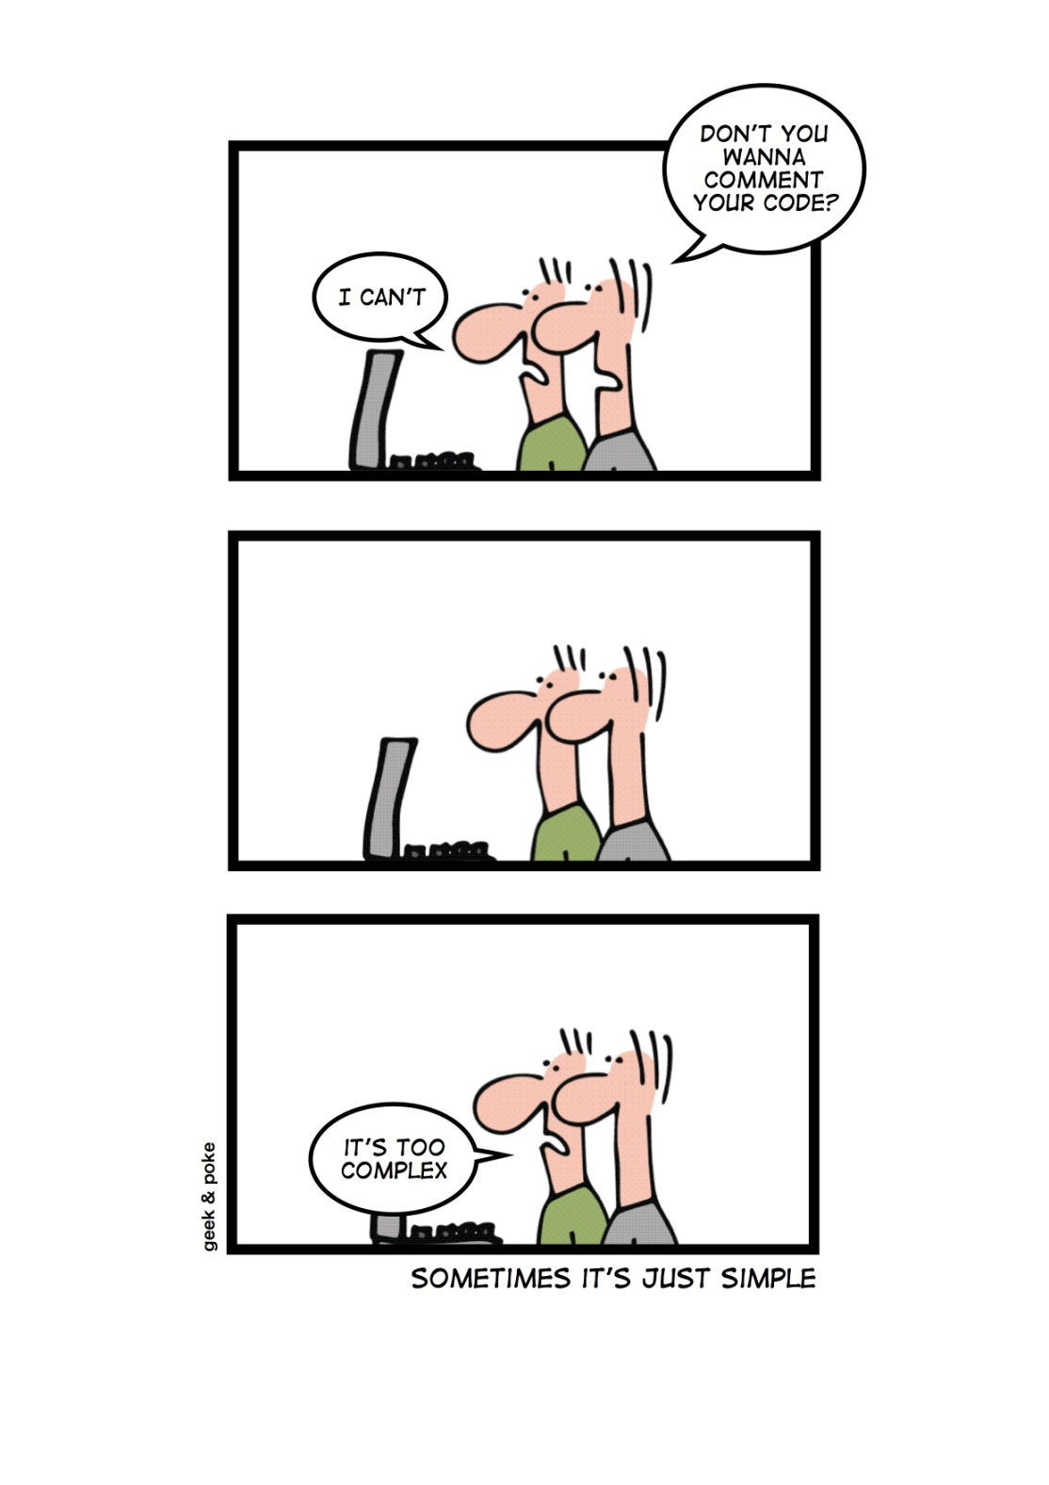
Messages www.cs.uoi.gr/~zarras/soft-devII.htm
Sources: M. Fowler Refactorings Catalog
W. Wake Refactoring Workbook

Slide 2
Message Chains

Slide 3
Message Chains
Symptoms
You see calls of the form: a.b().c().d()
Causes
An object cooperates with other objects to get things done. That part is OK; the problem is that we’re coupled both to the objects and the path to get to them.
This sort of coupling goes against two maxims of object-oriented programming: “Tell, Don’t Ask” and the Law of Demeter.
“Tell, Don’t Ask,” says that instead of asking for objects so you can manipulate them, tell them to just do the manipulation for you.
It’s phrased even more clearly in the Law of Demeter a method shouldn’t talk to strangers.

Slide 4
Message Chains
What to Do
Use Hide Delegate to make the method depend on one object only. (So, rather than a.b().c().d(), put a d() method on the a object.)

Slide 5
Message Chains
What to Do
If the manipulations actually belong on the target object (the one at the end of the chain), use Extract Method and Move Method to put them there.

Slide 6
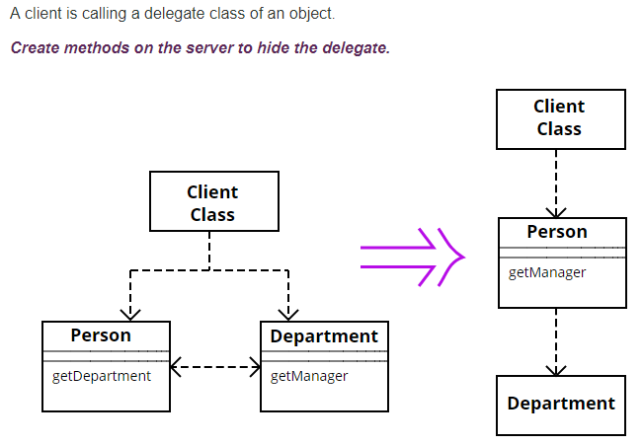
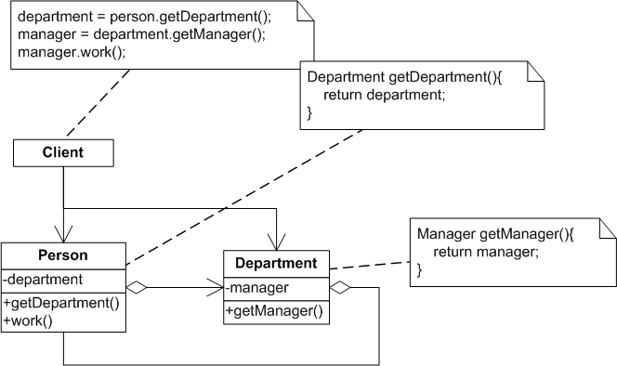
Hide Delegate

Slide 7
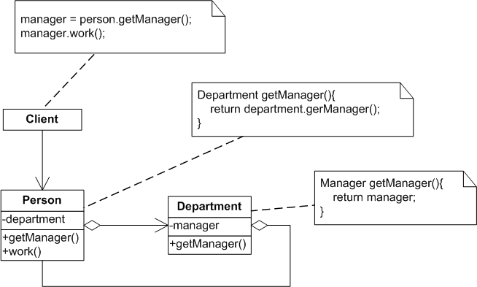
Hide Delegate

Slide 8
Middle Man

Slide 9
Middle Man
Symptoms
Most methods of a class call the same or a similar method on another object:
f() {delegate.f();}
Causes
One way this happens is from applying Hide Delegate to address Message Chains. Perhaps other features have moved out since then, and we’re left with mostly delegating methods.
Notes:
Draw the case where the regular class becomes middle man

Slide 10
Middle Man
What to Do
Remove Middle Man by having the client call the delegate directly.

Slide 11
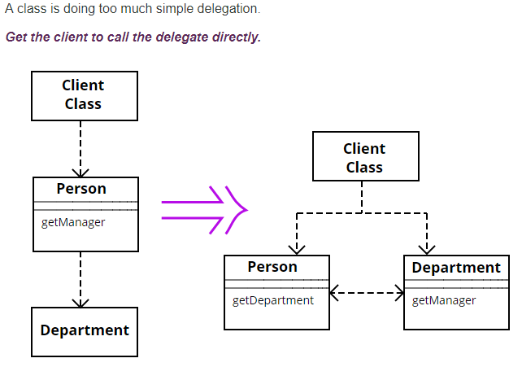
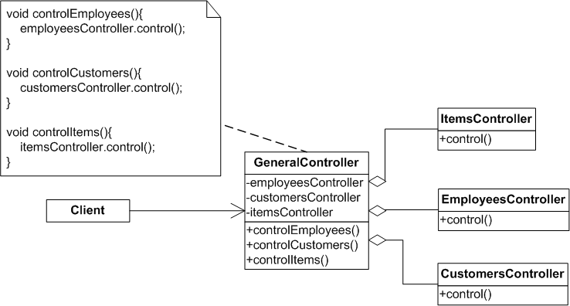
Remove Middle Man

Slide 12
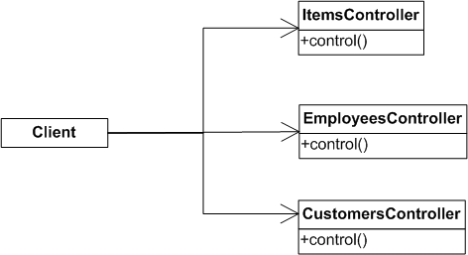
Remove Middle Man

Slide 13
Middle Man
What to Do
If the delegate is owned by the middle man or is immutable, and the middle man has behavior to add, and the middle man can be seen as an example of the delegate, you might Replace Delegation with Inheritance.

Slide 14
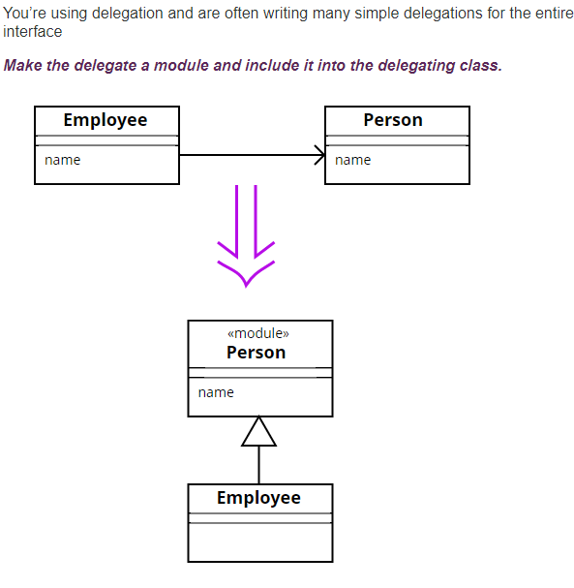
Replace Delegation with Inheritance

