Slide 1
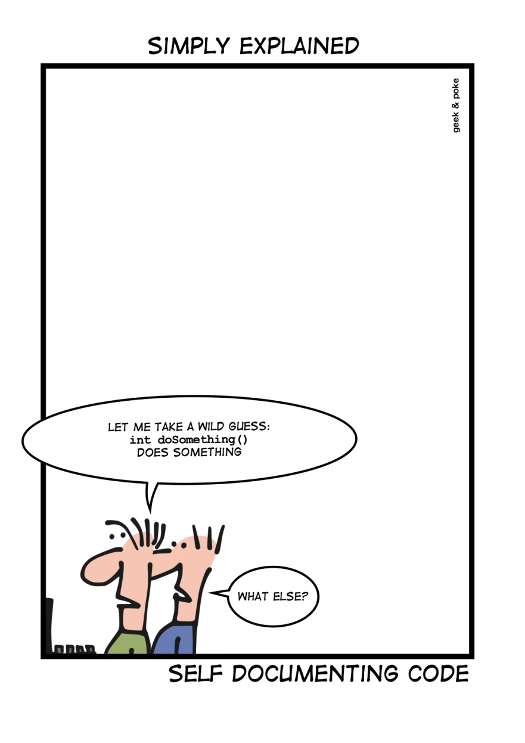
Interfaces www.cs.uoi.gr/~zarras/soft-devII.htm
Sources: M. Fowler Refactorings Catalog
W. Wake Refactoring Workbook

Slide 2
Incomplete Library Class

Slide 3
Incomplete Library Class
Symptoms
You’re using a library class, and there’s a feature you wish were on that class, but it’s
not. If it were a “normal” class, you’d modify it, but since somebody else owns the
library, you can’t change it.
Causes
The author of the library class didn’t anticipate your need.

Slide 4
Incomplete Library Class
What to Do
See if the owner of the class or library will consider adding the support you want.
If it’s just one or two methods, Introduce Foreign Method on a client of the library class. (This is still Feature Envy, but what can you do?)

Slide 5
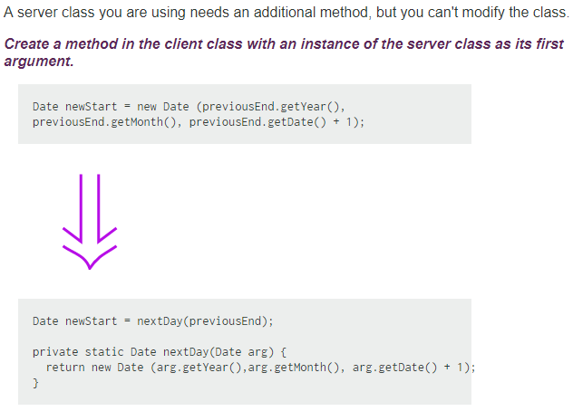
Introduce Foreign Method

Slide 6
Incomplete Library Class
What to Do
If you have several methods, Introduce Local Extension (adding a new pseudolibrary class).
You may decide to introduce a layer “covering” the library.

Slide 7
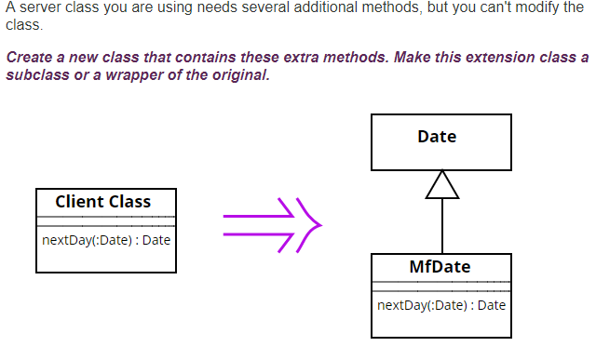
Introduce Local Extension

Slide 8
Refuse Bequest

Slide 9
Refuse Bequest
Symptoms
A class inherits from a parent, but just throws an exception instead of supporting a
method (honest refusal).
A class inherits from a parent, but an inherited routine just doesn’t work when
called on the class (implicit refusal),.
Inheritance doesn’t really make sense; the subclass just isn’t an example of the
parent.
Causes
Perhaps someone inherited from a class just for implementation convenience without really intending the class to be substitutable for the parent.

Slide 10
Refuse Bequest
What to Do
If the parent-child relationship does make sense, you can create a new child class via Extract Subclass, Push Down Field, and Push Down Method; let this class holds the non-refused behavior, and change clients of the parent to be clients of the new class. (Then the parent need not mention the feature.)
If there’s no reason to share a class relationship, then Replace Inheritance with Delegation.

Slide 11
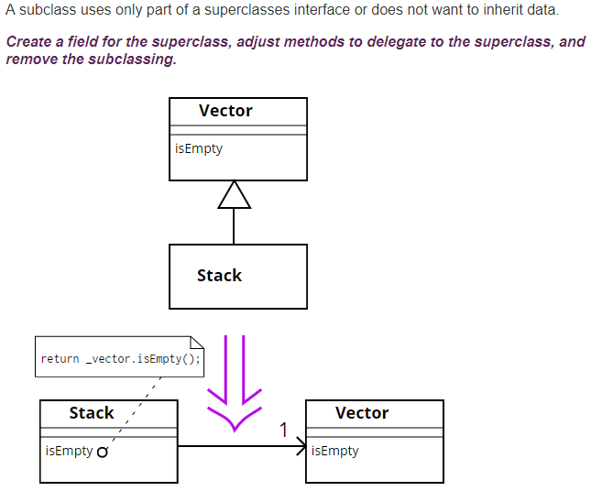
Replace Inheritance with Delegation (association, aggregation, or composition)
Notes:
A stack has a list of objects, a vector has a list of object so we decide to inherit … Give an example with methods Object get(i) – say a couple of variants that correspond to the discussion of refuse bequest (exception, or pointless method)

