Slide 1
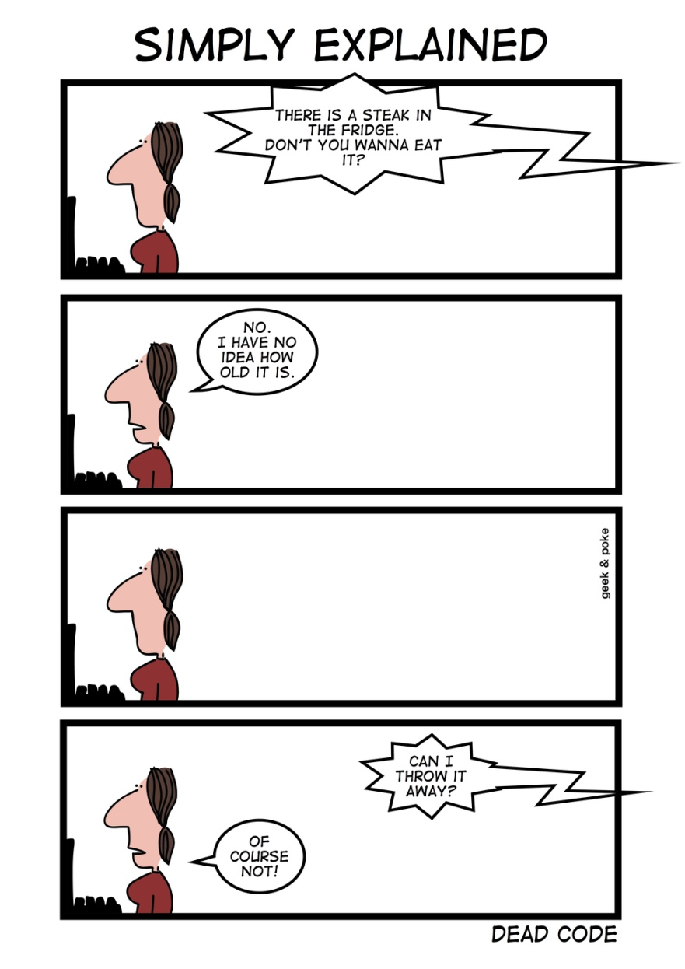
Unnecessary Complexity www.cs.uoi.gr/~zarras/soft-devII.htm
Sources: M. Fowler Refactorings Catalog
W. Wake Refactoring Workbook

Slide 2
Dead Code

Slide 3
Dead Code
Symptoms
A variable, parameter, field, block, method, or class is not used anywhere
Causes
Complicated logic resulted in some combinations of conditions that can’t actually happen; you’ll see this when simplifying conditionals.
Requirements have changed, or new approaches were introduced, without adequate cleanup.

Slide 4
Dead Code
What to Do
For an unnecessary class: Ensure there are no references, and remove it.
For an unnecessary method: Ensure there are no references, and remove it.
For an unnecessary field: Ensure there are no references, and remove it.
For an unnecessary parameter: Remove Parameter.
For an unused variable: Remove it.

Slide 5
Lazy Class

Slide 6
Lazy Class
Symptoms
A class isn’t doing much: its parents, children, or callers seem to be doing all the
associated work, and there isn’t enough behavior left in the class to justify its continued existence.
Causes
Typically, all the class’ responsibilities were moved to other places in the course of
refactoring.
What to Do
If parents or children of the class seem like the right place for its behavior, fold it into one of them via Collapse Hierarchy.
Otherwise, fold its behavior into its caller via Inline Class.

Slide 7
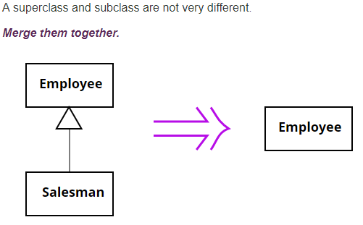
Collapse Hierarchy

Slide 8
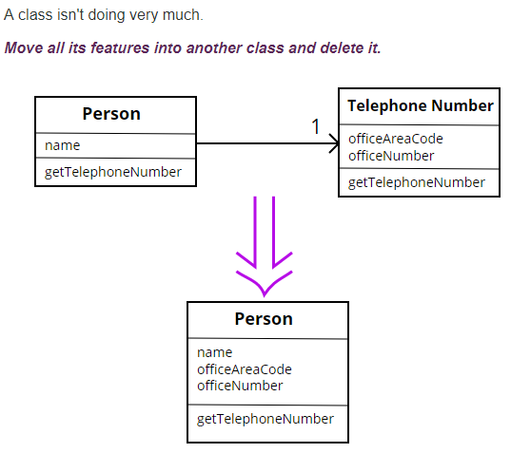
Inline Class

Slide 9
Inline Class
Inline Class is the reverse of Extract Class.
Use Inline Class if a class is no longer pulling its weight and shouldn't be around any more.
Often this is the result of refactoring that moves other responsibilities out of the class so there is little left.
Then I want to fold this class into another class, picking one that seems to use the weak class the most.

