Slide 1
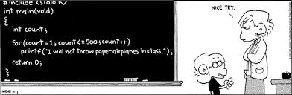
Clean Formatting www.cs.uoi.gr/~zarras/soft-devII.htm
from Clean Code by R. C. Martin, a.k.a “Uncle Bob”

Slide 2
The Purpose of Formatting
The purpose of a computer program is to tell other people
what you want the computer to do. – Donald Knuth
The purpose of formatting is to facilitate communication. The
formatting of code conveys information to the reader.

Slide 3
Vertical & Horizontal Formatting
In code format we distinguish 2 aspects:
Vertical formatting which concerns blocks of lines of code and refers to the way code is structured from top to bottom
Horizontal formatting which concerns a single line of code and refers to the way it is structured from left to right

Slide 4
Vertical Formatting
How big should a source file be?
How big are most Java source files?

Slide 5
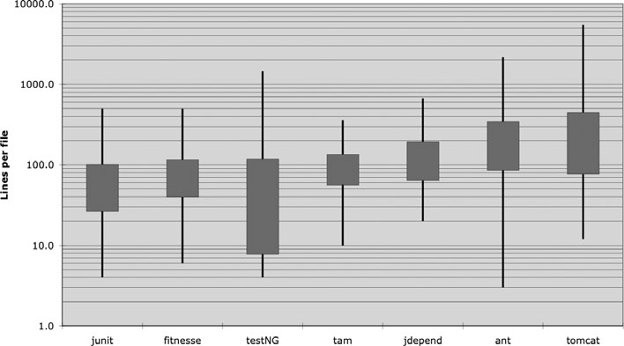
Vertical Formatting
How big should a source file be?
How big are most Java source files?
JUnit, FitNesse, and T&M are composed of relatively small files. None are over 500 lines and most of those files are less than 200 lines.
Tomcat and Ant, on the
other hand, have some files that are several thousand lines long and close to half are over
200 lines.
So what is the conclusion ?
Notes:
Box plot divides an ordered set of values in n equal parts (3 in our case) then we depict the range of the values that belong to each part . Here we divide into small medium high values
box που κυμαίνεται το 1/3 των αρχείων

Slide 6
Vertical Formatting
It appears to be possible to build significant systems
(FitNesse is close to 50,000 lines) out of files that are typically 200 lines long, with an upper limit of 500.
Although this should not be a hard and fast rule, it should be considered
very desirable.
Small files are usually easier to understand than large files are !!!
Notes:
box που κυμαίνεται το 1/3 των αρχείων

Slide 7

How to structure the file vertically ? The Newspaper Metaphor
We would like a source file to be like a newspaper article.
Think of a well-written newspaper article.
You read it vertically.
At the top you expect a headline that will tell you what the story is about and allows you to decide whether it is something you want to read.
The first paragraph gives you a synopsis of the whole story, hiding all the details while giving you the broad-brush concepts.
As you continue downward, the details increase until you have all the dates, names, quotes, claims, and other.
Notes:
Ok about the size how about the contents ???

Slide 8
How to structure the file vertically ? The Newspaper Metaphor
We would like a source file to be like a newspaper article.
The file name should be simple but explanatory. The name, by itself, should be sufficient to tell us whether we are in the right module or not.
The topmost parts of the source file should provide the high-level concepts and algorithms.
Detail should increase as we move downward, until at the end we find the lowest level functions and details in the source file.

Slide 9
The Newspaper Metaphor
We would like a source file to be like a newspaper article.
A newspaper is composed of many articles; most are very small.
Some are a bit larger.
Very few contain as much text as a page can hold.
Notes:
box που κυμαίνεται το 1/3 των αρχείων

Slide 10
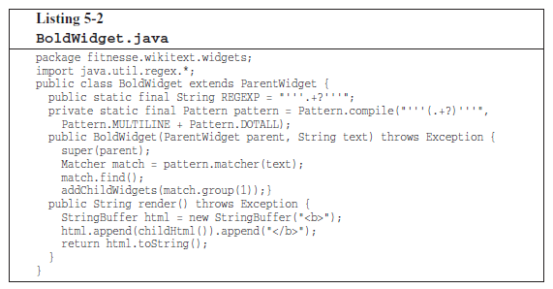
Vertical Openness
Take a look for a while !!

Slide 11
Vertical Openness
What is the name of the class ?
What is the package it belongs too ?
How many imports does it have ?
How many methods ?
How many attributes ?
Notes:
box που κυμαίνεται το 1/3 των αρχείων

Slide 12
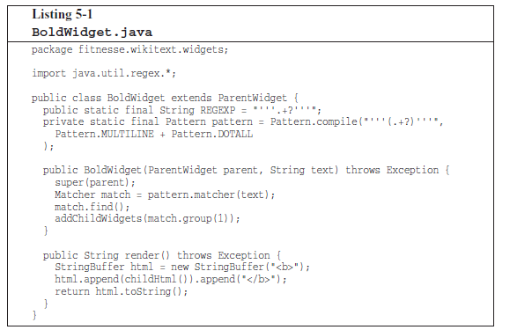
Vertical Openness
Same code much better formatted !! The difference is vertical openness
Notes:
box που κυμαίνεται το 1/3 των αρχείων

Slide 13
Vertical Openness
Vertical openness means separate the concepts with blank lines
A piece of code describes a number of concepts:
For a class we have:
the package where it belongs
other classes that are used/imported (i.e. dependencies)
the state of the class objects (i.e. the set of fields)
each one of the methods that constitute the behavior
Notes:
box που κυμαίνεται το 1/3 των αρχείων

Slide 14
Vertical Openness
There are blank lines that separate the package declaration, the import(s), and each of the functions.
This extremely simple rule has a profound effect on the visual layout of the code.
Each blank line is a visual cue that identifies a new and separate concept.
As you scan down the listing, your eye is drawn to the first
line that follows a blank line.
Take a look for a while !!
Same code much better formatted !!
The difference is a bit of vertical openness
Notes:
box που κυμαίνεται το 1/3 των αρχείων

Slide 15
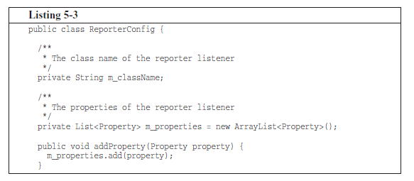
Vertical Density
Take a look for a while !! Do you see the inconvenience here ??
Notes:
From the testNG framework

Slide 16
Vertical Density
Take a look for a while !! Do you see the inconvenience here ??
Notice how the useless comments break the close association of the two attributes that constitute the state of the class objects !!!
Notes:
box που κυμαίνεται το 1/3 των αρχείων

Slide 17
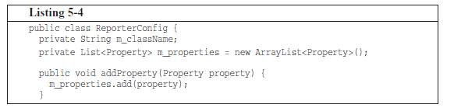
Vertical Density
Much easier to read.
It fits in an “eye-full”. We can look at it and see that this is a class with two attributes and a method, without having to move our head or eyes much.
The previous listing forces us to use much more eye and head motion to achieve the same level of comprehension.

Slide 18
Vertical Density
What have we done ??
We increased the vertical density, by putting together lines of code that belong to the same concept (i.e. the state definition of the class objects)
So lines of code that are tightly related (defining a concept) should appear vertically dense.
Notes:
box που κυμαίνεται το 1/3 των αρχείων

Slide 19
Vertical Distance
Vertical distance is the distance between concepts that relate with each other, like methods that call each other
Concepts that are closely related should be kept in a small vertical distance!!
Notes:
box που κυμαίνεται το 1/3 των αρχείων

Slide 20
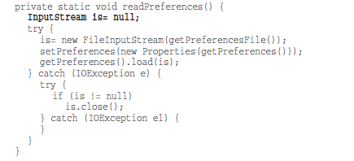
Vertical Distance
Variables should be declared as close to their usage as possible.
Because our functions are very short, local variables could appear at the top of each function, as in this function from JUnit
Notes:
box που κυμαίνεται το 1/3 των αρχείων

Slide 21

Vertical Distance
Control variables for loops should usually be declared within the loop statement, as in this function from JUnit.

Slide 22
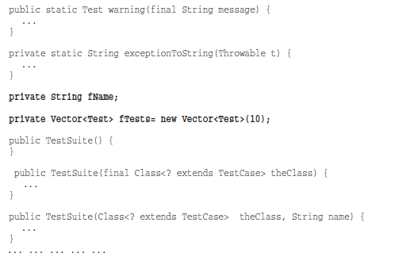
Vertical Distance
How about these for class attribute declarations
(from the Junit TestSuite class) ??

Slide 23
Vertical Distance
How about this for class attribute declarations (from the Junit TestSuite class) ??
Two attributes declared in the middle of the class !! It would be hard to hide them in a better place. Someone reading this code would have to stumble across the declarations by accident !!!

Slide 24
Vertical Distance
But putting the attributes at the top (or bottom) shall increase the vertical distance between them and the functions that use them ???
Notes:
box που κυμαίνεται το 1/3 των αρχείων

Slide 25
Vertical Distance
But putting the attributes at the top (or bottom) shall increase the vertical distance between them and the functions that use them ???
Not really, because in a well-designed – cohesive - class, they are used by many, if not all, of the methods of the class !!!

Slide 26
Vertical Distance
There have been many debates over where class attributes should go.
In C++ we commonly practiced the so-called scissors rule, which put all the attributes at the bottom.
In Java, however, is to put them all at the top of the class.
The important thing is for the attributes to be declared in one well-known place. Everybody should know where to go to see the declarations !!!
Notes:
\

Slide 27
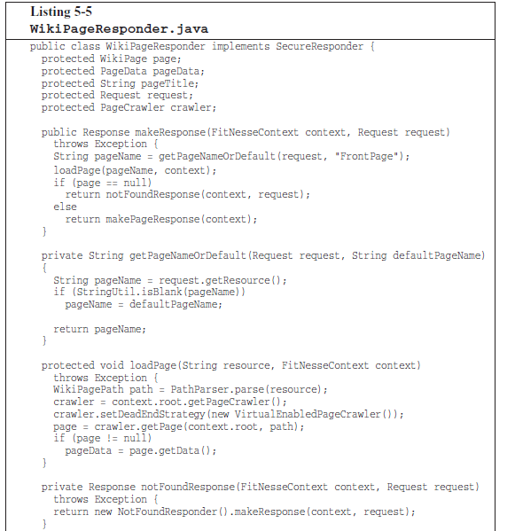
Vertical Distance
What do we observe here ??

Slide 28
Vertical Distance
What do we observe here ??
If one function calls another, they should be vertically close,
and the caller should be above the callee, if at all possible.
This gives the program a natural flow, according to the newspaper metaphor., (a.k.a step-down rule)

Slide 29
Horizontal Formatting
How wide should a line be?

Slide 30
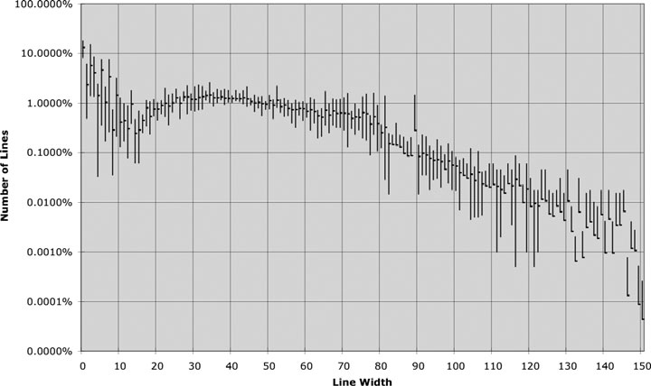
Horizontal Formatting
How wide should a line be?
Every size from 20 to 60 represents about 1% of the total
number of lines.
That’s 40 percent!
Another 30 percent are less than 10 characters wide.
Programmers clearly prefer short lines !!!
Notes:
Y-axis
For each width gives the range of the numbers of lines in the different projects

Slide 31
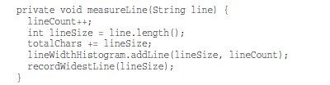
Horizontal Openness & Density
Surround the assignment operators with white space to accentuate them. Assignment statements have two distinct and major elements: the left side and the right side. The spaces make that separation obvious.
On the other hand, don’t put spaces between the function names and the opening
parenthesis. This is because the function and its arguments are closely related.
Separate arguments within the function call parenthesis to accentuate the comma and show that the arguments are separate.
Notes:
the way to play with openness/density is white spaces…
τι κάνει αυτός ο κώδικας ??
για παράδειγμα βάζουμε κενά πριν/μετα από τον τελεστή =
αντίθετα δεν βαζουμε κενό μεταξύ του ονόματος μιας συνάρτησης και της παρένθεσης …
μεταξύ των παραμέτρων βάζουμε κενά για να τονίσουμε τη διαφορετικοτητα

Slide 32
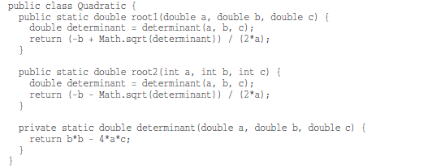
Horizontal Openness & Density
Notice how nicely the equations read.
The factors have no white space between them because they are high precedence.
The terms are separated by white space because addition and subtraction are lower precedence.
Notes:
τι κάνει αυτός ο κώδικας ??
παράγοντες , προσθετέοι, αφαιρετέοι, μειωτέοι

Slide 33
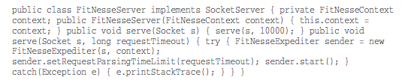
Indentation
How about this as horizontal formatting ??
Notes:
στοίχιση

Slide 34
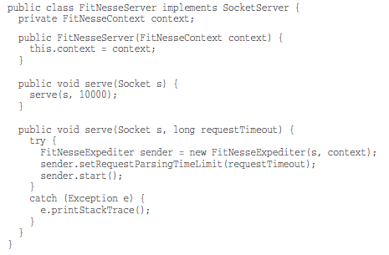
Indentation
A source file is a hierarchy rather like an outline. There is information that pertains to the file as a whole, to the individual classes within the file, to the methods within the classes, to the blocks within the methods, and recursively to the blocks within the blocks.
To make this hierarchy of scopes visible, we indent the lines of source code in proportion to their position in the hierarchy.

Slide 35
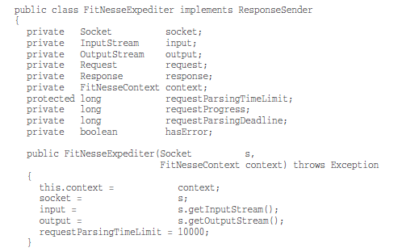
Horizontal Alignment
Once upon a time….!!!
Do you see the problem here ??

Slide 36
Horizontal Alignment
The alignment seems to emphasize the wrong things and leads the eye away from the true intent.
In the list of declarations above we are tempted to read down the list of variable names without looking at their types.
Likewise, in the list of assignment statements we are tempted to look down the list of rvalues without ever seeing the assignment operator.
Notes:
box που κυμαίνεται το 1/3 των αρχείων

Slide 37
Indentation
while((result = dis.read()) != null);
System.out.println(result);
What does this do ??
Notes:
box που κυμαίνεται το 1/3 των αρχείων

Slide 38
Indentation
while((result = dis.read()) != null);
System.out.println(result);
What does this do ??
Sometimes the body of a while or for statement is a dummy !!
Unless you make that semicolon visible by indenting it on it’s own line, it’s just too hard to see.
Notes:
box που κυμαίνεται το 1/3 των αρχείων

Slide 39
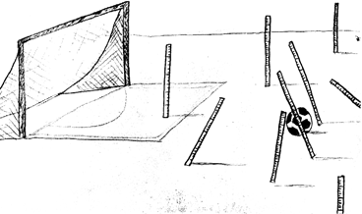
Team Rules
Every programmer has his own favorite formatting rules, but if he works in a team, then the team rules.
A team of developers should agree upon a single formatting style, and then every member of that team should use that style.
We want the software to have a consistent style.
We don’t want it to appear to have been written by a bunch of disagreeing individuals.

Slide 40
Java Coding Standard Style
Oracle

Slide 41
Java Conventions
Source file organization

Slide 42
Java Conventions
Source file organization
A Java source file should contain the following elements, in the following order:
Copyright/ID block comment
package declaration
import declarations
one or more class/interface declarations
At least one blank line should separate all of these elements.

Slide 43
Java Conventions
Package naming

Slide 44
Java Conventions
Package naming
Generally, package names should use only lower-case letters and digits, and no underscore. Examples:
java.lang
java.awt.image
dinosaur.theropod.velociraptor

Slide 45
Java Conventions
Class/Interface naming
Notes:
1-* λέξεις
ουσιαστικά
κάθε λέξη κεφαλαίο γράμμα

Slide 46
Java Conventions
Class/Interface naming
All type names (classes and interfaces) should use the InfixCaps style.
Class names should be nouns or noun phrases.
Start with an upper-case letter, and capitalize the first letter of any subsequent word in the name, as well as any letters that are part of an acronym. All other characters in the name are lower-case.
Do not use underscores to separate words.
Examples:
// GOOD type names:
LayoutManager, ArrayIndexOutOfBoundsException
// BAD type names:
ManageLayout // verb phrase
awtException // first letter lower-case
array_index_out_of_bounds_exception // underscores
Notes:
1-* λέξεις
ουσιαστικά
κάθε λέξη κεφαλαίο γράμμα

Slide 47
Java Conventions
Field naming

Slide 48
Java Conventions
Field naming
The names should be nouns or noun phrases.
Names of non-constant fields (reference types, or non-final primitive types) should use the infixCaps style.
Start with a lower-case letter, and capitalize the first letter of any subsequent word in the name, as well as any letters that are part of an acronym. All other characters in the name are lower-case.
Do not use underscores to separate words.
Examples:
char recordDelimiter;
Names of fields being used as constants should be all upper-case, with underscores separating words.
Examples:
MIN_VALUE, MAX_BUFFER_SIZE, OPTIONS_FILE_NAME

Slide 49
Java Conventions
Method naming
Notes:
1-* λεξεις
1^{η} λέξη ρήμα

Slide 50
Java Conventions
Method naming
Method names should be imperative verbs or verb phrases. Examples:
Method names should use the infixCaps style.
Start with a lower-case letter, and capitalize the first letter of any subsequent word in the name, as well as any letters that are part of an acronym. All other characters in the name are lower-case.
Do not use underscores to separate words.
// GOOD method names:
showStatus(), drawCircle(), addLayoutComponent()
// BAD method names:
mouseButton() // noun phrase; doesn’t describe function
DrawCircle() // starts with upper-case letter
add_layout_component() // underscores
Notes:
1-* λεξεις
1^{η} λέξη ρήμα

Slide 51
Java Conventions
Blank lines

Slide 52
Java Conventions
Blank lines
A blank line should also be used in the following places:
After the copyright block comment, package declaration, and import section.
Between class declarations.
Between method declarations.
Between the last field declaration and the first method declaration in a class.

Slide 53
Java Conventions
Blank spaces
A single blank space (not tab) should be used:
Between a keyword and its opening parenthesis. This applies to the following keywords: catch, for, if, switch, while.
After any keyword that takes an argument.
Example: return true;
Between two adjacent keywords.
Before and after binary operators except .(dot).
After a comma in a list.
After the semi-colons in a for statement, e.g.:
for (expr1; expr2; expr3) {

Slide 54
Java Conventions
Continuation lines
Lines should be limited to 80 columns.
Lines longer than 80 columns should be broken into one or more continuation lines, as needed.
All the continuation lines should be aligned
// RIGHT
foo(long_expression1, long_expression2, long_expression3,
long_expression4);
// RIGHT
foo(long_expression1,
long_expression2,
long_expression3,
long_expression4);

