Slide 1
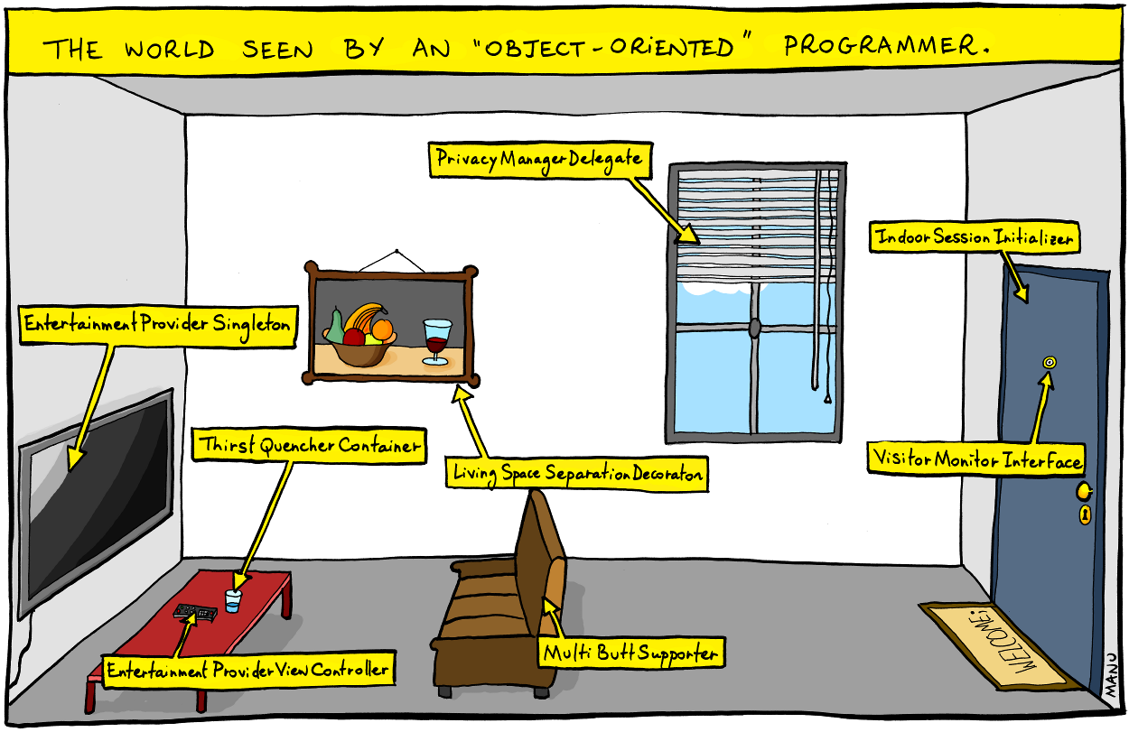
Clean Classes www.cs.uoi.gr/~zarras/soft-devII.htm
from Clean Code by R. C. Martin, a.k.a “Uncle Bob”

Slide 2
Class Organization
Following the standard Java convention, a class should begin with a list of attributes.
Public static constants, if any, should come first. Then private static attributes, followed by private instance attributes.
Public functions/methods should follow the list of attributes. We like to put the private utilities called by a public function right after the public function itself. This follows the stepdown rule and helps the program read like a newspaper article.

Slide 3
Encapsulation
We like to keep our attributes and utility functions/methods private, but we’re not fanatic about it.
Sometimes we need to make an attribute or utility function/methods protected.
There is seldom a good reason to have a public attribute !!!

Slide 4
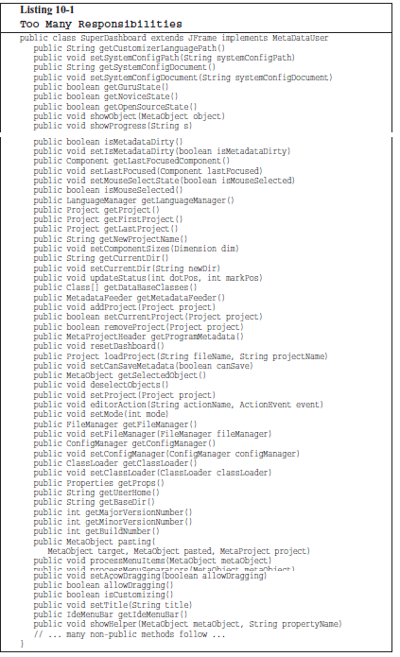
Classes should be small!!
With functions we measured size by counting physical lines.
Listing 10-1 outlines a class, SuperDashboard, that exposes about 70 public methods.
Most developers would agree that it’s a bit too super in size.
Some developers might refer to SuperDashboard as a “God class”

Slide 5
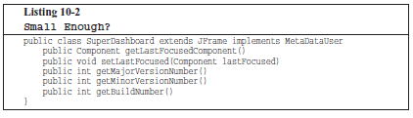
Classes should be small!!
But what if SuperDashboard contained only 5 methods ?
Five methods isn’t too much, is it?

Slide 6
Classes should be small!!
With classes we use a different measure. We count responsibilities.
In this case the class is NOT small, despite its small number of methods, SuperDashboard has too many responsibilities.
The name of a class should describe what responsibilities it fulfills.
In fact, naming is probably the first way of helping determine class size. If we cannot derive a concise name for a class, then it’s likely too large. The more ambiguous the class name, the more likely it has too many responsibilities.
For example, class names including weasel words like Processor or Manager or Super often hint at unfortunate aggregation of responsibilities.

Slide 7
Classes should be small!!
We should also be able to write a brief description of the class in about 25 words, without using the words “if,” “and,” “or,” or “but.”
How would we describe the SuperDashboard?
“The SuperDashboard provides access to the GUI component that last held the focus, and it also allows us to track the version and build numbers.”
The first “and” is a hint that SuperDashboard has too many responsibilities.

Slide 8
Classes should be small!!
Is there any well known principle that promotes small classes ???

Slide 9
The Single Responsibility Principle
This principle gives us both a definition of responsibility, and a guideline for class size.
Classes should have one responsibility—one reason to change !!

Slide 10
The Single Responsibility Principle
The seemingly small SuperDashboard class has two reasons to change.
First, it tracks version information that would seemingly need to be updated every time the software gets shipped.
Second, it manages Java Swing components (it is a derivative of JFrame, the Swing representation of a top-level GUI window).

Slide 11
Organizing for change
For most systems, change is continual.
Every change subjects us to the risk that the remainder of the system no longer works as intended. Effort is needed to analyze the impact of changes, compile, test, etc.
In a clean system we organize our classes so as to reduce this effort.
Big classes that violate SRP are significant impediments towards reducing this effort
➔ A change to a big class can affect many things inside the class
➔ A change to a big class may affect the clients and big classes have many clients
Notes:
A change to a big class can affect many inside things
A change to a big class may affect the clients and big classes have many clients

Slide 12
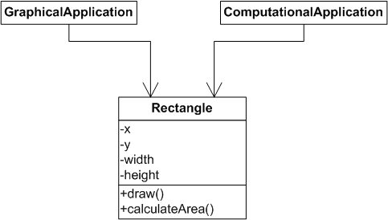
Organizing for change
Suppose that we want to change the drawing method
Notes:
A change to a big class can affect many inside things
A change to a big class may affect the clients and big classes have many clients

Slide 13
Organizing for change
Changing the drawing method may lead to re-compilation and re-testing both applications because the tools “see” the class level dependencies and NOT the low level implementation
However this SHOULDN’T be the case because only the GraphicalApplication uses the drawing method !!!
Notes:
A change to a big class can affect many inside things
A change to a big class may affect the clients and big classes have many clients

Slide 14
Organizing for change
Can we solve the problem and avoid the extra effort??
Notes:
A change to a big class can affect many inside things
A change to a big class may affect the clients and big classes have many clients

Slide 15
Organizing for change
Rectangle violates SRP
It has >1 responsibities
Drawing
Geometrical calculations
Notes:
A change to a big class can affect many inside things
A change to a big class may affect the clients and big classes have many clients

Slide 16
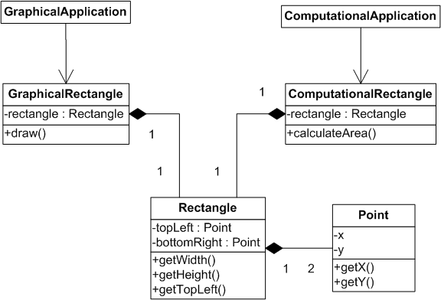
Organizing for change
Solution:
we break the responsibilities to different “smaller” classes…..
NOW changing the drawing method affects only the GraphicalApplication
Notes:
A change to a big class can affect many inside things
A change to a big class may affect the clients and big classes have many clients

Slide 17
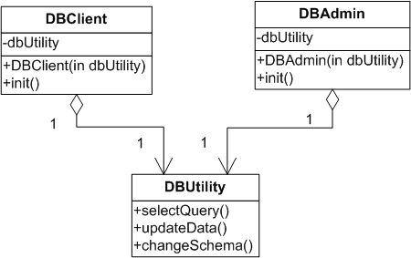
Isolating from change
Changes to any method affect both DBAdmin and DBUser
Both should be re-tested, re-compiled, etc…
But it shouldn’t because DBUser only uses selectData() while DBAdmin only uses updateData() and changeSchema()
Notes:
in DIP we had many classes that played the same role. We used an iface to represent this role – this allow to easily change the role players classes
we may also have one class that can play many roles for different clients. In this case it is useful to use ifaces for the different roles. It isolates client classes that don’t relate with a role from role changes

Slide 18
Isolating from change
Maybe we should separate selectQuery and updateData, changeSchema to different classes ????
What if we DON’T have time to split DBUtility ?
Or what if it DOES NOT MAKE SENSE to split it because it is generally cohesive, providing a single responsibility (ACCESS TO Database) ?
How can we organize better for change?
Notes:
in DIP we had many classes that played the same role. We used an iface to represent this role – this allow to easily change the role players classes
we may also have one class that can play many roles for different clients. In this case it is useful to use ifaces for the different roles. It isolates client classes that don’t relate with a role from role changes

Slide 19
Isolating from change
The Interface Segregation Principle (ISP) says that our classes should not depend upon methods that they don’t use !!
The idea then is to extract different interfaces that match the needs of the client classes…
Notes:
in DIP we had many classes that played the same role. We used an iface to represent this role – this allow to easily change the role players classes
we may also have one class that can play many roles for different clients. In this case it is useful to use ifaces for the different roles. It isolates client classes that don’t relate with a role from role changes

Slide 20
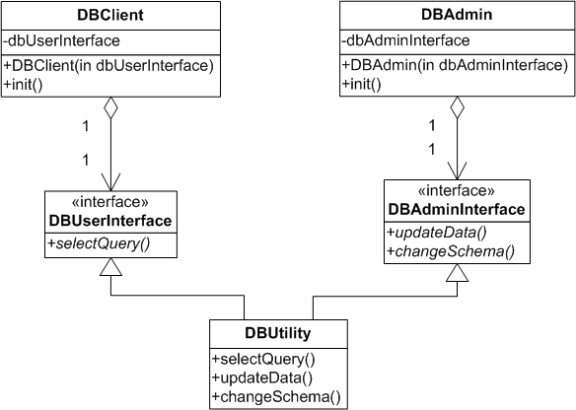
Isolating from change
DBClient and DBAdmin are now isolated from changes to methods they do not use as they use different interfaces implemented by the same class
Notes:
in DIP we had many classes that played the same role. We used an iface to represent this role – this allow to easily change the role players classes
we may also have one class that can play many roles for different clients. In this case it is useful to use ifaces for the different roles. It isolates client classes that don’t relate with a role from role changes

Slide 21
Isolating from change
Needs will change, therefore code will change.
A client class depending upon concrete classes is at risk when those classes change.
We can introduce interfaces and abstract classes to isolate the impact of those changes.
The Dependency Inversion Principle (DIP) says that our classes should depend upon abstractions, not on concrete details !!
Also known as Abstract Coupling

Slide 22
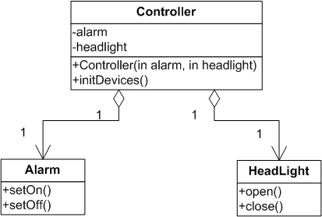
Isolating from change
Changes to Alarm or HeadLight affect Controller…..
Should be re-tested, re-compiled, etc

Slide 23
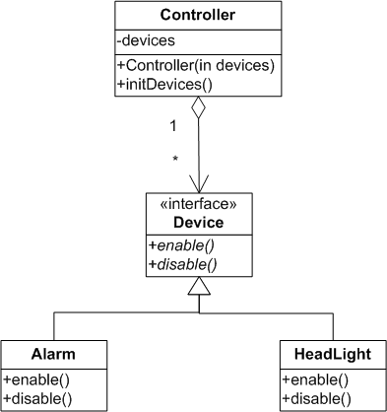
Isolating from change
Controller is isolated from change

Slide 24
Organize for extension
Needs change (DIP, ISP) but also new needs may be added, therefore code should be extended.
Extensions should be done without much effort.
Preferably, only by adding new classes and without having to understand and modify the internals of the software
Is there any well known principle that promotes this goal ??

Slide 25
Organize for extension
Needs change (DIP, ISP) but also new needs may be added, therefore code should be extended.
Extensions should be done without much effort.
Preferably, only by adding new classes and without having to understand and modify the internals of the software
Is there any well known principle that promotes this goal ??
The Open Closed Principle (OCP) says that our software should be open for extensions and closed to modifications !!

Slide 26
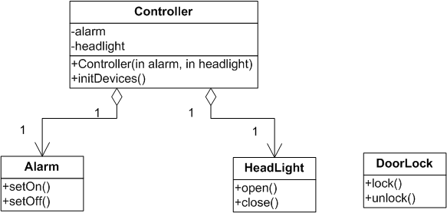
Organize for extension
To add a new device here that locks/unlocks doors we have to change Controller

Slide 27
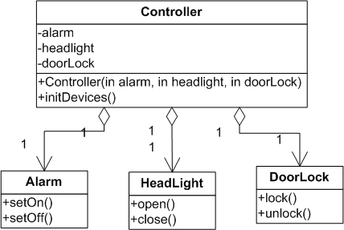
Organize for extension
To add a new device here that locks/unlocks doors we have to change Controller

Slide 28
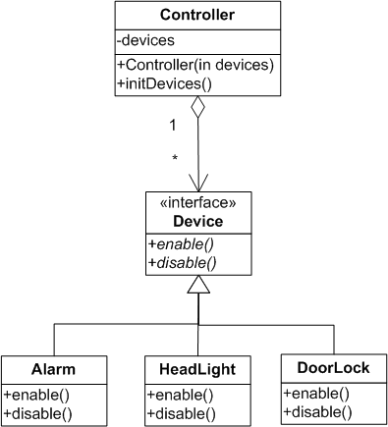
Organize for extension
Abstract Coupling makes the Controller open for extension and closed to modification
Controller is now open for extension and closed to modification because it uses an interface instead of concrete classes

