Slide 1
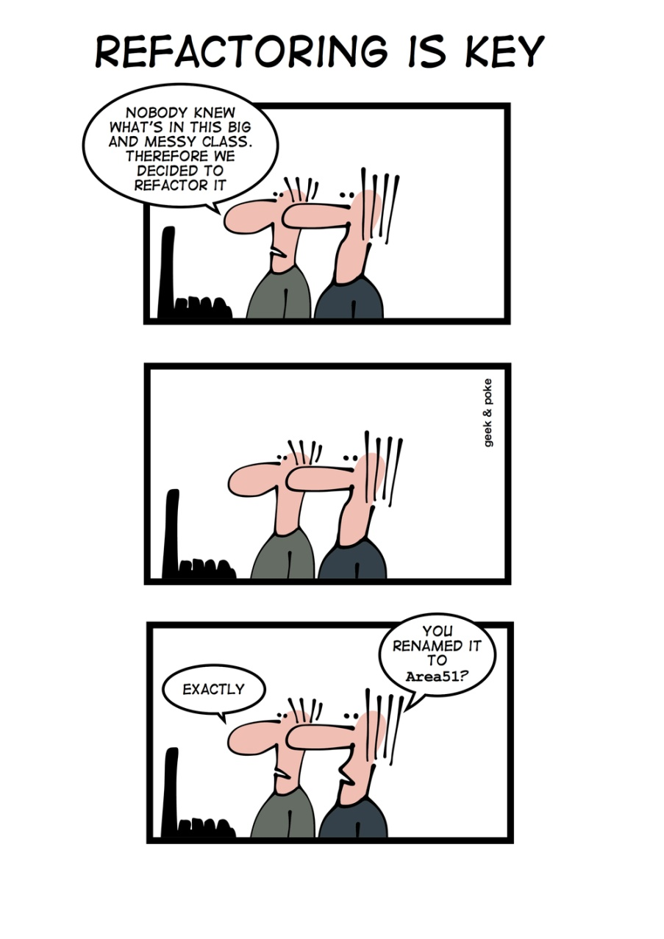
Common Smells www.cs.uoi.gr/~zarras/soft-devII.htm
Sources: M. Fowler Refactorings Catalog
W. Wake Refactoring Workbook

Slide 2
Comments

Slide 3
Comments
Symptoms
Scan the text for “//” or “/*” (comment markers).
Causes
Usually, for the best of reasons. The author realizes that something isn’t as clear as it could be, and adds a comment.
Some comments are particularly helpful:
Legal comments, informative, Javadoc public API, TODO, amplification, warnings. Etc….

Slide 4
Comments
What to Do
When a comment explains a block of code, you can often use Extract Method to
pull the block out into a separate method.
The comment will often suggest a name for the new method.

Slide 5
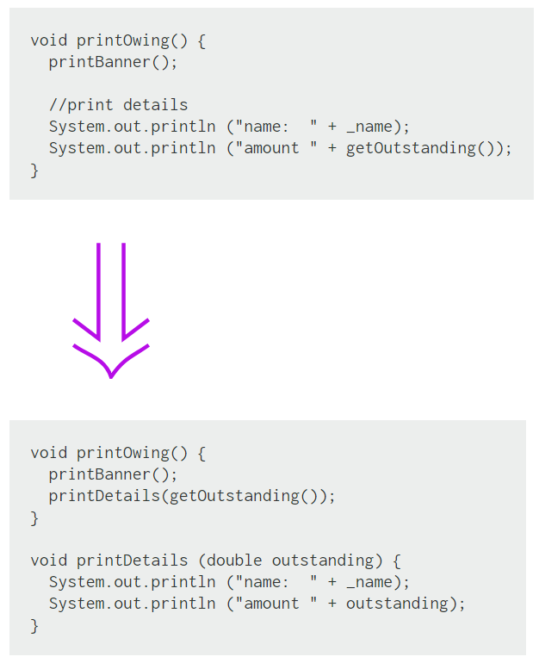
Extract Method
If you have a code fragment that can be grouped together.
Turn the fragment into a method whose name explains the purpose of the method.

Slide 6
Extract Method
Extract Method is one of the most common refactorings
If you have a code fragment that can be grouped together.
Turn the fragment into a method whose name explains the purpose of the method.
Short, well-named methods increase the chances that other methods can reuse them.
It allows the higher-level methods to read more like a story.
Overriding also is easier when the methods are fine grained.
Small methods really work only when you have good names, so you need to pay attention to naming.

Slide 7
Comments
What to Do
When a comment explains what a method does (better than the method’s name!),
use Rename Method using the comment as the basis of the new name.

Slide 8
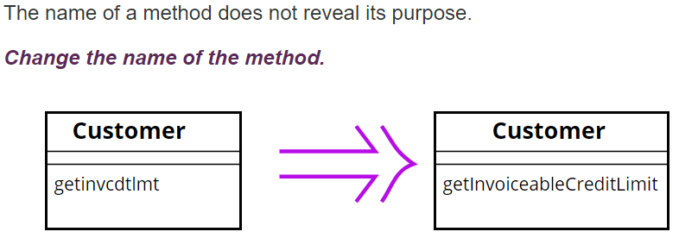
Rename Method
Before changing the name, check if the method overrides (or is overridden) a super class method (by subclasses methods). In that case all the names must change.
Changing the name implies changing the callers of the method.
What we do if this is not possible ??
We can keep the previous version of the method and make it call the new one to avoid duplication; mark the old version of the method as deprecated

Slide 9
Comments
What to Do
When a comment explains preconditions, consider using Introduce Assertion to
replace the comment with code.

Slide 10
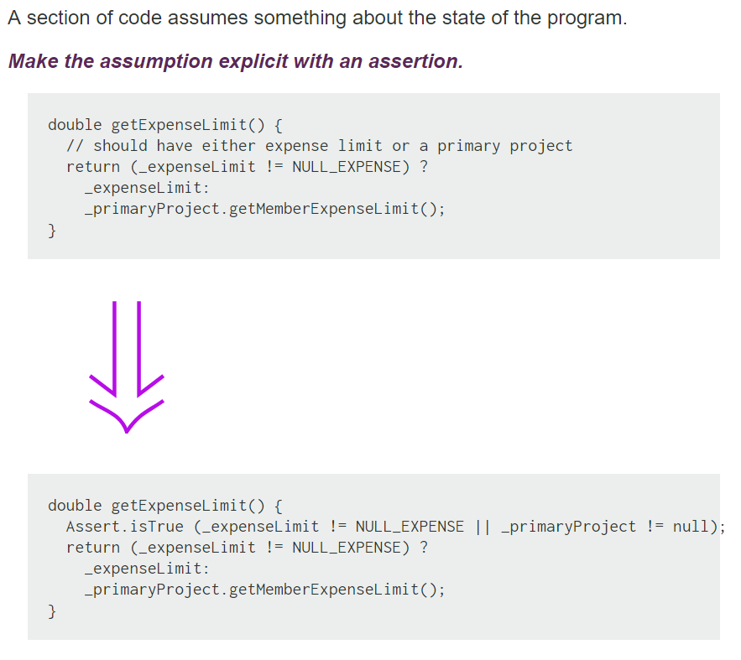
Introduce Assertion
public void setup() {
Connection conn = getConnection();
// conn should be != null to the
// rest of the code to work…
…….
}
// In Java there is a specific programming construct!!
// Don’t confuse it with Junit
// To enable them java –ea
public void setup() {
Connection conn = getConnection();
assert conn != null : "Connection is null";
}
Notes:
assert _expenseLimit != NULL_EXPENSE || …;
Have to run with VM arguments -ea

Slide 11
Introduce Assertion
Often sections of code work only if certain conditions are true. Such assumptions often are not stated but can only be decoded by looking through an algorithm.
Sometimes the assumptions are stated with a comment.
A better technique is to make the assumption explicit by writing an assertion.
Assertions act as communication and debugging aids. In communication they help the reader understand the assumptions the code is making. In debugging, assertions can help catch bugs closer to their origin.

Slide 12
Long Method

Slide 13
Long Method
Symptoms
Large number of lines in the method. (immediately suspicious of any method with more than five to ten lines.)
Causes
A method has started down a path, and rather than break the flow or identify the helper objects, the author adds “one more thing.”
Code is often easier to write than it is to read, so there’s a temptation to write blocks that are too big.

Slide 14
Long Method
What to Do
Use Extract Method to break up the method into smaller pieces. Look for comments or white space that delineate “interesting” blocks.

Slide 15
Long Method
What to Do
You may find other related refactorings (those that clean up straight-line code, conditionals, and variable usage) helpful before you even begin splitting up the method.

Slide 16
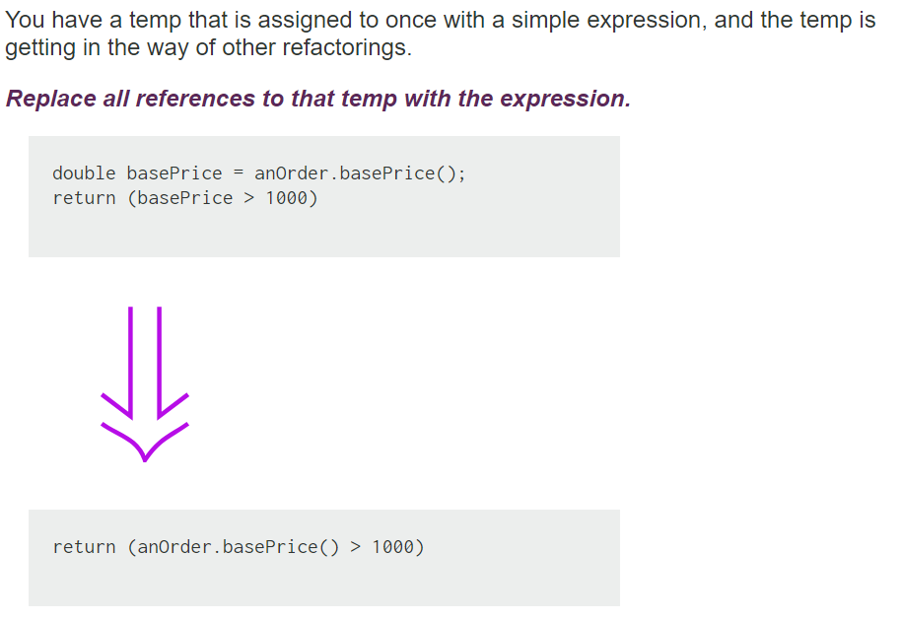
Inline Temp
Notes:
Say about separate query from modifier importance

Slide 17
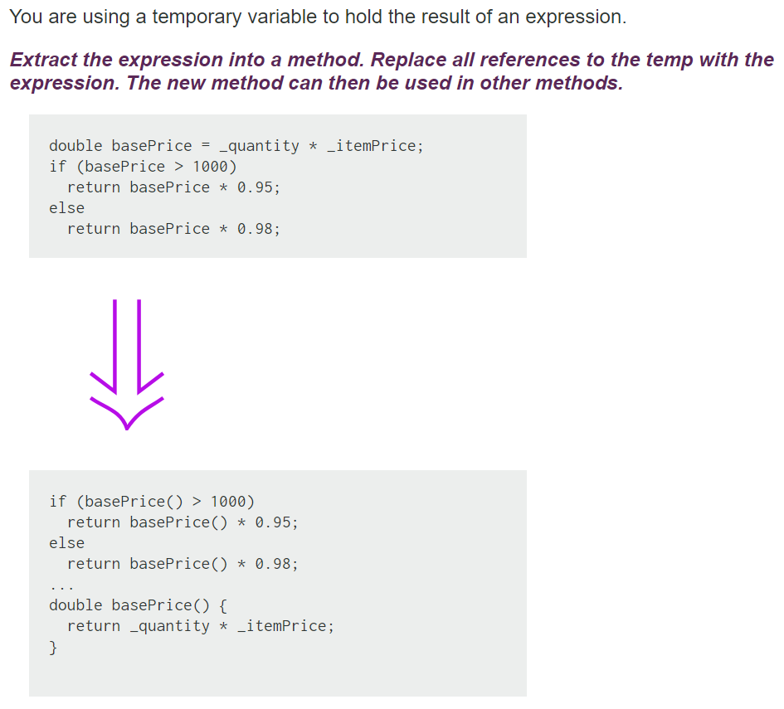
Replace Temp with Query

Slide 18
Replace Temp with Query
Replace Temp with Query often is a vital step before Extract Method.
Local variables make it difficult to extract, so replace as many variables as you can with queries.
The straightforward cases of this refactoring are those in which temps are assigned only to once. Other cases are trickier (e.g. see Split Temporaty Variable) but possible.

Slide 19
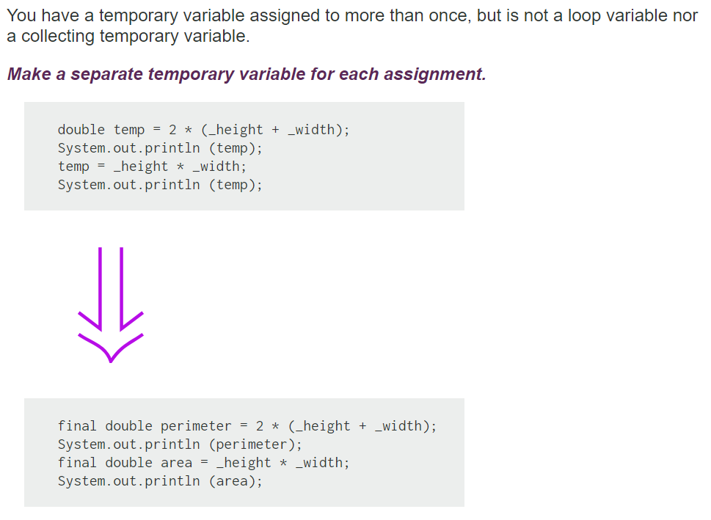
Split Temporary Variable

Slide 20
Split Temporary Variable
Temporary variables are made for various uses.
Some of these uses naturally lead to the temp's being assigned to several times. Loop variables change for each run around a loop (such as the i in for (int i=0; i<10; i++). Collecting temporary variables collect together some value that is built up during the method.
Many other temporaries are used to hold the result of a bit of code for easy reference later.
These kinds of variables should be set only once. That they are set more than once is a sign that they have more than one responsibility within the method.
Any variable with more than one responsibility should be replaced with a temp for each responsibility. Using a temp for two different things is very confusing for the reader.

Slide 21
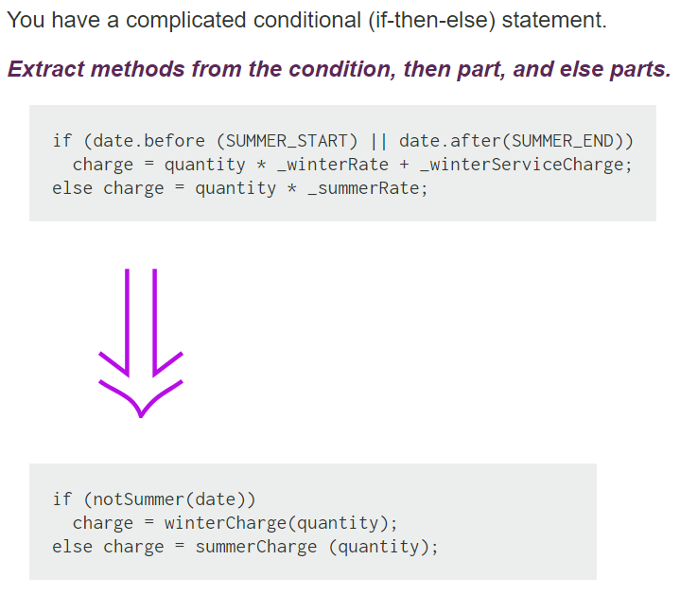
Decompose Conditional

Slide 22
Decompose Conditional
One of the most common areas of complexity in a program lies in complex conditional logic. As you write code to test conditions and to do various things depending on various conditions, you quickly end up with a pretty long method. Length of a method is in itself a factor that makes it harder to read, but conditions increase the difficulty.
As with any large block of code, you can make your intention clearer by decomposing it and replacing chunks of code with a method call named after the intention of that block of code.
With conditions you can receive further benefit by doing this for the conditional part and each of the alternatives.
This way you highlight the condition and make it clearly what you are branching on. You also highlight the reason for the branching.

Slide 23
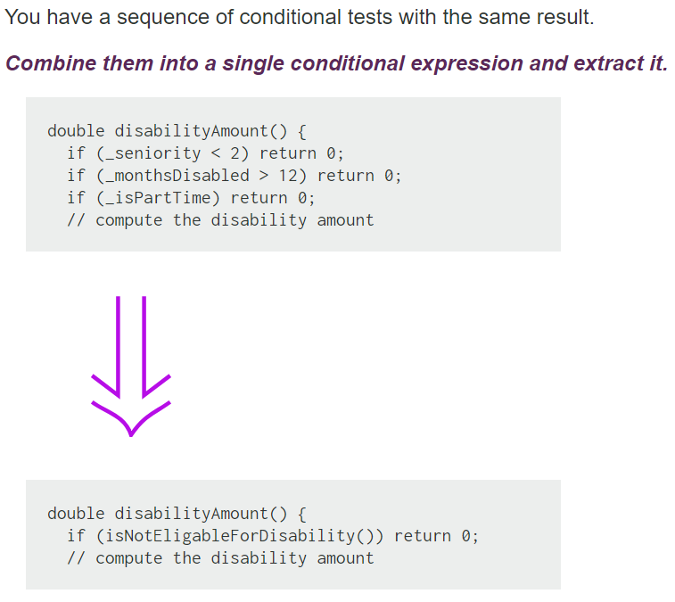
Consolidate Conditional

Slide 24
Consolidate Conditional
Sometimes you see a series of conditional checks in which each check is different yet the resulting action is the same. When you see this, you should use ands and ors to consolidate them into a single conditional check with a single result.
Consolidating the conditional code is important for two reasons.
First, it makes the check clearer by showing that you are really making a single check. The sequence has the same effect, but it communicates carrying out a sequence of separate checks that just happen to be done together.
The second reason for this refactoring is that it often sets you up for EXTRACT METHOD and DECOMPOSE CONDITIONAL.
The reasons in favor of consolidating conditionals also point to reasons for not doing it. If you think the checks are really independent and shouldn't be thought of as a single check, don't do the refactoring.
**** Check that any of the conditionals has side effects. If there are side effects, you won't be able to do this refactoring
Notes:
Side effects issue…
The code that executes if true may return meaning that only one condition is evaluated – and – the respective side effects take place. In the refactored case you evaluate all the conditions

Slide 25
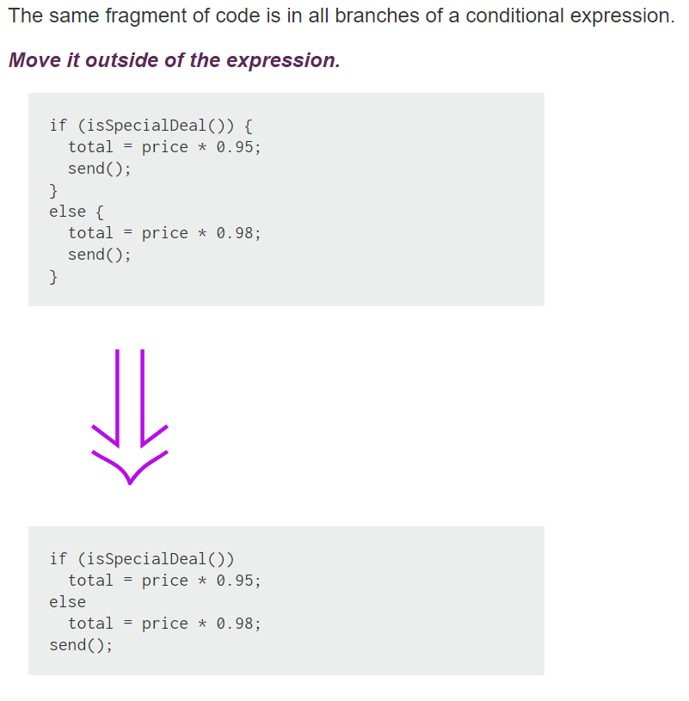
Consolidate Duplicate Conditional Fragments

Slide 26
Consolidate Duplicate Conditional Fragments
Sometimes you find common code executed in all legs of a conditional. In that case you should move the code to outside the conditional. This makes clearer what varies and what stays the same. Simplifies DECOMPOSE CONDITIONAL too.
If the common code is at the beginning, move it to before the conditional.
If the common code is at the end, move it to after the conditional.
If the common code is in the middle, look to see whether the code before or after it changes anything. Depending on this, you can move the common code forward or backward to the ends.
If there is more than a single statement, you should extract that code into a method.

Slide 27
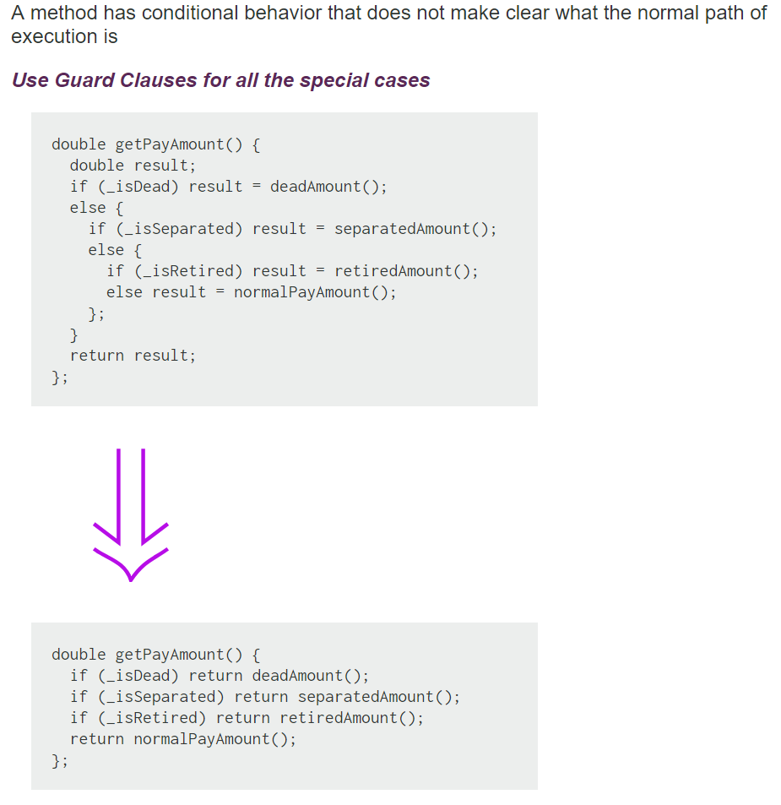
Replace Nested Conditional with Guard

Slide 28
Replace Nested Conditional with Guard
We find that conditional expressions come in two forms.
--- The first form is a check whether either course is part of the normal behavior.
--- The second form is a situation in which one branch from the conditional indicates normal behavior and the other indicates an unusual condition.
These kinds of conditionals have different intentions, and these intentions should come through in the code.
--- If both are part of normal behavior, use a condition with an if and an else leg.
--- If the condition is an unusual condition, check the condition and return if the condition is true. This is called guard clause.
The key point about Replace Nested Conditional with Guard Clauses is one of emphasis. If you
are using an if-then-else construct you are giving equal weight to the if leg and the else leg. This communicates to the reader that the legs are equally likely and important. Instead the guard clause says, "This is rare, and if it happens, do something and get out."

Slide 29
Large Class

Slide 30
Large Class
Symptoms
Large number of instance variables
Large number of methods
Large number of lines
Very general name
Causes
A little bit at a time. The author adds “one more capability” to a class, and eventually it grows too big.
Sometimes the problem is a lack of insight into the parts that make up the whole class.
In any case, the class represents too many responsibilities folded into one object.

Slide 31
Large Class
What to Do
In general, you’re trying to break up the class.
*** If the class has Long Methods, address that smell first.
Extract Class, if you can identify a new object that has part of this class’s responsibilities
Notes:
Explain that the resolution of long methods is important before extract class to have something to move to the extracted class
In fact there is this paper that puts order in smell resolution that may be interesting

Slide 32
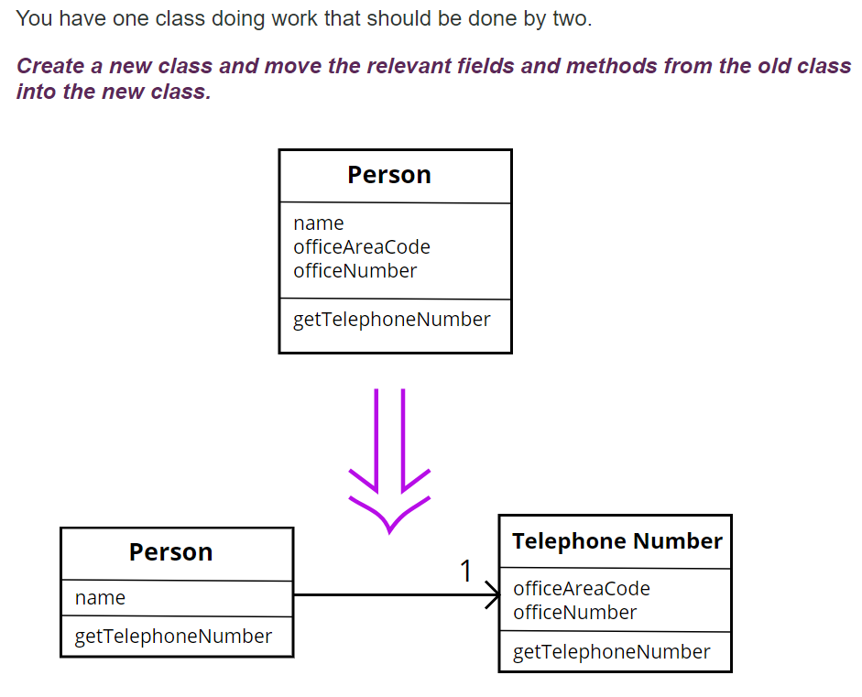
Extract Class

Slide 33
Extract Class
In practice, classes grow.
You add some operations here, a bit of data there. You add a responsibility to a class feeling that it's not worth a separate class, but as that responsibility grows and breeds, the class becomes too complicated.
Such a class is one with many methods and quite a lot of data. A class that is too big to understand easily.
You need to consider where it can be split, and you split it.
A good sign is that a subset of the data and a subset of the methods seem to go together. Other good signs are subsets of data that usually change together or are particularly dependent on each other.

Slide 34
Large Class
What to Do
In general, you’re trying to break up the class.
If the class has Long Methods, address that smell first.
Extract Subclass, if you can divide responsibilities between the class and a new subclass

Slide 35
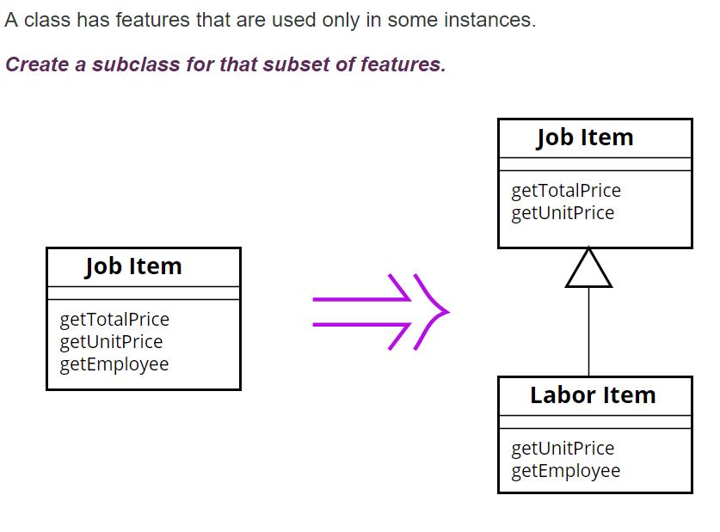
Extract Subclass

Slide 36
Large Class
What to Do
Extract Interface,
you can identify subsets of features that clients use
you have no time to extract class or
it is very complex to extract class or
It does not make sense to extract class because it is cohesive

Slide 37
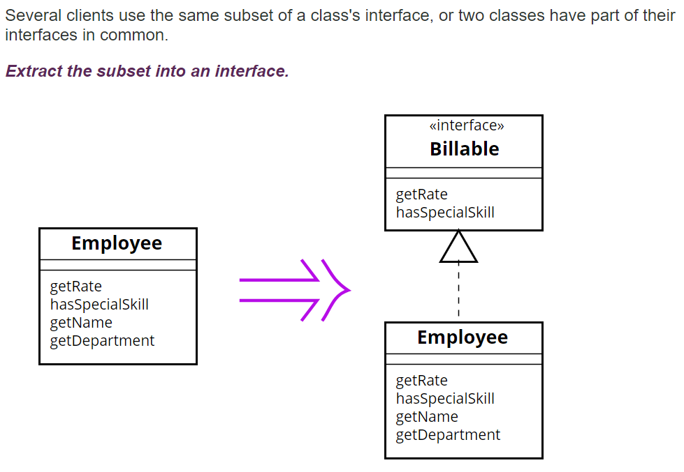
Extract Interface
Notes:
How does this reduce size?? (in the intro of large class we had loc, nom, noa)

Slide 38
Extract Interface
Classes use each other in several ways.
Use of a class often means ranging over the whole area of responsibilities of a class.
Another case is use of only a particular subset of a class's responsibilities by a group of clients.
For the second case it is often useful to define an interface for the subset of responsibilities.
That way it is easier to see how the responsibilities of a class divide wrt how they are used by other classes and the different roles played by the class
Notes:
Here can draw a combination of extract interface and progressive extract class to refactor a complicate legacy god class

Slide 39
Long Parameter List

Slide 40
Long Parameter List
Symptoms
Count the number of parameters to a method.
(Even three or four might be too many.)
Causes
An author often tries to minimize coupling between objects. Instead of the called object being aware of relationships between objects, you let the caller locate everything; then the method concentrates on what it is being asked to do with the pieces.
Or, the author generalizes the routine to deal with multiple variations: there’s a general algorithm and a lot of “control” parameters.

Slide 41
Long Parameter List
What to Do
For control parameters Replace Parameter with Explicit Methods

Slide 42
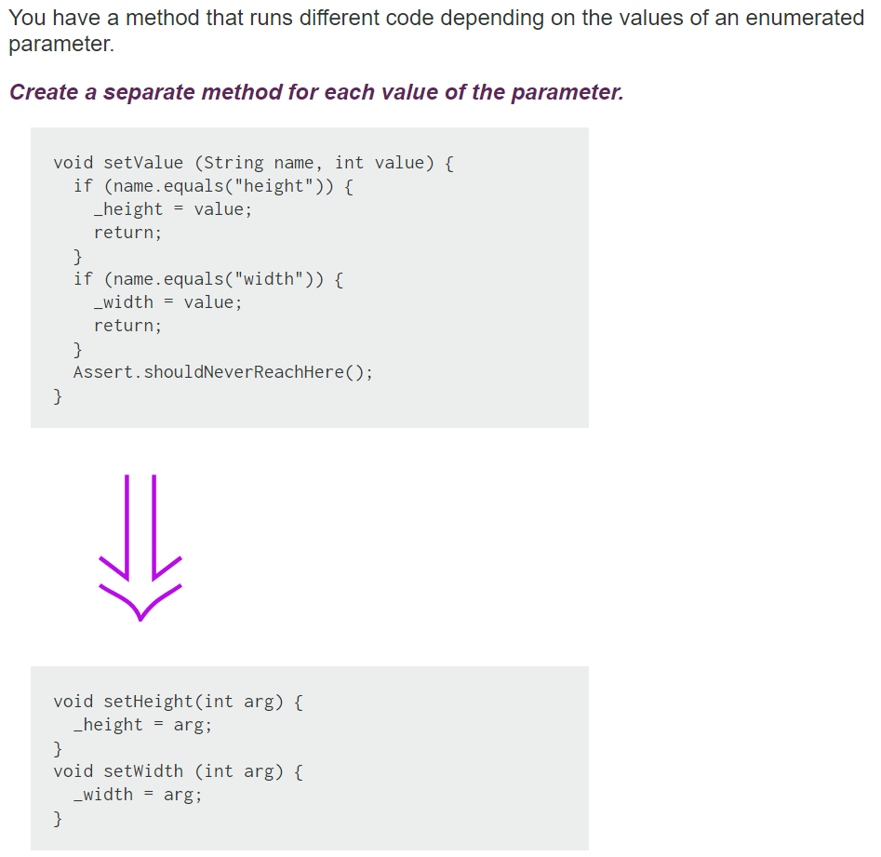
Replace Parameter with Explicit Methods

Slide 43
Replace Parameter with Explicit Methods
The usual case for this refactoring is that you have discrete values of a parameter, test for those values in a conditional, and do different things.
Remember, methods should do one thing that can be expressed in a simple TO statement.
Otherwise, the caller has to decide what it wants to do, set the parameter, and generally do more work than needed.

Slide 44
Long Parameter List
What to Do
If the parameter value can be obtained from an object or method that the called method already knows, Replace Parameter with Method.

Slide 45
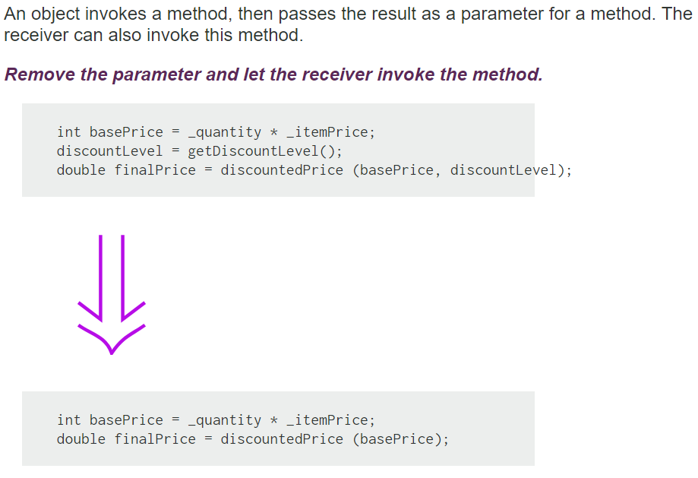
Replace Parameter with Method
Notes:
In different places you may initialize discount level differently before calling discountPrice()
This is a tradeoff to apply the refactoring because it may complicate the code, or it may not be possible, or you may endup with duplicate code (different methods that call a third method :-)
This can be a good question + a nice pattern for plop!!!

Slide 46
Replace Parameter with Method
If a method can get a value that is passed in as parameter by another means, it should. Long parameter lists are difficult to understand, and we should reduce them as much as possible.
One way of reducing parameter lists is to look to see whether the receiving method can make the same calculation.

Slide 47
Long Parameter List
What to Do
If the parameters come from a single object, try Preserve Whole Object.

Slide 48
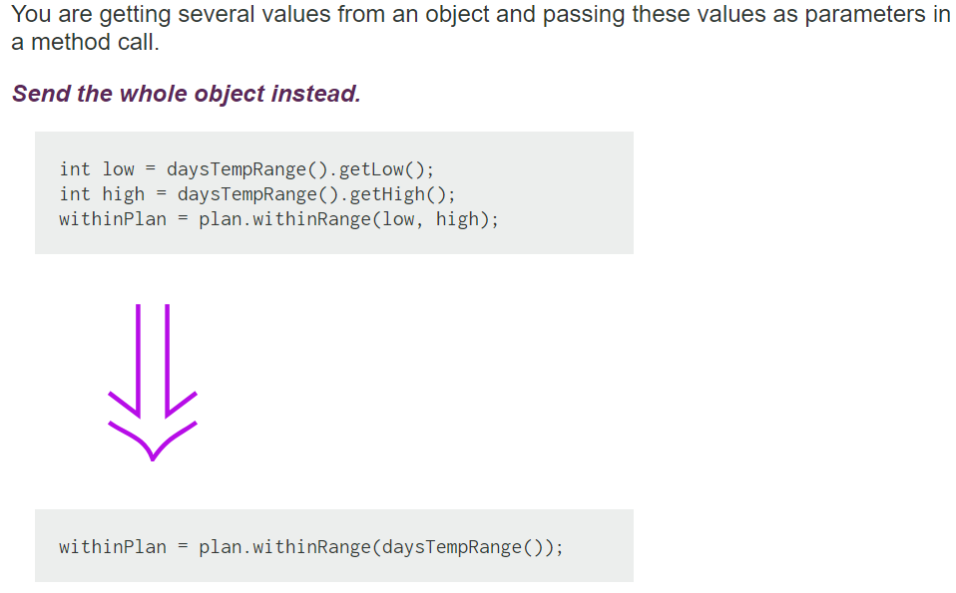
Preserve Object
Notes:
theme how can we combine this refactoring with another to get rid of the coupling issue ?

Slide 49
Preserve Object
Preserve Whole Object often makes the code more readable.
Long parameter lists can be hard to work with because both caller and callee have to remember which values were there.
There is a down side. When you pass in values, the called object has a dependency on the values, but there isn't any dependency to the object from which the values were extracted.
Passing in the required object causes a dependency between the required object and the called object. If this is going to mess up your dependency structure, don't use Preserve Whole Object.
Notes:
theme how can we combine this refactoring with another to get rid of the coupling issue ?

Slide 50
Long Parameter List
What to Do
If the data is not from one logical object, you still might group them via Introduce Parameter Object.

Slide 51
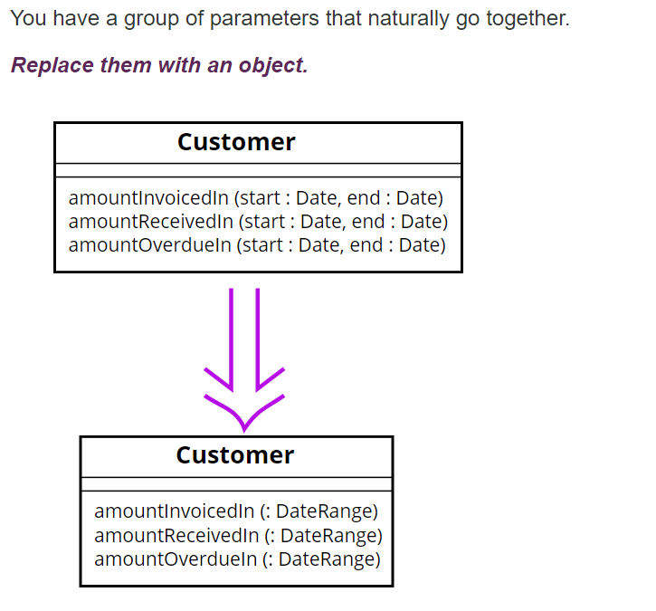
Introduce Parameter Object

Slide 52
Introduce Parameter Object
Often you see a particular group of parameters that tend to be passed together. Several methods may use this group, either on one class or in several classes.
Such a group of classes is a data clump and can be replaced with an object that carries all of this data. It is worthwhile to turn these parameters into objects just to group the data together.
This refactoring is useful because it reduces the size of the parameter lists, and long parameter lists are hard to understand.
You get a deeper benefit, however, because once you have clumped together the parameters, you soon see behavior that you can also move into the new class.
Often the bodies of the methods have common manipulations of the parameter values. By moving this behavior into the new object, you can remove a lot of duplicated code.

